Slide 1
A Novel Self-Evolving Multi-Agent
Architecture for Power System Monitoring and
Protection against Attacks of Malicious Intent
Mr. Arangamanikkannan Manickam
Mr. Gerald Swann
Dr. Sukumar Kamalasadan
Dr. Dennis Edwards
Dr. Sharon Simmons

Slide 2
Presentation Outline
Overview
BMAC Architecture
  Overall BMAC Architecture
  Architecture of a Single BMAC
Simulation Example on an SMIB Power grid
  Test 1 – Normal agent operation
  Test 2 – Agent attacked and mutated
  Mutation process
Analysis on Multi-machine power system
Summary

Slide 3
Overview
Multi-agent methodology is used for power system monitoring and protection
Code mutation makes MAM less susceptible to attacks such as buffer overflow attacks and even if the attack succeeds it’s hard to get repeated
MAM also adopts a voting methodology which alleviates agent malfunction in the presence of an attack
This architecture is tested on a Single Machine Infinite Bus (SMIB) power and a two area network with eight bus and five generators and presented the results for two area system.

Slide 4
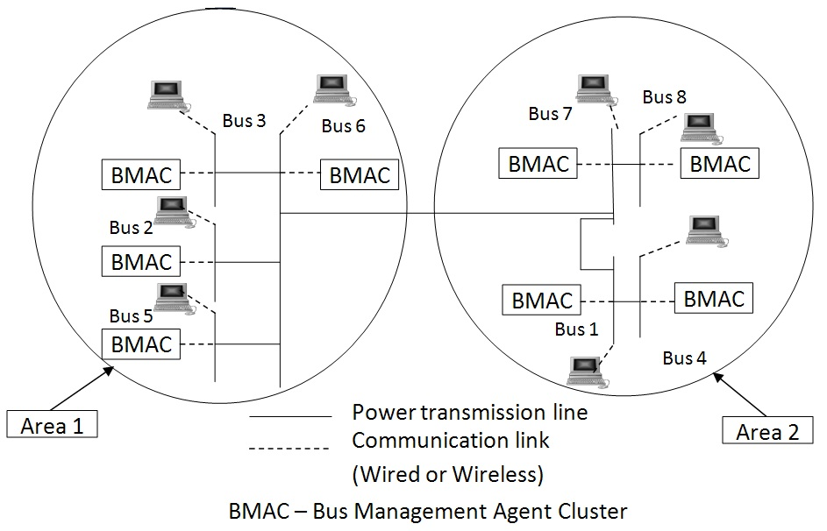
Overall BMAC Architecture

Slide 5
Architecture of a Single BMAC
BMAC
AMS
DF
MAM
Communication Agent
Mutation Agent
Monitoring/ Resurrection Agent
Distributed / Voting Agent
Agent
Agent
Agent

Slide 6
Architecture of a Single BMAC
Placed at each bus
Includes Multi-agent Methodology (MAM) + Agent Management Service Agent (AMS) + Directory Facilitator Agent (DF)
MAM follows Multi-level Security Model (MSM)
AMS – White pages
DF – Yellow pages
BMAC protects the generator and protects itself by “mutation” process

Slide 7
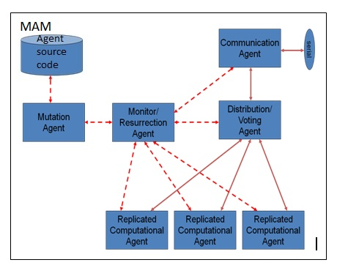
Multi-agent Methodology (MAM)

Slide 8
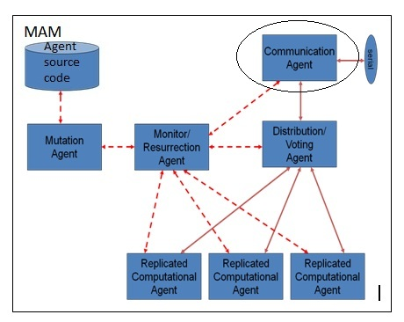
Multi-agent Methodology (MAM)
Communication Agent (CA)
It is the communication end point
It does the data authentication and validation
It sends and receives data from DVA
It also validates the response from the DVA

Slide 9

Multi-agent Methodology (MAM)
Distributed/Voting Agent (DVA)
DVA further validates the data
It distributes the data to all replicated agents
It does voting from the responses received from the replicated agents
Identifies agent malfunction and informs MRA

Slide 10

Multi-agent Methodology (MAM)
Replicated Computational Agent (RCA)
RCA performs the actual power monitoring/protection operation
All RCAs are initialized at the same state
It is compromised if
  It did not respond
  It responds slowly
  It sends incorrect response
All RCAs are mutated
Same attack cannot be successful in the future

Slide 11
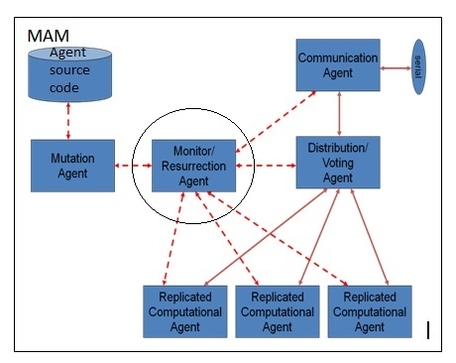
Multi-agent Methodology (MAM)
Monitoring and Resurrection Agent (MRA)
It is the initiator of all other agents
It monitors all other agents and controls their operation
Main Functions
  Resurrection of RCA
    Compromised agent is killed
    New agent is built and resumed
    DVA is informed
    Input values are buffered
  Resurrection of higher level agents
Implemented in software

Slide 12

Multi-agent Methodology (MAM)
Mutation Agent (MA)
It works under the command from MRA
Mutates the agent source code and alters the code structure
It is done in a single step and thus avoid direct examination
Some additional instructions are added which does not affect the normal functional behavior of the agent
  Example: Adding null instructions like (x=x+0, y=y*1)

Slide 13
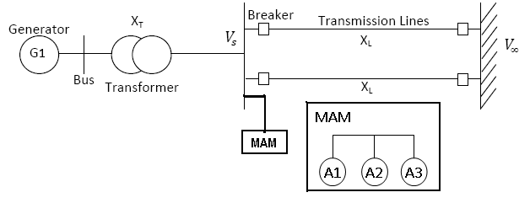
Simulation Example on a SMIB Power Grid
Agent monitors the Voltage and Speed of the generator
If abnormal operation detected, signal is sent by the BMAC to isolate the generator from the system

Slide 14
Simulation Example on a SMIB Power Grid – Voting
Case/Response | Agent 1 | Agent 2 | Agent 3
Case 1 | 0 | 0 | 0
Case 2 | 0 | 0 | 1
Case 3 | 0 | 0 | -
Case 1 – All agents act normal
Case 2 – One agent is malfunctioning
Case 3 – One agent is killed

Slide 15
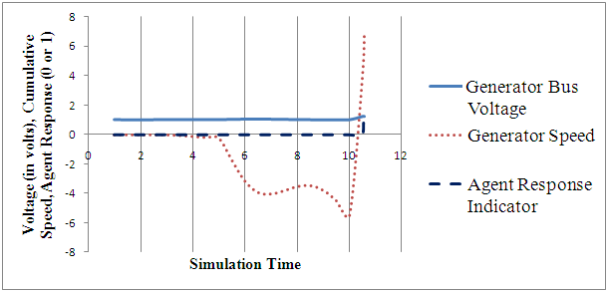
Simulation Example on a SMIB Power Grid – Test 1
Test conducted with samples of data and agent responses for normal and abnormal conditions are studied

Slide 16
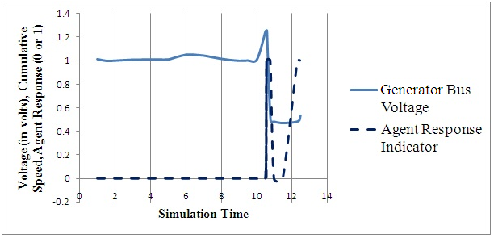
Simulation Example on a SMIB Power Grid – Test 2
Agent dies → Mutated again and sends response
This case demonstrates fault tolerance and reliability

Slide 17
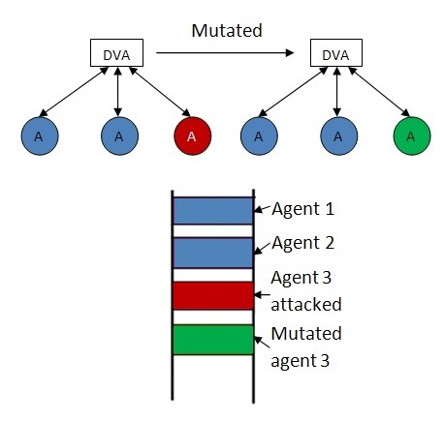
Mutation process
Mutation is initially done when the system starts and done when an agent is restarted
Mutation modifies the runtime stack
Mutation alters the memory layout
Same attack cannot be successful in the future

Slide 18
Analysis on Multi-machine Power System
Tools used:
  Power System Model – PSCAD
  Agent Design – C language
Agent communication - Wireless link
Model parameters are extracted from real life Power System data
Network communication is vulnerable to attacks
Agent monitors the generator and assist in generator shut down and load management.

Slide 19
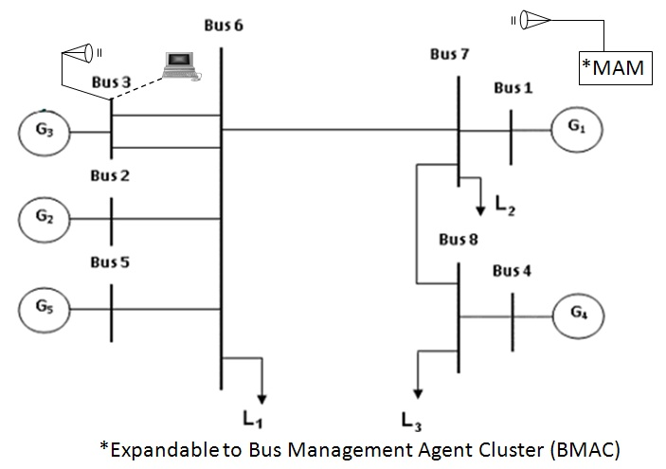
Analysis on Multi-machine Power System – Two area Multi-machine model

Slide 20
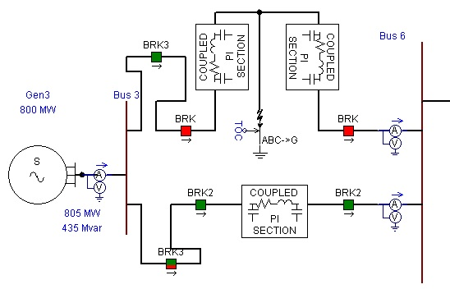
Analysis on Multi-machine Power System – Test scenario
Attack target – Generator 3
At t = 5 seconds, initial disturbance is applied for 0.1 seconds
BRK opens immediately after the fault and remain open until t=15 seconds
At t=10 seconds, BRK2 opens and remain open until 22 seconds

Slide 21
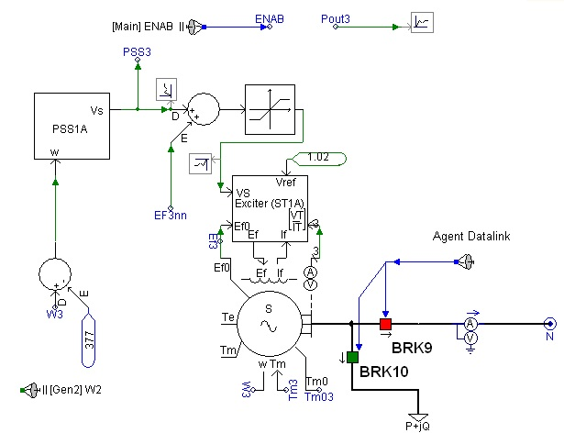
Analysis on Multi-machine Power System – Generator 3 Controller

Slide 22
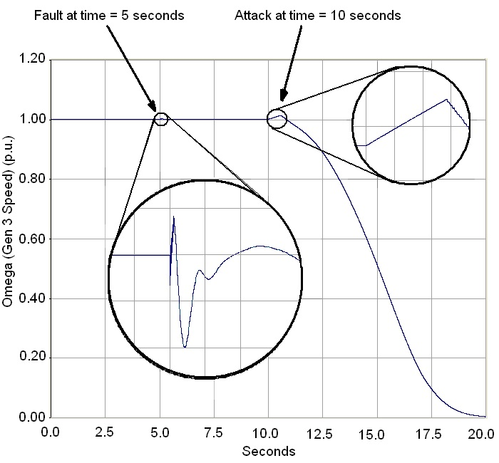
Analysis on Multi-machine Power System – Generator 3 speed variations

Slide 23
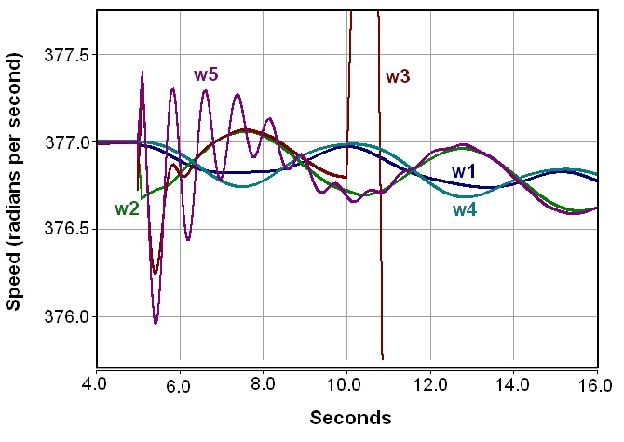
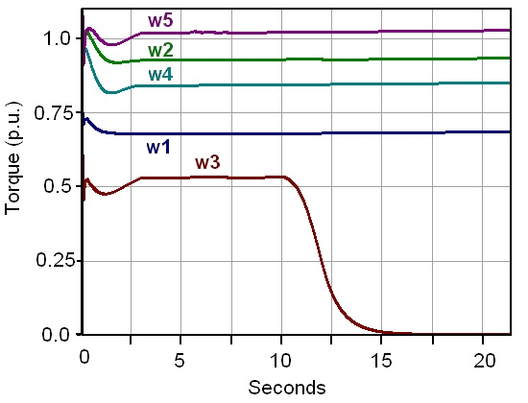
Analysis on Multi-machine Power System – Generator Speed and Torque

Slide 24
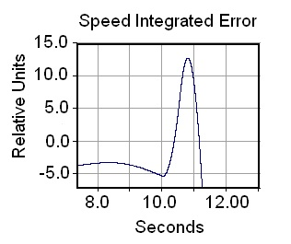
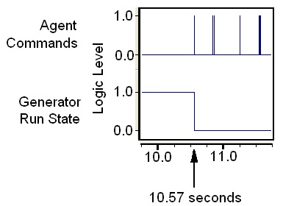
Analysis on Multi-machine Power System – Speed integral error

Slide 25
Summary
A novel, self-evolving multi-agent methodology (MAM) for power system monitoring and protection is proposed
The software mutation can be applied to any controller that is accessible through communication link
The mutated agent structure is accessible only through the controlled communication channel
The voting methodology performed by the Distributed Voting Agent (DVA) detects agent malfunction
Simulation studies conducted on a power system SMIB and a two area, 5-machine, 8 bus system
It is demonstrated that our proposed methodology is capable of not only detecting the power grid attack but can also continuously monitor and isolate the generator bus even in the presence of a sustained attack

Slide 26
Questions???

Slide 27

Communication Agent
Start
Notify MRA that it is up
It is responsible for communicating with the bus and other agents in the power system network.
Communicate with Bus/Other agents
Validate/Check for Intrusion
No
If Normal
Ignore the data
Yes
Communicate with DVA and send the data back

Slide 28
Mutation Agent
START
READ SOURCE CODE
This agent performs the mutation and loads the replicated agent code in memory.
MUTATE THE SOURCE CODE
COMPILE THE MUTATION
EXECUTE
STOP

Slide 29
Monitoring/Resurrection Agent
Start
Create and start CA, DVA, RCA
It does the initial mutation and monitors all the agents and gives re-birth if anything fails.
Monitor all the modules
If attacked
No
Yes
Remove compromised module
Rebuild and start the new module
Join new module to remaining agents

Slide 30
Distributed/Voting Agent
Start
Notify MRA that it is up
This agent is responsible to get rid of the abnormal behavior of agents. It is also a bridge between communication agent and replicated agents.
Obtain data from CA
Validate incoming data
IF NORMAL
No
Ignore data
Yes
Send a copy to each RCA
Get data from all RCA
Vote
Send output to CA

Slide 31
Replicated Computational Agent
Start
Get Data from DVA
It does monitoring or supervisory activity.
Extract value and check for boundary
If within boundary
No
Send response to shut down the generator
Yes
Send Normal response

Slide 32
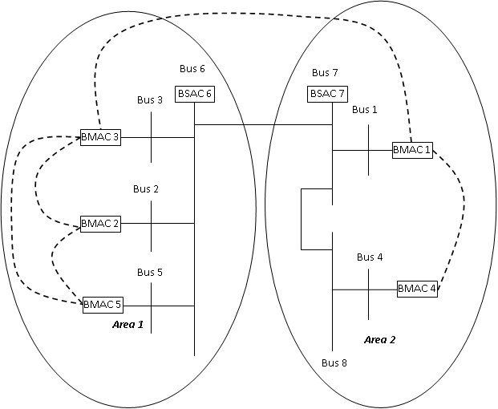
Power System with BMACs and BSACs

Slide 33
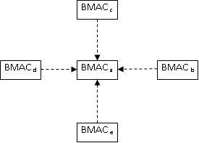
Inter-agent Communication

Slide 34
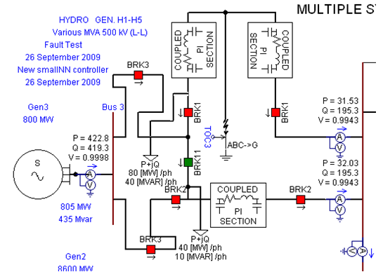
Testing Inter-agent Communication

Slide 35
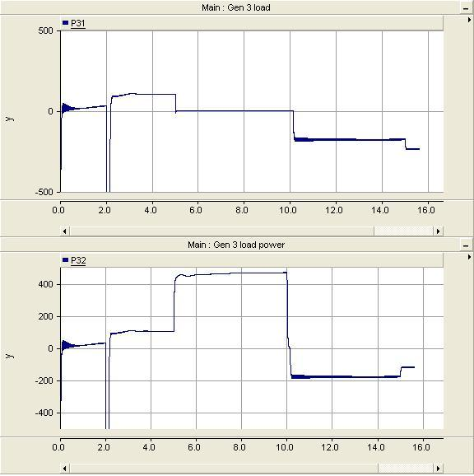
Testing Inter-agent Communication

