Slide 1
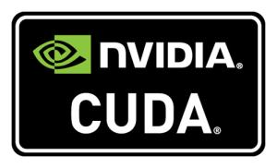
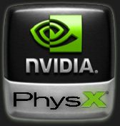
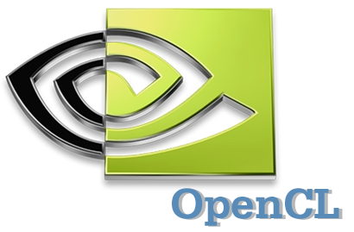
CUDA PERFORMANCE TESTING USING GRAYSCALE CONVERSION ALGORITHM
Advanced Computer Systems
Arangamanikkannan Manickam
Notes:
This presentation introduces Cg (“C for graphics”) and explains why it would be useful when teaching a computer graphics course.

Slide 2
Overview
System and software configuration
Algorithm Description
Source code Explanation
Performance tests GPU Vs CPU
Results
Notes:
Real-time graphics has progressed dramatically over the past several years. Today’s consumer-level graphics boards can deliver many times the performance of million-dollar graphics workstations of a decade ago.
Modern graphics processing units (GPUs) are also massively programmable, allowing the creation of a truly infinite number of new effects and algorithms.

Slide 3
System configuration
AMD Athlon™ 64 Processor 3700+
Memory: 2 GB
Graphics Processor: NVIDIA GeForce GT220
CUDA cores – 48
Graphics Clock – 625 MHz
Processor Clock – 1360 MHz
Memory Clock – 790 MHz
Memory – 1 GB DDR3
Memory Interface width – 128 bit

Slide 4
Software configuration
Fedora 13 (Goddard)
Kernel linux 2.6.34.7-61.fc13.x86_64
NVIDIA Driver version: 260.19.12
Cuda toolkit version 3.2.9
GPU computing SDK version 3.2
OpenCV version 2.1.0

Slide 5
Grayscale conversion algorithm
The lightness method averages the most prominent and least prominent colors: (max(R, G, B) + min(R, G, B)) / 2.
The average method simply averages the values: (R + G + B) / 3.
The luminosity method is a more sophisticated version of the average method.
It forms a weighted average to account for human perception.
The formula for luminosity is 0.21 R + 0.71 G + 0.07 B.

Slide 6
Grayscale conversion algorithm
The lightness method averages the most prominent and least prominent colors: (max(R, G, B) + min(R, G, B)) / 2.
The average method simply averages the values: (R + G + B) / 3.
The luminosity method is a more sophisticated version of the average method.
It forms a weighted average to account for human perception.
The formula for luminosity is 0.21 R + 0.71 G + 0.07 B.

Slide 7
OpenCV
OpenCV is a Computer Vision library
It is used by realtime image processing
Applications of OpenCV
Facial Recognition Systems, Gesture Recognition Systems, etc,.
Our Application: to load and store images

Slide 8
OpenCV…
cvLoadImage
Loads an image from file given the file name path
Returns a pointer to IplImage data structure
cvSaveImage
Saves an image to a file
IplImage is given as an input
cvCreateImage
Creates a pointer to IplImage given the width, height and depth
cvReleaseImage
Releases the IplImage object from memory

Slide 9
OpenCV…
IplImage has following parameters
Width
Height
No of channels
Image size
Image Data Array
Images are not stored by pixel instead they are stored as arrays of color levels
Reduces processor overhead
Color values are stored in BGR order
ImageData Index | 0 | 1 | 2 | 3 | 4 | 5
Color | B | G | R | B | G | R

Slide 10
Performance Comparision
Test data
Images with various resolution
320 × 240
640 × 480
800 × 600
1024 × 768
1280 × 1024
1440 × 900
1600 × 1200
1680 × 1050
1920 × 1200
2048 × 1536
2560 × 1920
3200 × 2400

Slide 11
Performance comparision – GPU only

Slide 12
Performance Comparision – GPU and CPU

Slide 13
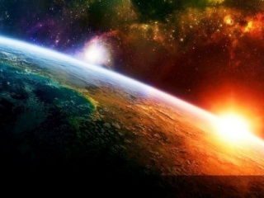
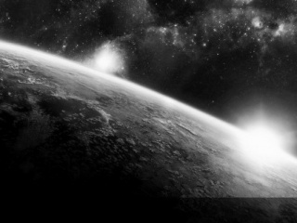
Grayscale Conversion Results

Slide 14
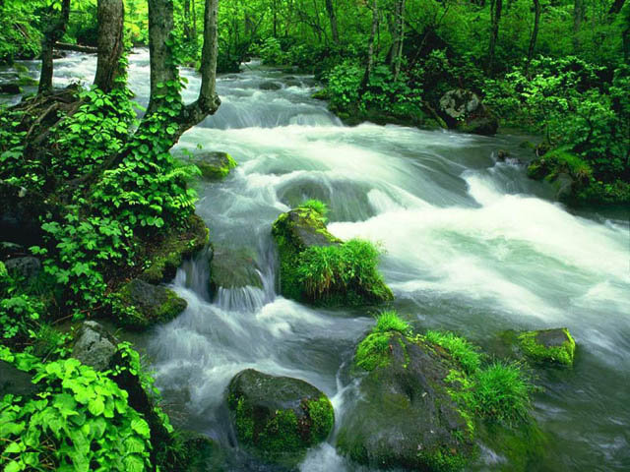
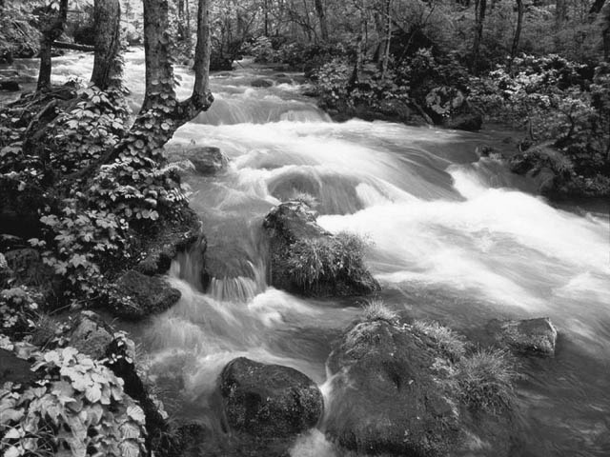
Grayscale Conversion Results

Slide 15
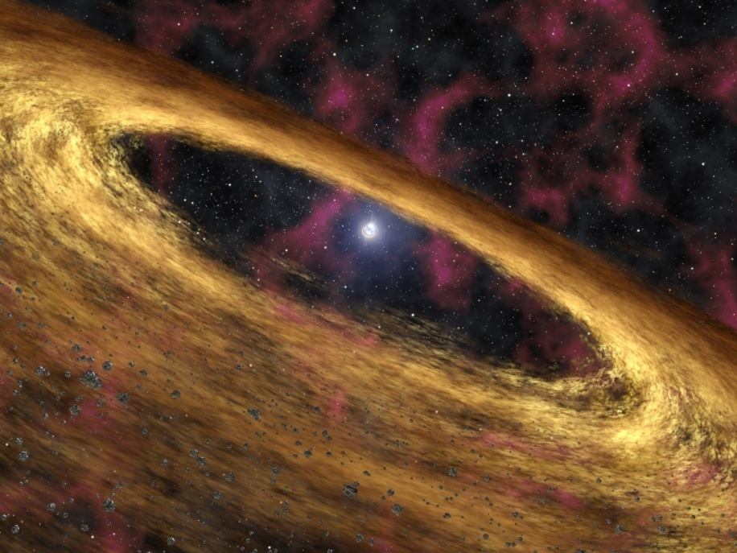
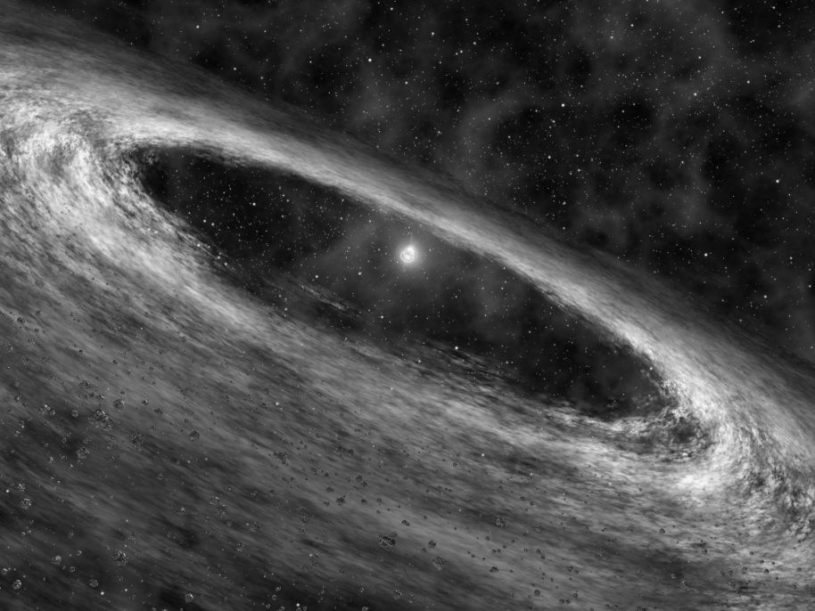
Grayscale Conversion Results

Slide 16
Conclusion
GPU results are almost less than 0.01 ms for all image resolutions and variations in computation time are insignificant
CPU results grow exponentially with respect to the image resolution

Slide 17
Questions???

