Slide 1

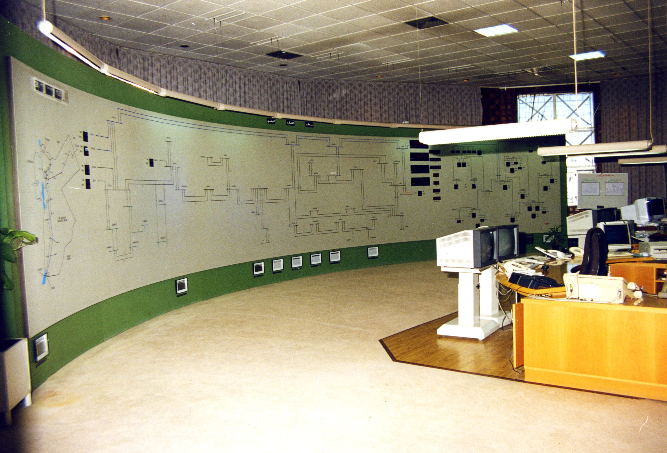

Critical Software Security Through Replication and Virtualization
Dennis Edwards Sharon Simmons Arangamanikkannan Manickam
Hardware Protected
Previous Results
Source
network
SCADA
Multi-level security model for agent-based control of power distribution grid
Funded by the Department of Energy in cooperation with Florida State University
Serial communication to sensors and actuators
Controls generation based on load and anticipatory commands
Originally vulnerable to attack from network and serial lines
Demonstrated recovery on RTDS at CAPS
Mutation
Agent
Communication
Agent
Monitor/
Resurrection
Agent
serial
Sensors &
Actuators
Distribution/
Voting
Agent
Replicated
Computational
Agent
Replicated
Computational
Agent
Replicated
Computational
Agent
Normal I/O
Control Signals
Limitations of Previous Results
Specialized prevention of buffer overflow attacks
Designed specifically for agent-based systems
Dynamic port binding (i.e., servers) not supported
Operating system remains vulnerable (trusted base)
Required hardware protection of single-point-of-failure
Agents represent simple computational code
Proposed Research
Multi-layered security model leveraged from previous success in agent-based systems
Provides for replication of critical software with voting to determine correct response
Each replicated server is computationally equivalent code on a different virtual platform
Individual platform weaknesses mitigated by isolating failures to one replicate/platform
Provides for dynamic port binding for network servers
Service providers monitored by guest OS
Guest OS monitored by virtual machine and host OS
Consequences of successful attack limited to Guest OS
Host OS
network
Communication
Interface
Virtual Machine
NAT
Server
Server
Server
Guest OS 1
Guest OS 2
Guest OS 3
Prototypical Experiment
OS X
network
Guest OSes have private IP addresses which prevents direct contact with outside
Each Apache server bind to port 80 on virtual machine
Communication Interface uses well-known IP address and port to outside world
Static route in Host OS allows communication between Communication Interface and Apache server processes
Service requests arrive at Communication Interface and are replicated to servers
Responses sent to Communication Interface where voting occurs
System currently in experimentation/design stage
Communication
Interface
(Voting)
VirtualBox
NAT
Apache
Apache
Apache
Windows XP
Linux F10
Solaris

