Slide 1






Tech Mahindra
wastebin
Help us to Collect
We help you to Connect
Corporate bin

Slide 2
Design of WasteBin

Slide 4
Sensor to check the level of waste in dustbin

Slide 5
Module Diagram
Waste level measure sensor
GPS
Microcontroller
Wi-Fi module
Power

Slide 6
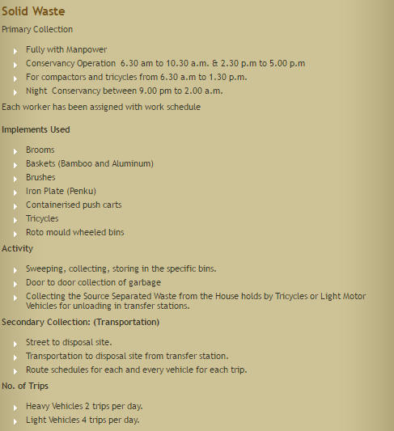

Slide 7
Before using WasteBin

Slide 8

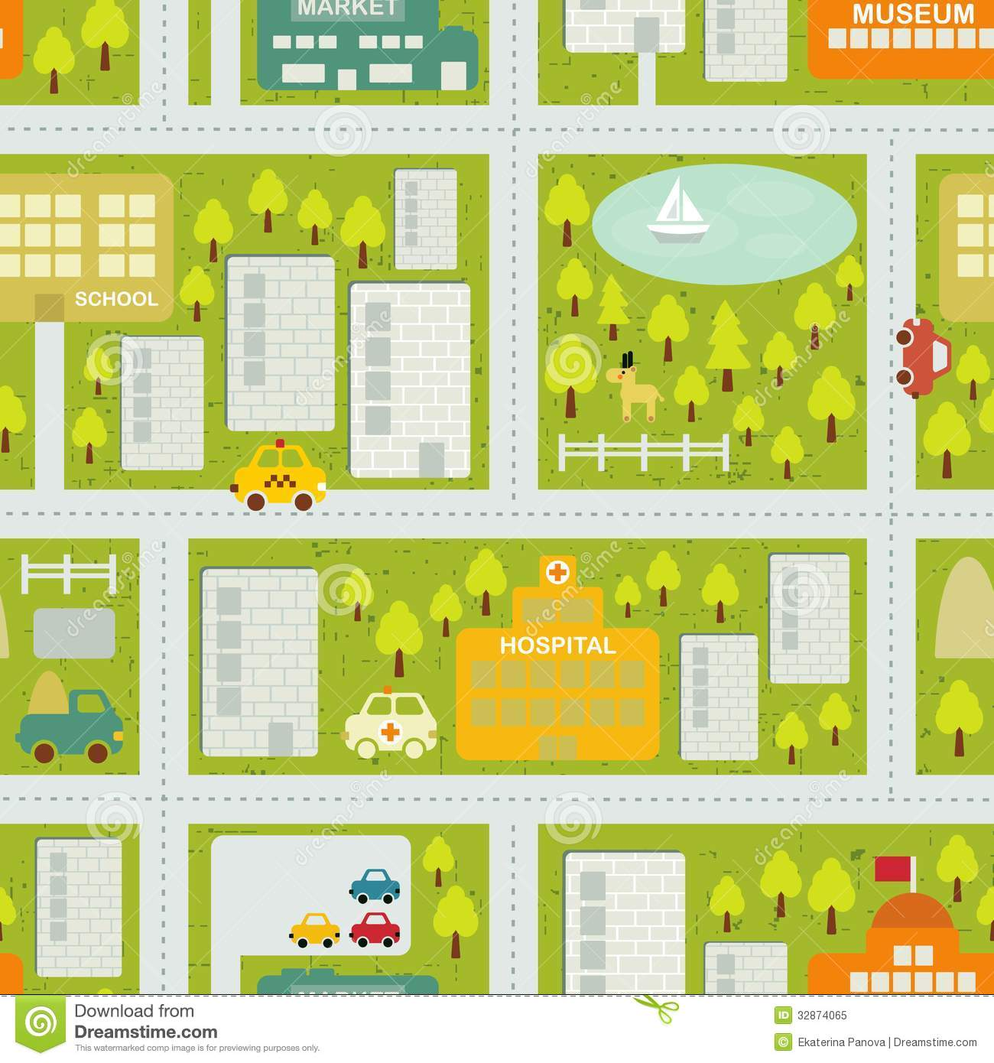


Route A
Garbage collector vehicle
Route B
Dustbin
Route C

Slide 9
After Implementation of WasteBin

Slide 10
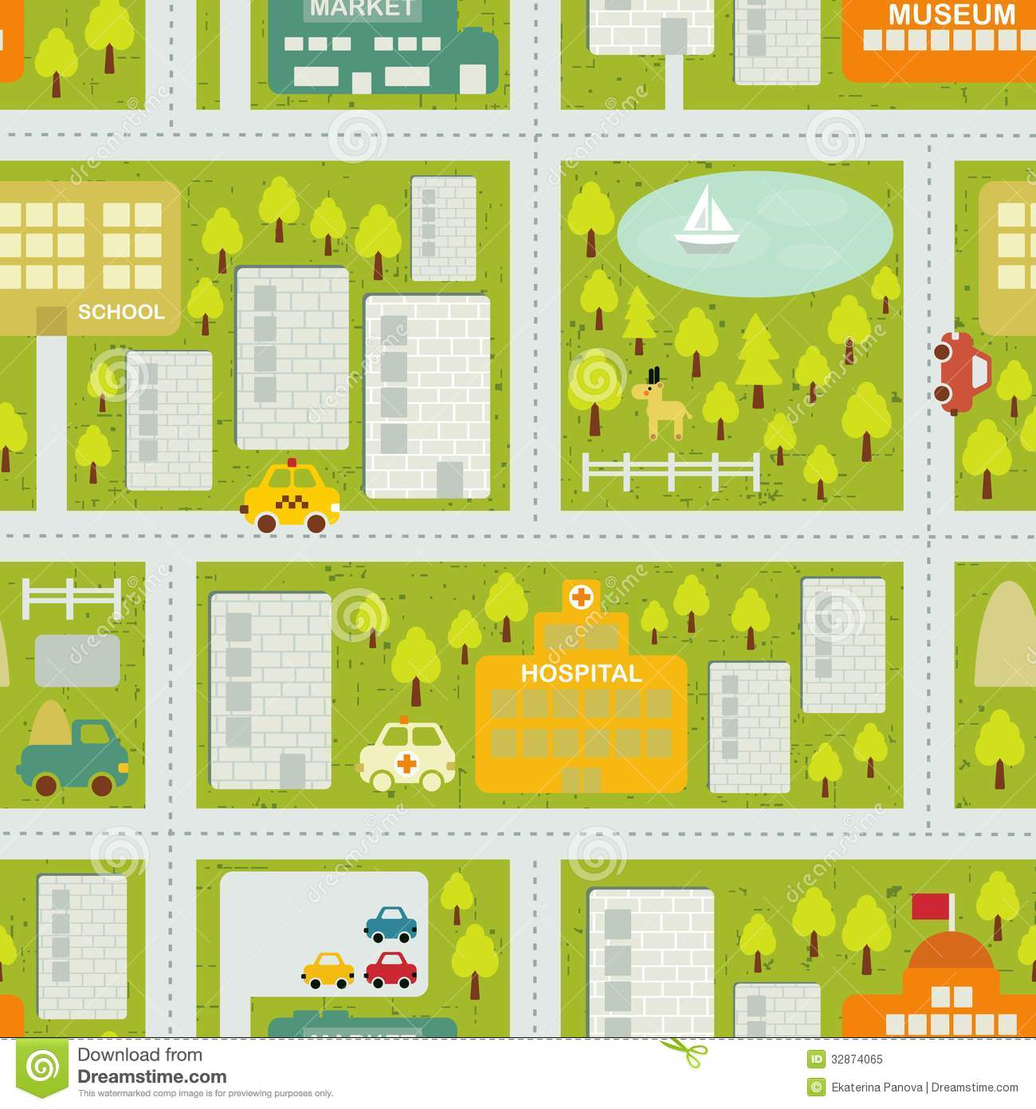
Dynamic Routes optimization
87%
57%
97%
67%
98%
97%
94%
97%

Slide 11


Scheduling the truck
WasteBin 1
85%
55%
75%
WasteBin 1
Cloud
Smart Waste Management System
WasteBin 1

Slide 12


Advantageous of using WasteBin
Fuel Conception
Efficient allocation of Trucks and labour
Time optimization to collect cabbages

