Slide 1

Life expectancy
Exploratory Data Analysis

Slide 2
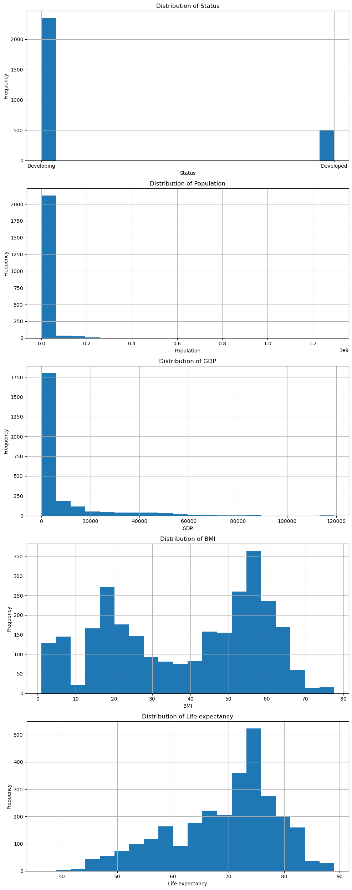
Histograms of chosen variables
Status: Shows the distribution between different statuses, likely with a categorical distinction (e.g., Developing vs. Developed).
Population: Highlights the distribution of population sizes across the countries in the dataset, showcasing a wide range with a concentration at lower values, indicating that many countries have smaller populations.
GDP: Demonstrates the distribution of GDP values, which appears to be heavily skewed towards lower GDP values, suggesting that many countries have a relatively low GDP.
BMI: Shows the distribution of BMI values across the dataset, indicating a relatively normal distribution but with some skewness towards lower BMI values.
Life Expectancy: Presents the distribution of life expectancy across countries, showing a somewhat normal distribution with a tendency towards higher life expectancy values.

Slide 3
Mode, Mean, Spread, Tails
Population:
Mode: 444 (The most frequently occurring population number in the dataset)
Mean: Approximately 12,834,572 (Average population)
Standard Deviation: Approximately 61,960,940 (Indicates a widespread in population sizes)
Skewness: 15.75 (Highly positive skew, indicating a long tail to the right with most countries having smaller populations)
GDP:
Mode: 1.68 (The most frequently occurring GDP value in the dataset)
Mean: Approximately 7,664 (Average GDP)
Standard Deviation: Approximately 14,466 (Indicates a widespread in GDP values)
Skewness: 3.15 (Positive skew, indicating that most countries have lower GDPs with a long tail towards higher values)
BMI:
Mode: 58.5 (The most frequently occurring BMI value in the dataset)
Mean: Approximately 38.5 (Average BMI)
Standard Deviation: Approximately 20 (Indicates a widespread in BMI values)
Skewness: -0.25 (Slightly negative skew, indicating a tail to the left)
Life Expectancy:
Mode: 73 (The most frequently occurring life expectancy in the dataset)
Mean: Approximately 69.3 years (Average life expectancy)
Standard Deviation: Approximately 9.53 years (Indicates variability in life expectancy)
Skewness: -0.66 (Negative skew, indicating a tail to the left with most countries having higher life expectancy)

Slide 4
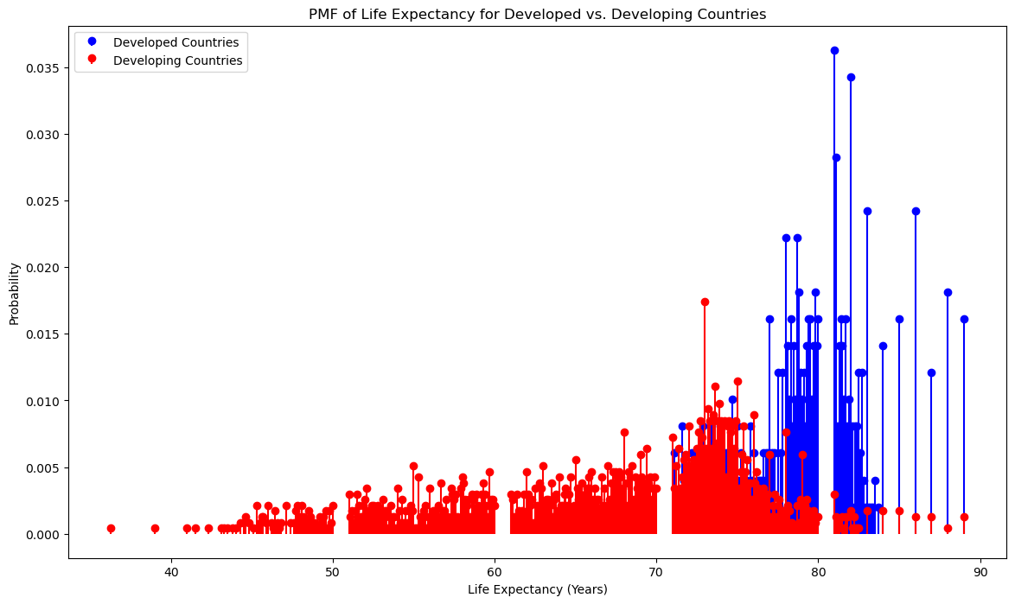
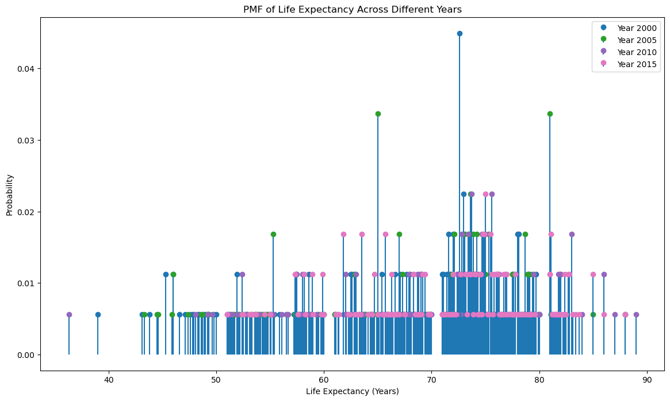
Probability Mass Functions

Slide 5
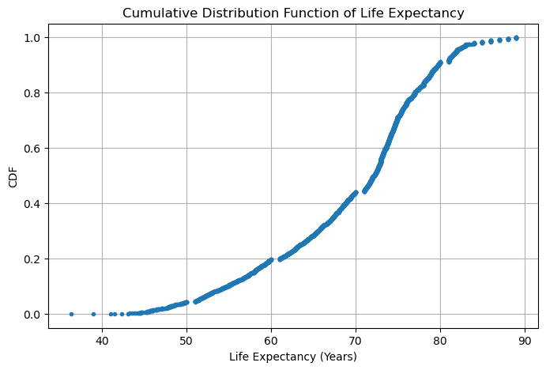
Cumulative Distribution Function
The Cumulative Distribution Function (CDF) plot for "Life Expectancy" shows the proportion of countries (or data points) that have a life expectancy up to a certain value. This plot helps in understanding how life expectancy is distributed across the dataset, indicating, for example, what percentage of the data points have a life expectancy less than a specific threshold.

Slide 6
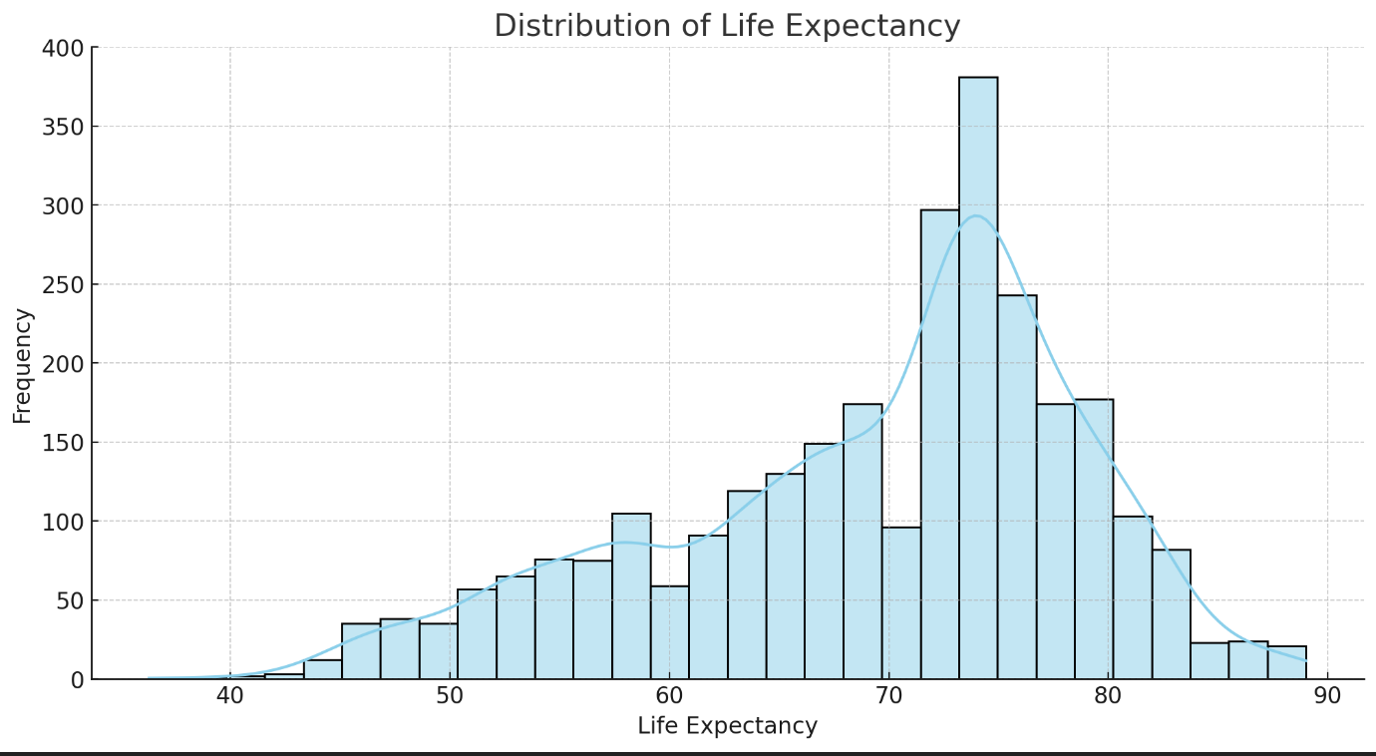
Analytical Distribution
For an analytical distribution analysis, I focused on the "Life expectancy" variable. This choice is motivated by the interest in understanding the distribution of life expectancy across different countries and over the years, which can provide insights into global health trends and the effectiveness of health policies.

Slide 7
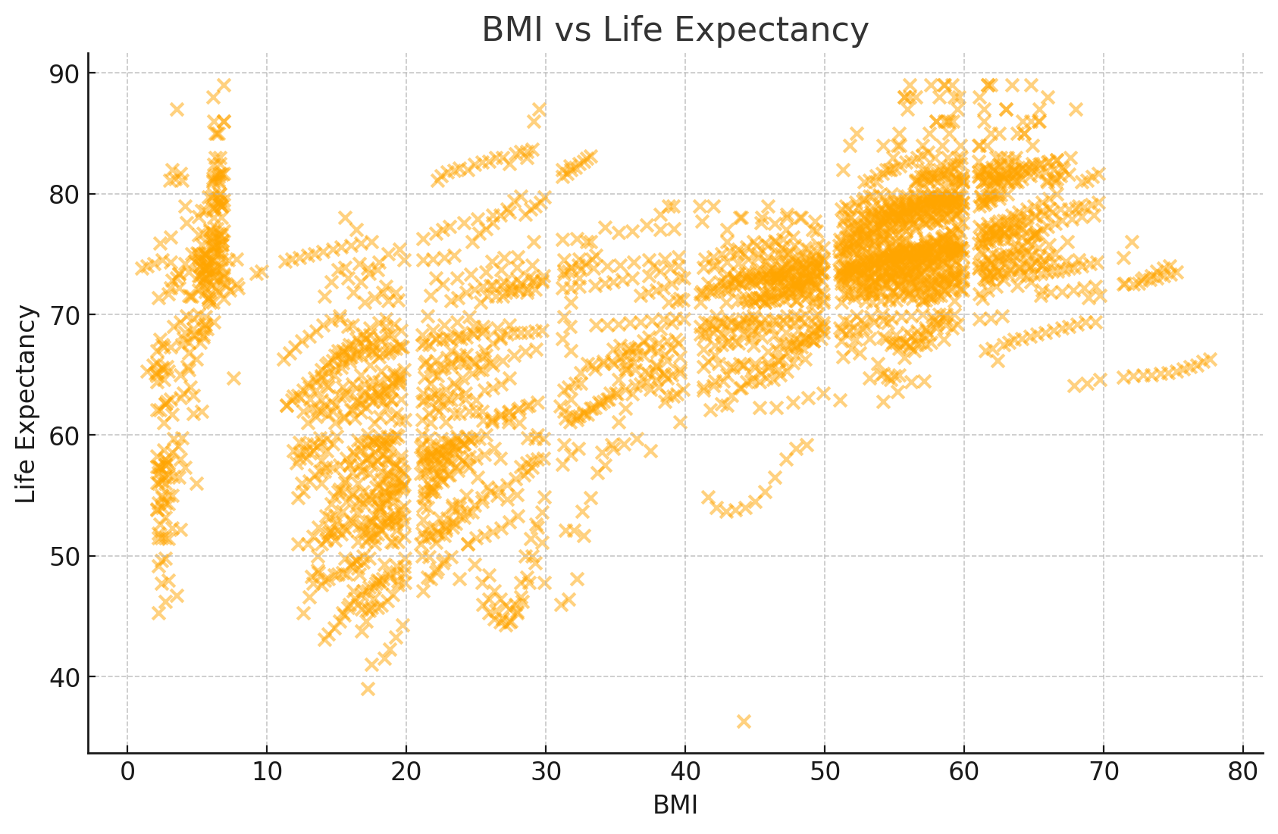
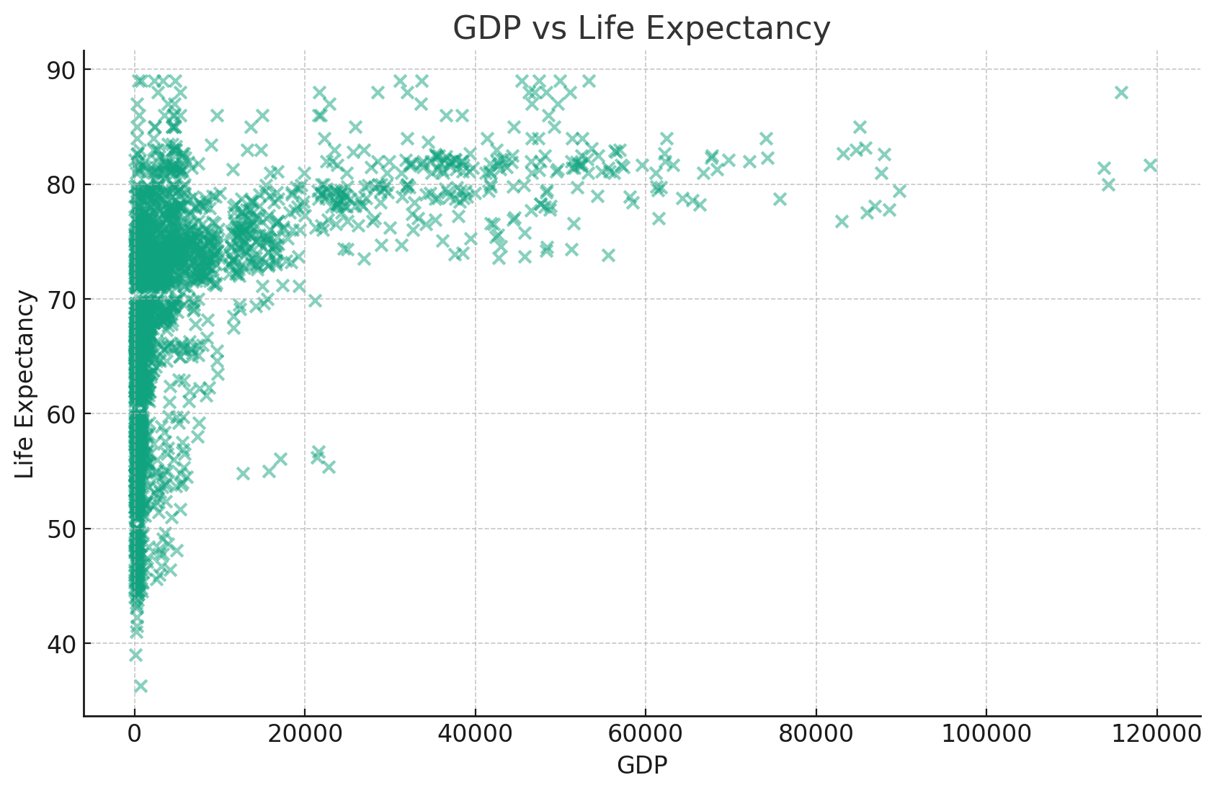
Analysis and Conclusion
GDP and Life Expectancy: The moderate positive correlation indicates an association where countries with higher GDPs tend to have higher life expectancies. However, the correlation is not strong enough to imply that GDP directly causes higher life expectancy, as many other factors (such as healthcare quality, nutrition, and public health policies) can influence this relationship.
BMI and Life Expectancy: The moderate positive correlation suggests that a higher BMI (within healthy ranges) is associated with higher life expectancy, potentially reflecting better nutrition and health status. However, as with GDP, this does not imply causation. Excessively high or low BMI levels can have adverse health effects, and the relationship is likely influenced by a complex mix of lifestyle, healthcare access, and socioeconomic factors.

Slide 8
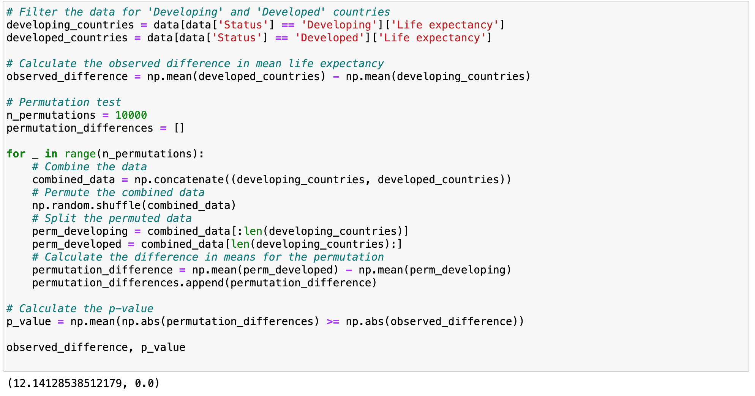
Permutation test to compare the life expectancy between "Developing" and "Developed" countries
The observed difference in mean life expectancy between Developed and Developing countries is approximately 12.14 years. The permutation test, conducted with 10,000 permutations, resulted in a p-value of 0.0. This indicates that the difference in life expectancy we observed is highly unlikely to have occurred by chance under the null hypothesis that there is no difference in life expectancy between Developing and Developed countries. Therefore, we can reject the null hypothesis and conclude that there is a statistically significant difference in life expectancy between Developing and Developed countries based on the data provided. ​

Slide 9
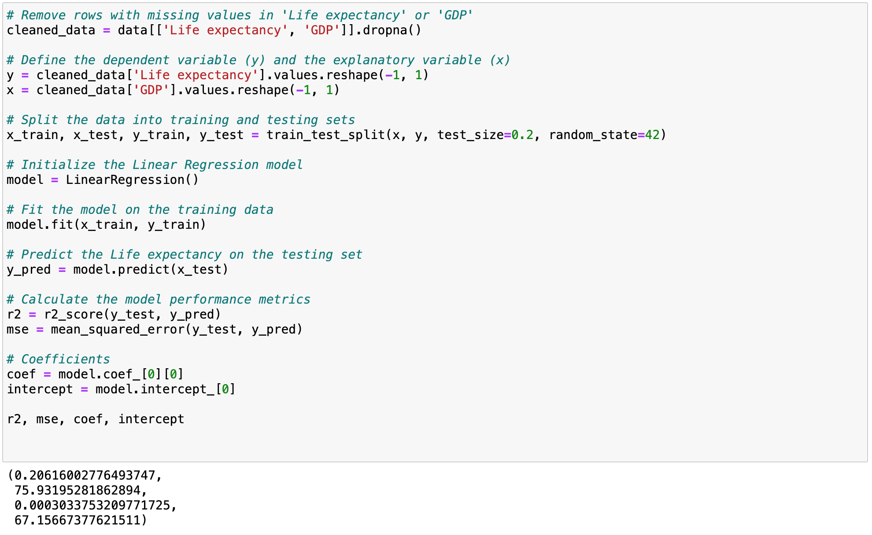
Simple Linear Regression Analysis
"Life expectancy" as the dependent variable and "GDP" as the explanatory variable
Analysis
Coefficient (Slope) of GDP: 0.000303, indicating that for each unit increase in GDP, life expectancy is expected to increase by 0.000303 units. This suggests a positive but very small impact of GDP on life expectancy.
Intercept: 67.157, implying that when GDP is 0, the predicted life expectancy is approximately 67.157 years.
R-squared (R²) Value: 0.206, which means that approximately 20.6% of the variance in life expectancy can be explained by GDP. This indicates a weak explanatory power of GDP on life expectancy in our model.
Mean Squared Error (MSE): 75.932, measuring the average of the squares of the errors—that is, the average squared difference between the estimated values and the actual value.
The R² value suggests that while there is some relationship between GDP and life expectancy, GDP alone does not strongly predict life expectancy, indicating that other factors also play significant roles in determining life expectancy.

Slide 10
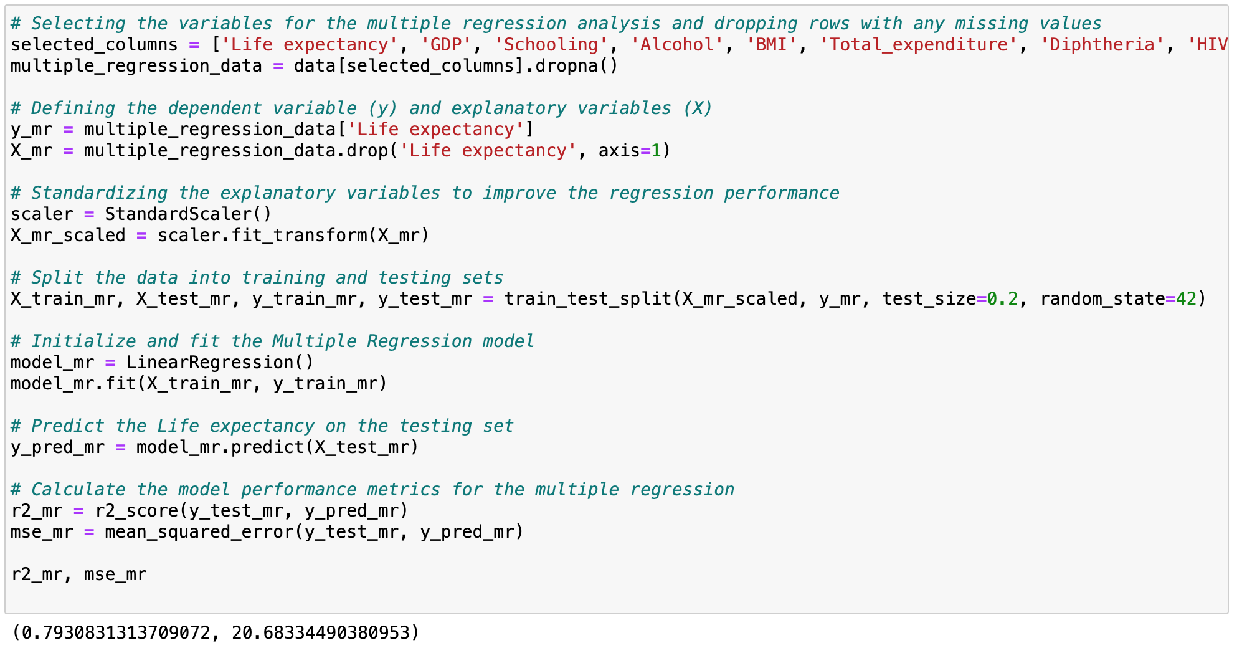
Multiple Regression Analysis
MRA with variables such as GDP, schooling, alcohol consumption, BMI, total health expenditure, diphtheria immunization rates, and HIV/AIDS prevalence
Analysis
R-squared (R²) Value: 0.793, indicating that approximately 79.3% of the variance in life expectancy can now be explained by this model. This is a substantial increase from the R² value obtained in the simple regression analysis, suggesting a much stronger explanatory power of these combined factors on life expectancy.
Mean Squared Error (MSE): 20.683, a considerable decrease from the MSE in the simple regression model. This lower MSE indicates that the model's predictions are much closer to the actual life expectancy values, highlighting the benefits of including multiple relevant variables in the analysis.

