Slide 1

Azure Networking Services
Sreehari Aranghat

Slide 2
Connectivity Services
Connect Azure resources and on-premises resources using any or a combination of these networking services in Azure - Virtual Network (VNet), Virtual WAN, ExpressRoute, VPN Gateway, Virtual network NAT Gateway, Azure DNS, Peering service, Azure Virtual Network Manager, Route Server, and Azure Bastion.

Slide 3
Application Protection Services
Protect your applications using any or a combination of these networking services in Azure - Load Balancer, Private Link, DDoS protection, Firewall, Network Security Groups, Web Application Firewall, and Virtual Network Endpoints.

Slide 4
Application Delivery Services
Deliver applications in the Azure network using any or a combination of these networking services in Azure - Content Delivery Network (CDN), Azure Front Door Service, Traffic Manager, Application Gateway, Internet Analyzer, and Load Balancer.

Slide 5
Network Monitoring
Monitor your network resources using any or a combination of these networking services in Azure - Network Watcher, ExpressRoute Monitor, Azure Monitor, or VNet Terminal Access Point (TAP).

Slide 6
Connectivity Services

Slide 7
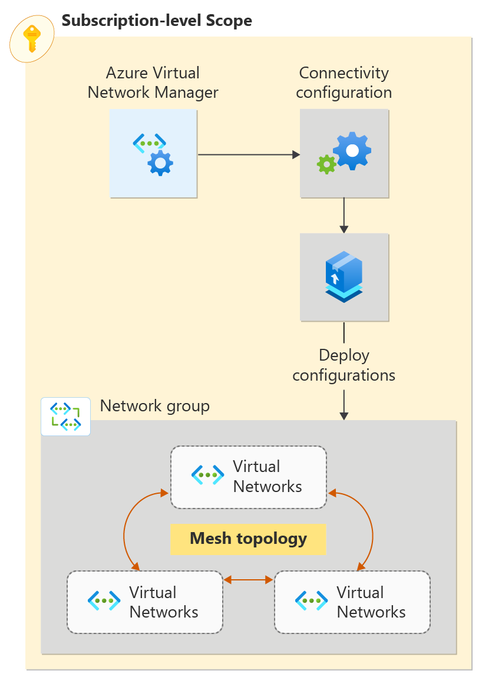
Azure Virtual Network
Azure Virtual Network Manager is a management service that enables you to group, configure, deploy, and manage virtual networks globally across subscriptions.
With Virtual Network Manager, you can define network groups to identify and logically segment your virtual networks.
Then you can determine the connectivity and security configurations you want and apply them across all the selected virtual networks in network groups at once.

Slide 8
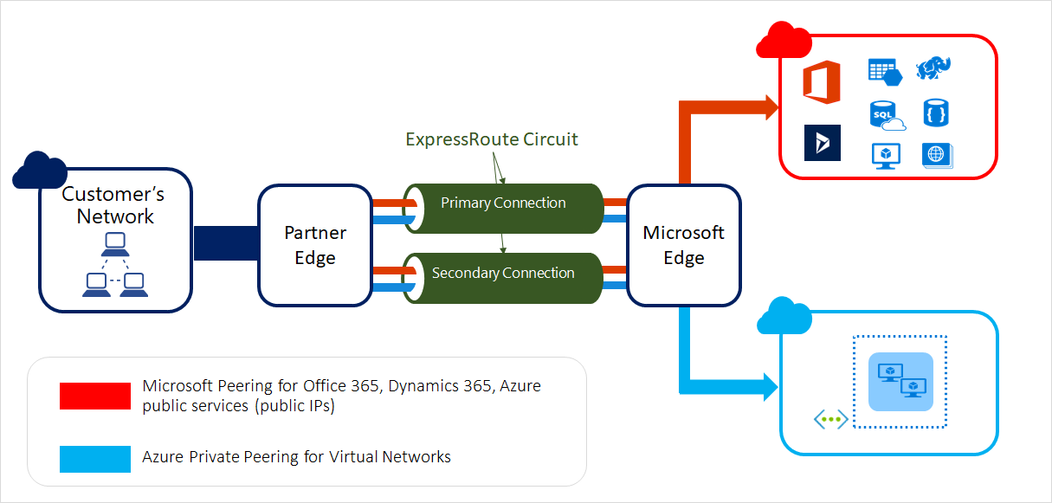
ExpressRoute
ExpressRoute enables you to extend your on-premises networks into the Microsoft cloud over a private connection facilitated by a connectivity provider.
This connection is private. Traffic doesn't go over the internet.

Slide 9
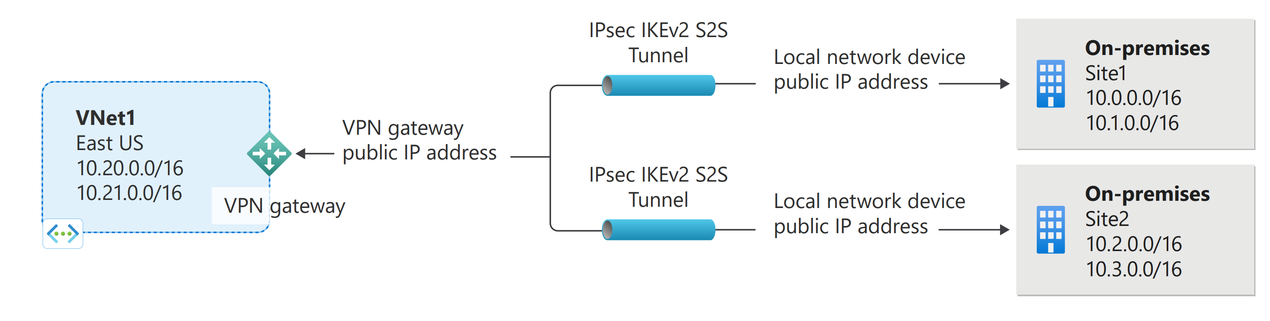
VPN Gateway
VPN Gateway helps you create encrypted cross-premises connections to your virtual network from on-premises locations, or create encrypted connections between VNets. There are different configurations available for VPN Gateway connections. Some of the main features include:
Site-to-site VPN connectivity
Point-to-site VPN connectivity
VNet-to-VNet VPN connectivity

Slide 10
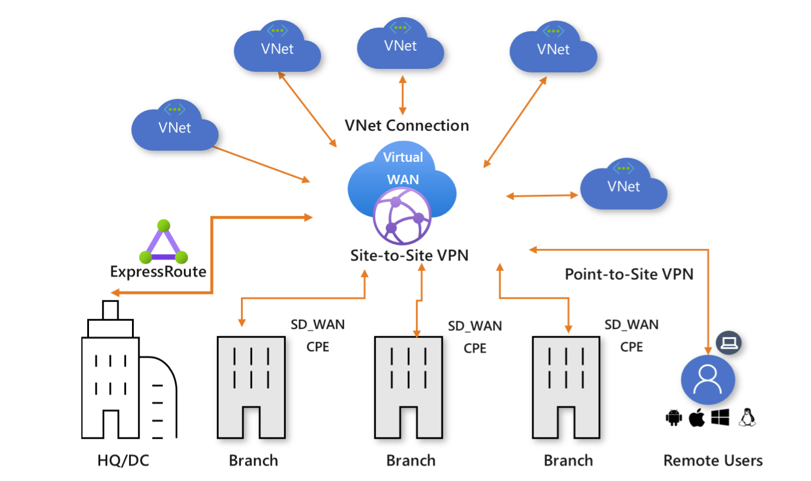
Virtual WAN
Azure Virtual WAN is a networking service that brings many networking, security, and routing functionalities together to provide a single operational interface. Connectivity to Azure VNets is established by using virtual network connections.

Slide 11
Azure DNS
Azure DNS provides DNS hosting and resolution using the Microsoft Azure infrastructure. Azure DNS consists of three services:
Azure Public DNS is a hosting service for DNS domains. By hosting your domains in Azure, you can manage your DNS records by using the same credentials, APIs, tools, and billing as your other Azure services.
Azure Private DNS is a DNS service for your virtual networks. Azure Private DNS manages and resolves domain names in the virtual network without the need to configure a custom DNS solution.
Azure DNS Private Resolver is a service that enables you to query Azure DNS private zones from an on-premises environment and vice versa without deploying VM based DNS servers.
Using Azure DNS, you can host and resolve public domains, manage DNS resolution in your virtual networks, and enable name resolution between Azure and your on-premises resources.

Slide 12
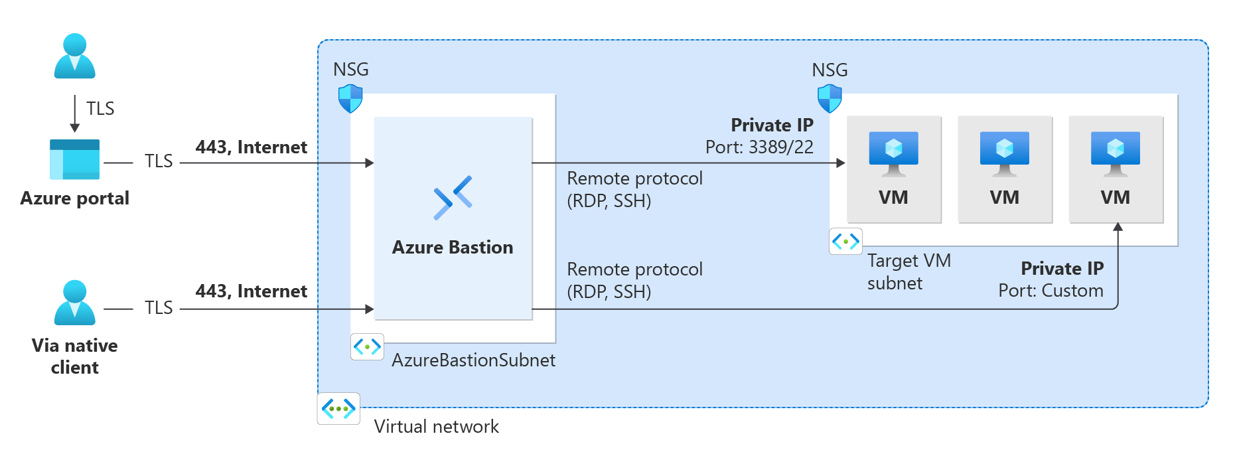
Azure Bastion
Azure Bastion is a service that you can deploy to let you connect to a virtual machine using your browser and the Azure portal, or via the native SSH or RDP client already installed on your local computer. The Azure Bastion service is a fully platform-managed PaaS service that you deploy inside your virtual network. It provides secure and seamless RDP/SSH connectivity to your virtual machines directly from the Azure portal over TLS. When you connect via Azure Bastion, your virtual machines don't need a public IP address, agent, or special client software.

Slide 13
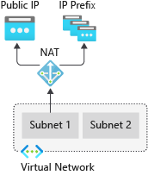
Virtual network NAT Gateway
Virtual Network NAT(network address translation) simplifies outbound-only Internet connectivity for virtual networks. When configured on a subnet, all outbound connectivity uses your specified static public IP addresses. Outbound connectivity is possible without load balancer or public IP addresses directly attached to virtual machines

Slide 14
Route Server
Azure Route Server simplifies dynamic routing between your network virtual appliance (NVA) and your virtual network. It allows you to exchange routing information directly through Border Gateway Protocol (BGP) routing protocol between any NVA that supports the BGP routing protocol and the Azure Software Defined Network (SDN) in the Azure Virtual Network (VNet) without the need to manually configure or maintain route tables.

Slide 15
Peering Service
Azure Peering Service enhances customer connectivity to Microsoft cloud services such as Microsoft 365, Dynamics 365, software as a service (SaaS) services, Azure, or any Microsoft services accessible via the public internet.

Slide 16
Application protection services

Slide 17
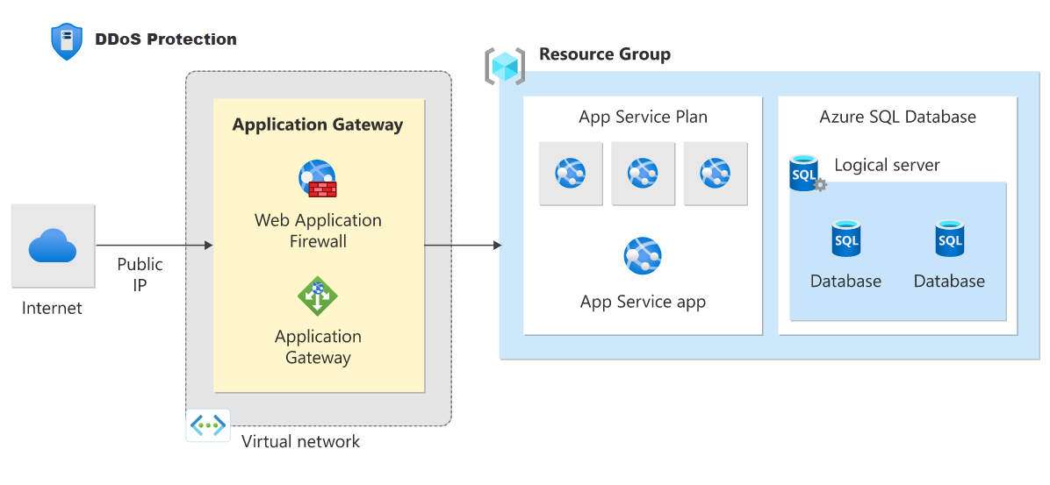
DDoS Protection
Azure DDoS Protection provides countermeasures against the most sophisticated DDoS threats. The service provides enhanced DDoS mitigation capabilities for your application and resources deployed in your virtual networks. Additionally, customers using Azure DDoS Protection have access to DDoS Rapid Response support to engage DDoS experts during an active attack.
Azure DDoS Protection consists of two tiers:
DDoS Network Protection, combined with application design best practices, provides enhanced DDoS mitigation features to defend against DDoS attacks. It's automatically tuned to help protect your specific Azure resources in a virtual network.
DDoS IP Protection is a pay-per-protected IP model. DDoS IP Protection contains the same core engineering features as DDoS Network Protection, but will differ in the following value-added services: DDoS rapid response support, cost protection, and discounts on WAF.

Slide 18
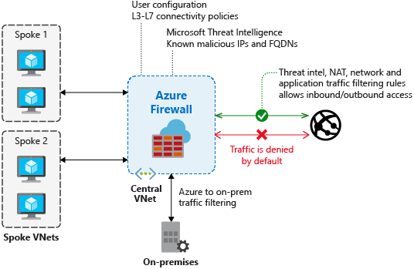
Azure Firewall
Azure Firewall is a managed, cloud-based network security service that protects your Azure Virtual Network resources. Using Azure Firewall, you can centrally create, enforce, and log application and network connectivity policies across subscriptions and virtual networks. Azure Firewall uses a static public IP address for your virtual network resources allowing outside firewalls to identify traffic originating from your virtual network.

Slide 19
Network security groups
You can filter network traffic to and from Azure resources in an Azure virtual network with a network security group. For more information, see Network security groups.

Slide 20
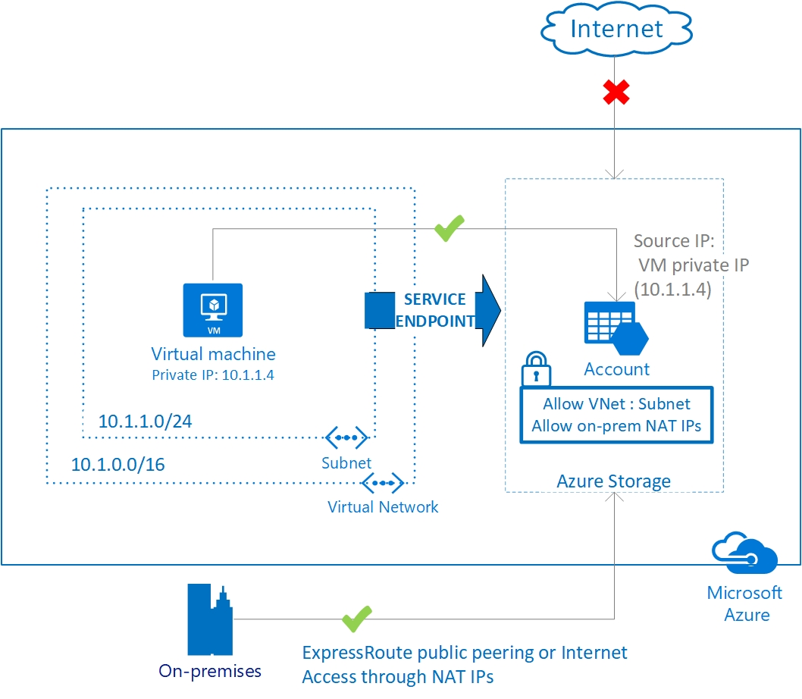
Service endpoints
Virtual Network (VNet) service endpoints extend your virtual network private address space and the identity of your VNet to the Azure services, over a direct connection. Endpoints allow you to secure your critical Azure service resources to only your virtual networks. Traffic from your VNet to the Azure service always remains on the Microsoft Azure backbone network.

Slide 21
Application delivery services

Slide 22
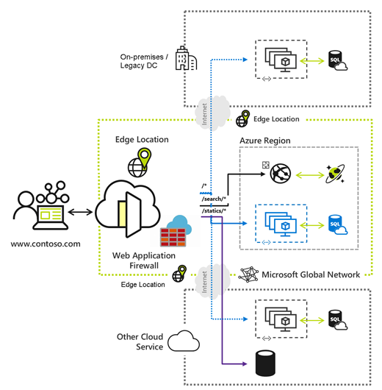
Azure Front Door
Azure Front Door enables you to define, manage, and monitor the global routing for your web traffic by optimizing for best performance and instant global failover for high availability.

Slide 23
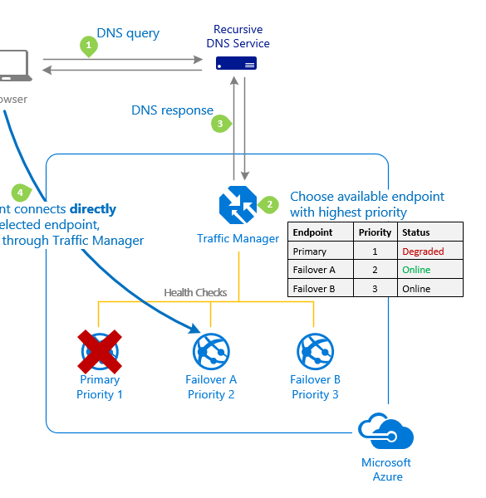
Traffic Manager
Azure Traffic Manager. is a DNS-based traffic load balancer that enables you to distribute traffic optimally to services across global Azure regions, while providing high availability and responsiveness. Traffic Manager provides a range of traffic-routing methods to distribute traffic such as priority, weighted, performance, geographic, multi-value, or subnet.

Slide 24
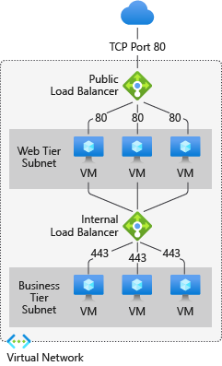
Load Balancer
Azure Load Balancer provides high-performance, low-latency Layer 4 load-balancing for all UDP and TCP protocols. It manages inbound and outbound connections.

Slide 25
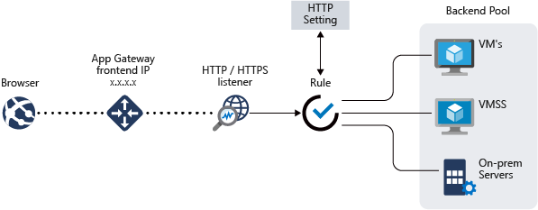
Application Gateway
Azure Application Gateway is a web traffic load balancer that enables you to manage traffic to your web applications.
It's an Application Delivery Controller (ADC) as a service, offering various layer 7 load-balancing capabilities for your applications.

Slide 26
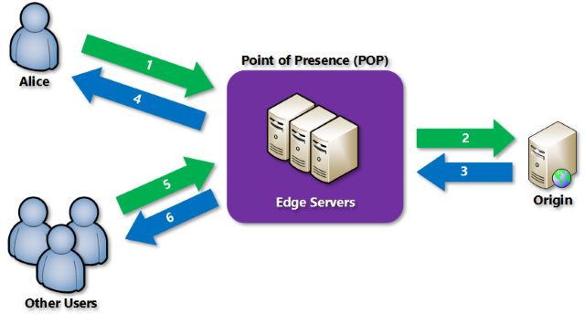
Content Delivery Network
Azure Content Delivery Network (CDN). offers developers a global solution for rapidly delivering high-bandwidth content to users by caching their content at strategically placed physical nodes across the world.

Slide 27
Network monitoring services

Slide 28
Azure Network Watcher
Azure Network Watcher provides tools to monitor, diagnose, view metrics, and enable or disable logs for resources in an Azure virtual network

Slide 29
Azure Monitor
Azure Monitor maximizes the availability and performance of your applications by delivering a comprehensive solution for collecting, analyzing, and acting on telemetry from your cloud and on-premises environments.
It helps you understand how your applications are performing and proactively identifies issues affecting them and the resources they depend on.

Slide 30
ExpressRoute Monitor
To learn about how to view ExpressRoute circuit metrics, resource logs and alerts

Slide 31
Network Insights
Azure Monitor for Networks (Network Insights). provides a comprehensive view of health and metrics for all deployed network resources, without requiring any configuration.

