Slide 1

Azure SQL Server and Cosmos DB
Presented By : Sreehari Aranghat

Slide 2


Data platform
On premises
Hybrid Cloud
Off premises
Shared Lower cost
Dedicated Higher cost
Higher administration
Lower administration

Slide 3



















SQL Database Service
A relational database-as-a-service, fully managed by Microsoft.
For cloud-designed apps when near-zero administration and enterprise-grade capabilities are key.
Perfect for organizations looking to dramatically increase the DB:IT ratio.

Slide 4



How is it different from VMs?
SQL Server in a VM
Azure SQL Database
Best for…
Resources
TCO
benefits
Scalability

Slide 5


Elastic scale & performance
Each performance level is assigned a defined level of throughput by the service.

Slide 6
Designed for predictable performance
Redefined
Across Basic, Standard, and Premium, each performance level is
assigned a defined level of throughput
Measure of power
Introducing the Database Throughput Unit (DTU) which represents database power and replaces hardware specs
% CPU
DTU is defined by the bounding box for the resources required by a database workload and measures power across the six performance levels.
% read
% write
Basic — 5 DTU
S0 — 10 DTU S1 — 20 DTU S2 — 50 DTU S3 — 100 DTU
P1 — 125 DTU P2 — 250 DTU P4 — 500 DTU P6 — 1,000 DTU P11 — 1,750 DTU
% memory

Slide 7
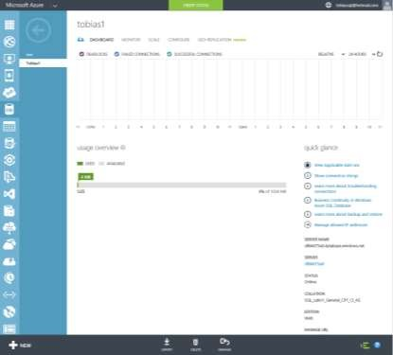




Dashboard views of metrics
Monitor
Quickly understand DB resource usage via percent of resources
consumed for each resource type over time and database size
Available in the management portal & via APIs
In contrast to a VM, no system- related overhead—focused on just the resources used to run your database workload
In-depth views (DMVs) are also available for deeper understanding and trouble- shooting (for example, at the query level)

Slide 8





Drive elastic scale out
Elastic Scale
Support temporary or sustained high-throughput app patterns
Elastic Scale across thousands of databases via custom sharding
Scale out via .Net Client libraries -- consumed by customer applications to support sharded database pattern
Enables developer and manageability functions
Supports split, merge, and move
operations on data

Slide 9


Point-in-time restore
Programmatic “oops recovery” of data deletion or alteration
Auto backups, transactional logs every 5 min Backups in Azure Storage and geo-replicated
Creates a side-by-side copy, non-disruptive REST API, PowerShell or Azure Portal Backups retention policy:
Basic, up to 7 days
Standard, up to 14 days
Premium, up to 35 days
Automated export of logical backups for long-term backup protection
SQL Database
Backups
sabcp01bl21
Azure Storage
sabcp01bl21
Geo- replicated
Restore from backup

Slide 10


Geo-restore
Emergency data recovery when you need it most
Available in Basic, Standard and Premium
Built on geo-redundant Azure Storage Recover to any Azure region
SQL Database Backups
sabcp01bl21
Azure Storage
sabcp01bl21
Geo- replicated
Restore to any Azure region

Slide 11



Azure Active Directory integration
Centrally manage user permissions
Alternative to SQL Server authentication
Limits proliferation of user identities across databases
Allows password rotation in a single place
Manage database permissions using external Azure Active Directory groups
Stops password storing by using integrated Windows authentication and other forms of authentication supported by Azure Active Directory
In preview

Slide 12






Row-Level Security
Protect data privacy by ensuring the right access across rows
Fine-grained access control over specific rows in a database table
Help prevent unauthorized access when multiple users share the same tables, or to implement connection filtering in multi-tenant applications
Administer via SQL Server Management Studio or SQL Server Data Tools
Customer1
Customer2
Customer3
SQL Database

Slide 13


Dynamic Data Masking
Prevent the abuse of sensitive data by hiding it from users
Configuration made easy in the new Azure portal
Policy-driven at the table and column level, for a defined set of users
Data masking applied in real-time to query results based on policy
Multiple masking functions available (e.g. full, partial) for various sensitive data categories (e.g. Credit Card Numbers, SSN, etc.)
Table.CreditCardNo
4465-6571-7868-5796
4468-7746-3848-1978
4484-5434-6858-6550
SQL Database
Real-time data masking; partial masking

Slide 14


Always Encrypted
Extra protection for sensitive data stored in SQL databases
Sensitive data remains encrypted and queryable at all times
SQL Server service does not have the keys Encryption keys remain with the client
No changes necessary for applications
Encrypted
query
ADO .NET
No app changes
Master key
Encrypted columnar
key

Slide 15






Azure SQL Database service tiers
*The 99.99% availability SLA does not apply to the existing Web and Business editions, which will continue to be supported at 99.9% availability.
here

Slide 16



Slide 17
What is Cosmos DB

Slide 18
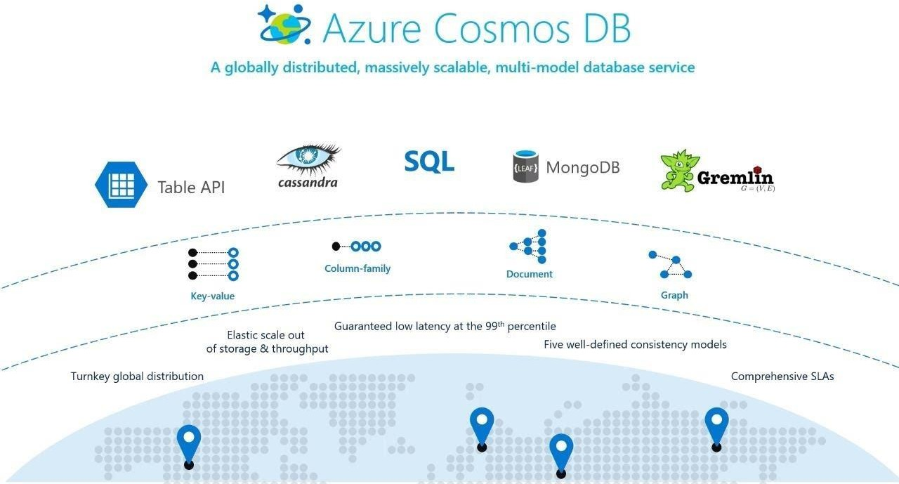
What is Azure Cosmos DB

Slide 19
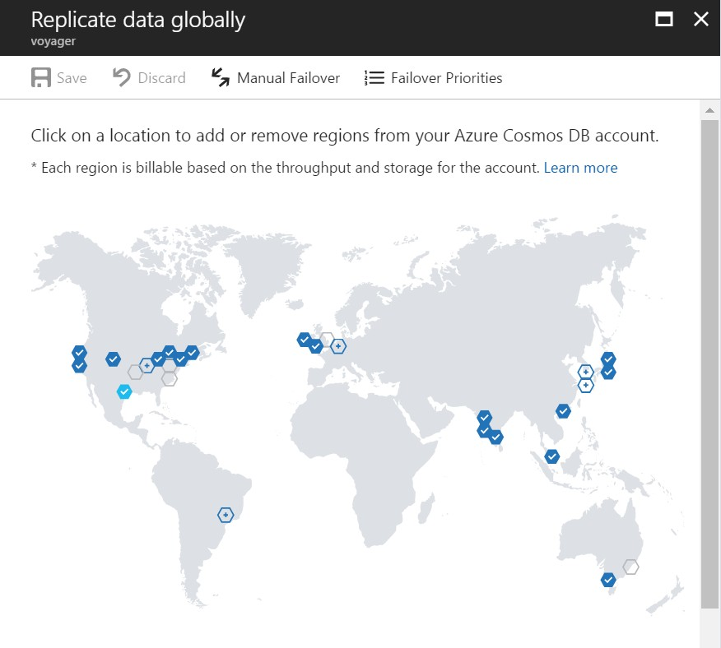
What is Azure Cosmos DB
Global Distribution
Worldwide presence
Automatic multi-region replication
Multi-homing APIs
Manual and automatic failovers

Slide 20
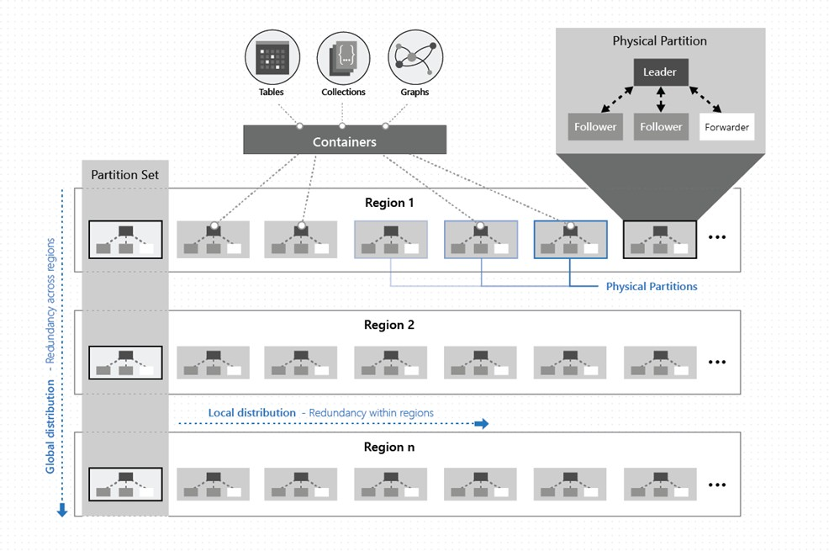
What is Azure Cosmos DB
Comprehensive SLAs
99.99% availability
Durable quorum committed writes
Latency, consistency, and throughput also covered by
financially backed SLAs
Made possible with highly-redundant architecture
Operation type | Single region | Multi-region (single region writes) | Multi-region (multi- region writes)
Writes | 99.99 | 99.99 | 99.999
Reads | 99.99 | 99.999 | 99.999

Slide 21
Cosmos DB Data Formats

Slide 22








Cosmos DB Data Formats

Slide 23




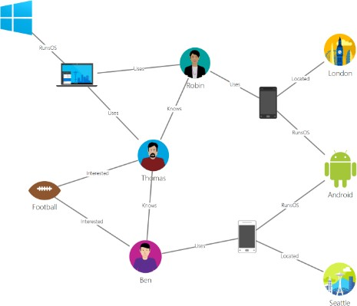





Cosmos DB Data Formats
The query syntax is geared at navigating graphs – you could say e.g. .has(‘person’, ‘name’, ‘Thomas’).outE(‘Knows’) to find people who Thomas knows.

Slide 24

















Cosmos DB Data Formats

Slide 25
Cosmos DB Design

Slide 26
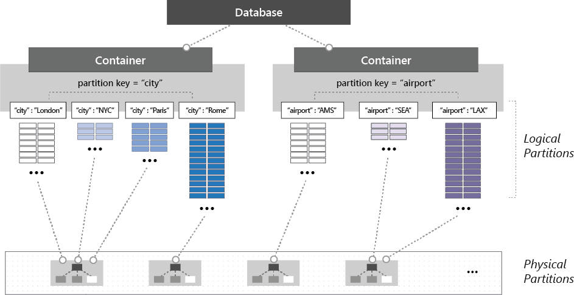
Containers and Databases

Slide 27
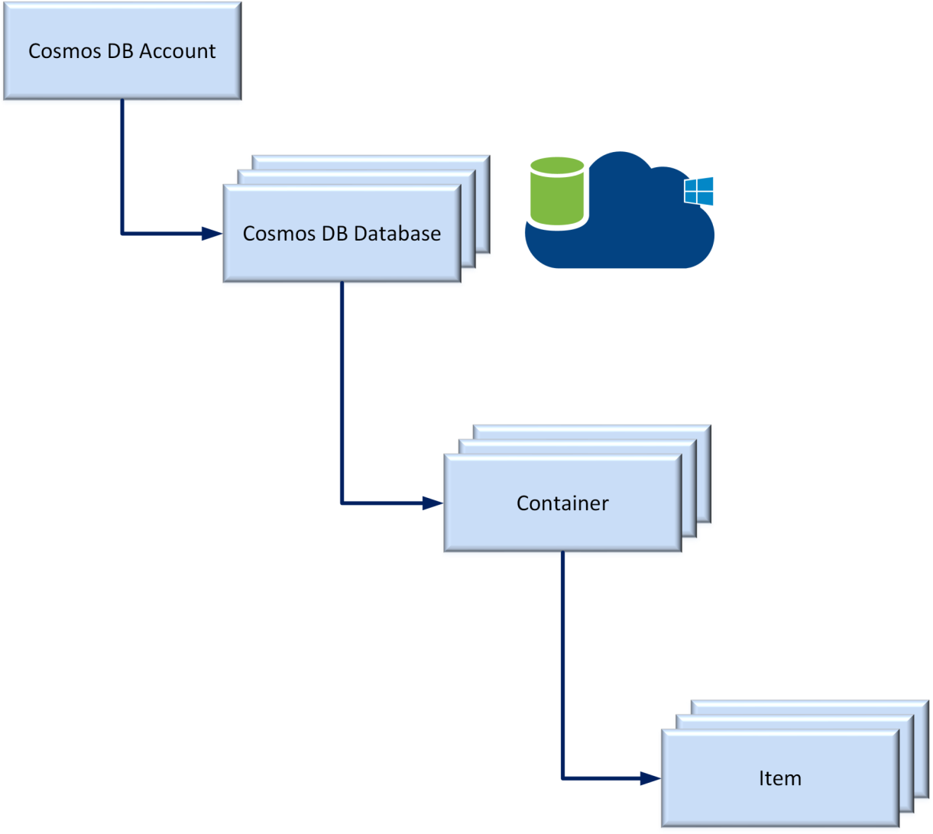





Cosmos DB Resources

Slide 28
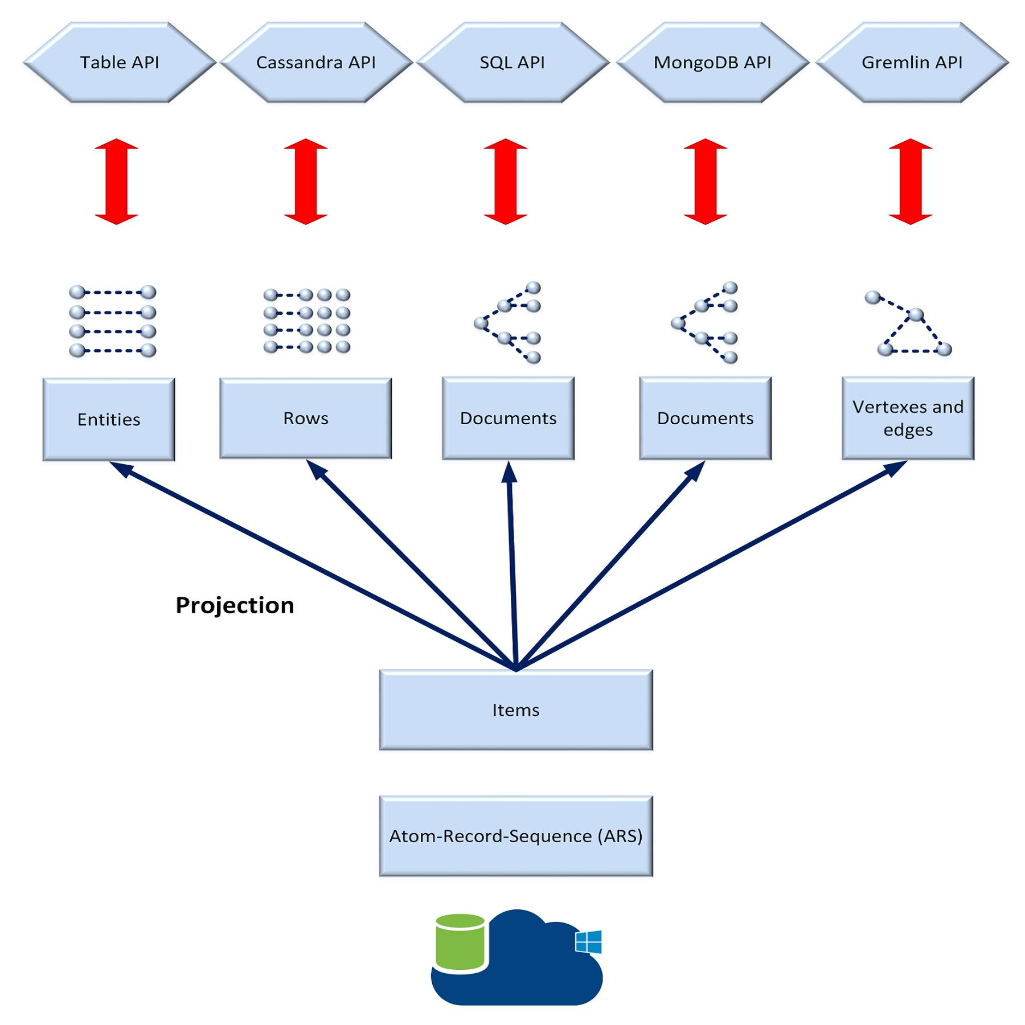

Cosmos DB Resources

Slide 29
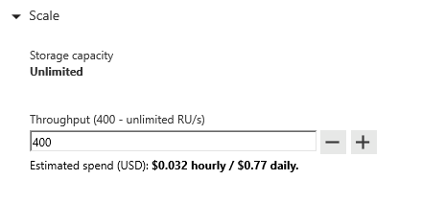
Request Units
Request Units (RUs) is a rate-based currency – e.g. 1000 RU/second
% Memory % CPU % IOPS
Abstracts physical resources for performing requests

Slide 30
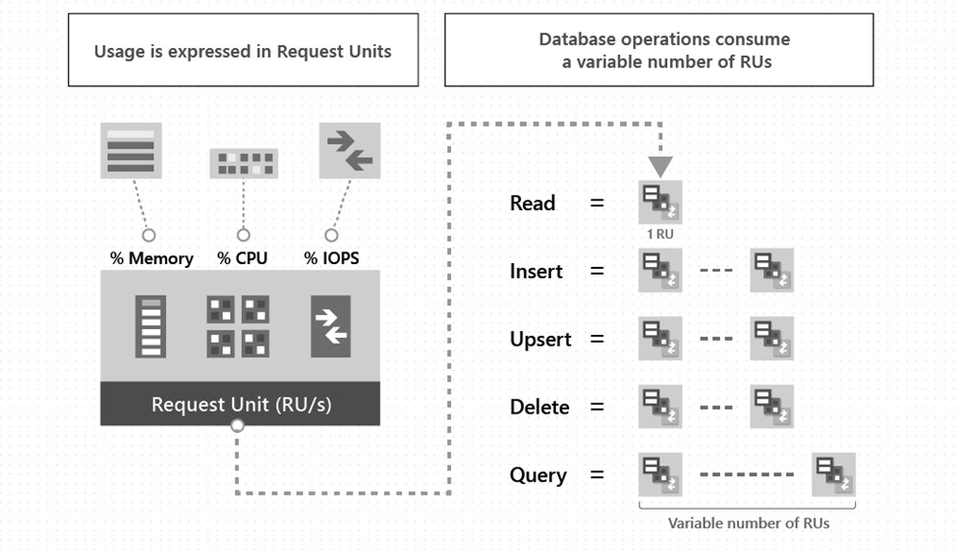
Cosmos DB Resources

Slide 31
Request Units
GET
=
Each request consumes # of RU
Approx. 1 RU = 1 read of 1 KB document
POST
=
Approx. 5 RU = 1 write of a 1KB document
Query: Depends on query & documents involved
PUT
=
Query
=
…

Slide 32
Developing against Cosmos DB (SQL API)

Slide 33





Developing against Cosmos DB SQL API

Slide 34
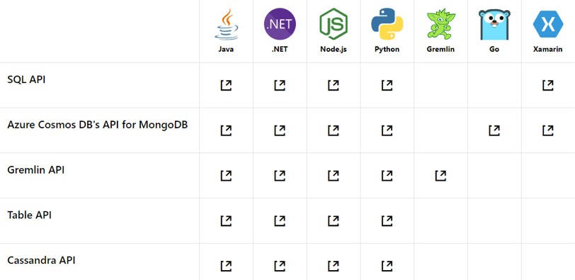
Cosmos DB APIs Support

Slide 35
Thank you!

