Slide 1

AZURE Storage Services
Sreehari Aranghat

Slide 2
Introduction to Azure Storage
Azure Storage is a comprehensive cloud storage solution provided by Microsoft, designed to cater to a wide range of data storage needs. It offers scalable, durable, and highly available storage across a variety of data objects, making it suitable for both large-scale applications and small projects

Slide 3

Key benefits: Scalability, Durability, Security, and Accessibility
Durable & Highly Available
Secure through encryption
Scalable
Managed
Accessible

Slide 4

Azure Storage data services
Azure Blobs : A massively scalable object store for text and binary data.
Azure Files : Managed file shares for cloud or on-premises deployments.
Azure Queues : A messaging store for reliable messaging between application components.
Azure Tables : A NoSQL store for schemeless storage of structured data.
Azure Managed Disks : Block-level storage volumes for Azure VMs.

Slide 5
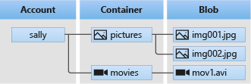
Azure Blob Storage
Serving images or documents directly to a browser.
Storing files for distributed access.
Streaming video and audio.
Writing to log files.
Storing data for backup and restore, disaster recovery, and archiving.
Storing data for analysis by an on-premises or Azure-hosted service.

Slide 6
Azure Files
Replace or supplement on-premises file servers:
“Lift and shift" applications
Simplify cloud development:
Shared application settings
Diagnostic share
Dev/Test/Debug

Slide 7

Azure Queues
Azure Queue Storage is a service for storing large numbers of messages. You access messages from anywhere in the world via authenticated calls using HTTP or HTTPS. A queue message can be up to 64 KB in size. A queue may contain millions of messages, up to the total capacity limit of a storage account. Queues are commonly used to create a backlog of work to process asynchronously

Slide 8
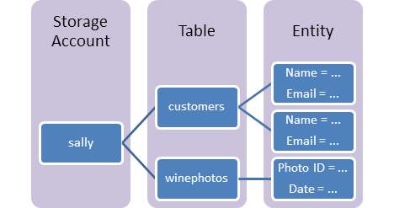
Azure Table
Azure Table storage stores large amounts of structured data. The service is a NoSQL datastore which accepts authenticated calls from inside and outside the Azure cloud. Azure tables are ideal for storing structured, non-relational data

Slide 9
Azure Disks
Azure Disk Storage offers high-performance, durable block storage for Azure Virtual Machines (VMs). These disks are mounted to VMs as OS or data disks. Azure Disks are designed for scenarios that require persistent, high-performance, low-latency disk storage, such as databases, enterprise applications, and other I/O intensive workloads.

