Slide 1
Customer 360
Graph-Based Demo — Architecture, Design, Data & Retrieval
Internal Review · NOT customer-facing · 2026-06-25
Selling ArangoDB the platform to a security buyer (Zscaler) — grounding & traceability are the pitch.

Slide 2
OVERVIEW
What this is
▸ A custom agent answers a free-form question by querying TWO ArangoDB graphs — a structured graph (Salesforce/Snowflake/DocuSign) and an unstructured GraphRAG KG (Slack/Docs/email/PDF) — and reasons across both.
– Every fact is traceable to the record, graph, and traversal it came from.
▸ Strategic purpose: a SALES DEMO to make ArangoDB legible to a Zscaler buyer — not a product, not yet a POC. The agent is the vehicle; ArangoDB is the product.
▸ Core value: a question only answerable by JOINING both graphs returns a correct, fully-sourced answer.
▸ Failure mode we engineer against: a confident wrong answer in front of a security buyer.
▸ Audience filter: trust is the pitch — grounded, traceable, refuses rather than hallucinates, ignores doc injection.
▸ 100% synthetic data; runs as a Next.js/Vercel dashboard over the existing managed ArangoDB cluster.

Slide 3
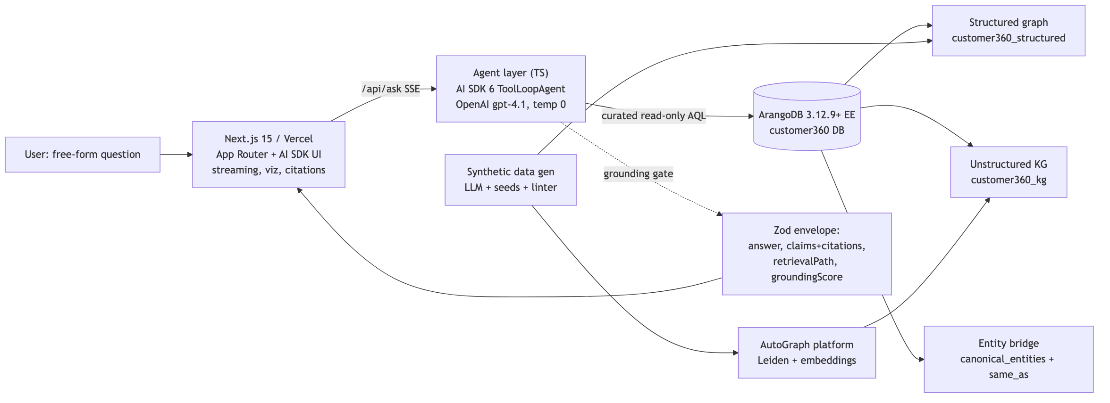
ARCHITECTURE
System Architecture
One Vercel deploy (UI + agent) over one ArangoDB cluster. AutoGraph runs build-time only — never on the query path.

Slide 4
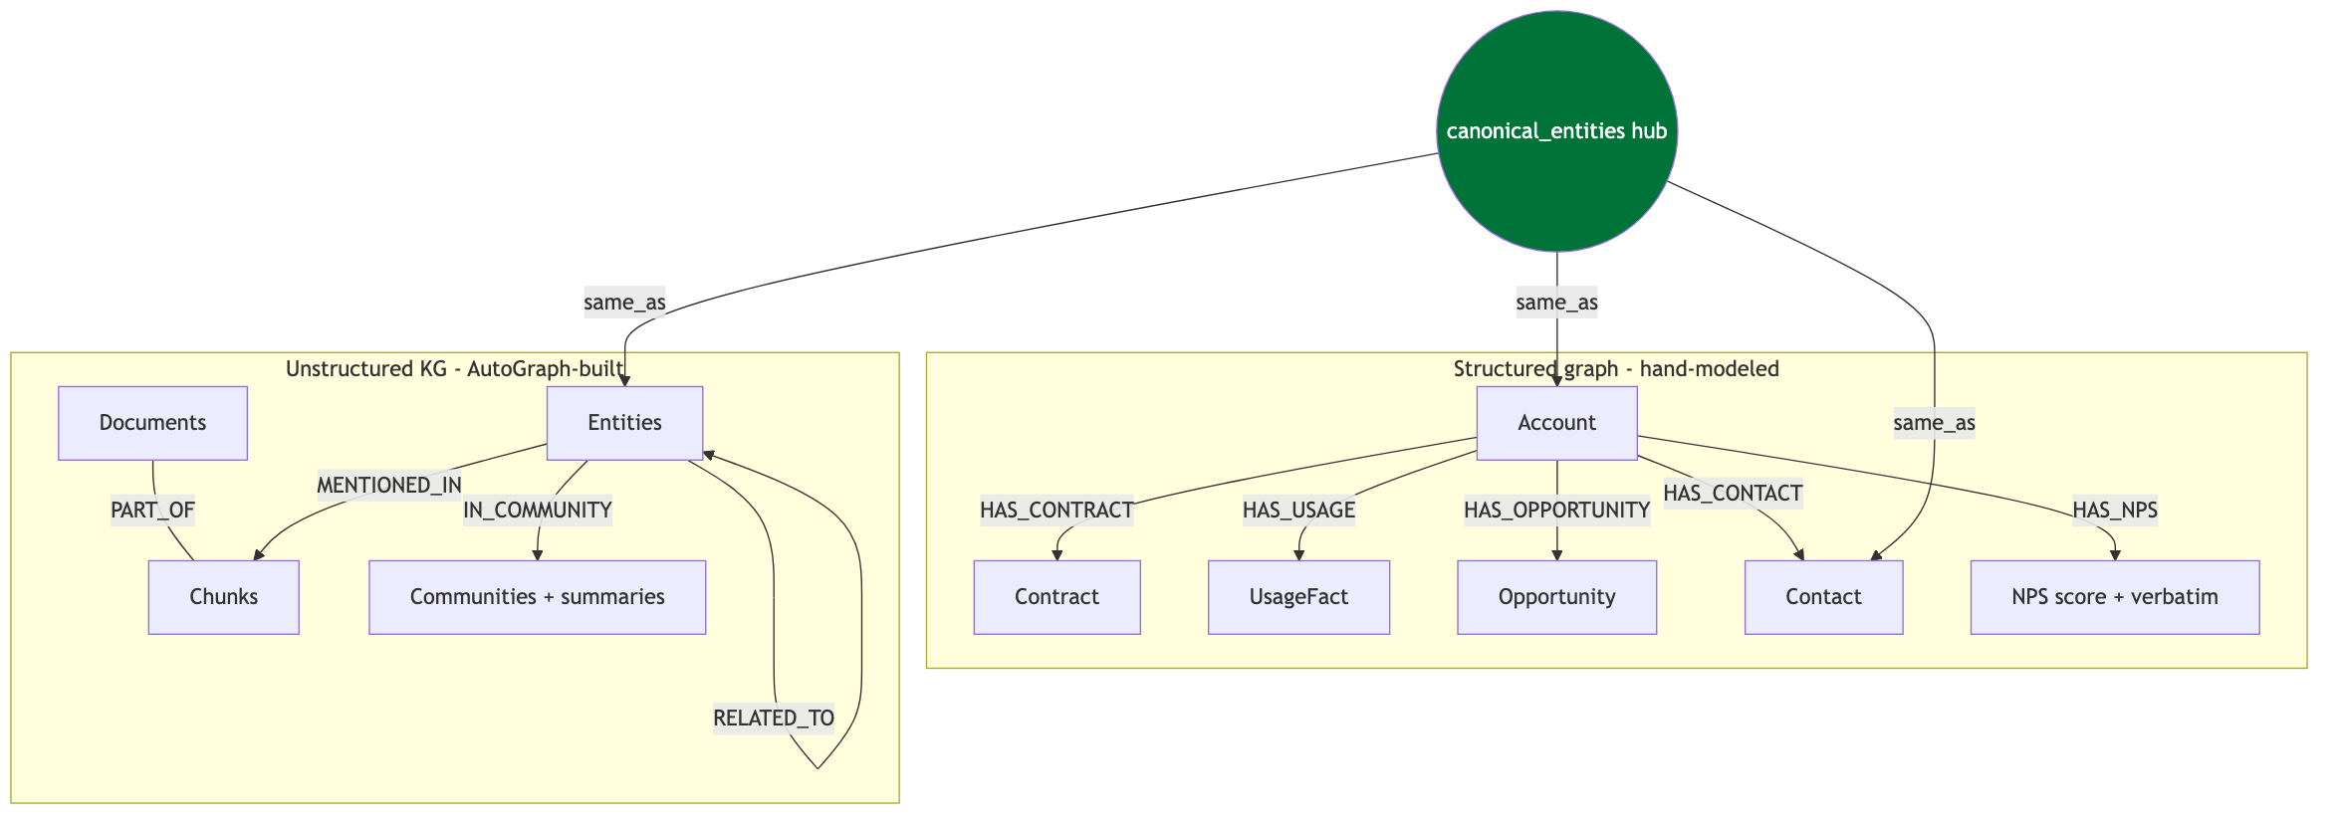
DESIGN
The Two-Graph Data Model + Entity Bridge
Two purpose-built graphs joined on a deterministic shared entity_id via the same_as edge — no runtime fuzzy matching.

Slide 5
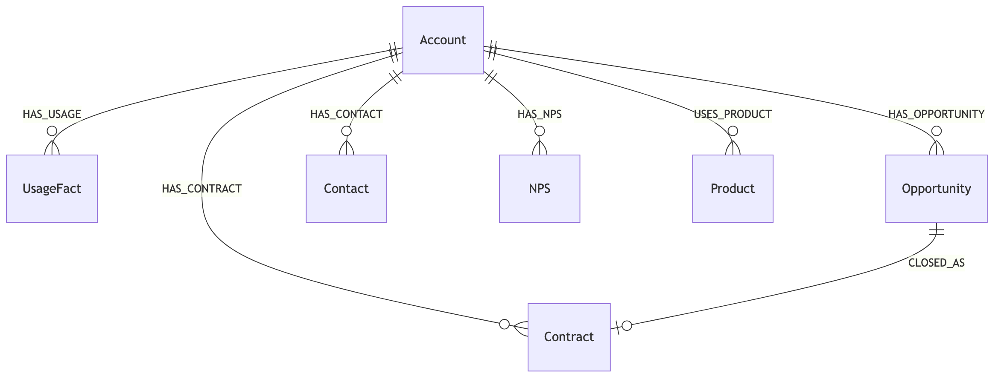
DESIGN
Structured Graph Schema — customer360_structured
7 vertex + 7 edge collections. NPS score (structured) sits over the verbatim comment (KG) — engine of the centerpiece question.

Slide 6
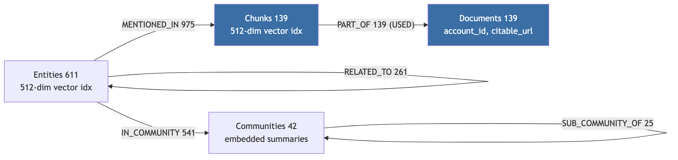
DESIGN
Unstructured KG Schema — customer360_kg (AutoGraph)
1,941 typed edges; only PART_OF (139) queried today. Entities/communities are built, vector-indexed, summarized — but unqueried (~93%).

Slide 7
DESIGN
Key Design Choices (and why)
▸ Orchestration: AI SDK 6 ToolLoopAgent (TS), planner-led, 12-step cap, temp 0 — same runtime as the UI → one Vercel deploy.
▸ Structured graph hand-modeled (not AutoGraph) — clean schema + named, explainable traversals.
▸ AutoGraph at build time only — borrow Leiden/RRF/embeddings; never put its opaque retriever on the query path.
▸ Cross-graph join via deterministic shared entity_id + same_as — no runtime fuzzy matching.
▸ 4 curated, read-only, LIMIT-bounded AQL tools; no generated AQL — a hallucinated query live is the failure mode to avoid.
▸ Grounding is pure code (enforceGrounding) — no model call decides grounding; ungrounded → structured refusal.
▸ Answer contract = Zod envelope {answer, claims[], citations[], retrievalPath[], groundingScore}.
▸ Determinism: temp 0 + N=3 majority-vote judge + 1-retry gate → trustworthy pre-demo green/red.

Slide 8
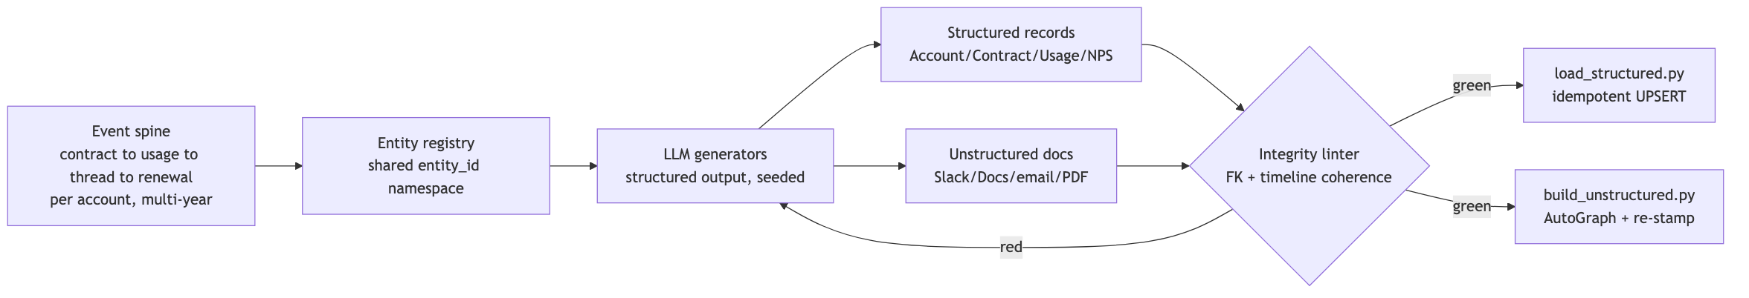
DATA
Data Generation — 100% synthetic, coherent, seeded
Event-spine first → shared entity_id → seeded LLM generators → integrity linter gate → idempotent load + AutoGraph build.

Slide 9
DATA
The Narrative: 3 Accounts, 9 Questions
📸 Hero answer (Q12) paste screenshot
▸ Northwind Analytics — healthy expansion: green AND genuinely healthy (true positive). Anchors Q7, Q5.
▸ Meridian Logistics — hidden risk: green metrics, RED sentiment (the false positive we catch). Anchors Q12★, Q2, Q9, Q8.
▸ Helio Retail — honest churn: usage AND sentiment decline together. Anchors Q13, Q14, Q15.
▸ Q12 is the centerpiece: every structured metric green, NPS score fine — yet Slack escalations, a quiet champion, a red QBR flag, and a negative NPS verbatim reveal it is at-risk.
– "Green" = a composite of structured signals. Green ≠ healthy — that gap is the demo.
– Only crossing both graphs surfaces the contradiction. A single-system tool answers "healthy ✓" — the confident-wrong answer.

Slide 10
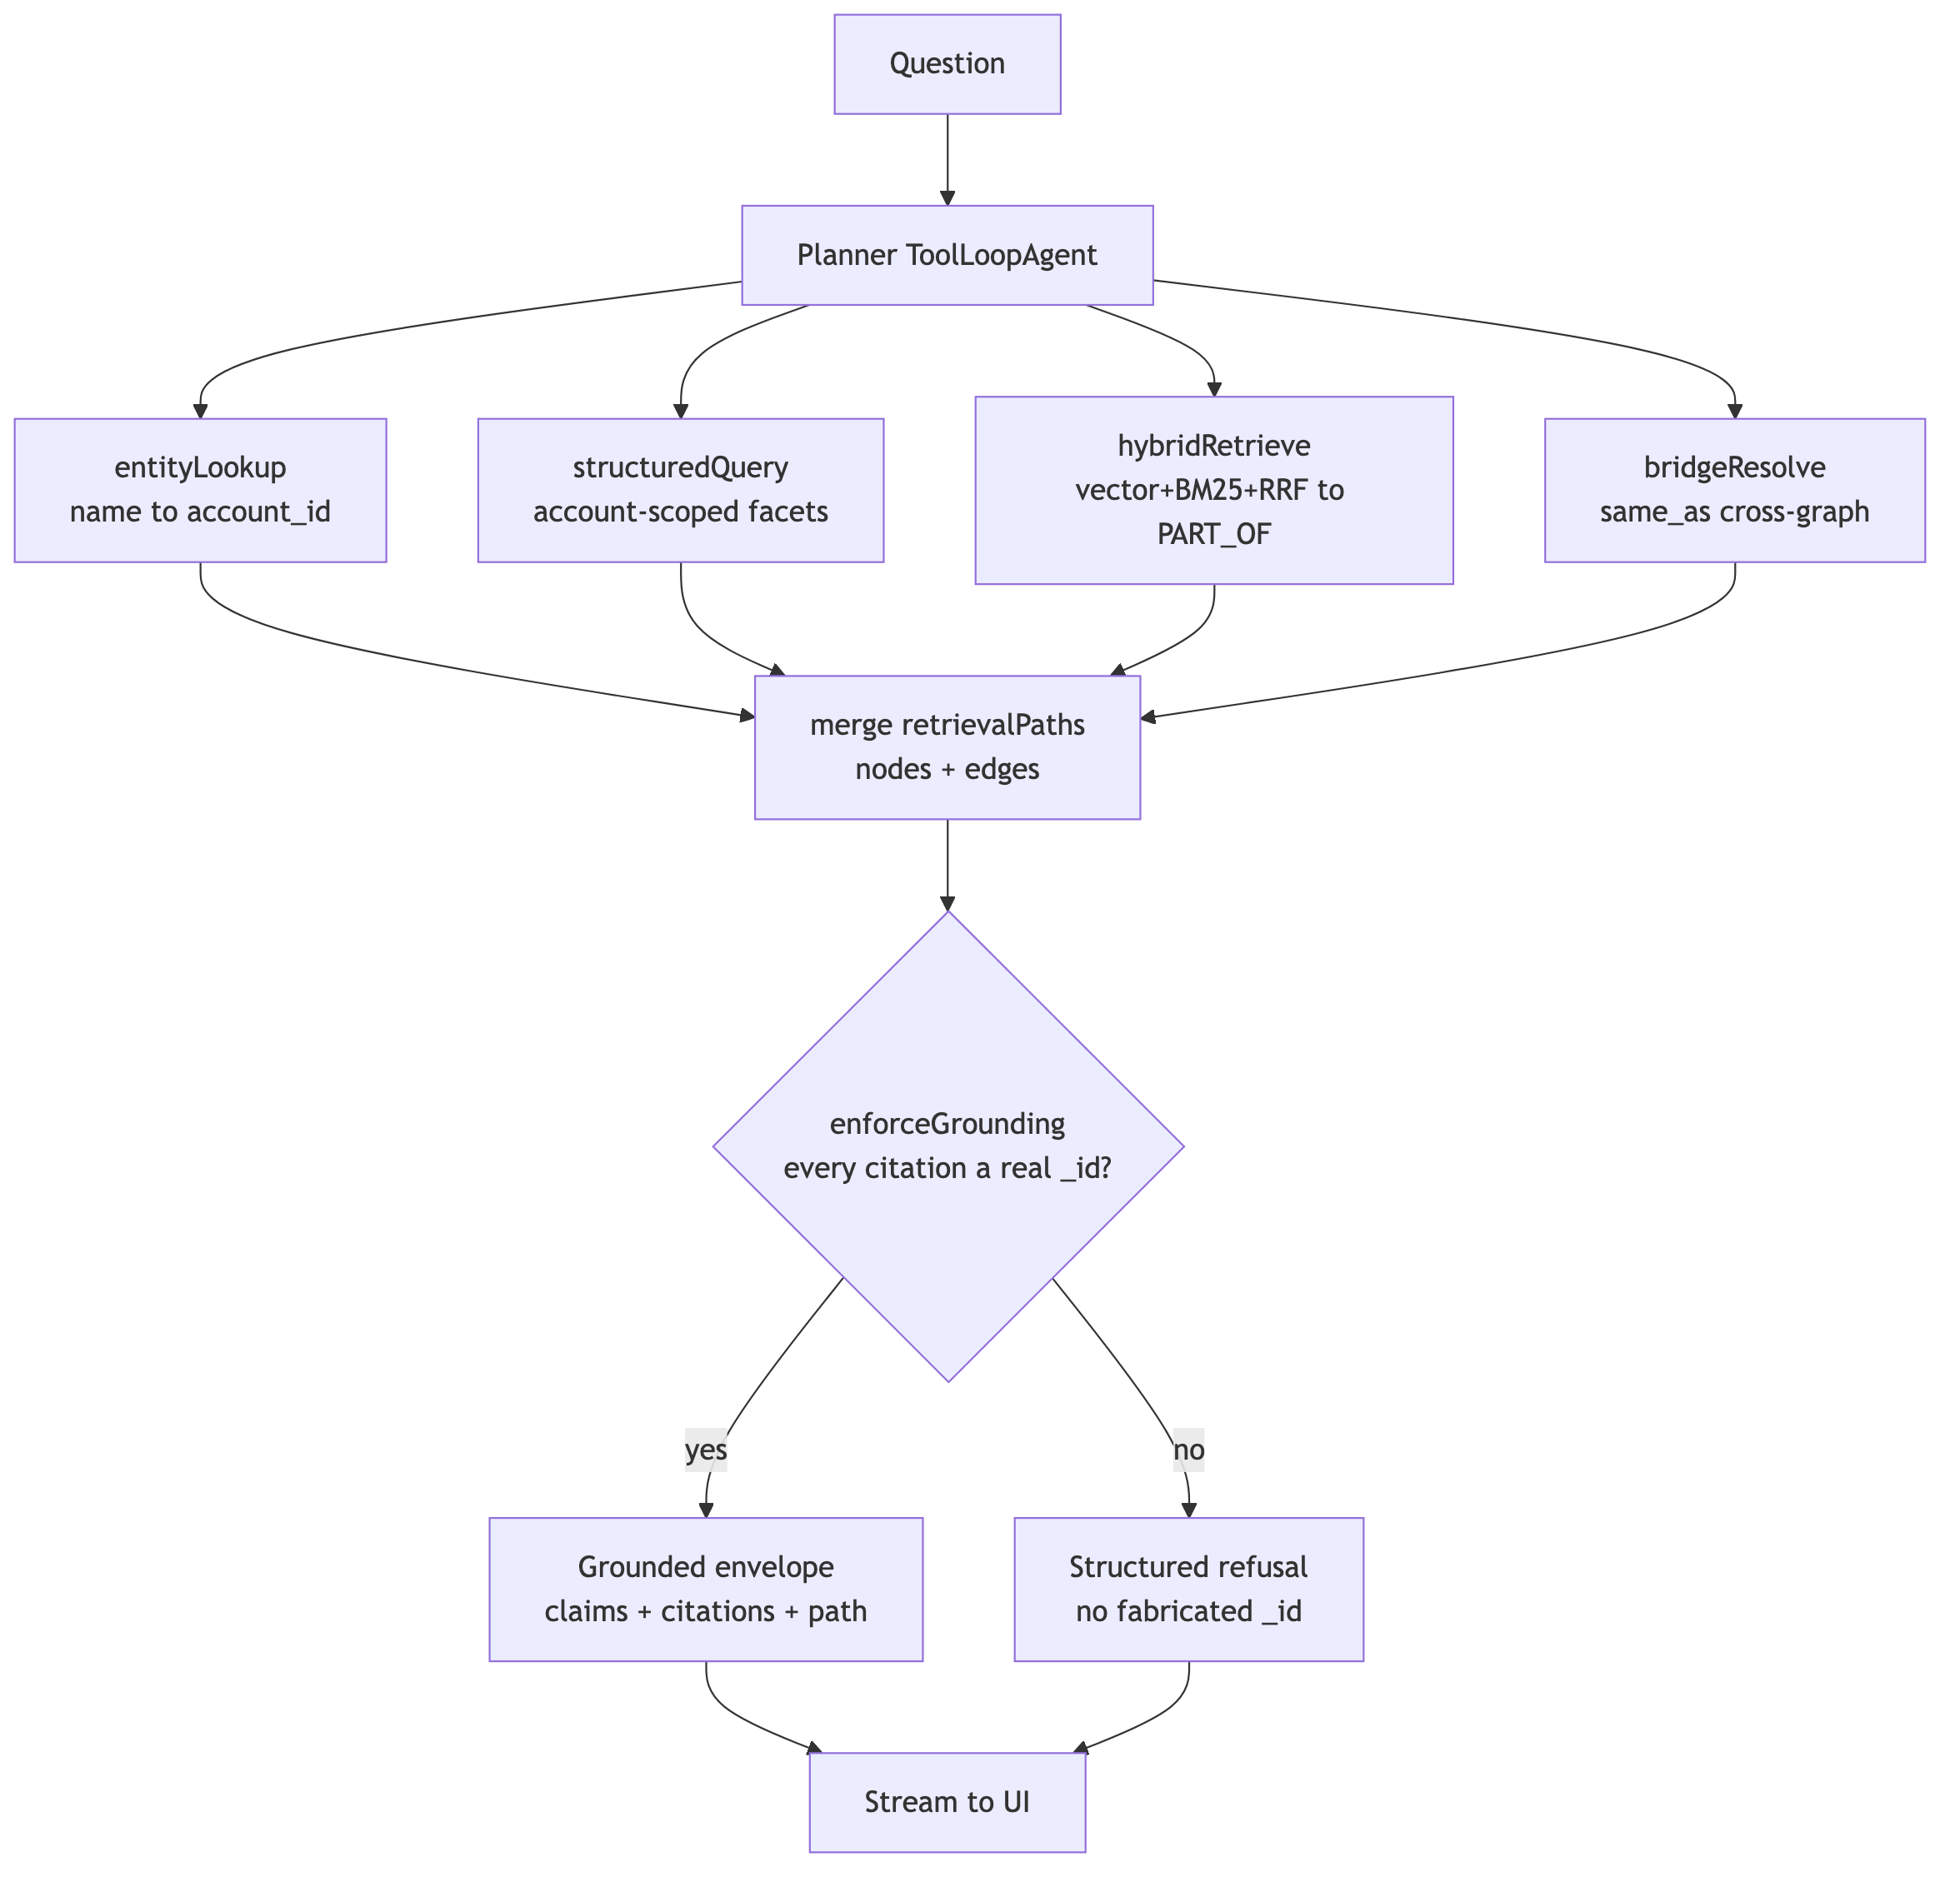
RETRIEVAL
Retrieval Approach — Planner + 4 Specialists
Each tool returns data + a retrievalPath fragment; pure-code grounding gate; validated envelope streamed to the UI.

Slide 11
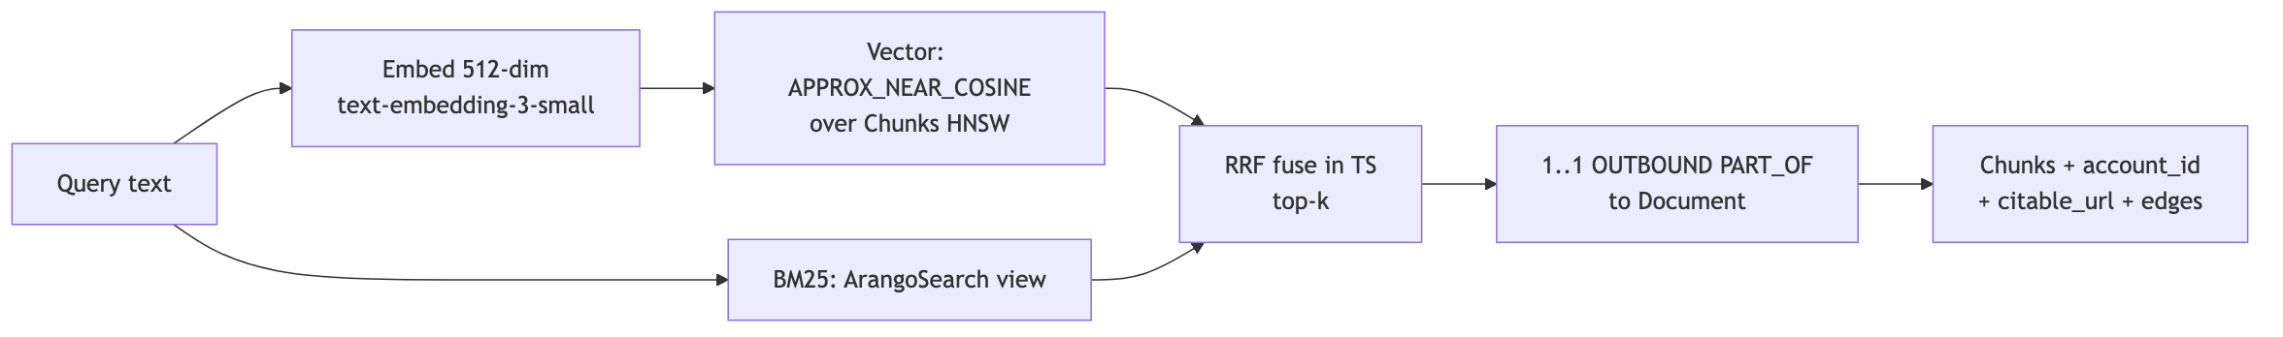
RETRIEVAL
Hybrid Retrieval — one engine, one query language
Vector + BM25 + graph traversal all in ArangoDB. Competitive contrast: "you'd need Neo4j + Pinecone + a search system + glue."

Slide 12
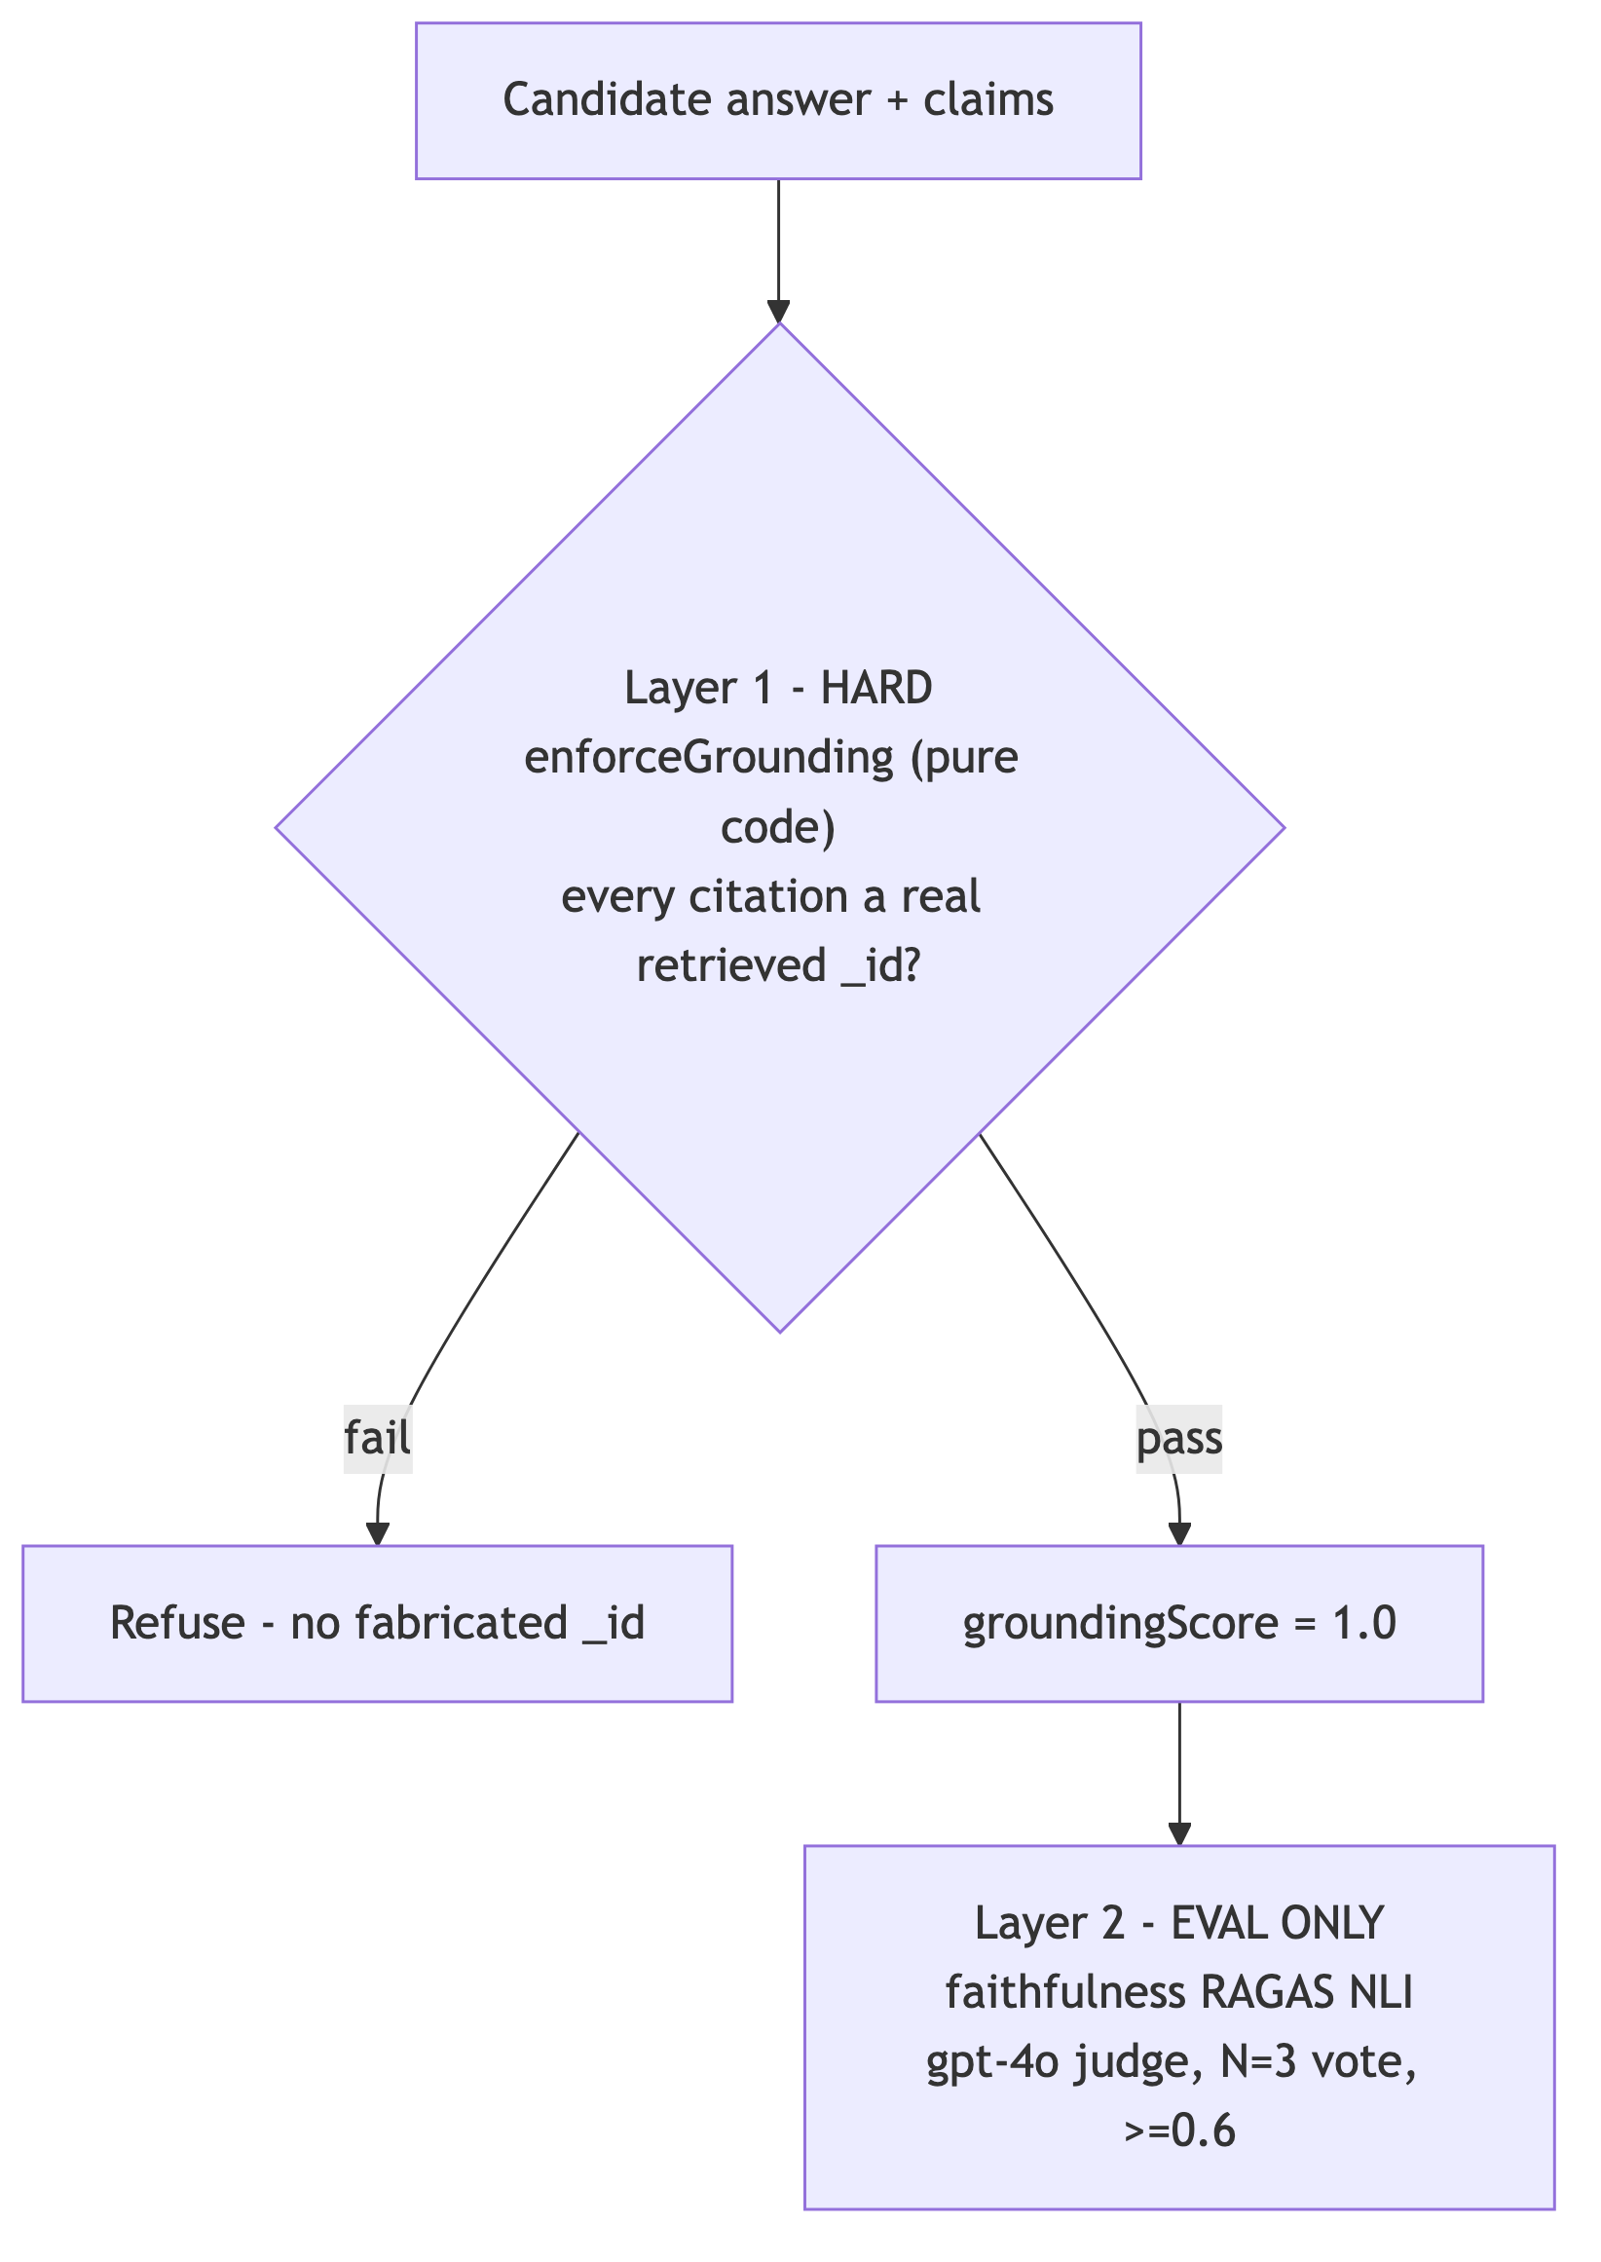
TRUST
Grounding & Trust Model — two layers
📸 Refusal (RefusalPanel) paste screenshot
Layer 1 (live, deterministic _id grounding) is the hard floor. Layer 2 (faithfulness) is eval-only — not the live gate.

Slide 13
TRUST
Eval Harness & Faithfulness
📸 Eval gate ALL-GREEN paste terminal screenshot
▸ One command, green/red — runs all 9 locked questions + adversarial refusals against the live planner + ArangoDB before any demo.
▸ Per question asserts: correct (non-)refusal, cross-graph reconciliation (≥1 structured AND ≥1 unstructured _id), groundingScore = 1.0, faithfulness ≥ 0.6, and (Q12/Q13) that the answer names the contradiction.
▸ Determinism: temperature 0, N=3 majority-vote judge (≥2/3 = supported), 1-retry to absorb a transient flake.
– Residual ~5% stochastic-judge variance is a SAFE failure (no fabrication).
▸ The 0.6 floor is honest, not tuned down — a drop below 0.6 on a stable run is a real regression.

Slide 14
INTERNAL ONLY — DO NOT SHOW THE CLIENT
Honest Current State
▸ REAL graph work today: hybrid retrieval + PART_OF sourcing traversal + same_as cross-graph bridge; deterministic grounding; claim-level provenance; live CDC; injection resistance.
▸ NOT yet: structured retrieval is flat scans (no traversal); the cross-graph JOIN lives in the planner's reasoning, not a single AQL query; entity/community KG layers built but unqueried; graph viz congested; prod not promoted.
▸ Phase 14 is the cut line before going Zscaler-facing — real traversal, single-AQL join, and "show me the query." The demo is notably strong after Phase 14.
– Do not overclaim graph depth now: if a technical buyer asks to see the structured query, it is currently a flat FILTER.

Slide 15
ROADMAP
Roadmap (v2 tail)
▸ Phase 14 — Graph-Depth + Explainability: real multi-hop traversal + single-AQL cross-graph join + "show me the query" reveal.
▸ Phase 15 — GraphRAG via Communities: hierarchical global→local retrieval over the built Leiden layer (summaries already exist + embedded).
▸ Phase 16 — Time-Travel: @asOf effective-dated traversal (honest: a modeling pattern, not native).
▸ Phase 17 — Agent Memory on ArangoDB: multi-turn, graph-resident memory ("agentic brain on Arango").
▸ Phase 18 — Presenter Control Panel + CDC reframe: one-click capability moments; name one-engine propagation.
▸ Demo Assets (parallel): talk track, maps-to-your-data one-pager, competitive one-liner, security slide.

Slide 16
APPENDIX
Screenshot Shot-List (to complete this deck)
▸ Run on localhost (npm run dev) or a preview deploy — prod isn't promoted. Use Meridian Q12 as the hero. Leave adversarial mode hidden.
– 1. Hero answer (Q12): claim list + inline citations + Trust chip "Grounded ✓". → Slide 9
– 2. Cross-graph subgraph viz (Q12): structured (left) + unstructured (right) + same_as bridge + edge-kind legend (solid/dashed/dotted).
– 3. Citation drawer: a Slack/QBR chunk's text AND a structured record's fields side by side.
– 4. Refusal: out-of-scope question → RefusalPanel, zero fabricated citations. → Slide 12
– 5. What-changed diff: trigger Simulate update, re-ask, capture WhatChangedBanner + highlights. (Optional)
– 6. Eval gate green: terminal all-green per-question summary. → Slide 13
– 7. Linter green (optional): synthetic-data integrity linter passing.
▸ Diagrams on slides 3,4,5,6,8,10,11,12 are rendered from Mermaid — edit the .mmd sources and re-render to update.

