Slide 1
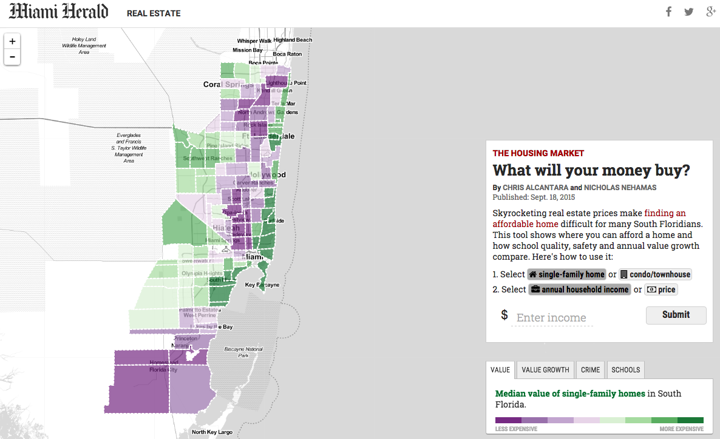
What will your money buy?
Miami Herald

Slide 2
Who are we?
Nicholas Nehamas Reporter on the Miami Herald business desk. Covers real estate and the economy and contributes to ongoing 2016 presidential race. Previously covered health care. Chris Alcantara Interactive news developer. Specializes in building data visualizations, multimedia projects and interactive graphics.

Slide 3
Project purpose
Because wages are low and foreign investors snap up available properties, Miami is one of the least affordable housing markets in the United States. We wanted to make a tool that readers could see where exactly in South Florida they could afford a home – and how those areas matched up on schools and safety.

Slide 4

What we found
Middle-class people are being pushed farther away from where they work and where the best schools and safest neighborhoods are.
Story also includes profiles of different neighborhoods around Miami-Dade County written by more than half-dozen reporters.

Slide 5
Planning
We didn’t just want to tell people our conclusions. We wanted to let them figure it out for themselves based on their income.
A calculator works, but we wanted to show people where they can afford a home.
We decided on a map, drawing inspiration from previous real estate coverage.

Slide 6
Development
Tools used: Leaflet, JavaScript, jQuery, Gulp, HTML and CSS/SCSS.
Decided to use Leaflet because:
We’ve used it before. Plenty of code to reference.
Thorough documentation and big community on Stack Overflow
Plays nicely with other libraries include, D3.js.
Meanwhile, Nick gathered data and compiled it into a format (JSON) used to feed the map. First time using GitHub.

Slide 7
Challenges
We realized early on we weren’t going to find perfect data. We had to compromise on what we could show and explain the decisions we made to readers. Also: Time. Inputting the data was labor-intensive, more so than we expected. Under the hood: Issues with function scoping for clearing layers off the map.

Slide 8
One month, two redesigns and several near-mental breakdowns later…

Slide 9
Success!

Slide 10
Works on mobile

Slide 11
Reaction
This interactive was one the more popular tool the Herald has published.
We received a lot positive feedback from readers, although many lamented the fact they couldn’t afford homes in the neighborhoods they wanted to live in.
Our editors also thought the project was a success, meaning we hope to have the opportunity to create more map-based interactives in the coming months.

Slide 12
What we learned
Communication between developer and reporter is crucial. Good for both to understand the goal. Also, good for reporter to translate “code talk” to “normal English” for editors.
Compromising on expectations and realities can lead to less stress and better results, especially while working in a small team.
Experimenting with new ways to tell a story is always good but make sure to have a backup plan when disaster strikes.
Seek help when stuck. There’s a lot the Internet can provide, but sitting with another person and talking out the problem can save hours of research.

Slide 13
Contact
Nicholas Nehamas nnehamas@miamiherald.com @NickNehamas 305-376-3745
Chris Alcantara calcantara@miamiherald.com @chrisalcantara github.com/chrisalcantara

Slide 14
Questions?

