Slide 1
Online Learning Center
Presented by Shikha Rani
January 11 , 2024

Slide 2
Online Learning Center
It is a web based application that serves as an online learning platform for both instructor and student. Here, a new user can register itself as a “STUDENT” or “INSTRUCTOR” on registration page. We have 3 types of user roles-
1- STUDENT-
Student will see list of her/his enrolled courses, grades, course details etc.
Student can enroll to a new course, and withdraw from already enrolled course as well.

Slide 3
2- INSTRUCTOR
- Instructor will see his existing running courses and students enrolled under instructor's courses.
- Instructor can update the progress of his students.
- Instructor can offer/start a new course under the list of Departments. And, a student can enroll to this course later on.

Slide 4
3- ADMIN-
The admin is a special user, who can create a new department under which an Instructor can offer/start multiple courses.
URL- HTTP://localhost:8080/register

Slide 5
    TECHNOLOGIES USED
    Java
    Spring Core
    Spring MVC
    Spring Boot
    Spring Data/Hibernate/JPA
    Spring Security
    Spring Test
    Thyme leaf
    HTML/CSS/JavaScript
    MySQL
    J Unit Testing
    GitHub

Slide 6
    TECHNOLOGIES USED
    Java
    Spring Core
    Spring MVC
    Spring Boot
    Spring Data/Hibernate/JPA
    Spring Security
    Spring Test
    Thyme leaf
    HTML/CSS/JavaScript
    MySQL
    J Unit Testing
    GitHub

Slide 7
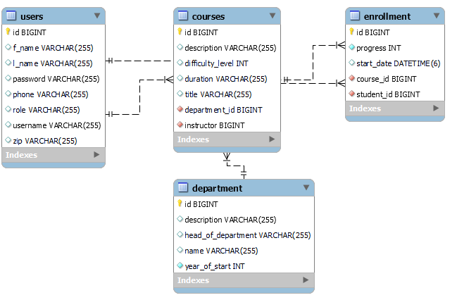
Entity Relationship diagram

Slide 8
Model/Database tables Info
Model or DB tables | Description
Users | To capture User's info. User can be STUDENT, INSTRUCTOR or ADMIN.
Department | Have a new department . Which can be created by ADMIN only.
Courses | A INSTRUCTOR can offer a Course under a department.
Enrollment | A student can enroll to a course and track his/her progress.

Slide 9
HTML/View pages
View (HTML Pages) | Description
Login.html | Login page where user can enter credentials.
Register.html | To register a new user. User can register with STUDENT or INSTRUCTOR role.
create_department.html | Create a new department by ADMIN user.
create_new_course.html | An INSTRUCTOR can offer/start/create a new course under a department.
instructor_home.html | Instructor home where s/he will see her/her courses and students list enrolled under them. Instructor can update the progress of students enrolled under them.
new_course_registration.html | A Student, can enroll to a new course In which s/he is not enrolled yet.
student_home.html | Student home page where student can see courses under which s/he is enrolled and see the progress as well.

Slide 10
Challenges
Spring security set-up
Finding background design
Designing the HTML pages
Mapping Hibernate relationships between entities
Testing
Thyme leaf form and dynamic content

Slide 11
Future add on
Upload instructional videos and lessons and track their progress.
Generate quizzes on portal.
Provide assignments.
Add more features.
Integrate with other training platforms.

Slide 12
Future add on
Upload instructional videos and lessons .
Function for saving past recordings on website for future.
Generate quizzes on portal.
Provide assignments
Can make my website more beautiful.
Update students attendance
Give more authorities to admin

