Slide 1
Banking Data Analysis
Presented By
Apoorv Ranjan

Slide 2
Brief description of datasets
Accounts Table
Branch Table
Customer Table
Employees Table
Transaction Table.

Slide 3
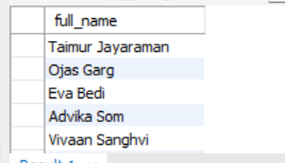
All customers who haven't made any transactions in the last year.
88 Customers are there.

Slide 4
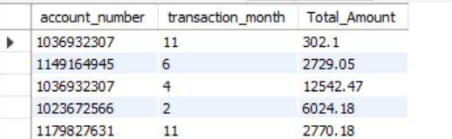
The total transaction amount per account per month.

Slide 5
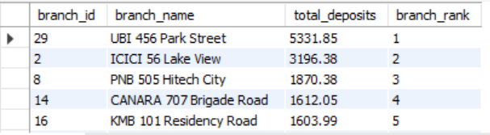
Branches Rank based on the total amount of deposits made in the last quarter.

Slide 6

Name of the customer who has deposited the highest amount.

Slide 7
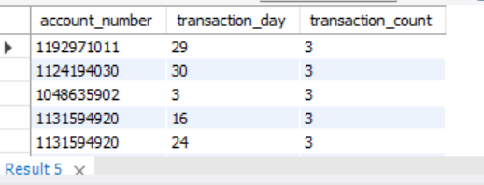
Accounts that have made more than two transactions in a single day
30 Accounts are there with more than two Transactions.

Slide 8
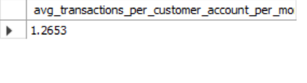
Average number of transactions per customer per account per month over the last year.

Slide 9
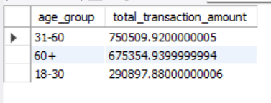
The total transaction amount performed by each age group in the past year. (Age groups: 0-17, 18-30, 31-60, 60+)

Slide 10

the branch with the highest average account balance

Slide 11
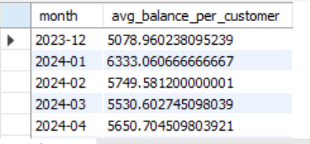
The average balance per customer at the end of each month in the last year.

