Slide 1

PREDICTIVE MAINTENANCE OF ELECTRIC MACHINES USING DEEP LEARNING
Presented By:
APOORV RANJAN (2022PSP0005)
Master of Technology (Department of Electrical Engineering)
Under the Guidance of:
Dr. Anup Shukla and Dr. Badri Narayan Subudhi.

Slide 2
CONTENT
INTRODUCTION
BACKGROUND
OBJECTIVE
LITERATURE REVIEW
DATASET
THE TRANSFORMER ARCHITECTURE
BERT MODEL
DATA PREPROCESSING
RESULTS AND DISCUSSION
COMPARISON WITH EXISTING WORK
CONCLUSION
REFERENCES

Slide 3
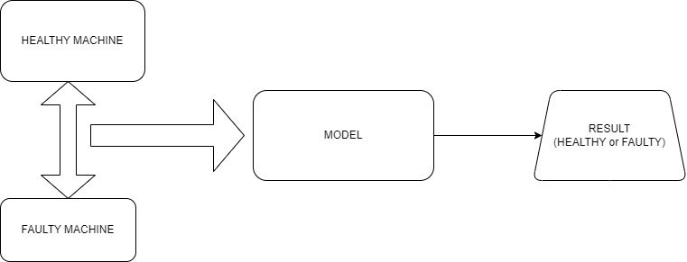
INTRODUCTION

Slide 4
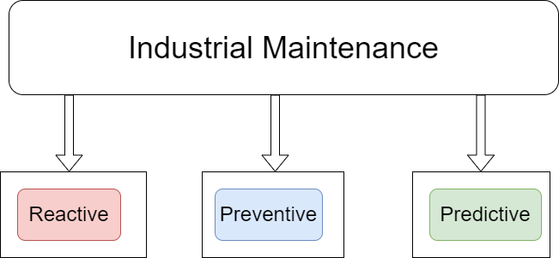
BACKGROUND
Industrial Maintenance

Slide 5
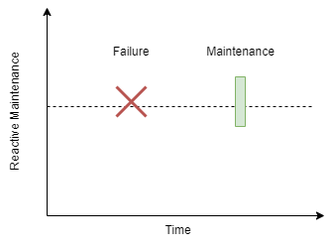
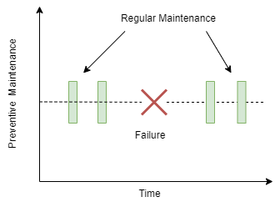
Reactive Maintenance
Preventive Maintenance

Slide 6
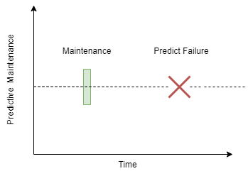
Predictive Maintenance

Slide 7
OBJECTIVE
To do health monitoring of the machine using vibrational data.
2. To classify the machine under Healthy and Unhealthy state.
3. The Bert Transformer Model is used for the Binary classification Task.

Slide 8
LITERATURE REVIEW
S.NO | TITLE/AUTHOR | WORK DONE | METHOD USED | LIMITATIONS
1 | O. Mey et al. , Machine Learning-Based Unbalance Detection, 2020 25th IEEE International Conference on Emerging Technologies and Factory Automation (ETFA), Vienna, Austria, 2020. | Unbalance Detection of a Rotating Shaft Using Vibration Data | CNN/Fully connected Neural network/Random Forest/HMM | With the smaller unbalances ,wider variations between the different approaches were found
2 | A. V. Malawade et al., Neuroscience-Inspired Algorithms , IEEE Transactions on Industrial Informatics, vol. 17, no. 12, pp. 7980-7990, Dec. 2021. | Predictive Maintenance of manufacturing systems | Hierarchical Temporal Memory(HTM) (Neuroscience) | RUL estimation

Slide 9
S.NO | TITLE/AUTHOR | WORK DONE | METHOD USED | LIMITATIONS
3 | Y. L. Karnavas,et al., "A Multi-Scale Deep Learning Attention-based Feature Method for Rolling Elements Bearing Fault Detection in Industrial Motor Drives," 2021 10th International Conference on Modern Circuits and Systems Technologies (MOCAST), Thessaloniki, Greece, 2021. | Rolling bearings fault detection in industrial motor drives. | Multi-scale dense convolutional blocks | Can't deal with more complex multi-scale architectures
4 | J. -H. Han, et al., "Motor Fault Diagnosis Using CNN Based Deep Learning Algorithm Considering Motor Rotating Speed," 2019 IEEE 6th International Conference on Industrial Engineering and Applications (ICIEA), Tokyo, Japan, 2019. | Done Motor fault diagnosis considering the speed of the motor. | Simplified CNN | The number of training data was limited to prove the results of the experiment.

Slide 10
S.NO | TITLE/AUTHOR | WORK DONE | METHOD USED | LIMITATIONS
5 | H. Matthew, et al. "Deep Learning Neural Networks Diagnosis of Power Transformer through Its DGA Data," 2022 9th International Conference on Electrical Engineering, Computer Science and Informatics (EECSI), Jakarta, Indonesia, 2022. | Diagnose faults in thermal power plant transformers by monitoring the concentration of various gas in transformer oil and using it to interpret the type of fault. | Neural Network using SGD and Adam’s Optimizer. | SGD is giving 68-70% of accuracy. Adam is giving high accuracy, but it has a higher variance and more prone to overfitting
6 | R. Fan, "Transformer-Based Deep Learning Method for the Prediction of Ventilator Pressure," 2022 IEEE 2nd International Conference on Information Communication and Software Engineering (ICICSE), Chongqing, China, 2022. | Predicted Ventilator Pressure using dataset provided by Google Brain in a Kaggle competition. Developed new method to overcome cost barrier of ventilator control. | Multi-head attention(MHA), Self-attention, and Transformer encoder. | Cost barrier.

Slide 11
S.NO | TITLE/AUTHOR | WORK DONE | METHOD USED | LIMITATIONS
7 | P. Shan, et al., "Image Feature-Based for Bearing Health Monitoring with Deep-Learning Method," 2019 Prognostics and System Health Management Conference (PHM-Qingdao), Qingdao, China, 2019. | Automatic recognition of the health condition and fault type and estimation of RUL with high accuracy and feasibility. | CNN is used for health condition recognition and LSTM is used for RUL estimation. | Failure threshold is set with same working condition. This threshold may be accurate with large data.
8 | O. Janssens, et al., "Deep Learning for Infrared Thermal Image Based Machine Health Monitoring," IEEE/ASME Transactions on Mechatronics, vol. 23, no. 1, pp. 151-159, Feb. 2018. | Application of deep learning (DL) techniques to infrared thermal (IRT) video data. Machine Fault Detection and Oil level Prediction is done. | CNNs are used for classification. The models learn to recognize patterns in IRT images associated with different machine conditions. | CNNs require a large amount of data. Maintenance costs are high for Installing an infrared thermal camera

Slide 12
DATASET
In total, datasets for 4 different unbalance strengths were recorded as well as one dataset with the unbalance holder without additional weight (i.e. without unbalance). Each dataset is provided as a CSV file with five columns:
Vin, Measured RPM, Vibration 1, Vibration 2, Vibration 3.
Sampling rate is 4096.
The CSV files’ names follow the “1D.csv” “2E.csv format to identify the division of the dataset.
“ D” for development or training, “E” for evaluation.
“0” = no unbalance, “4” = high unbalance.

Slide 13
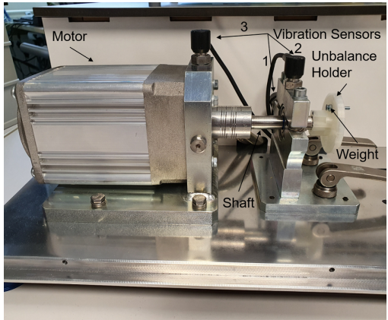
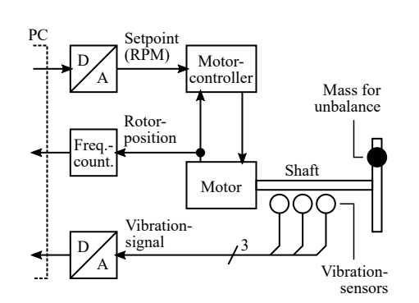
Measurement Setup
Measurement Setup
Block diagram for Measurement Setup
Image Source-[4]

Slide 14
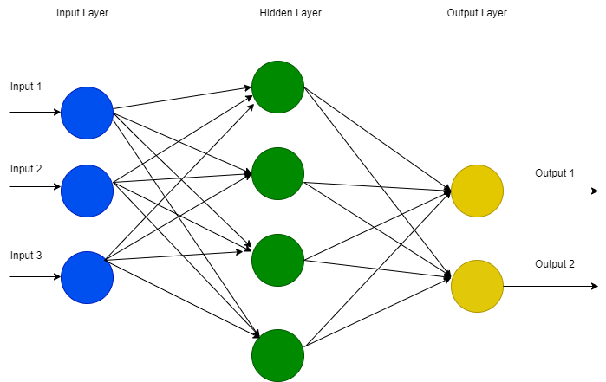
Deep Learning Models for Predictive Maintenance
Feed Forward Neural Network

Slide 15
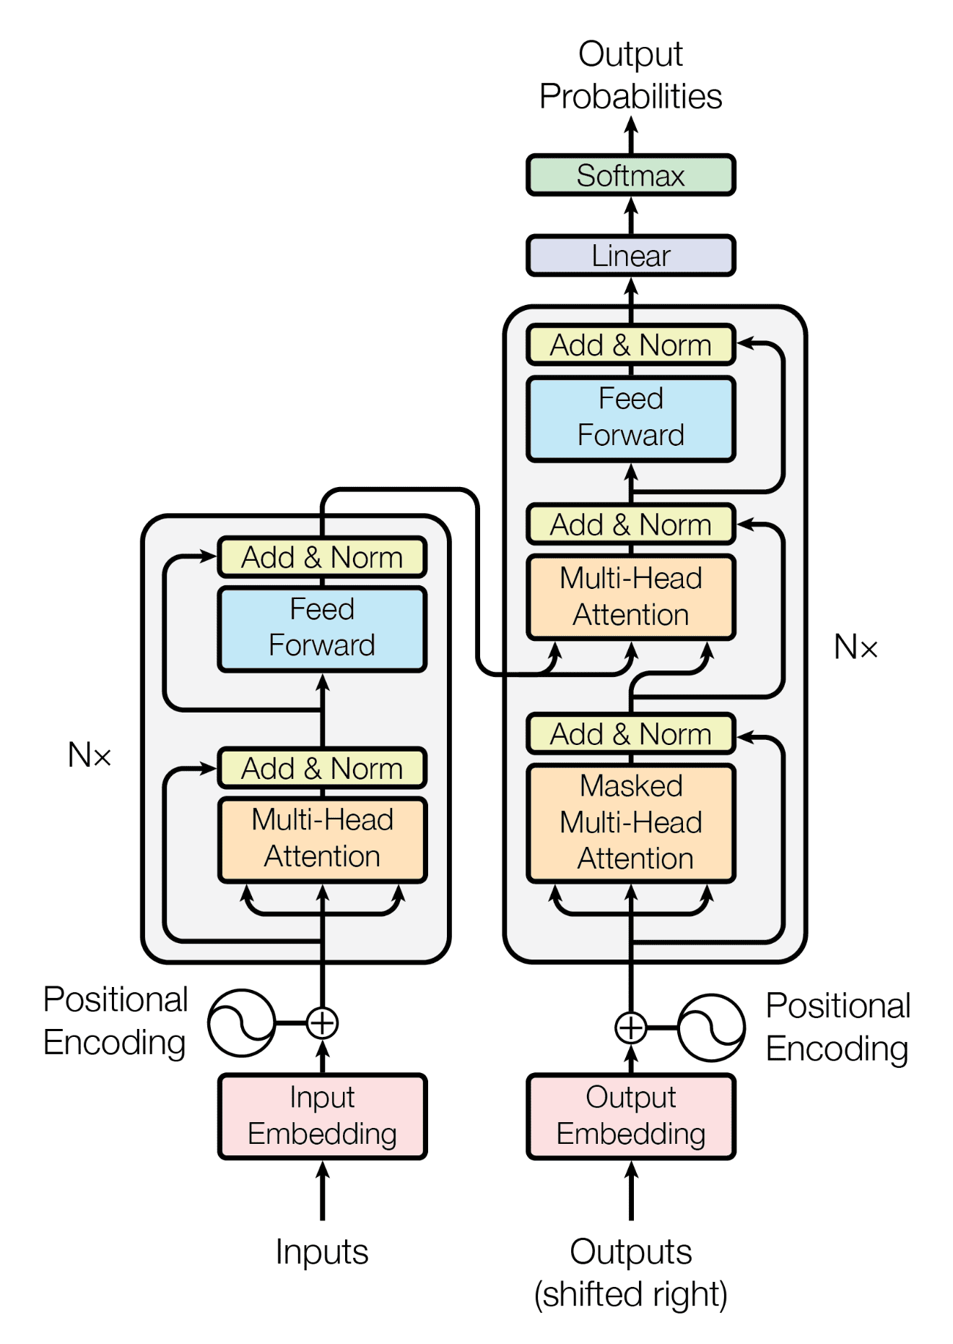
The Transformer Architecture
The Transformer architecture follows an encoder-decoder structure but does not rely on recurrence and convolutions to generate an output.
This Model tries to solve the Problem of parallelization which was there in the Recurrent neural network(RNN) and Long short term memory(LSTM).
Image Source-[9]

Slide 16
BERT MODEL
BERT stands for Bidirectional Encoder Representations from Transformers.
BERT is based on the Transformer architecture.
BERT is pre-trained on a large corpus of unlabeled text including the entire Wikipedia(2,500 Million words) and Book Corpus (800 million words).
BERT is a “deeply bidirectional” model. Bidirectional means that BERT learns information from both the left and the right side of a token’s context during the training phase.

Slide 17
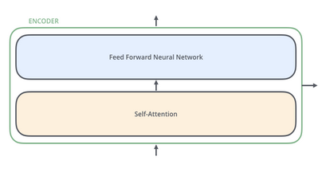
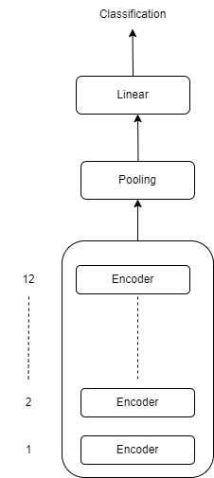
BERT’s Architecture
The BERT architecture builds on top of Transformer.
[A]
BERT_{BASE} (L=12, H=768, A=12, Total Parameters=110M) BERT_{LARGE} (L=24, H=1024, A=16, Total Parameters=340M) Where L = Number of layers (the total number of encoders)
H = Hidden size, A = Number of self-attention heads
Image source-[A] https://cdn.analyticsvidhya.com/wp-content/uploads/2022/10/p4.png

Slide 18
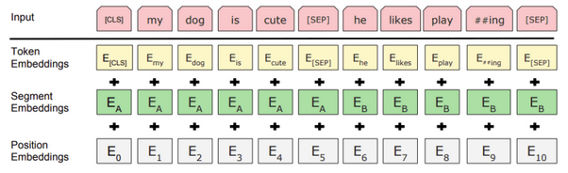
2- BERT Model Input
Position Embeddings- This is added to overcome transformer’s limitation which unlike RNN not able to capture “Sequence” or “order”.
Segment Embeddings: Added to differentiate between different sentences in tasks like question-answering, helping the model understand sentence boundaries.
Token Embeddings: These are the standard word embeddings representing the meaning of each token in the vocabulary.
Image source- [11]

Slide 19
How to Implement BERT
Steps involved
Import BERT – base- uncased
Build a Model according to use case using BERT pre-trained layers
Import Required Libraries & Dataset
Split the Dataset into train/test
Model Evaluation.
Fine – Tune.
Model Architecture.
Data Loader.

Slide 20
DATA PREPROCESSING
Raw Vibration Data from Sensor
Data Pre-Processing Block
Vibration Data after Pre-Process
Convert to List
FFT
Predicted Result (Healthy/ Unhealthy)
FINE TUNE MODEL
Train, Val, Test Data Loader
‘Bert Trainer’ Class (Bert Like Architecture)

Slide 21
Training

Slide 22
Performance Evaluation
Accuracy
Precision
Recall
F-1 Score
Average Loss

Slide 23
Hyperparameters:-
ADAMW Optimizer is used.
Binary Cross Entropy Loss is used.
Sigmoid Activation Function is used.
Learning Rate is Set to 5e-06

Slide 24
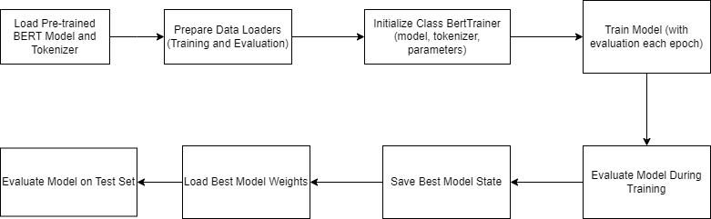
IMPLEMENTATION
BERT TRAINER CLASS

Slide 25
Results and Discussion
The transformer model has been used in this paper.
Bert for sequence Classification which uses Transformer architecture is used.
The best training accuracy achieved with this algorithm is 99.9% and the best Validation accuracy is 98.56%.
Final Test Accuracy is 98.44%
Recall=0.9792, Precision=0.973, F1 Score=0.9761, Loss=0.069.

Slide 26
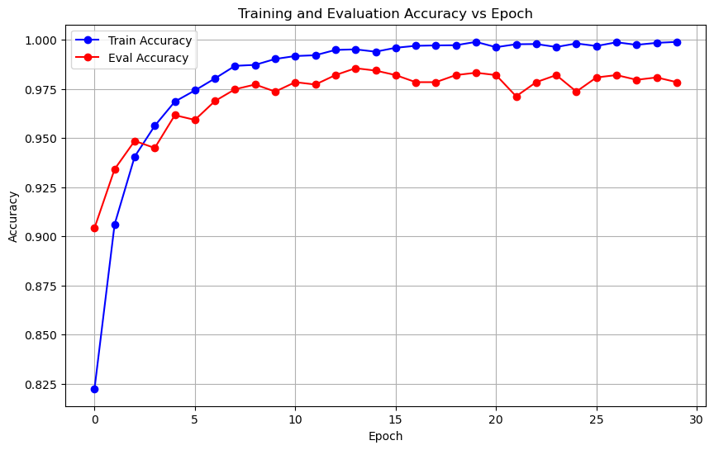

Slide 27
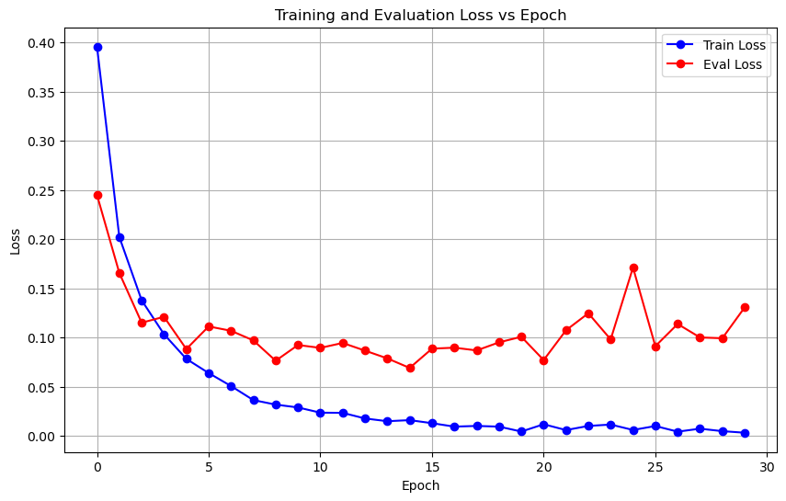

Slide 28
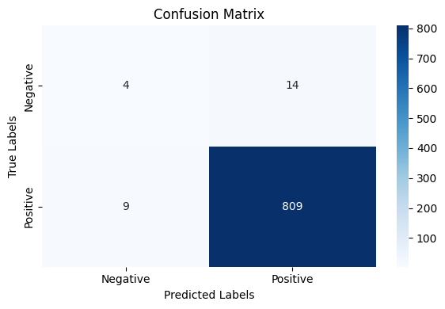

Slide 29
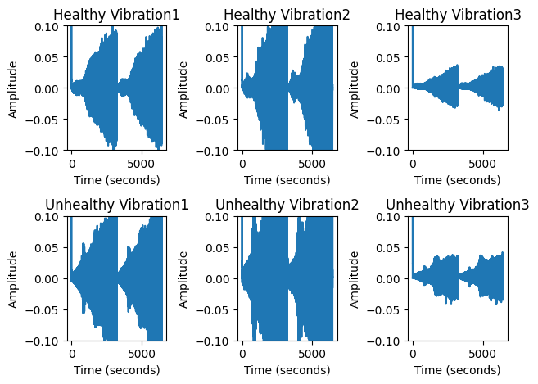
Dataset Plots
Plot of 0D(Healthy) and 4D(Unhealthy) dataset.

Slide 30
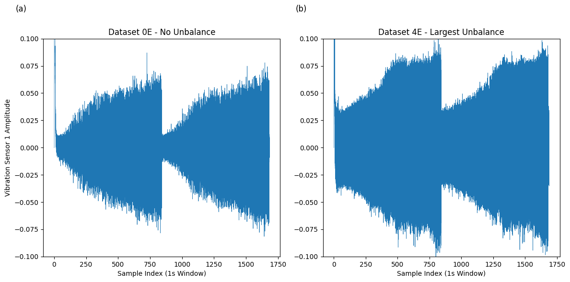

Slide 31
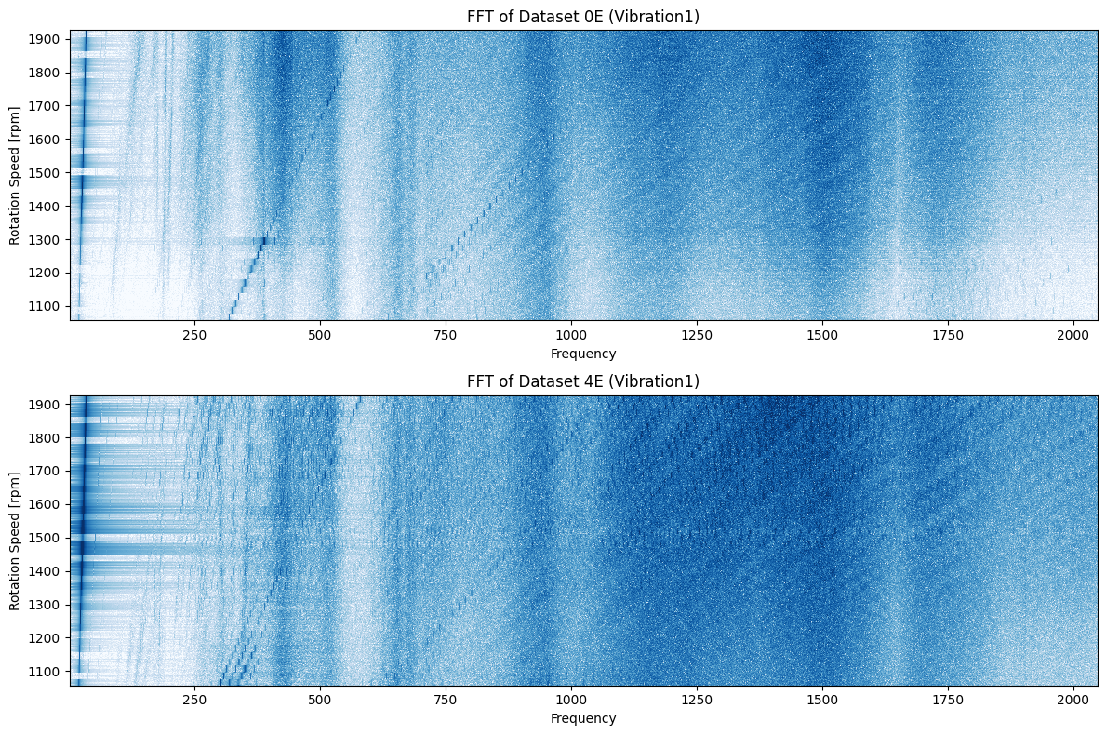

Slide 32
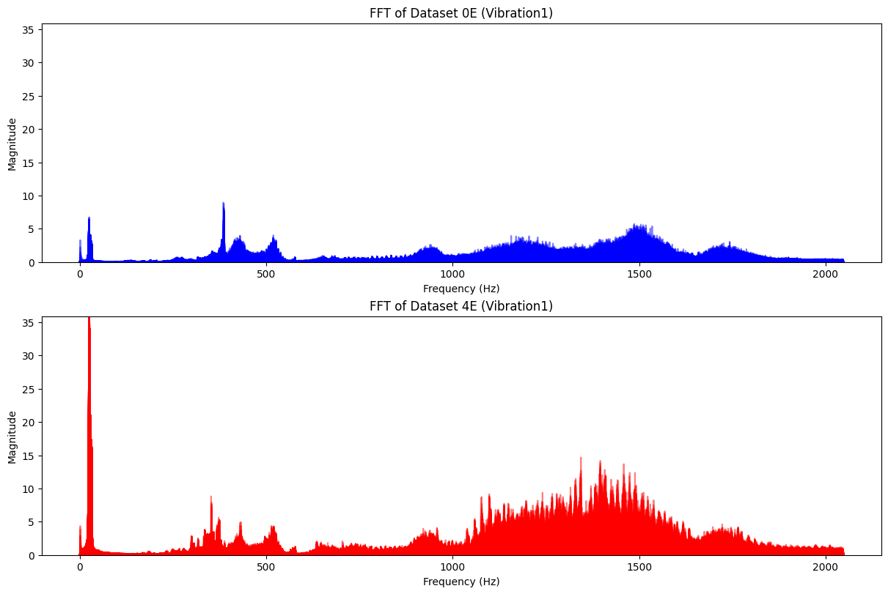

Slide 33
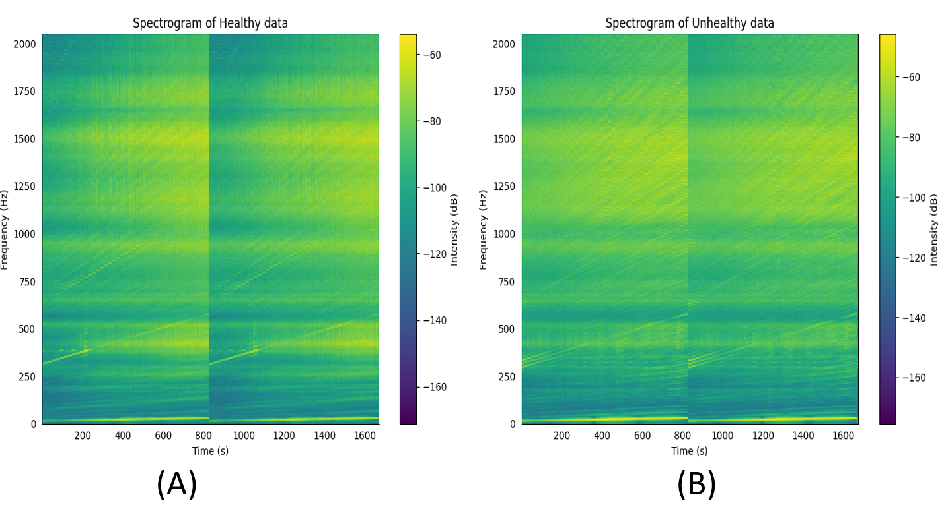

Slide 34
Comparison with Existing Work.
Result from the Existing paper O. Mey, W. Neudeck, A. Schneider and O. Enge-Rosenblatt, "Machine Learning-Based Unbalance Detection of a Rotating Shaft Using Vibration Data,”
With the Bert Transformer Model used in this paper train accuracy achieved is 99.9% and test accuracy is 98.44%.
Method Used | Accuracy Achieved
CNN | 94% and 93.6% (With 2 and 4 convolution blocks)
FCNN | 91.6%
Random Forest | 93.2%

Slide 35
Previous Year Work
Method Used | Accuracy Achieved
CNN | 98.06%

Slide 36
Conclusion
In the original paper, the maximum accuracy achieved was 94%. However, we were able to improve upon this accuracy to 98.4% by utilizing the Bert Transformer Model. Our results showed a higher maximum accuracy compared to the original paper.
In conclusion, this thesis has demonstrated the potential of applying the BERT Transformer Model which to the field of predictive maintenance. By achieving a higher accuracy than previously reported methods, it has been shown that advanced deep learning models can be effectively adapted to new domains, offering significant performance improvements.

Slide 37
REFERENCES
[1] J. -H. Han, D. -J. Choi, S. -K. Hong and H. -S. Kim, "Motor Fault Diagnosis Using CNN Based Deep Learning Algorithm Considering Motor Rotating Speed," 2019 IEEE 6th International Conference on Industrial Engineering and Applications (ICIEA), Tokyo, Japan, 2019
[2] Y. L. Karnavas, S. Plakias and I. D. Chasiotis, "A Multi-Scale Deep Learning Attention-based Feature Method for Rolling Elements Bearing Fault Detection in Industrial Motor Drives," 2021 10th International Conference on Modern Circuits and Systems Technologies (MOCAST), Thessaloniki, Greece, 2021
[3] H. Matthew, A. D. Ayu, I. H. Suherman, A. Subiantoro and B. Kusumoputro, "Deep Learning Neural Networks Diagnosis of Power Transformer through Its DGA Data," 2022 9th International Conference on Electrical Engineering, Computer Science and Informatics (EECSI), Jakarta, Indonesia, 2022.
[4] O. Mey, W. Neudeck, A. Schneider and O. Enge-Rosenblatt, "Machine Learning-Based Unbalance Detection of a Rotating Shaft Using Vibration Data," 2020 25th IEEE International Conference on Emerging Technologies and Factory Automation (ETFA), Vienna, Austria, 2020.

Slide 38
[5] X. Cheng, M. Zhao, J. Zhang, J. Wang, X. Pan, and X. Liu, "TransNILM: A Transformer-based Deep Learning Model for Non-intrusive Load Monitoring," 2022 International Conference on High-Performance Big Data and Intelligent Systems (HDIS), Tianjin, China, 2022.
[6] P. Shan, P. Hou, H. Gve, L. Yu, Y. Li, and L. Gu, "Image Feature-Based for Bearing Health Monitoring with Deep-Learning Method," 2019 Prognostics and System Health Management Conference (PHM-Qingdao), Qingdao, China, 2019.
[7] R. Fan, "Transformer-Based Deep Learning Method for the Prediction of Ventilator Pressure," 2022 IEEE 2nd International Conference on Information Communication and Software Engineering (ICICSE), Chongqing, China, 2022.
[8] O. Janssens, R. Van de Walle, M. Loccufier, and S. Van Hoecke, "Deep Learning for Infrared Thermal Image Based Machine Health Monitoring," IEEE/ASME Transactions on Mechatronics, vol. 23, no. 1, pp. 151-159, Feb. 2018, doi: 10.1109/TMECH.2017.2722479.
[9] AshishVaswani, NoamShazeer, NikiParmar, JakobUszkoreit, LlionJones, Aidan N. Gomez, Łukasz Kaiser, and Illia Polosukhin. “Attention is all you need”. In Advances in Neural Information Processing Systems, volume 30, 2017.
[10] Kenton, Jacob Devlin Ming-Wei Chang, and Lee Kristina Toutanova. "Bert: Pre-training of deep bidirectional transformers for language understanding." Proceedings of naacL-HLT. Vol. 1. 2019.
[11] Jacob Devlin, Ming-Wei Chang, Kenton Lee, and Kristina Toutanova. “BERT: Pre-training of Deep Bidirectional Transformers for Language Understanding.” arXiv:1810.04805, 2018.

Slide 39
THANK YOU

