Slide 1
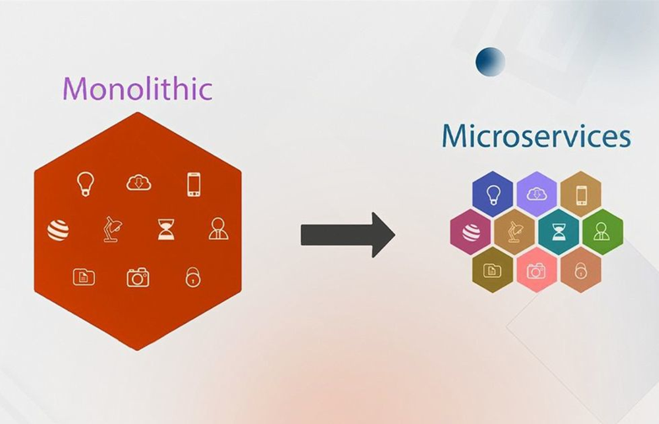
Project Catalyst: Modernizing the Legacy Enterprise Platform
A Strategic Approach to Microservices, Cloud, and Agility
Presented By: Ashish Ranjan

Slide 2
Executive Summary: The Vision
Objective: De-risk, decouple, and accelerate by transforming our monolithic legacy system into a scalable, cloud-native microservices architecture.
Key Drivers:
Agility & Speed: Enable independent, faster deployment of features.
Scalability & Resilience: Scale components independently; isolate failures.
Cost Optimization: Reduce reliance on expensive legacy hardware & licensing.
Developer Enablement: Attract talent with modern stacks and clear ownership.
Guiding Principles: Incremental Strangulation, Automation, Continuous Delivery.
As-Is: Monolith
To-Be: Microservices
Our current monolithic architecture is a single, tightly coupled application. This design leads to:
The transformation into a scalable, cloud-native microservices architecture will enable:
Slow development cycles
Rapid, independent feature deployment
Difficulty scaling specific components
Granular scalability and improved resilience
High operational costs
Reduced reliance on expensive legacy hardware
Challenges in adopting new technologies
Attraction and retention of top engineering talent
Objective: De-risk, decouple, and accelerate our enterprise platform by adopting a modern, agile approach.

Slide 3
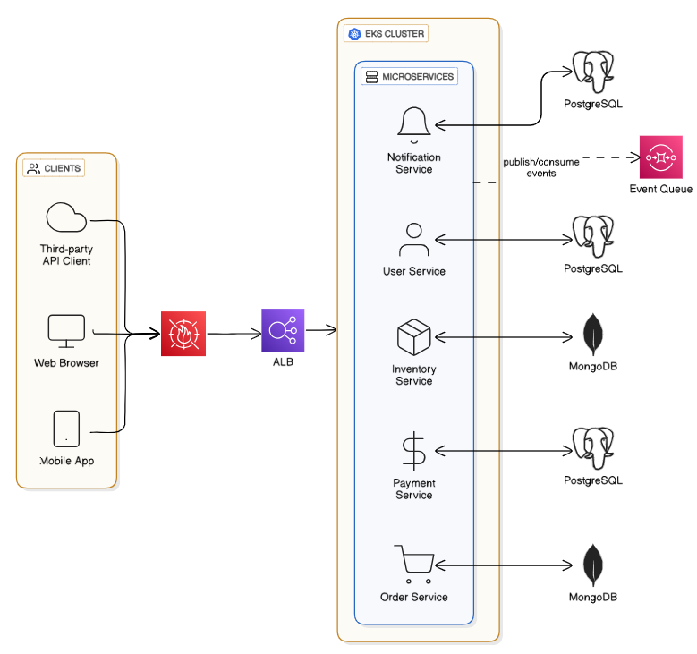
Target Architecture: Microservices
Objective: De-risk, decouple, and accelerate our enterprise platform by adopting a modern, agile approach.

Slide 4
Target Architecture: Microservices Ecosystem
Application Load Balancer and WAF: Single entry point for routing and security
Microservices Layer:
Runtime: Node.js
Framework: NestJS & Express (for simpler services).
Ownership: Cross-functional teams own full lifecycle of their services.
Cloud-Native Foundation:
Containerization: Docker
Orchestration: Kubernetes (EKS/AKS/GKE)
Objective: De-risk, decouple, and accelerate our enterprise platform by adopting a modern, agile approach.

Slide 5
Data Migration Strategy Transition from Oracle: Phase 1
Phase 1: Assessment and Prep-work:
Analyze the existing Oracle database schema, including tables, views, stored procedures, functions, triggers, and packages. Some Oracle-specific features and data types that may not have direct equivalents in PostgreSQL (e.g., PL/SQL)
Convert Oracle DDL to PostgreSQL-compatible DDL. Tools like Ora2Pg or AWS Schema Conversion Tool (SCT) can automate a significant portion of this process. For complex or highly customized procedures, manual rewriting may be necessary.
In case of migration to MongoDB check for commercial Automated tools like studio3t. Check potential for denormalization in MongoDB. Complex transformations may need to develop custom Extract, Transform, Load (ETL) scripts.
Prepare CDC 3rd party tools like Debezium for 1-way and both ways replication or write own CDC scripts using RDBMs native CDC capabilities (and MongoDB Change Streams) and Kafka pipelines
Assessment & CDC Mirroring
Dual-Write & Validation
Cutover & Decommission

Slide 6
Data Migration Strategy Transition from Oracle: Phase 2, 3, 4
Phase 2: Bulk Data migration and Replication
Run bulk data migration tools and custom migration scripts prepared in phase 1 during a maintenance window or low traffic hours.
Check data integrity of migrated data including intended data transformations completeness.
Run complete Test Automation and Load Test using new Databases.
Do if any further performance tuning needed.
Drop migrated data and re-run the migration with latest data from Source.
Assessment & CDC Mirroring
Dual-Write & Validation
Phase 3: Two-Way Write & Validation
Start 2-way replication using CDC and test replicated data sanity both ways.
Application instances start using both old and new databases.
Automated scripts will continuously validate data consistency.
Cutover & Decommission
Phase 4(Final): Cutover & Decommission
All read traffic will be redirected to the new database.
Once stability is confirmed, writes to Oracle will cease, and the legacy database will be decommissioned

Slide 7
Testing & Quality Assurance: Comprehensive Coverage
Achieving high quality in a microservices environment requires a robust, multi-layered testing strategy.
Unit/Component Testing
Mandatory for each microservice using frameworks like Jest or Mocha.
Contract Testing
Using tools like Pact to ensure compatibility between microservices, reducing brittle integration tests.
Integration Testing
Validating interactions between services and databases.
Performance & Load Testing
Baselining the monolith and systematically testing each new service and the entire platform under load using tools like JMeter
Blue-Green Deployment
Testing new versions with live traffic before full cutover, enabling instant rollback for safety.

Slide 8




Rollout & Cutover Plan: Dual-Run for Minimum Risk
For critical transactional services, we will implement a dual-run strategy, running both new and old systems in parallel for a defined period.
Traffic Shadowing
Phased Cutover
Automated Rollback
Mirroring production traffic to the new system allows us to validate performance and functionality without impacting live users.
Beginning with an internal Pilot, progressing to a Canary Release (e.g., 5% > 25% > 50% traffic), and finally Full Rollout (100% traffic shift).
Triggers based on key health metrics (error rates, latency) will ensure instantaneous rollback using Blue-Green deployments.

Slide 9
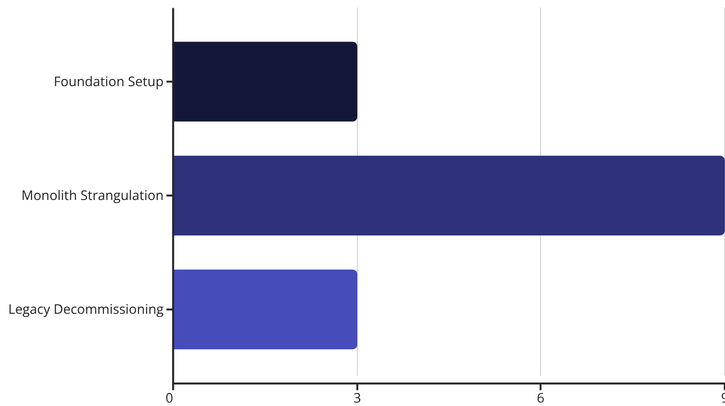
Team & Execution Plan: Key Roles & Phased Timeline
Key Roles & Responsibilities
Phased Execution (12-18 Month Outlook)
Product Owner
Defines scope & priorities for service domains.
Architect
Defines target state, patterns, and governance.
DevOps Engineer
Implements CI/CD, provisioning, and monitoring.
Full-Stack Squad
Cross-functional teams building & owning individual micro-services.
DevOps Toolchain: GitHub Actions/Jenkins → Docker → Kubernetes → Terraform → Prometheus/Grafana

Slide 10




Guiding Principles for Modernization
Our transformation journey is anchored by key principles to ensure success:
Incremental Strangulation
API-First Design
Gradually breaking down the monolith into smaller, manageable microservices, reducing risk.
Designing services around clear, well-defined APIs to foster loose coupling and reusability.
Automation Everywhere
Continuous Delivery
Automating testing, deployment, and infrastructure to ensure speed and consistency.
Enabling frequent, reliable releases to accelerate feature delivery and feedback cycles.
These principles will guide every decision, ensuring a smooth, efficient, and successful modernization.

Slide 11

Developer Enablement & Talent Attraction
Modernizing our platform isn't just about technology; it's about empowering our teams and attracting top-tier talent. A modern stack and clear ownership foster a vibrant, productive engineering culture.
Increased Autonomy: Small, cross-functional teams owning their services from design to deployment.
Faster Feedback Loops: Quicker iterations mean developers see the impact of their work sooner.
Skill Development: Exposure to cutting-edge cloud technologies and architectural patterns.
Reduced Technical Debt: Opportunities to refactor and build clean, maintainable codebases.
This cultural shift is crucial for long-term innovation and maintaining a competitive edge in the talent market.

Slide 12
Next Steps & Conclusion
1
2
3
Secure Executive Sponsorship
Form Pilot Team
Define MVP Scope
Assemble a dedicated cross-functional squad to tackle the first service and data domain, building initial momentum.
Identify the initial bounded context for strangulation and migration to ensure early value delivery and learning.
Align on vision, budget, and a comprehensive timeline for the project.
This modernization is a journey, not a flip-the-switch project. Our incremental, phased approach minimizes risk, delivers value early, and builds momentum, ultimately creating a future-proof, agile, and scalable platform.

