Slide 1
Urban Ghost Kitchen Analytics
A Data Analytics Case Study on Cloud Kitchen Orders, Revenue & Delivery Performance
Prepared by Arannayava Debnath
Python | Pandas | MySQL | SQL | SQLAlchemy | Matplotlib

Slide 2
Business Problem
Urban Ghost Kitchen operates 25 delivery-only kitchens serving 1,000 customers through an app-based ordering platform. Leadership needs a data-driven view of performance, cancellations and demand patterns to guide operational decisions.
Key Business Questions
• Which kitchens generate the highest order volume and revenue?
• What factors are driving order cancellations across the platform?
• Which menu categories and items contribute most to revenue?
• When does customer demand peak, and how does that affect delivery time?
• Are new customers more likely to cancel than returning customers?

Slide 3
Dataset & Data Model
CUSTOMERS
KITCHENS
ORDERS
MENU ITEMS
1,000
25
20,000
45,000
Master customer records
Active delivery-only kitchens
Total logged orders
Item-level order records
Relational Data Model
CUSTOMERS
1 : M
ORDERS
M : 1
KITCHENS
1 : M
MENU ITEMS

Slide 4
Analytics Workflow
Raw CSV
Profiling
Cleaning
Feature
Engineering
MySQL
SQL
Python
Validation
Insights
Each stage is version-controlled and validated before moving to the next: raw data is profiled, cleaned and enriched in Python/Pandas, loaded into MySQL, queried with SQL, and validated back in Python before insights are drawn.

Slide 5
Data Quality & Preparation
Data Quality Issues
Cleaning Methodology
• 1,000 customers exist in the master data, but only 980 unique customers appear in the orders table - a 20-customer gap.
• Inconsistent status labels across delivered, cancelled and refunded orders.
• Missing or partial timestamps affecting delivery-time calculations.
• Duplicate and orphaned menu-item records requiring reconciliation.
• Standardized order-status categories into Delivered, Cancelled and Refunded.
• Removed duplicate records and validated primary/foreign key integrity.
• Reconciled the customer master table against the orders table.
• Validated the cleaned dataset in Python before loading it into MySQL.

Slide 6
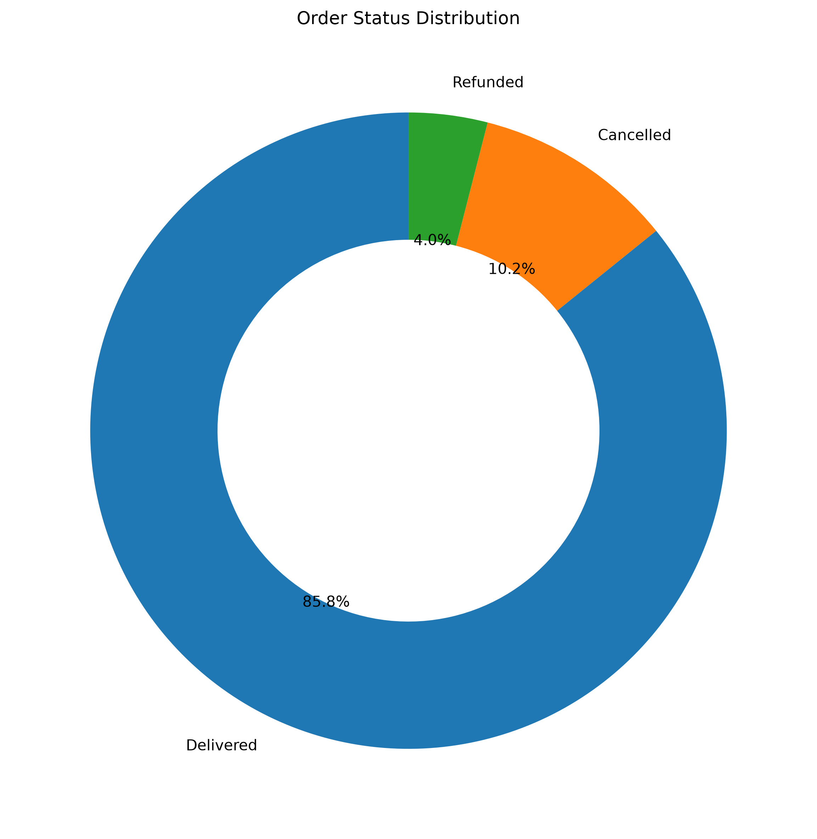
Overall Business Performance
TOTAL ORDERS
DELIVERED
CANCELLED
REFUNDED
CANCELLATION RATE
20,000
17,162
2,038
800
10.19%
85.8% of total orders
10.19% cancellation rate
4.0% of total orders
Delivered → 85.81%
Cancelled → 10.19%
Refunded → 4.00%
Order Status Distribution
Delivered → 85.81%
Cancelled → 10.19%
Refunded → 4.00%

Slide 7
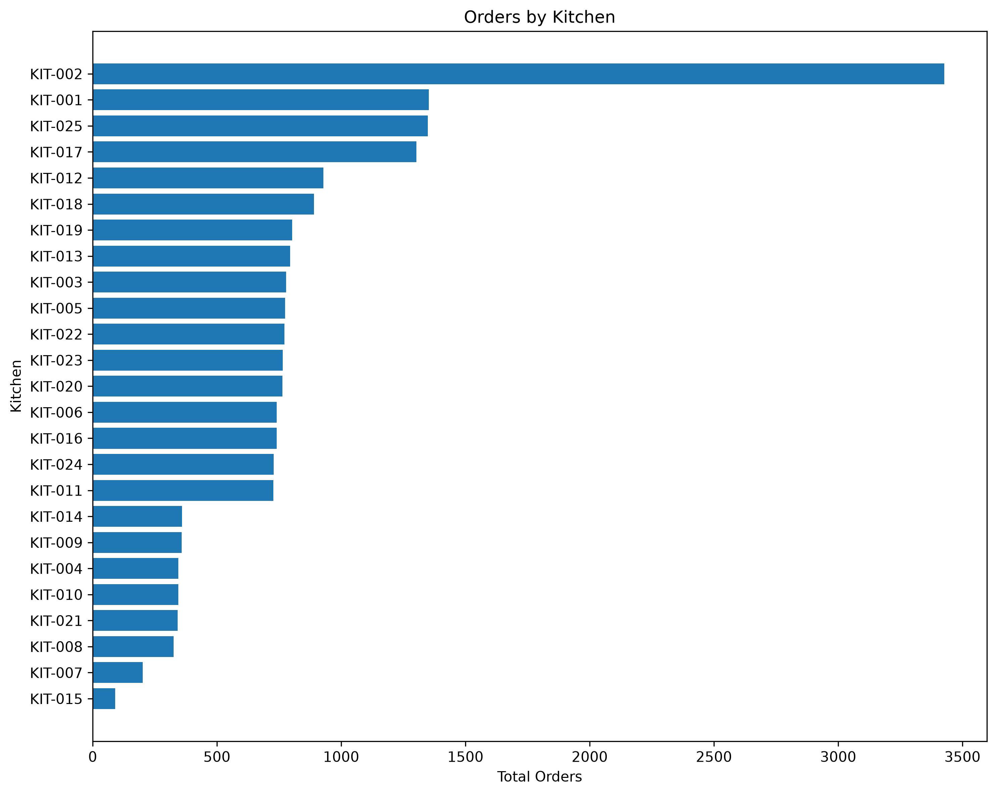
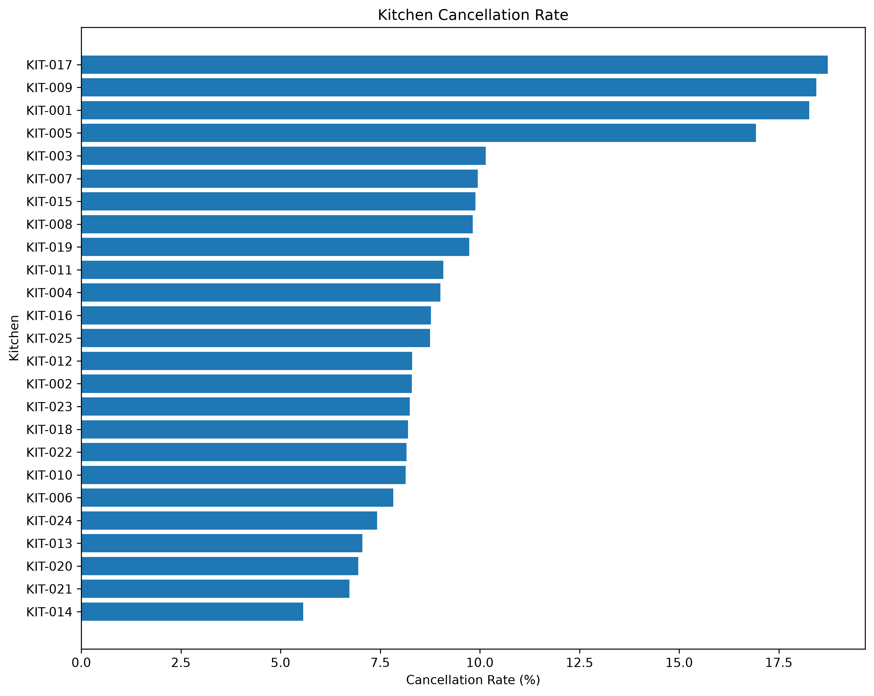
Kitchen Performance
TOP KITCHEN BY ORDERS
TOP KITCHEN ORDERS
TOP KITCHEN REVENUE
AVG DELIVERY TIME
KIT-002
3,427
₹1.95M
29.31 min
Highest order volume
KIT-002
KIT-002 total revenue
Platform-wide
Orders by Kitchen
Kitchen Cancellation Rate

Slide 8
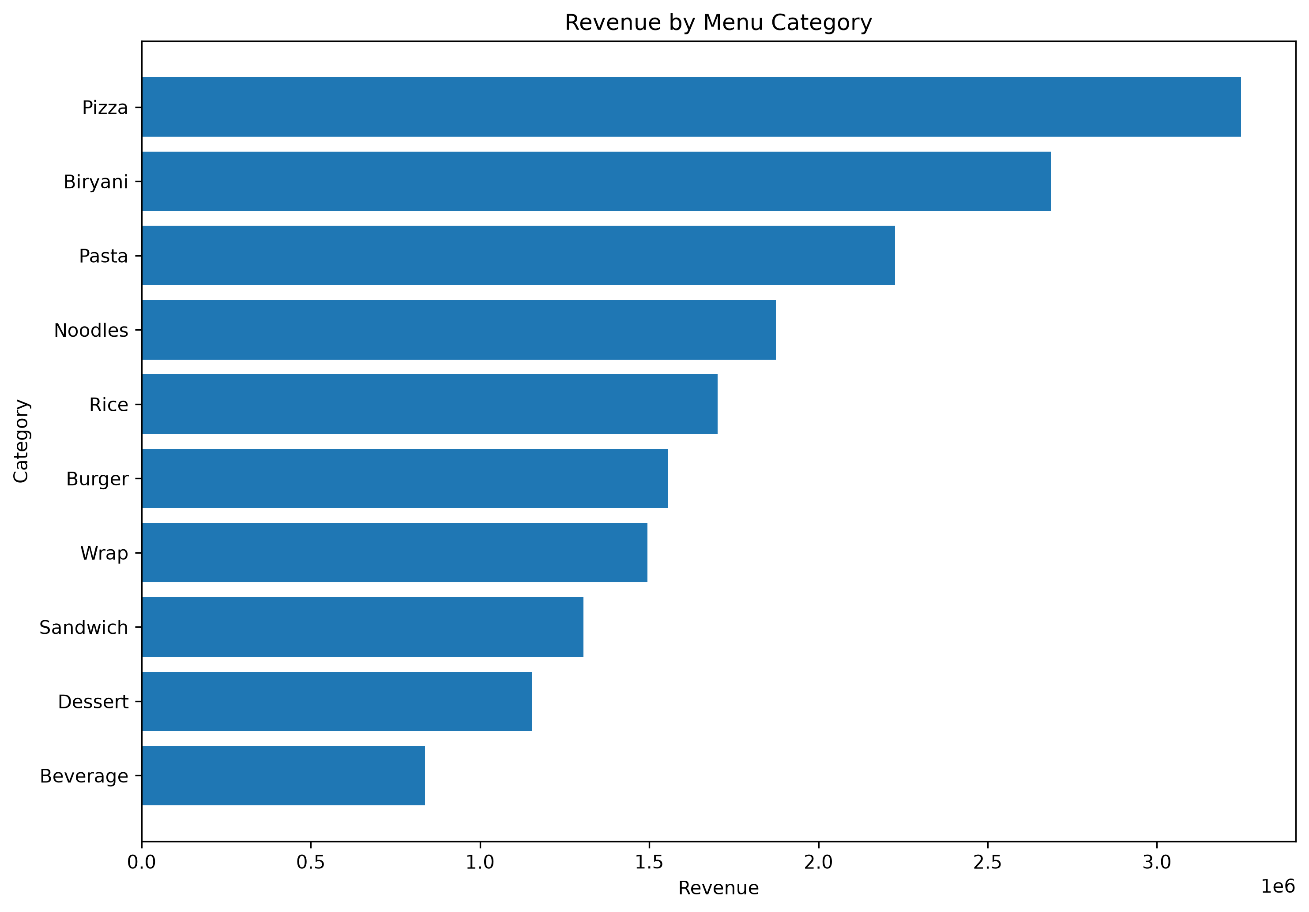
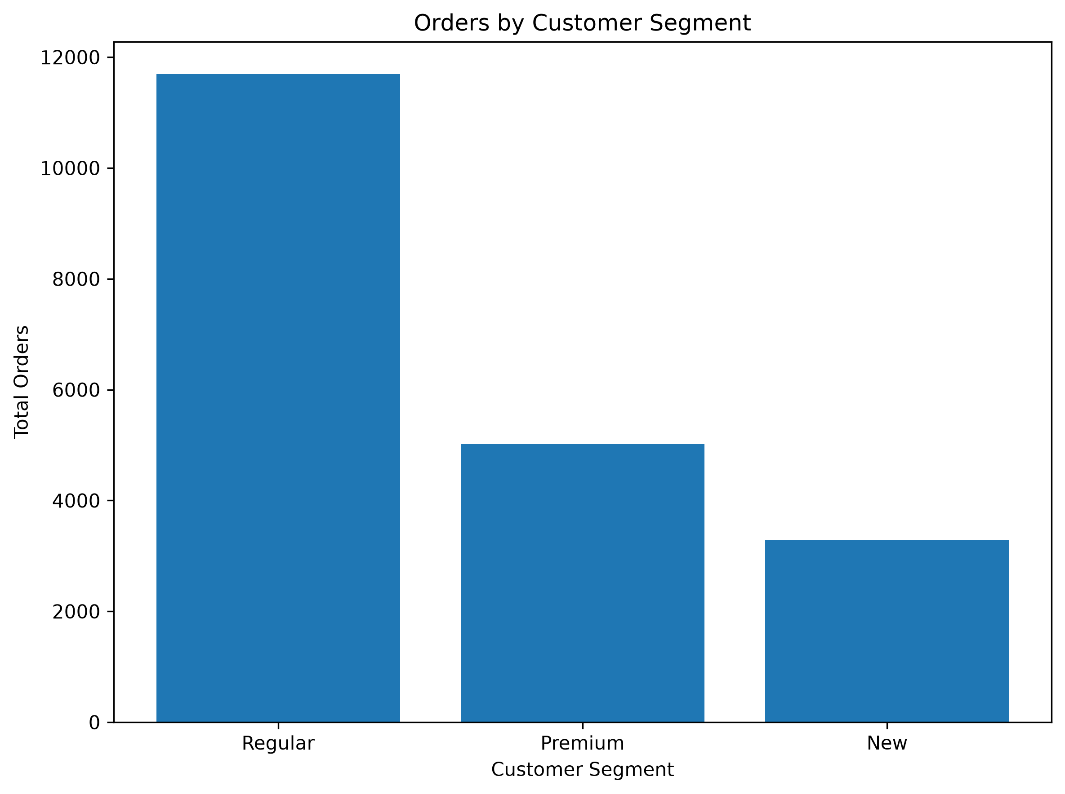
Menu & Customer Insights
TOP REVENUE CATEGORY
TOP CUSTOMER
TOP CUSTOMER SPEND
Pizza
CUS-00582
₹156,944.26
₹3,248,288.52 revenue
276 orders placed
CUS-00582 lifetime spend
Revenue by Menu Category
Orders by Customer Segment

Slide 9
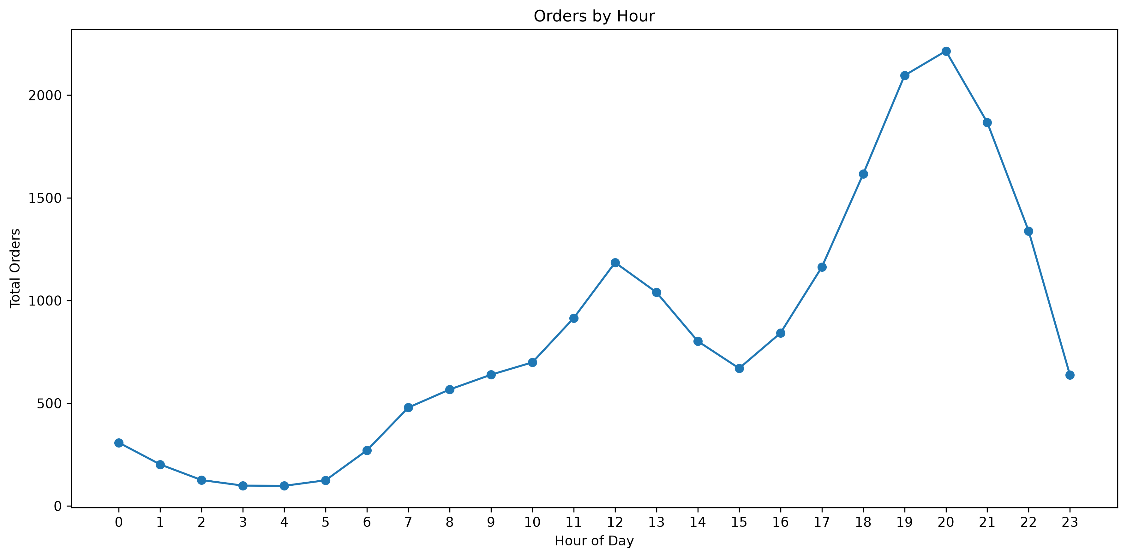
Demand & Delivery Patterns
AVERAGE DELIVERY TIME
SHORT DISTANCE
LONG DISTANCE
29.31 min
20.45 min
57.81 min
Platform-wide average
Average delivery time
Average delivery time
Peak demand window: 18:00–21:00 (33.7% of orders) | Peak individual hour: 20:00
Orders by Hour

Slide 10
Business Opportunities
• Investigate high-cancellation kitchens to identify and resolve root causes.
• Review menu pricing and category strategy based on revenue concentration.
• Prepare operations and staffing for the 18:00-21:00 evening demand peak.
• Investigate the elevated 11.14% cancellation rate among new customers.
• Reconcile the 20-customer gap between master data (1,000) and orders data (980).

Slide 11
Key Takeaways
• Platform-wide cancellation rate stands at 10.19%, with new customers cancelling more often, at 11.14%.
• KIT-002 leads all kitchens in both order volume (3,427) and revenue (₹1,949,309.57).
• Pizza is the top revenue-generating menu category at ₹3,248,288.52.
• Demand peaks sharply between 18:00 and 21:00, contributing to longer delivery times.
Arannayava Debnath
Python | Pandas | MySQL | SQL | Matplotlib
GitHub: github.com/your-username/urban-ghost-kitchen-analytics

