Slide 1
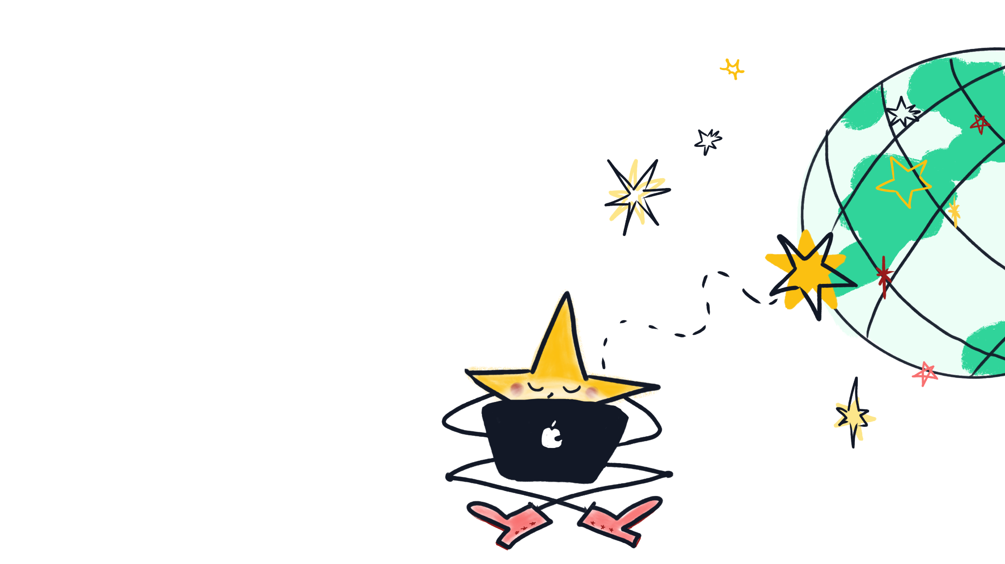
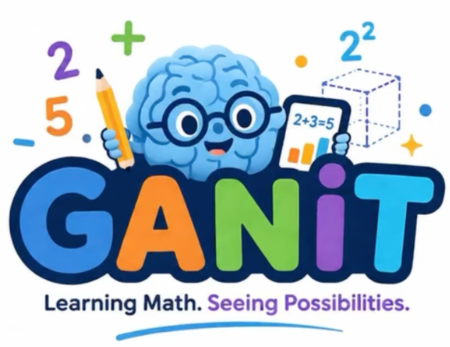
GANIT - GenAI Adaptive Numeracy Improvement and Training
Aarav Kapoor
Grade 5, Bullis Charter School

Slide 2
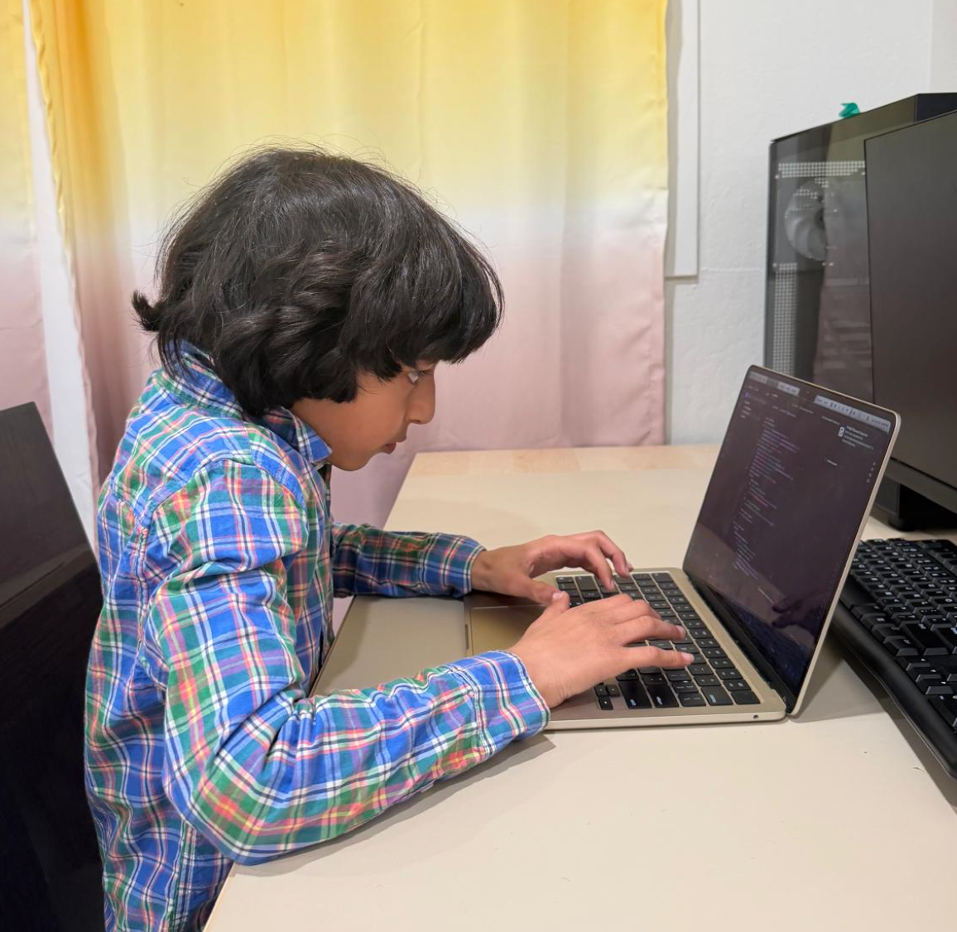
WHO I AM
WHAT I BUILT
Who am I
Aarav Kapoor
Grade 5, Bullis Charter School
Spring 2026
Project Summary
GANIT is an AI + AR mobile math app built to help children with dyscalculia, ADHD, autism, and math anxiety learn through stories, visuals, and small calm steps.
Using Socratic methods and immersive learning, GANIT makes math fun, going beyond traditional practice to exploration.
It is available as a web app and on the iOS App Store. The Android app is being prototyped.
01
Notes:
Slide 1: Who I Am & What I Built
Title: My Project in an AI-Driven World
Name, age, school
One-sentence project summary: What did you create, and what problem does it solve?
What inspired you? Connect your project to a personal interest, community need, or world challenge.
Optional: Add a compelling image or short quote that captures your motivation.

Slide 3
MY Process
The Problem
The Idea
Iterations
1 in 5 children in the US experience arithmetic differences.
I interviewed 6 friends about main issues with existing math apps.
What is your favorite game?
What do you think about this app
Line rider vs. Spaceship game (Reward system for the app)
Friends said “Addition is scary”, “Multiplication confuses me”
“UGH” is said all the time!
Found that no app combined generative AI + AR + story-based mini lessons for learners with dyscalculia, ADHD, or math anxiety.
Can bringing tactile and 360° math experiences to every smartphone make math magical?
Built early prototypes, tested with classmates, iterated on feedback.
AR boot time fixed, placement UX (Flow of app) redesigned, deprecated library replaced.
Quest-Based Learning: Missions instead of worksheets
Visual & Colorful: Big number blocks, drag-and-drop groups, slow animations
Adaptive: adjusts to each student's speed
Kind & Supportive: Calming messages, no rushing, no judgment
Built for Neurodiversity: Designed for kids with dyscalculia, ADHD, autism, and math anxiety
Rewards & Customization: Line rider videos
02
Notes:
Slide 2: My Process
Title: The process behind the project

Slide 4
MY Process
Literature Review
Finalizing idea/features
Building the app
Testing & iterating
Feedback & evolution
I interviewed 3-4 first & second graders, along with interviewing a 5th grade friend. This helped me with my reward system.
Researched dyscalculia & math anxiety (PubMed, IEEE, Google Scholar).
Getting the idea of what the app is going to be about, starting the journey of GANIT.
- Finalizing details for how the app would teach math differently
- Starting to develop a “game plan”
Coded to have many features to make it accessible to many people.
Used RealityKit, ARKit, UIKit packages
To make it accessible for colorblind individuals, added random shapes
We constantly ran our app on an iPad, then went back to fix things.
We fixed, boot time issues, deprecated code, and added random colors & shapes.
iOS app used by 10+ peers, conducted another survey to quantify their feedback.
- We made many additions to the app, such as the boot time fix
- We also upgraded existing features
03
Notes:
Slide 2: My Process
Title: The process behind the project

Slide 5
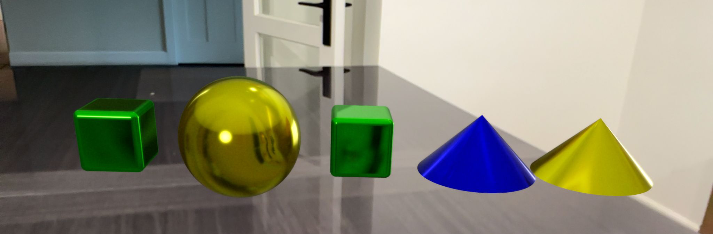
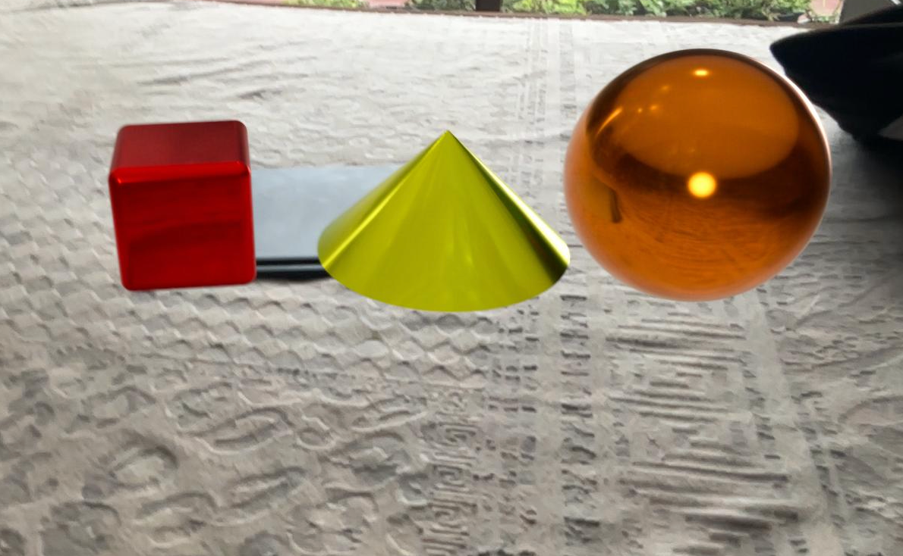
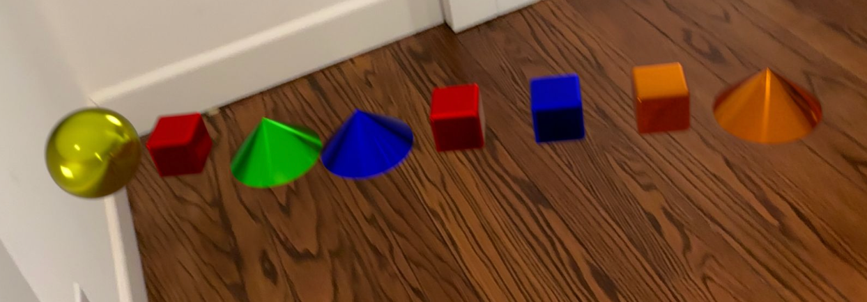
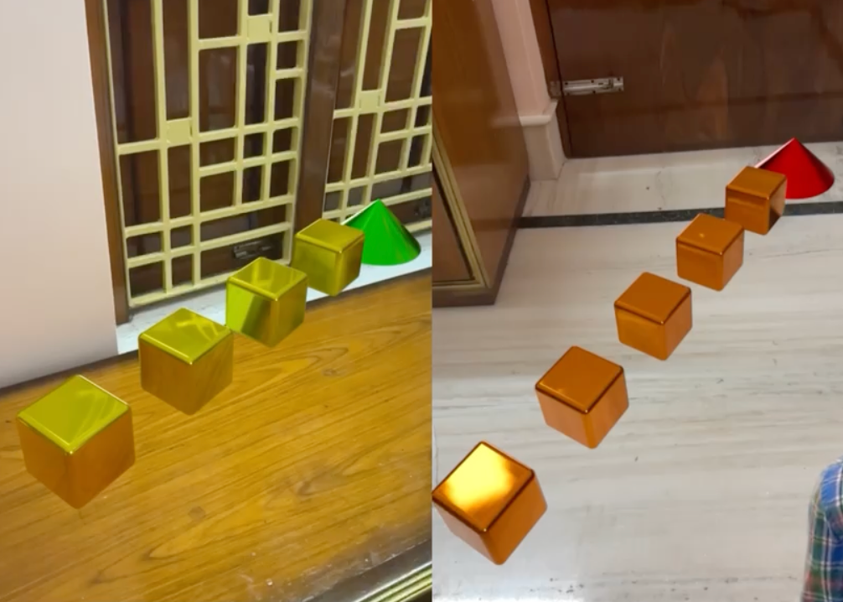
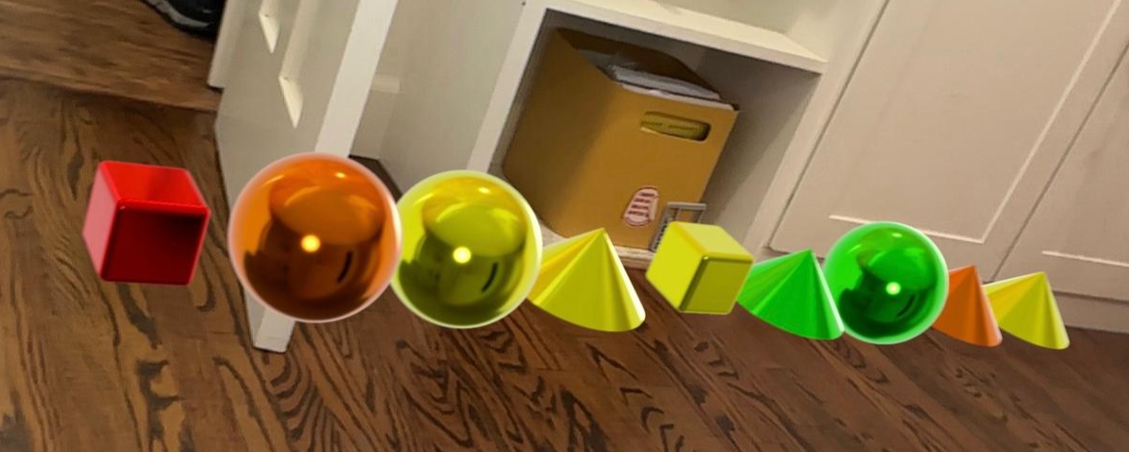
Final Project
Live App: goganit.app (iOS)
Current features:
• AR mode: place & count 3D spheres, visualise exponents in AR space
• GenAI quiz generator: single-digit through advanced arithmetic
• Story-based lesson flow with step-by-step pacing
• Calm, encouraging feedback system throughout
• Placement exam for automatic skill-level detection
04
Notes:
Slide 2: My Process
Title: The process behind the project

Slide 6
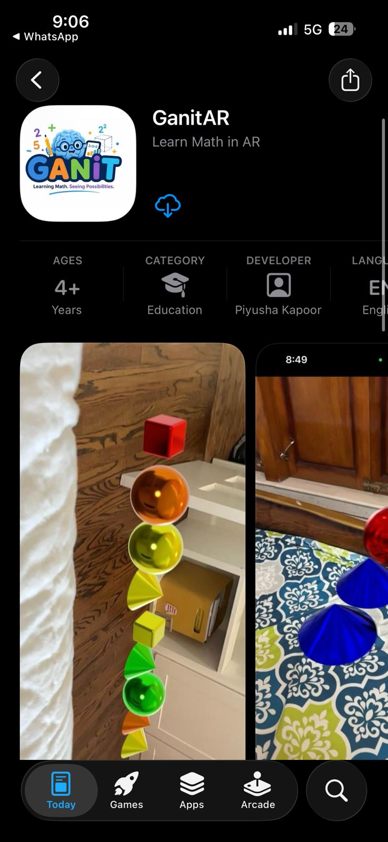
Final Project
https://ganit-phi.vercel.app/
04
Notes:
Slide 2: My Process
Title: The process behind the project

Slide 7
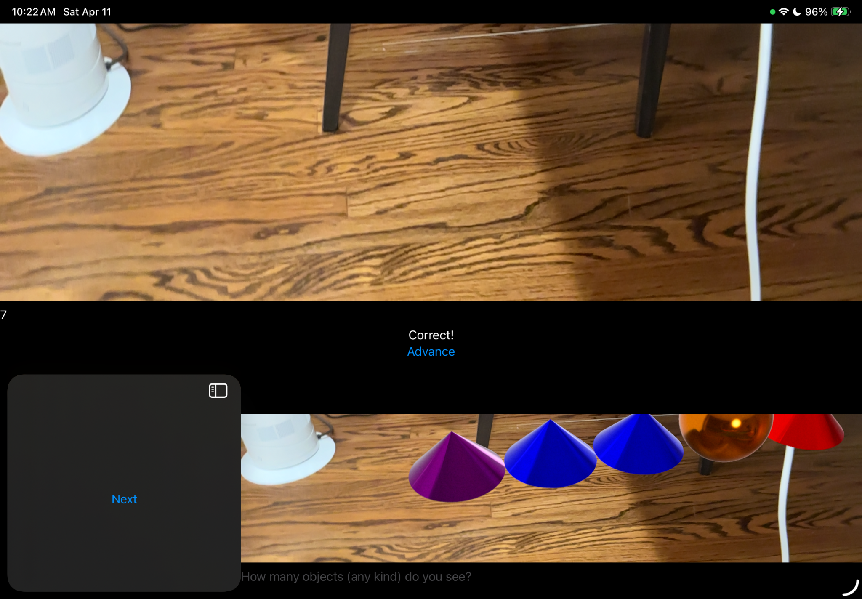
MY Growth & Learnings
Growth:
2 Major Errors:
Picture-in-picture problems (took a week to fix!)
Accidentally put a radius of 20m (oops)
Display library deprecated mid-build → researched and changed to a supported alternative
AR boot time was 2+ minutes → optimised the loading flow to around 20 seconds.
AR object placement was unintuitive & painful→ redesigned placement UX (Flow of app) with visual guides
AR objects comes up at wrong scale → corrected coordinate system and radius values
Invited classmates to join GoGanit team for collaborative testing and feedback
Skills:
• Coding: Swift, ARKit, RealityKit, genAI
• Research: Academic papers, evidence-based design decisions
• Leadership: Built and ran GoGanit team
• Resilience: Iterated across many failed prototypes and setbacks
• Time management: Balanced school and competitions
05
Notes:
Slide 3: My Growth & Learnings
Title: Learning by Doing
Walk us through your growth: iterations, setbacks, breakthroughs.
What skills did you develop that can’t be automated? (e.g., perseverance, focus, time management)
Include 1–2 visual artifacts (early notes, rough drafts, prototypes).
Reflect on how your mindset or abilities evolved through the experience.
📌 Timeless Skills: Growth, Grit, and Discipline — Mastery comes from showing up again and again.

Slide 8
HOW I USED AI as a tool to amplify
My AI Philosophy
AI Tools & Resources
AI should make learning feel calm, personal, and encouraging, especially for children who learn differently.
AR should augment both visual and color-blind learners with multi-sensory experiences
Math can feel fun and adventurous, because children explore on their own. That is not because of preset curriculum which can also restrict their curiosities
ChatGPT, Claude, NotebookLM, Gemini, ARCore
- ChatGPT & Claude: brainstorming features, refining story tone and lesson UX
- Gemini: auto-generated 540 questions (30 × 3 topics × 6 levels), then filtered and edited
- NotebookLM: organising research notes and academic citations (PubMed, IEEE, Google Scholar)
- ARKit + RealityKit + ARCore: building the immersive AR math experience
06
Notes:
Slide 4: Thinking Differently
Title: How I Solved This in My Own Way
Describe your unique approach to the problem.
What tools or resources did you use?
How did you apply critical thinking to uncover new possibilities?
If AI was involved, how did you guide it or push beyond its limits?
📌 Timeless Skills: Creativity & Critical Thinking — Asking better questions and charting your own path.

Slide 9
WHY IT MATTERS Now & Tomorrow
With $2,500, I would
Tangible Impact Thus Far
GANIT helps children with dyscalculia, ADHD, autism, and math anxiety learn math through calm, story-based, AR-powered lessons. Tested with classmates across multiple cycles with consistent positive feedback on the calm UX and AR mode.
• $200 - Improve AR quality + age-specific curriculum
• $1000 - 10 school outreach events at K–5 institutes ($100 each)
• $500 - conduct 2 mental math hackathons at school (app users participate for free)
• $100 - Cloud hosting for up to 1,000 users
• $200 - AI chatbot for real-time in-app support
• $500 - contingency + future development store (invest)
Long-term vision: Make GANIT free and accessible to every child who struggles with math — everywhere.
With $2,500 I would expand GANIT with richer AR, age-specific curriculum, school outreach events, cloud hosting for 1,000+ users, and a real-time AI chatbot. Long-term: make GANIT free and accessible to every child who struggles with math — everywhere.
07
Notes:
Slide 5: Real-World Impact & What’s Next
Title: Why It Matters—Now and Tomorrow
Who did this project help or inspire? Include real-world feedback or results if available.
What’s your vision for the future of this project?
How would you use the $1,000 to scale or deepen your impact? (e.g., build a prototype, host an event, share it more widely)
How could this evolve in a world increasingly shaped by AI?
📌 Timeless Skills: Agency, Initiative, and Systems Thinking — Turning ideas into change.

Slide 10
How I’ve Grown
MY Why
I developed coding (Swift, ARKit, RealityKit, genAI), research skills (reading academic papers), leadership (founding GoGanit), and resilience (learning from multiple setbacks and failed builds). I also learned how to give and receive feedback constructively.
Looking Ahead
I now see myself as someone who can identify a real problem, build a solution from scratch, and keep improving through failure. GANIT taught me that technology is most powerful when it is built with empathy .
My north star is making Math feel safe, calm, and possible for every child — especially those who have been told they are not a “math person.” GANIT is my first step toward that goal, and I plan to keep building.
[Insert photo of Aarav here]
08
Notes:
Slide 6 (Optional): My Why
Title: What This Taught Me About Being Human
What’s one powerful insight or emotion you’ll carry forward?
A quote, mantra, or personal story that encapsulates your journey
How has this experience changed the way you see yourself as a learner, creator, or leader?
What would you tell someone else starting their journey of learning or building in an AI world?
📌 Timeless Skill: Storytelling — Inspiring others by being real and reflective.

