Slide 1
LoneWolf

Slide 2
Theme:
Agriculture

Slide 3
Problem :-
Uneven distribution of agriculture work force

Slide 4
Facts :-
India ranks second worldwide in farm outputs
Agriculture is the third largest sector of Indian economy with approx. GVA 17.32%.
Agriculture date back to Indus Valley civilisation
It recruit almost 50% of manpower
Some most developed agriculture states are Punjab, UP, MP, Haryana, Bihar, Andhra Pradesh, Maharashtra, West Bengal, Gujrat
Total arable land in India 15 73 50 000 sq Km which is roughly 52.92% and continue diminishing
The average size of the holding has been estimated as 1.15 hectare
Source : Wikipedia , mapsofindia.com, business-standard.com

Slide 5
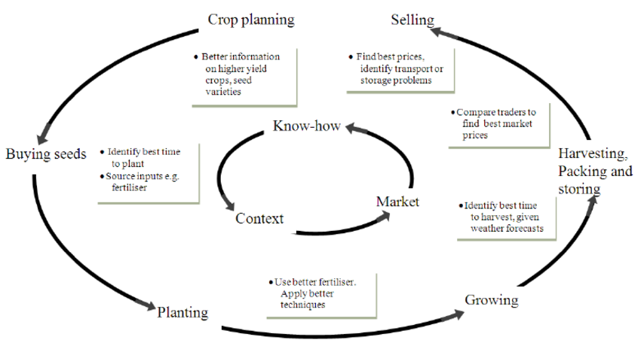
Agriculture in India mainly depend up monsoon, & it also depend on seasons
Agriculture Cycle
Two ways to complete the cycle, machine aid(technology) , human aid(labour Force)
Source : Wikipedia , mapsofindia.com, business-standard.com

Slide 6
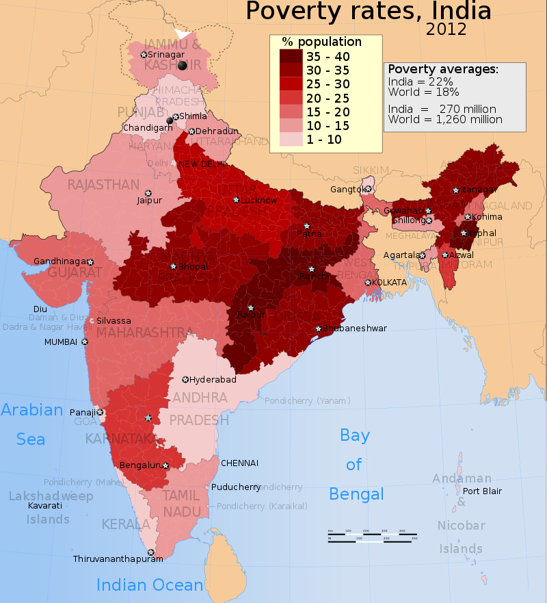
Communication Between Two Unknown parties
The problem is that people migrate without a clue whether there is any work or not
This Cost less Wedge
Timing mismatch for crop
Main Problem is communication gap between worker and work provider
……………………
They have very low literacy rate and know very little about technology
So they cannot relay completely on internet

Slide 7
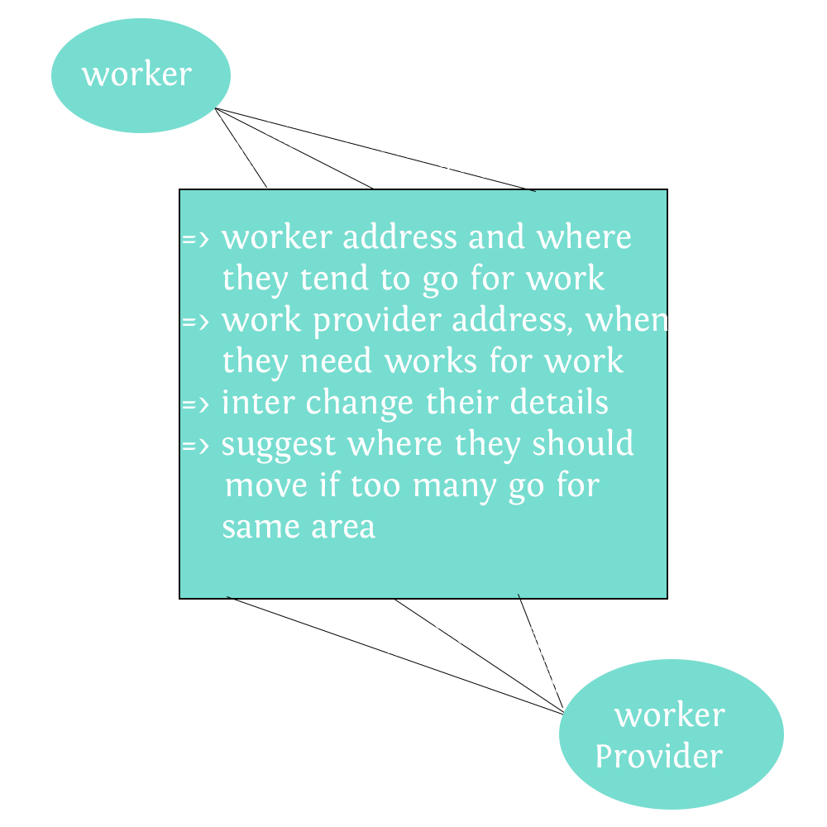
Solution
Resources required:-
- web server , web application and database
- interactive voice response (ivr) setup
- short message service (sms) response setup
- resource to build database

Slide 8
Akhilesh YMCA University of Science and Technology, Faridabad
https://github.com/deathmachine0/code-n-counter3.git

