Slide 1

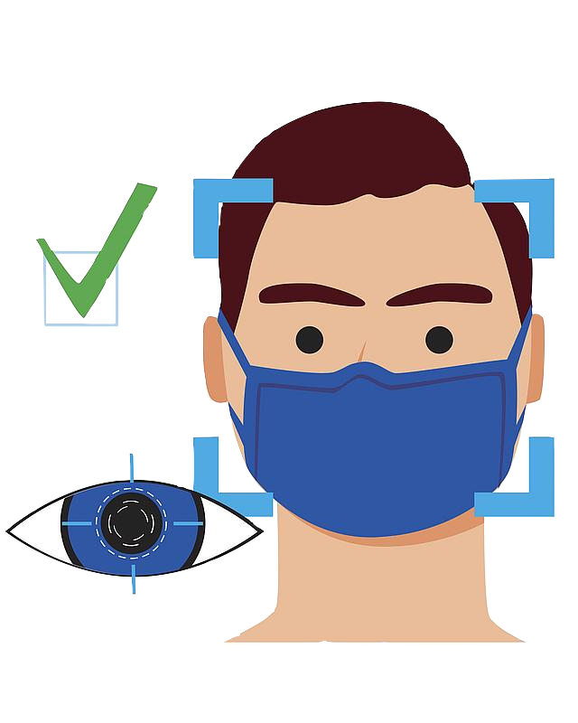
Face IT!
By:
Aatish Suman
Adheesh Phadnis
Anupama Mohan Rao
Lakshya Gupta
Vidushi Mishra

Slide 2
Agenda
Business Idea
Product Idea and its Relevance
Scope of the Idea
Implemented Architecture
Technology stack
Walkthrough
Future Goals
Appendix
Agenda

Slide 3
Business Idea
WHO advises to wear masks/face coverings in public areas.
Masks are the new norm.
Helps reduce risk of COVID-19 exposure/spread by 85%

Slide 4
Product Idea and its Relevance
Product Idea
Real-time face mask detection system
End-to-end cloud hosted service.
Uses images from live feed images.
Automated handling of doors using face mask detection model.
Product Relevance
Face coverings in public places in the new normal.
CCTV cameras are available everywhere
Juxtaposition of these two ideas to help aid the fight against COVID-19

Slide 5
Functionalities
Automated door control
Automated Alerts
Real-time monitoring
Multichannel recognition

Slide 6






Customers
Universities
Airports
Malls
Hospitals
Offices
Restaurants

Slide 7
Stakeholders
Investment Banks
Institutional Investors
Angel Investors
Venture Capitalists

Slide 8
Cost Model Updates
Change of instance costs from t4g.xlarge to t2.xlarge and t2.medium
Instance costing reduced by 66%
t2.medium : $31/mo
T2.X4large : $72/mo

Slide 9
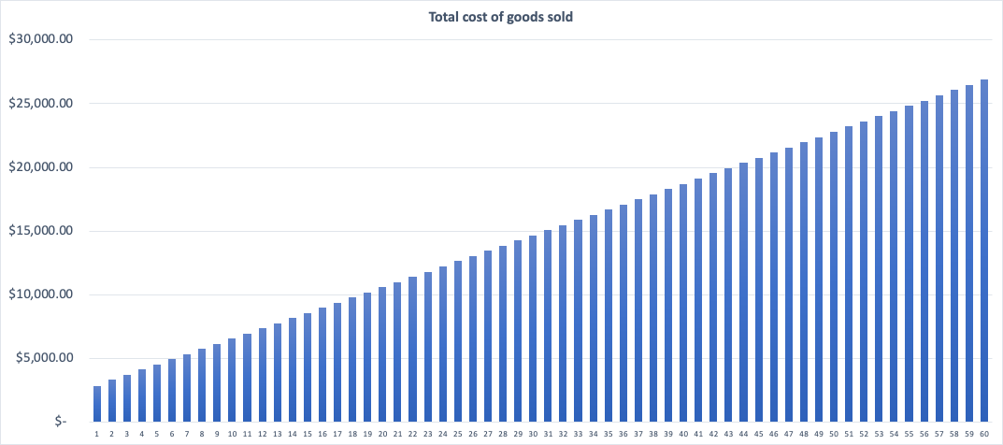
Cost Model
Subscription fees increase by 10% every 6 months
Customer projection factor: 5/mo
Equity structure : 51%-49%
Marketing cost constant
Overhead costs can be scaled
Instance cost proportional to customers
S3 cost projection factor : 1.1/mo

Slide 10
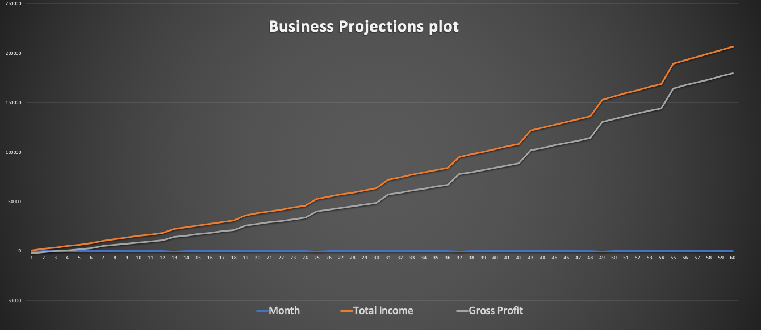
Revenue model
SaaS starting @$320 /mo/5 cameras
Ultimate Gross profit YoY of $180,000 in 5th years

Slide 11
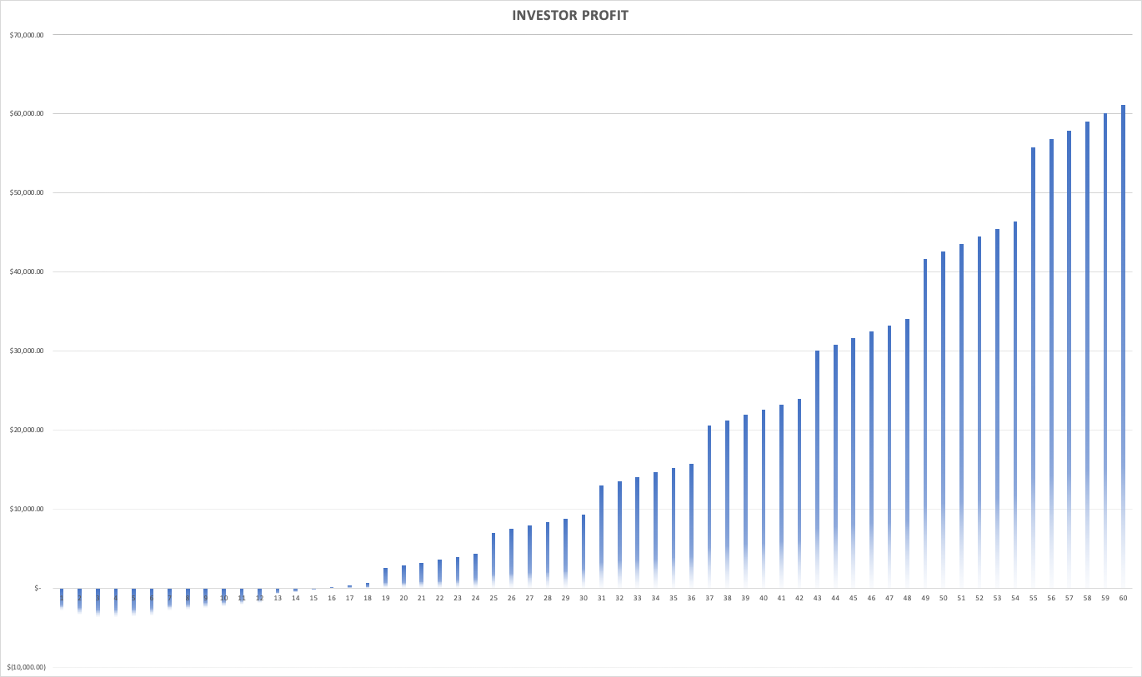
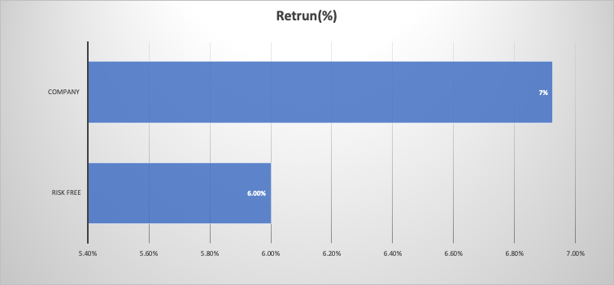
Investor Return
7% above risk free rate (6%)
Breakeven at 1.5 years
Total investment($) : 892,489
Total value in 5 years ($) : 1,059,657

Slide 12
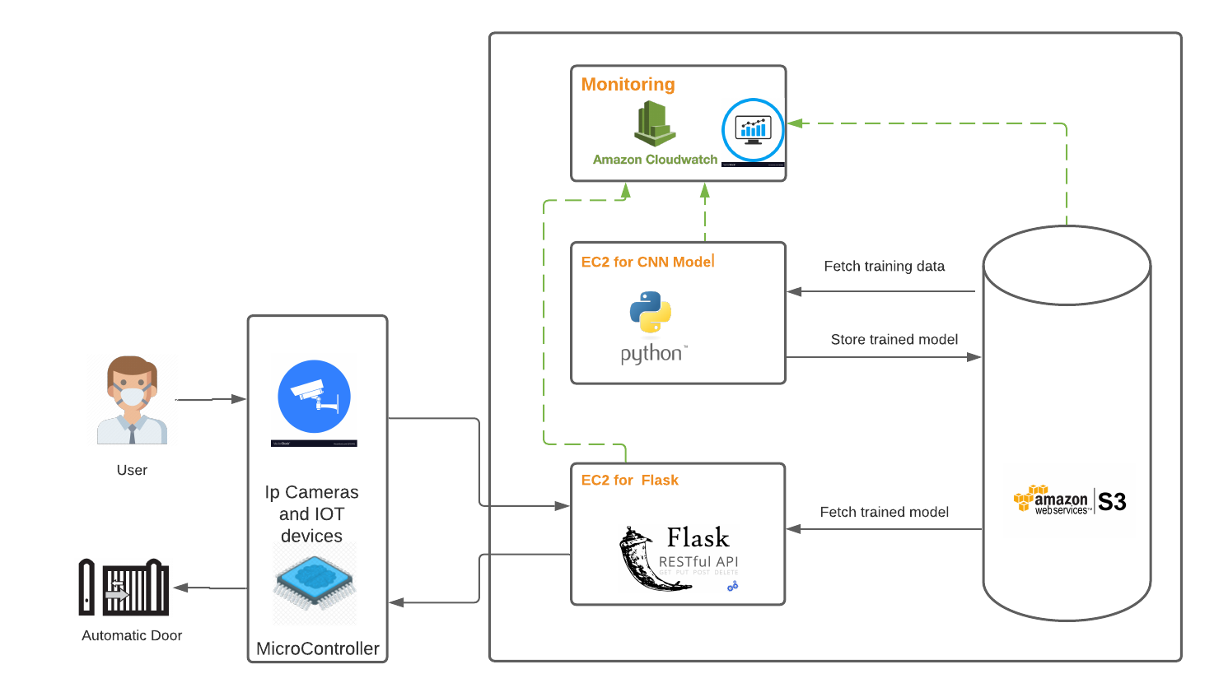
Architecture Diagram

Slide 13
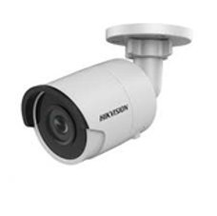
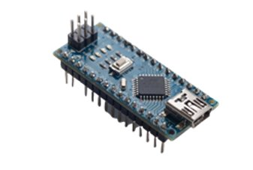
IOT Components
IP Camera
Captures and sends images using the TCP/IP protocol
Remotely accessible
Used for surveillance at most public places
Microcontroller
Small capacity computer
Contains one or more CPUs, memory and programmable input/output peripherals

Slide 14
Cloud Components
EC2 Instance 1
Used for traing the model
Higher performance Instance
S3 bucket
Storage of the training data
Storage of the model
EC2 Instance 2
Flask API hosting(Port 5000)
React UI hosting (Port 3000)
CloudWatch
Monitering CPU usage
Monitering logs
Monitering Network traffic
t2.medium
t2.xlarge

Slide 15
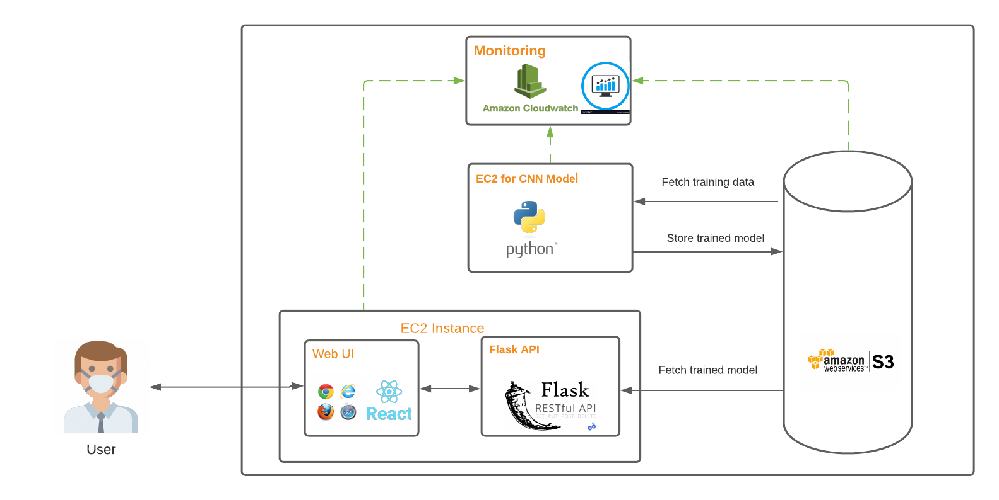
Architecture Diagram(Demo)

Slide 16
Technology Components
Transfer learning + CNN Model
keras
API
flask
python
User Interface
React
CSS
HTML
opencv

Slide 17
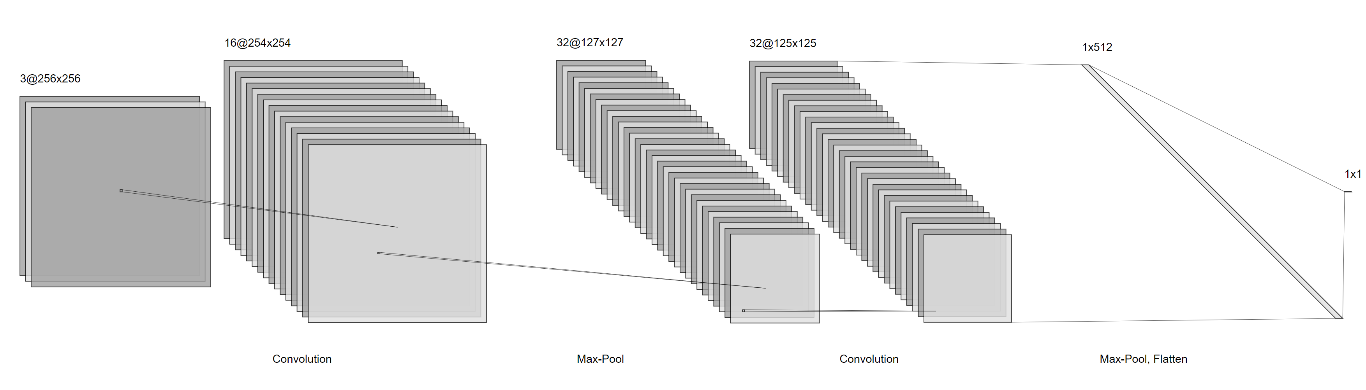
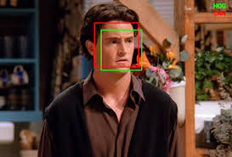
ML model
Face detection using pretrained model - opencv (https://docs.opencv.org/3.4/db/d28/tutorial_cascade_classifier.html)
CNN model to detect mask

Slide 18
Flask API
Input: base64 image
Processing: Converting the image followed by mask prediction
Output: Class of the image in JSON (1 or 0)
Port Used: 5000

Slide 19
User Interface
Technology Used: React JS, HTML, CSS
Port Used: 3000
Leveraging webcam to capture image.
Sending 1 image per second to Post API request
Displaying Response from the API

Slide 20
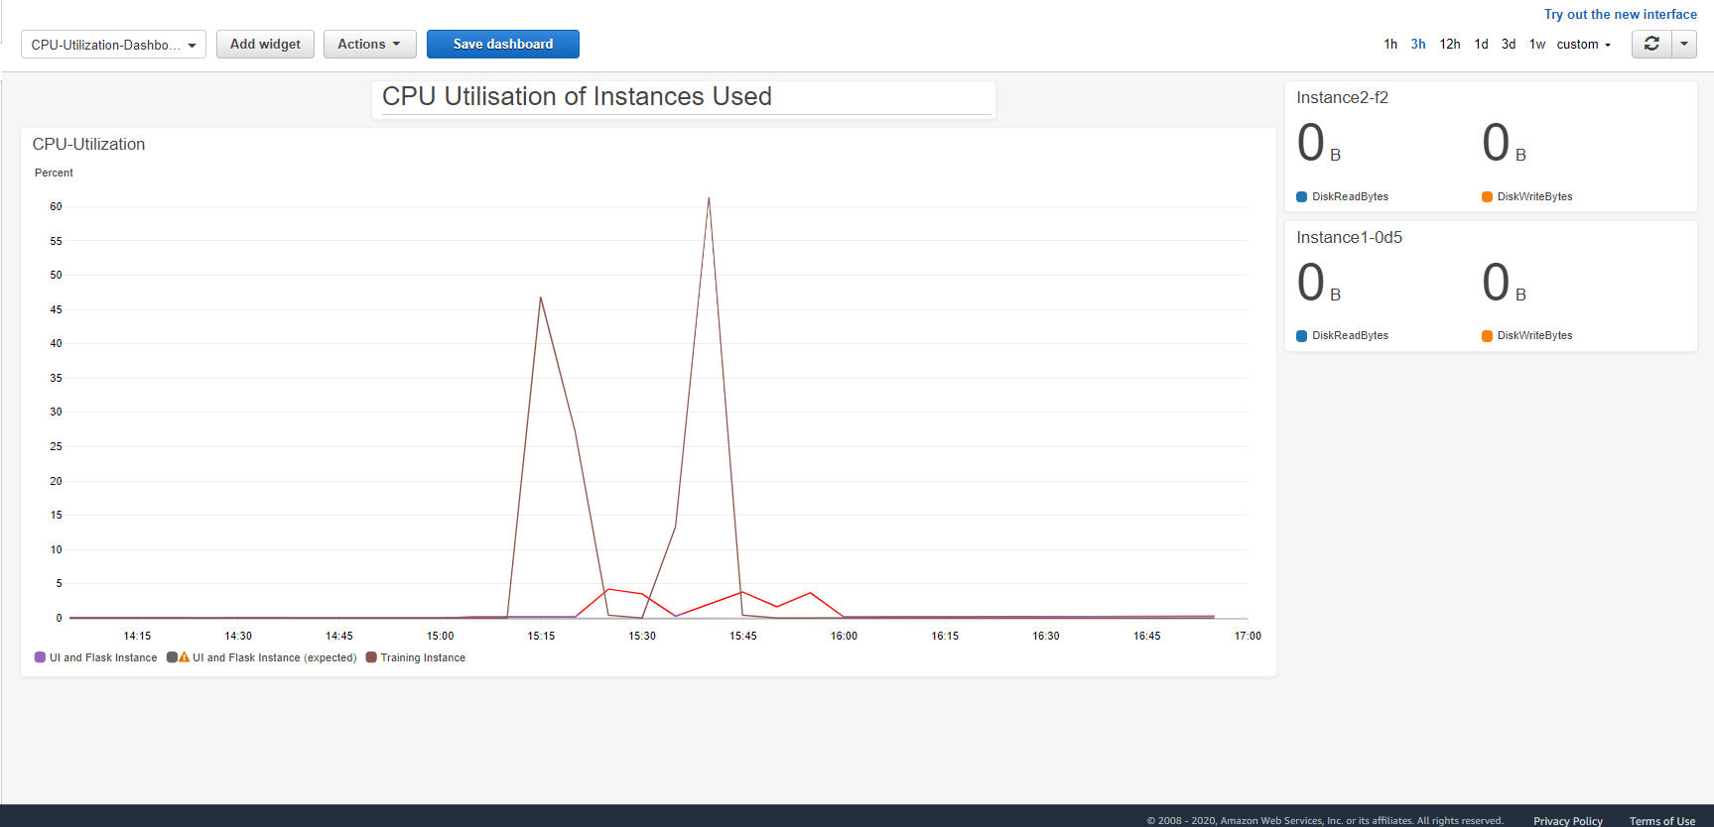
Cloud watch

Slide 21
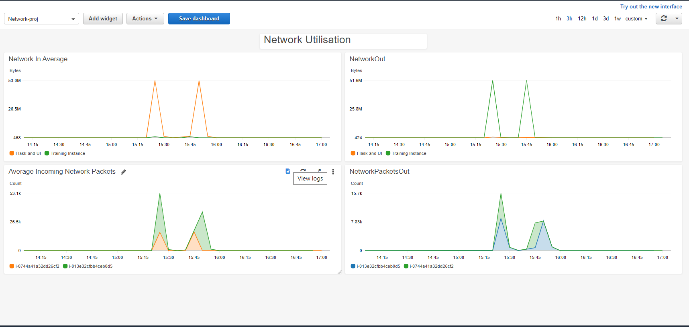

Slide 22



Future Goals
Attendance of employees and students
Expansion to CCTV cameras in parking lots for Number plate detection
Shoplifting and burglary detection

Slide 23

Check out our code here!
https://github.com/aatishsuman/maskDetection
https://github.com/lakshyagupta2409/FaceItUI

Slide 24

Thank you!
We are now open to questions

