Slide 1

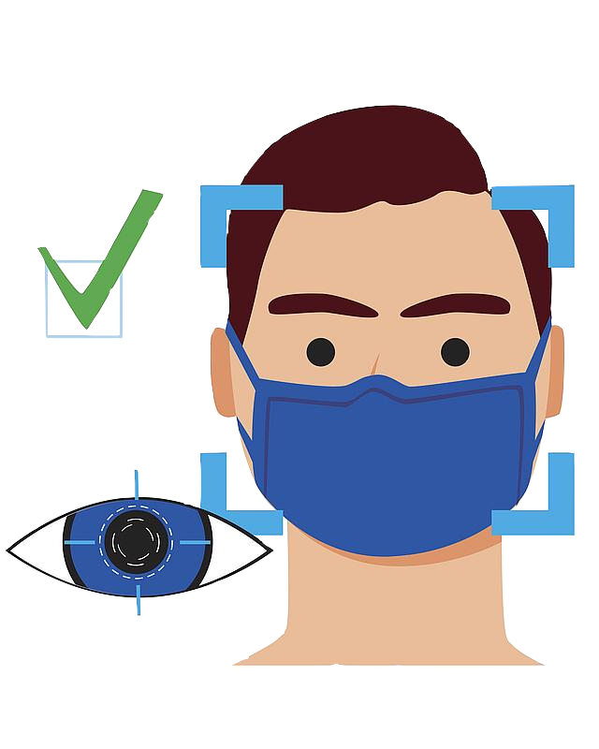
Face IT! (Patent pending)
by:
Aatish Suman
Adheesh Phadnis
Anupama Mohan Rao
Lakshya Gupta
Vidushi Mishra

Slide 2

Product Description
An end-to-end cloud hosted service for real-time face mask detection in live feed images.
Face masks reduce COVID-19 spread by 85%.
Approximately 25 million CCTV cameras are operating around the world.
W.H.O.
Victorian Auditor-General's office

Slide 3
Customers
Universities
Airports
Malls
Hospitals
Offices
Restaurant

Slide 4
Competitor Analysis
 | Face it! (Patent Pending) | Kogniz
Price | $4,000 Per annum | < $10,000
Privacy | Data storing is not necessary since we intend to only trigger an action | Data is collected and stored, although encrypted
Application | Used for entry-points | Used within the premisis
No of cameras | Five camera locations | Just one.
Compatibility | No dependency | Must be used with Kogniz cameras
Features | Can be customized. | Comes as a package.

Slide 5
Business Model
Subscription based model
Customer centric

Slide 6
Model Assumptions : Technology
Basic subscription for one customer equals 5 cameras on average
Every customer gets a separate instance(assuming 5 cameras average)
Marketing cost is constant for 5 years
Head costs can be kept constant or scaled per year
S3 bucket cost increases by a factor of 1.1 per month

Slide 7
Model Assumptions : Finance
Subscription fees increase by 10% every 6 months
Every month the customer base increases by 5
Equity split : Company-Investor : 51%-49%
Risk free rate: US Treasury rate for 5 years – 6%
Compounding assumption : Continuous
Investor excess return is calculated over risk free return
Tax considerations of any kind are neglected for simplicity

Slide 8
Model Assumptions: Other
Additional hiring : 2 Systems Engineers and 2 Customer support agents
5 members receive no salary. Only equity I.e (10.2%) each

Slide 9
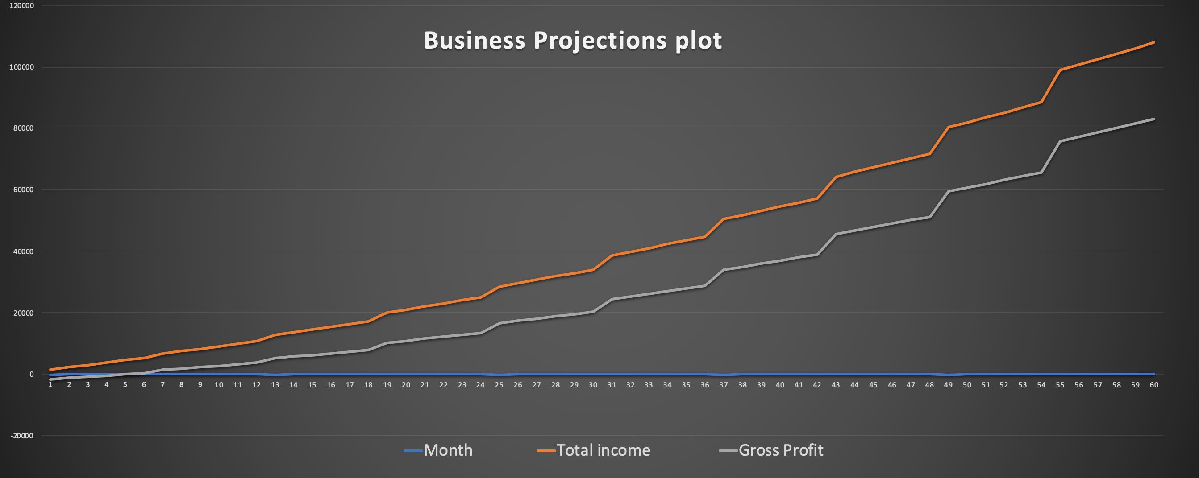
Revenue and Profit projections for 5 years

Slide 10
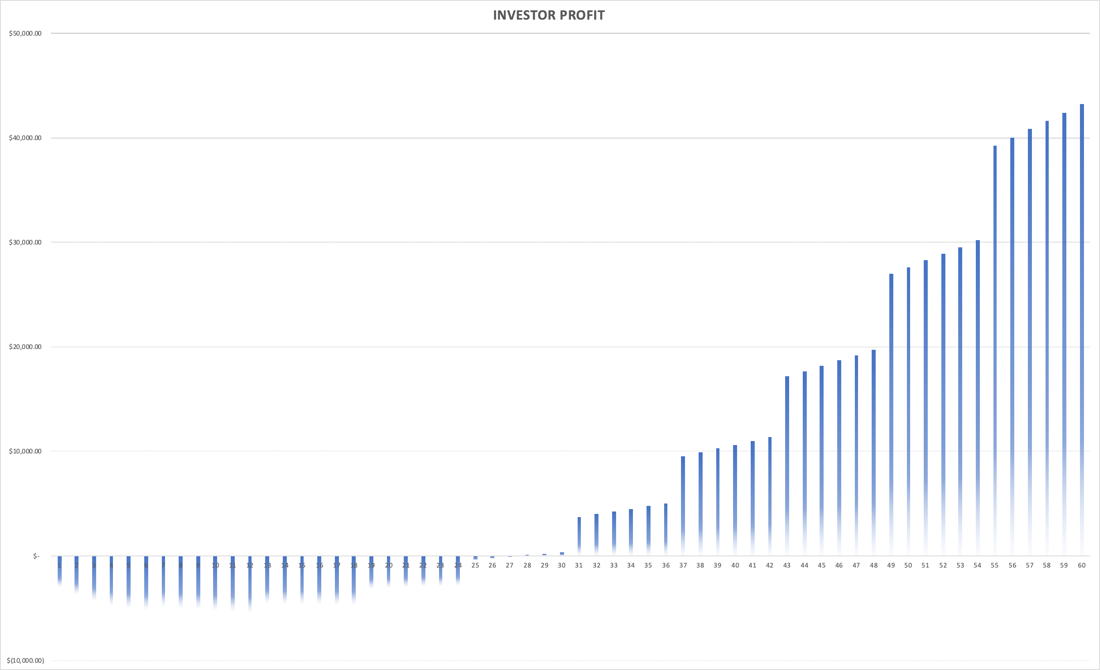
Investor Return 5 years

Slide 11
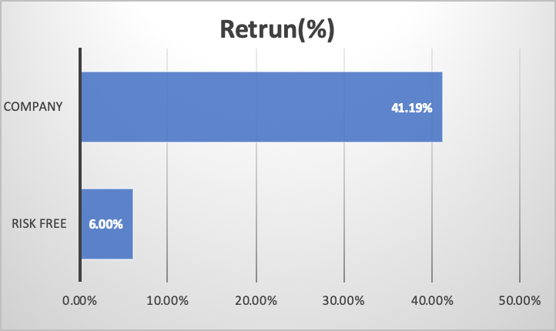
Excess return over risk free return
Market return 5 years continuous compounding at risk free rate : 6%
Return from company for 5 years : 5%- 19%

Slide 12
Stakeholders
Investment Banks
Institutional Investors
Angel Investors
Venture Capitalists

Slide 13
Scope of The Idea
Automated door control
Automated Alerts
Real time monitoring
Multichannel Recognition

Slide 14

Architecture – platform
Platform – AWS
Mature infrastructure with better community and product support
Variety of IoT services and monitoring tools
Type – Infrastructure as a Service
Computational needs for ML model can change – adding GPUs, memory, etc.

Slide 15
Architecture – components
Cloud-based components
2 EC2 instances
S3 bucket
IoT components
IP Camera
Microcontroller

Slide 16
Scope of the Idea
Automated Door CONTROL
Real Time Monitoring
Automatic
Alerts
Multi-Channel Recognition

Slide 17
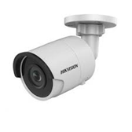
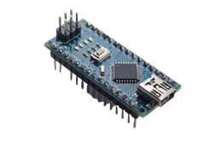
Architecture – IoT Components
IP Camera
Captures and sends images using the TCP/IP protocol
Remotely accessible
Used for surveillance at most public places
Microcontroller
Small capacity computer
Contains one or more CPUs, memory and programmable input/output peripherals

Slide 18
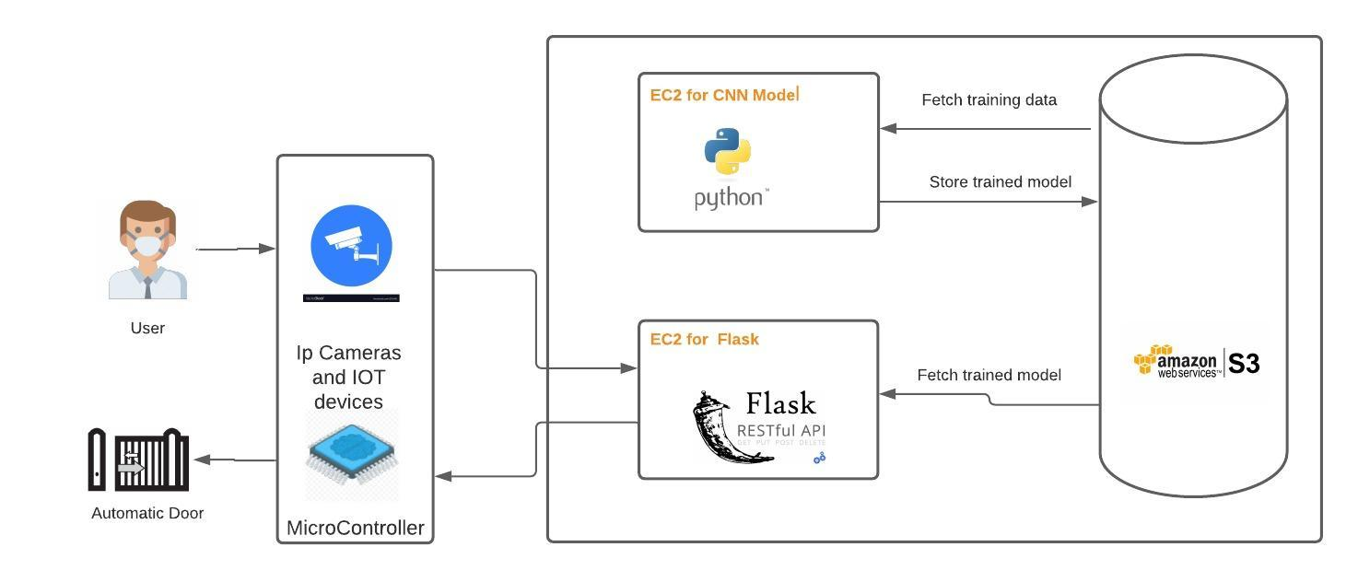
Architecture Diagram

Slide 19
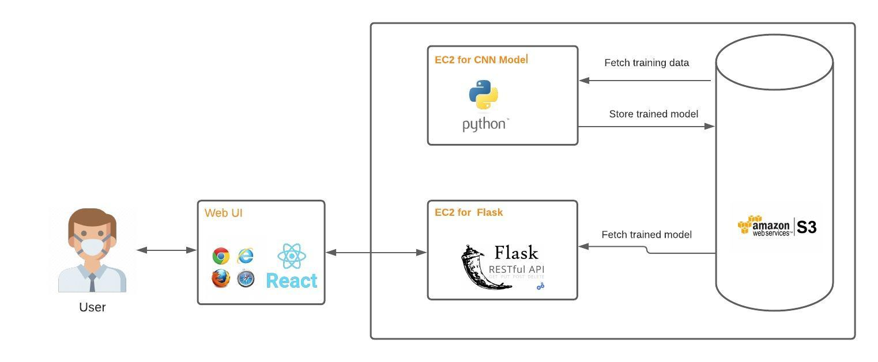
Goals and expectations for the final presentation
Instead of IOT devices we will be building a UI using React JS.
Functionality:
Input: Image/Video using webcam
Output: Prediction of ML Model in form of 'Yes' or 'No'

Slide 20
Future Goals
Can be expanded to CCTV cameras in parking lots for Number plate Detection
Detection of shoplifting and burglary
Attendance of employees and students

Slide 21
Thank you.

