Slide 1
CENT DATABASE
PRESENTED BY: ANUPAMA RAO PRACHI SANKPAL SHRIPAD LADDHA

Slide 2
PROBLEM STATEMENT
CENT research center wants to maintain a database to keep track of equipment that have been borrowed and loaned out to the students/ research faculty.
As the current equipment loaning system, follows the archaic method, using pen and paper to make records of the equipment loaned out it is not accurate and efficient to keep track.
It is difficult for the user to remember his/her return date as there is no formal receipt generated, so it is likely possible that the user may forget to return by the expected date of return.
Again tracking, who did not return, will be an issue. Thus, disturbing the consistency of equipment count.

Slide 3
SOLUTION
We have created a database using MSSQL and implemented an application using PowerApps to provide CENT users an easy way to borrow any equipment from the CENT inventory.
This app also helps, CENT affiliated users to keep track of the loaned items approved by them.
On borrowing an equipment, the user who has requested for it receives an email notification on his/her registered email address with the university.
This solves the issue of the user not able to remember when they have to return the equipment they have borrowed.
Also, its helps to link the person who has approved the equipment with the borrower.

Slide 4
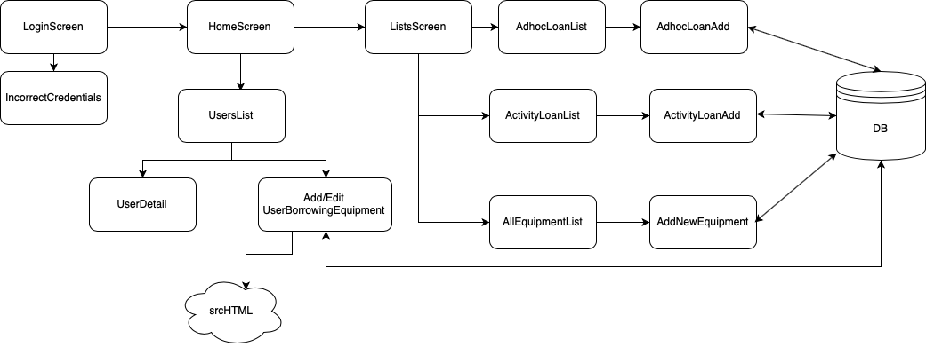
SOLUTION

Slide 5
BENEFITS
Less risk of losing the data
More reliability of data
Resolved the inconsistencies of equipment count
Paper-less receipt to the user
CENT affiliated person can keep a track of equipment that he/she has loaned out.
Two-fold security:
1.Loaned Equipment
2.Database Security

Slide 6
POSSIBLE FUTURE PLANS
Scanning the barcode using camera to add it into our database.
The final project now was implemented for CENT affiliated personnel. However, the users side of the app wasn't shown.
We did do the user side of the app but we were unable to finish to on time to merge it with our existing app.
UI is not consistent, as each parts of the app has been implemented by different people in the team.

