Slide 1
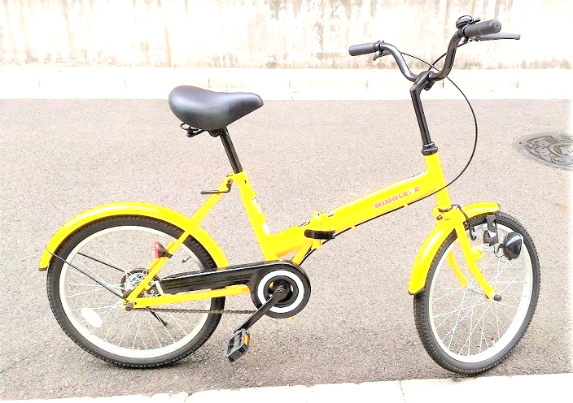
Kawasaki City, Kanagawa, Japan
LCD
Android
Smart phone
Accelero-
meter
Temperature
Humidity
Speed
GPS
I2C
USB
hub
Scheduler
Analog In
USB
Hall
sensor

