Slide 1
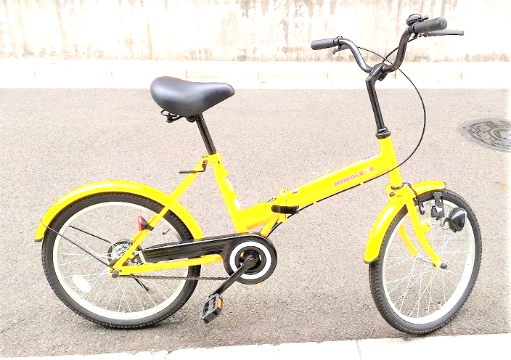
Kawasaki City, Kanagawa, Japan
LCD
I2C2
Android
USB
LCD
Scheduler
I2C1
Speed
Temperature
Humidity
Accelero-
meter
Analog In
Hall
sensor

