Slide 1
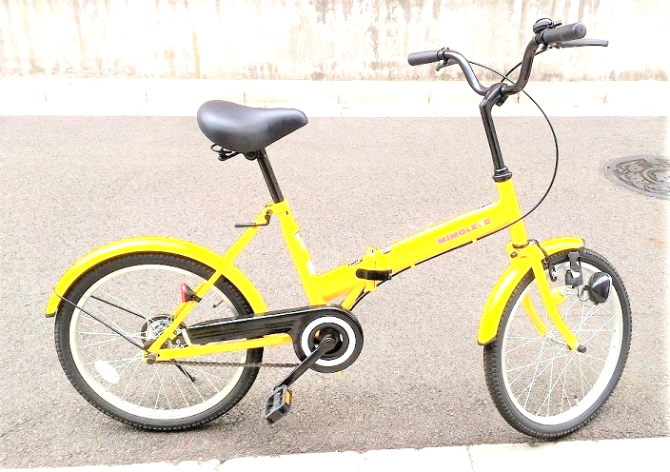
Kawasaki City, Kanagawa, Japan
LCD
I2C2
Accelero-
meter
GPS
I2C2
Temperature
Humidity
I2C1
ESP-WROOM-02 is in sleep mode while running
LCD
Battery
Scheduler
3.3V
5V
Speed
ESP-WROOM-02
UART
Application block
Analog In
EEPROM
128KB
(I2C)
Hall
sensor

