Slide 1
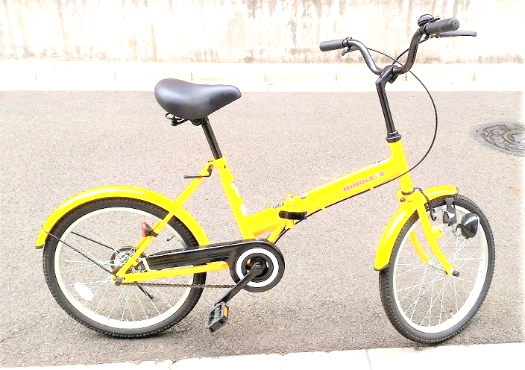
Kawasaki City, Kanagawa, Japan
LCD
I2C2
Android
USB
LCD
Scheduler
I2C1
Speed
Temperature
Humidity
Accelero-
meter
Analog In
Hall
sensor

Slide 2
Speed calculation
r(rpm) = c(5sec) * 60/5
s(km/h) = πl * r * 60
l
c

