Slide 1
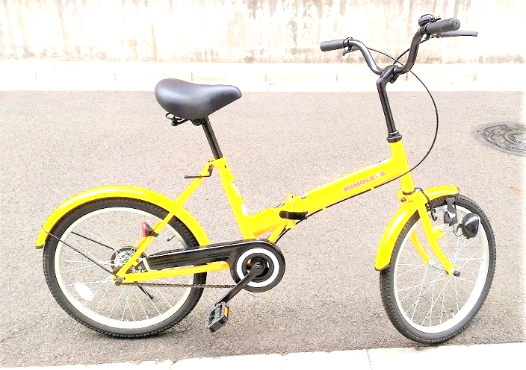
Kawasaki City, Kanagawa, Japan
LCD
I2C2
Accelero-
meter
GPS
I2C2
Temperature
Humidity
EEPROM
128KB
(I2C)
I2C1
LCD
Battery
Scheduler
5V
Speed
ESP-WROOM-02
Analog In
Hall
sensor

