Slide 1
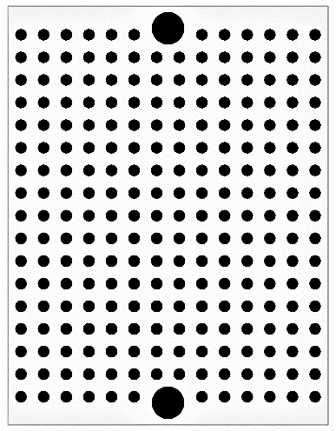
Three-terminal regulator
TA48M033D (a)
Microchip RN4020
USB micro-B connector
Pin socket
TX
RX
47μF
GND
5V
1
5
(a)
0.1μF
GND
GND
5V
HV
LV
5V
UART
GND
Diode
GND
UART
(for RN4020 management)
TX
RX
Pin socket
Logic level converter
Diode
JP
Pin socket

