Slide 1
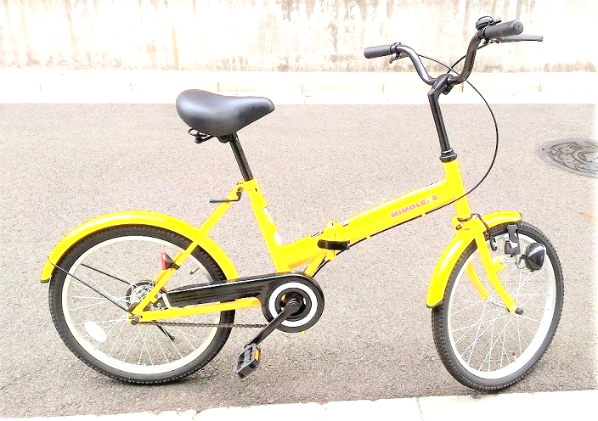
Kawasaki City, Kanagawa, Japan
LCD
I2C2
Accelero-
meter
GPS
I2C2
Temperature
Humidity
I2C1
SPI
SD memory
8GB
LCD
Battery
Scheduler
ESP-WROOM-02
3.3V
5V
Speed
Logic level shifter
UART
UART
Analog In
Hall
sensor

