Slide 1
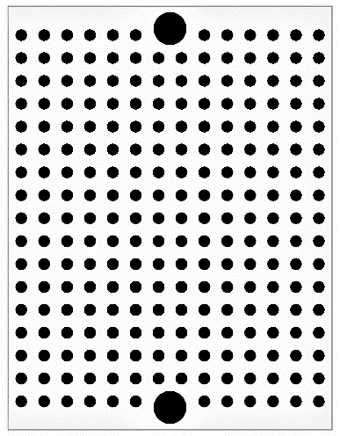
Microchip RN4020
(3.3V system)
GND
5V
RX
TX
USB micro-B connector
(for power supply)
Pin header
UART
Pin socket
47μF
GND
5V
PIC16F1
Arduino
Etc
(5V system)
5V
GND
1
5
(a)
0.1μF
UART-USB
Converter
(for management)
5V
GND
GND
5V
HV
LV
5V
5V
GND
GND
Diode
GND
GND
RX
TX
TX
UART
UART
RX
Pin socket
Pin socket
Logic level converter
Diode
JP
Pin socket
Pin header
(a) Three-terminal regulator TA48M033D

