Slide 1
Microchip
RN4020
← 17 holes →
USB micro-B
connector
GND
5V
TX
RX
47μF
USB terminal
(power supply)
5V
GND
3.3V
Three-terminal regulator
TA48M033D
1
5
0.1μF
← 14 holes →
HV4
LV4
HV3
LV3
5V
GND
GND
5V
GND
HV
LV
GND
HV2
LV2
TX
HV1
LV1
RX
Pin socket
Logic level converter
Pin socket

Slide 2
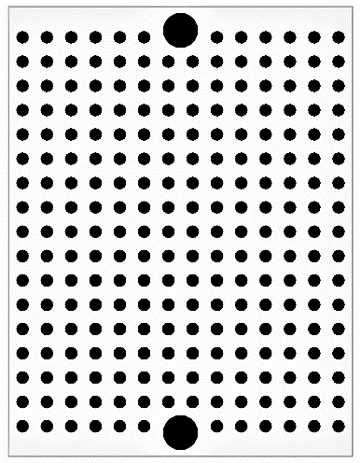
USB micro-B connector
Pin socket
Pin socket
Logic level converter
Pin socket

