Slide 1
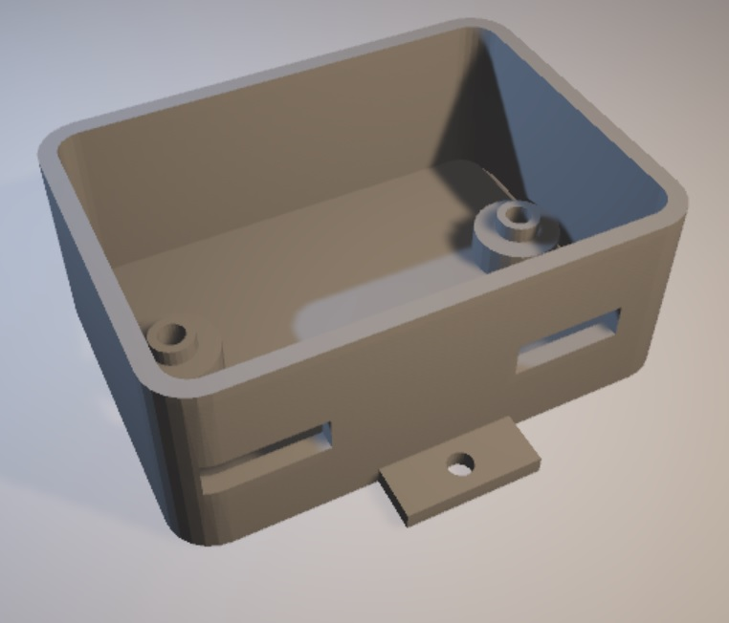
Sensor/actuator CAN node
Requirements for sensor/actuator node
MCP2515 and MCP2561 on base board
5V three-terminal regulator (Max. 500mA)
Polyswitch (100mA) and diode for circuit protection
PIC16F1829 MCU on sensor/actuator board (daughter board)
CAN1
CANL
CANH
CANL
CANH
CAN0
6V~9V
GND
TX
RX
UART

