Slide 1
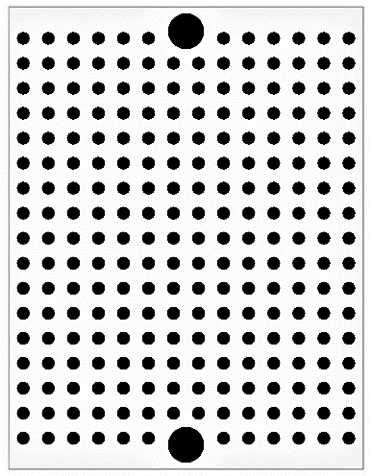
CAN adaptor to UART
Murata CERALOCK 8MHz
(1)
(2)
(3)
OSC1
OSC2
VSS
Rf 1MΩ
RXCAN
TXCAN
LED(red)
MCP2515
0.1μF
A
SI
SO
CS
VDD
SCK
1kΩ
0.1μF
RXD
TXD
VDD
VSS
RA0
RA1
SCK
SDI
SDO
VSS
MCP2561
120Ω
PIC16F1825
0.1μF
CANL
STBY
VDD
MCLR
SPLIT
CANH
RX
JP1
51kΩ
TX
RX
VSS
CANH
CANH
VDD
TX
CANL
CANL
UART
CAN
CAN

