Slide 1
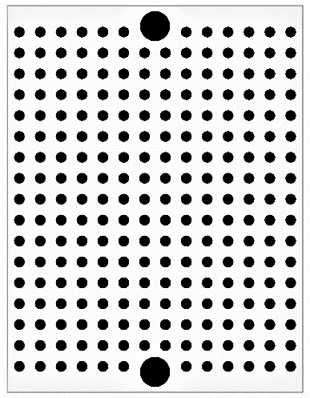
CAN adaptor to UART
Murata CERALOCK 8MHz
(1)
(2)
(3)
OSC1
OSC2
VSS
Rf 1MΩ
RXCAN
TXCAN
LED(red)
MCP2515
0.1μF
A
SI
SO
CS
VDD
SCK
1kΩ
0.1μF
RXD
TXD
VDD
VSS
RA0
RA1
SCK
SDI
SDO
VSS
MCP2561
120Ω
PIC16F1825
0.1μF
CANL
STBY
VDD
MCLR
SPLIT
CANH
RX
JP1
51kΩ
TX
RX
VSS
CANH
CANH
VDD
TX
CANL
CANL
UART
CAN
CAN

Slide 2
CAN adaptor to UART
Murata CERALOCK 8MHz
(3)
(2)
(1)
OSC2
OSC1
VSS
Rf 1MΩ
TXCAN
RXCAN
0.1μF
MCP2515
LED(red)
SI
A
VDD
SO
CS
SCK
0.1μF
1kΩ
TXD
RXD
VDD
VSS
SDO
SDI
SCK
RA1
RA0
VSS
120Ω
MCP2561
STBY
CANL
PIC16F1825
0.1μF
CANH
SPLIT
MCLR
VDD
JP1
RX
TX
51kΩ
CANH
CANH
VDD
TX
CANL
CANL
VSS
RX
CAN
CAN
UART

