Slide 1
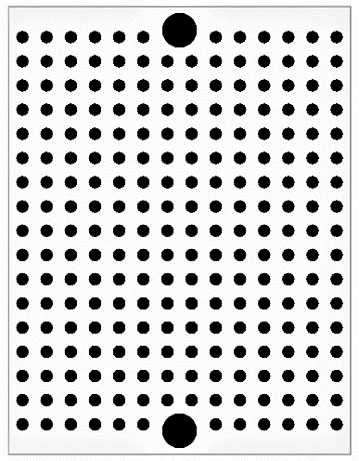
PIC16F1825 CAN node
Murata CERALOCK 8MHz
(2)
VSS
RXCAN
(3)
(1)
OSC1
OSC2
TXCAN
MCP2515
0.1μF
RESET
SCK
SI
SO
CS
VDD
10kΩ
0.1μF
VSS
VSS
TX
RXD
VDD
TXD
RX
RA2
SCK
SDI
SDO
MCP2561
0.1μF
PIC16F1825
CANL
CANH
SPLIT
STBY
VDD
51kΩ
120Ω
JP1
RX
TX
VSS
VDD
CANL
CANH
CANL
CANH
Jumper pin
(termination)
UART
CAN
CAN

Slide 2
Murata CERALOCK 8MHz
(2)
VSS
RXCAN
(3)
(1)
OSC1
OSC2
TXCAN
MCP2515
0.1μF
RESET
SCK
SI
SO
CS
VDD
10kΩ
0.1μF
VSS
VSS
TX
RXD
VDD
TXD
RX
RA2
SCK
SDI
SDO
MCP2561
0.1μF
PIC16F1825
CANL
CANH
SPLIT
STBY
VDD
51kΩ
120Ω
JP1
RX
TX
VSS
VDD
CANL
CANH
CANL
CANH
Jumper pin
(termination)
UART
CAN
CAN

