Slide 1
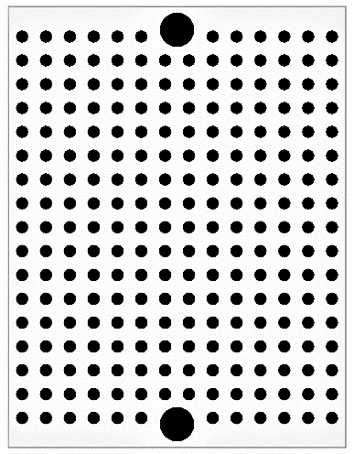
September 9th, 2017
Door controller
I2C bus
Hall sensor
Vout
5V
GND
SDA
GND
LED red
5V
SCL
A
1kΩ
VSS
RA2
RC1
RC0
RC2
PIC16F1825 I/P
0.1μF
MCLR
RC5
RC3
VDD
RC4
51kΩ
100μF
-
+
TX
RX
5V
GND
UART
Y
O
B
Servo motor sg90

