Slide 1
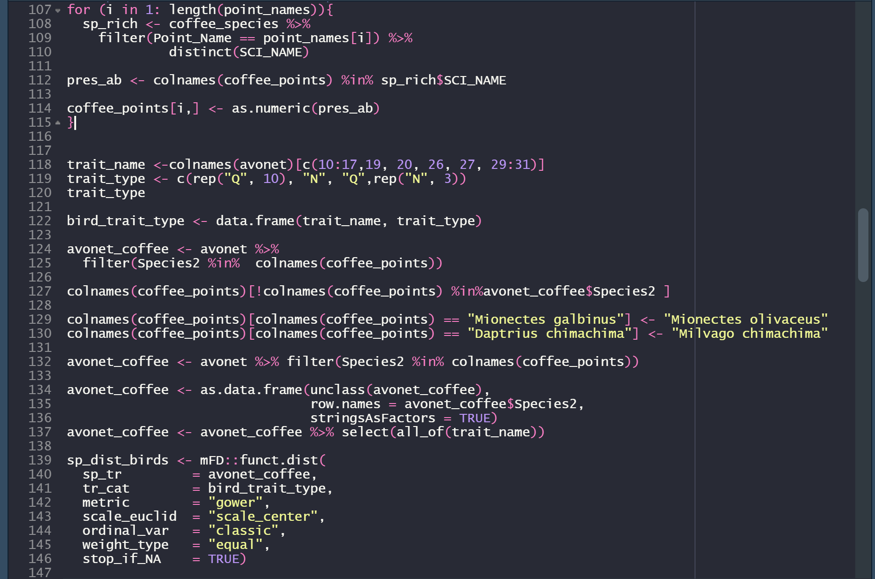
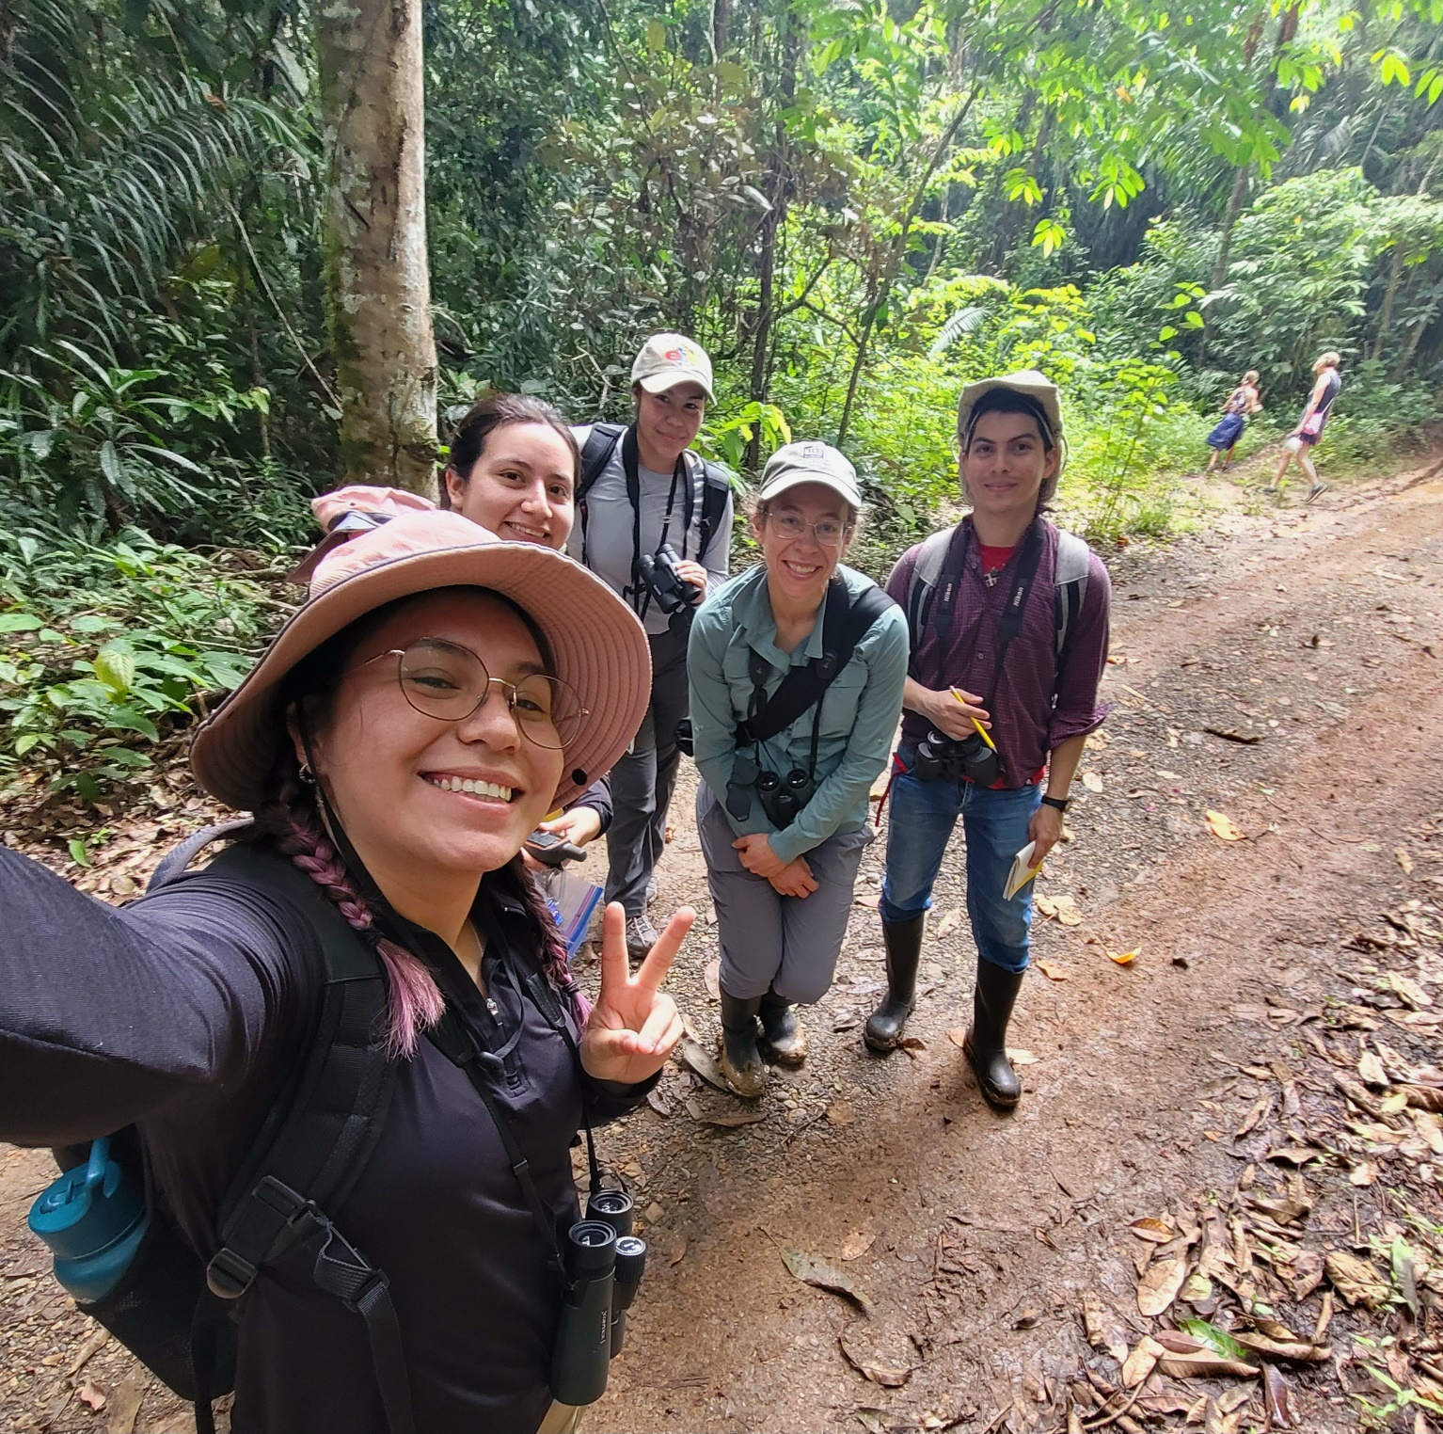
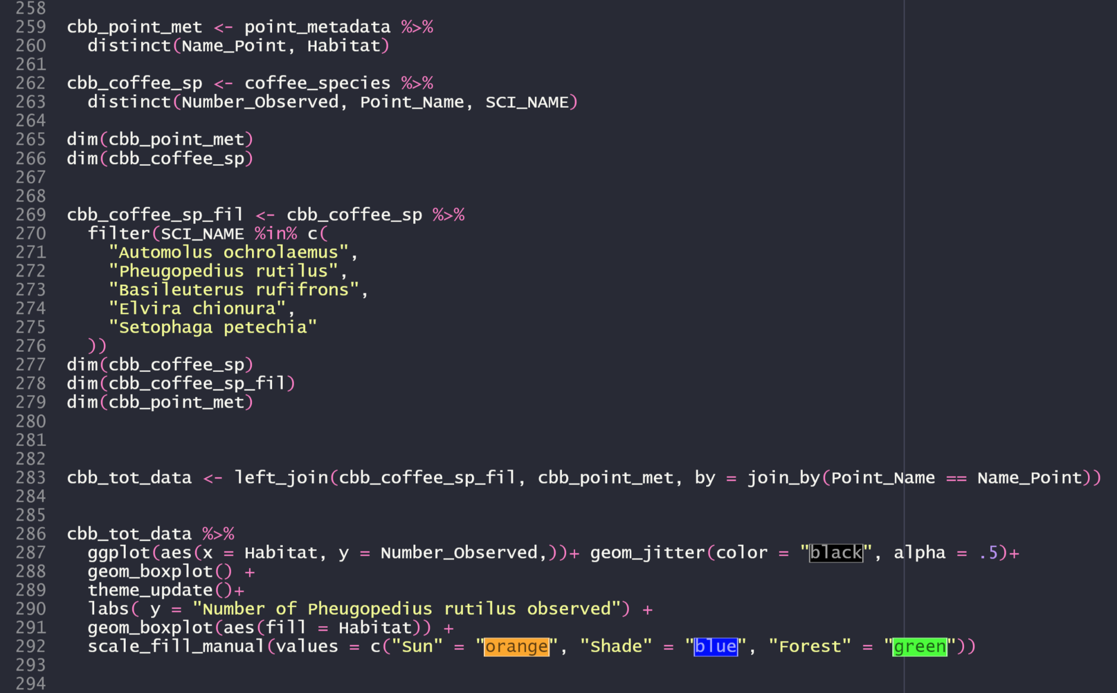
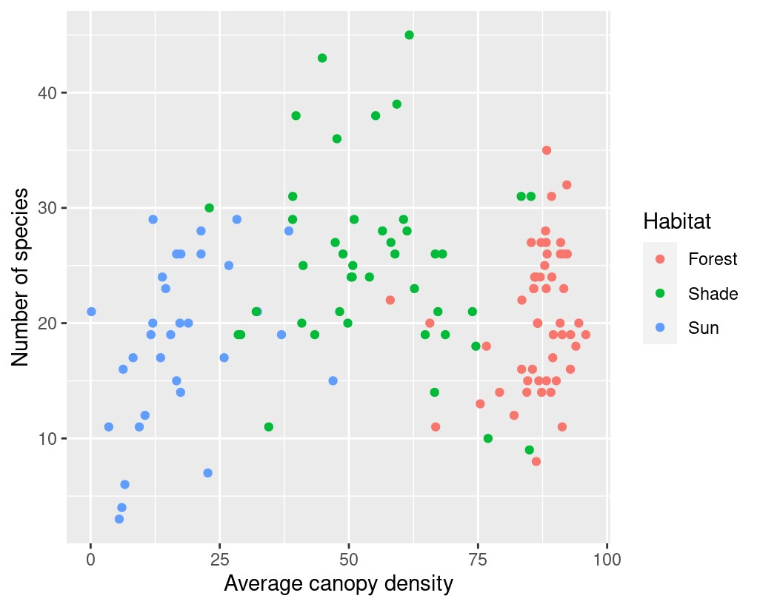
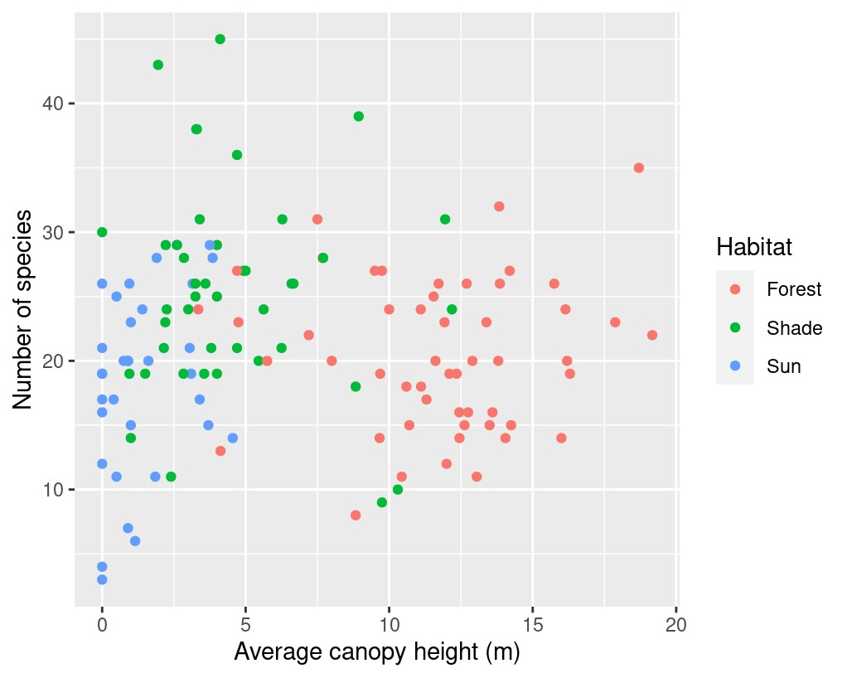
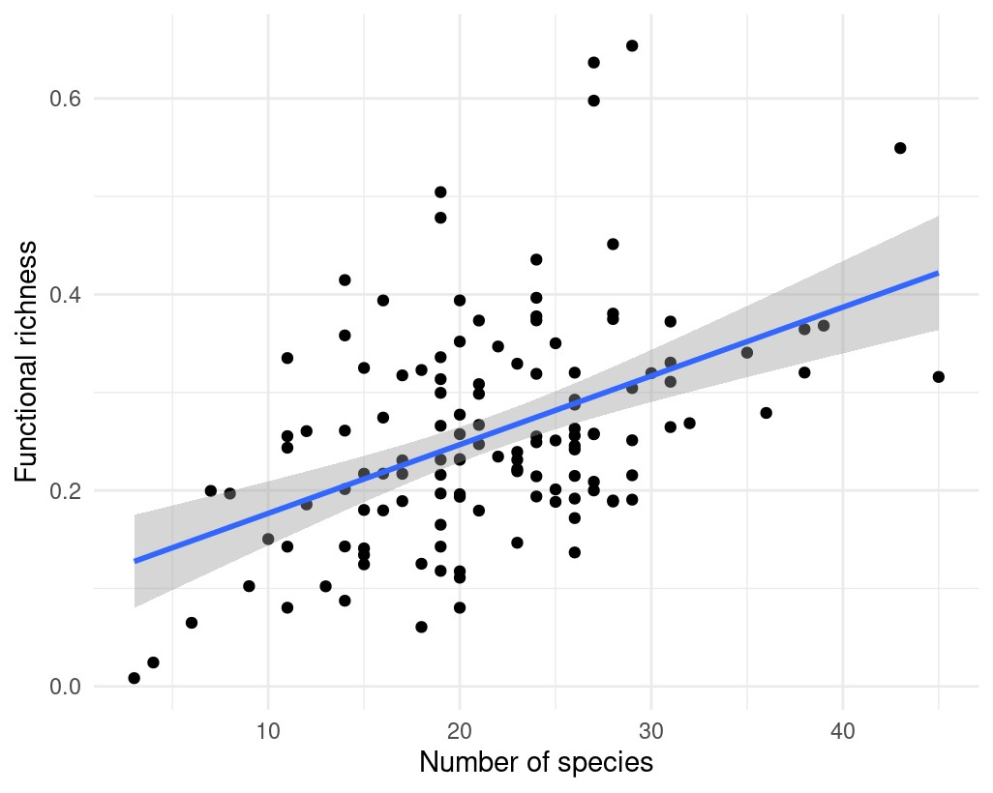
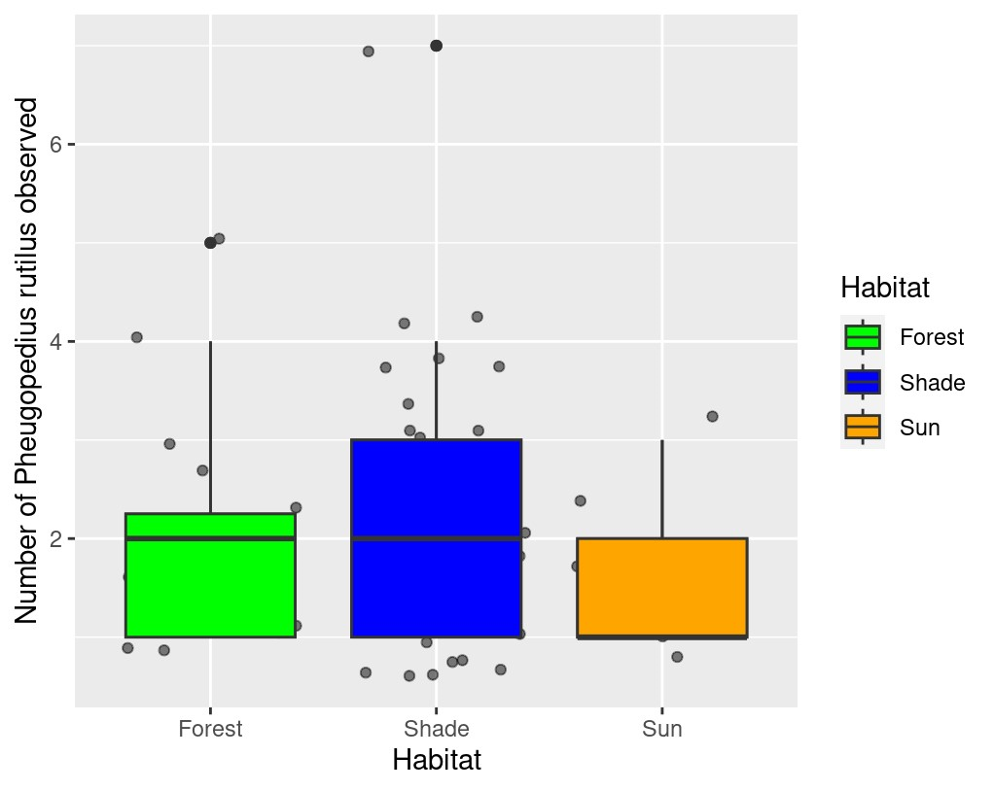




Understanding differences in avian biodiversity across varying environments
Arantza Lira, Katherine Arauz Ponce, Ruth Bennet, PhD, Alexander E. White, PhD, Mario Castellanos
Introduction
Commercial agriculture and the strong demand for coffee have been responsible for 70% of the deforestation and loss of bird habitat in the tropics.
The Bird Friendly coffee certification has made it a goal to urge farmers to switch to shade-grown coffee, thus guaranteeing a balance of vegetation cover, tree height, and biodiversity that produces high-quality habitat for birds and other wildlife
Participated in a 10-week data science course with the Smithsonian data science lab
at the Tropical Research Institute in Panama
Methods and Materials
Grad student (KP) used bird identification tools and observations to gather data through point counts in Panama. The AVONET global trait dataset included measurements and details about various bird species.
The data includes information about the habitat, including details about the vegetation, the types of birds present, their features, and other ecological measurements.
I conducted a statistical analysis using RStudio and the mFD package
Results
Figure 1. Shade coffee locations have the highest reported species count, although inconsistent. Forest is not a coffee region, it is used as a location for comparison
(Percentage)
Figure 2. Functional richness is not directly coupled with taxonomic richness. Functional richness was measured using quantitative and categorical variables from the AVONET global trait dataset.
Figure 3. Shade-grown coffee farms attract more pest-eating species. However, a tradeoff present is an increase in fungal issues in shaded regions due to the shaded, cool, and humid climate canopies create.
Conclusions
Shade coffee regions have a greater count of bird species and pest-eating bird species. However, The visuals further demonstrate that the number of species present in an ecosystem or community does not necessarily determine the diversity or complexity of functions that the ecosystem performs. Going forward, I would like to determine what percentage of each function is performed per ecosystem and how they improve the quality of coffee production. Additionally, I want to assess the financial advantages of organic pest control and the trade-offs between fungal problems in the sun and shade.
Contact
Acknowledgments
Arantza Lira
University of California, Santa Barbara
Email: alira@ucsb.edu
Phone: (442)-235-4737
This UCSB-Smithsonian Scholars Program received federal support from the Latino Initiatives Pool, administered by the Smithsonian Latino Center.

