Slide 1
Keyword Search For Sıgn Language (KWS)
Project members:
Aras güngöre
Burak Batuhan polat
Prıncıpal ınvestıgator:
Murat saraçlar

Slide 2
Sign Language
Facilitates communication for deaf and hard-of-hearing individuals.
Preserves cultural identity and heritage of deaf communities.
Enhances social inclusion and accessibility in various settings.
Bridges the communication gap between deaf and hearing individuals.
Empowers deaf individuals to express themselves and participate fully.

Slide 3
Scope of thıs project
Improve accessibility and communication in sign language.
Enable quick access to specific signs and phrases.
Enhance sign language education and learning.
Support creation of sign language dictionaries.
Improve sign language recognition and research.

Slide 4
LSE_ESAUDE_UVIGO SPANISH SIGN LANGUAGE DATASET

Slide 5
LSE_ESAUDE_UVIGO SPANISH SIGN LANGUAGE DATASET: content
The LSE_eSaude_UVIGO dataset consists of sign language videos signed by 10 individuals and partially annotated with 100 signs.
Unlike common datasets collected from real-time translation or subtitled broadcasting, this dataset focuses on sign language expressions related to the health domain in Spanish Sign Language.
The dataset emphasizes expressivity and naturalness, enhancing the realism of the collected sign language data.
The videos were recorded at a frame rate of 25 frames per second (fps) under uniform illumination conditions in a studio environment.
The annotations in the dataset were meticulously created by deaf individuals and professional translators, ensuring accuracy and quality.

Slide 6
LSE_ESAUDE_UVIGO SPANISH SIGN LANGUAGE DATASET: ANNOTATION
The annotation process involves the use of two associated Tiers: 'M_Glosa' and 'Var'.
The 'M_Glosa' Tier is used to indicate the selected gloss locations within the videos, while the 'Var' Tier is used to denote variants of the signed gloss.
Linguistic variants include minor alterations such as changes in hand configuration, unusual non-dominant hand usage, shifts in location, and relaxed execution.
Non-linguistic variants encompass situations where a similar sign exists, signs are out of frame, blocked by body parts, or have very short durations.
Annotations include important information such as begin and end timestamps, excluding transitions between signs, and the use of '*' prefix to indicate linguistic and non-linguistic variants.

Slide 7
LSE_ESAUDE_UVIGO SPANISH SIGN LANGUAGE DATASET: mssl track
The MSSL (multiple-shot supervised learning) track contains a training set, a validation set, and a testing set.
The MSSL training set (MSSL_Train_Set) consists of video files with annotations for 60 signs, amounting to a total duration of 2.5 hours.
The MSSL validation set (MSSL_Val_Set) includes video files with annotations for the same 60 signs, totaling 1.5 hours in duration.
The MSSL testing set (MSSL_Test_Set) comprises video files with annotations for the same 60 signs, with a total duration of 1.5 hours.

Slide 8
LSE_ESAUDE_UVIGO SPANISH SIGN LANGUAGE DATASET: oslwl track
The OSLWL (one-shot learning and weak labels) track also consists of a query set, a validation set, and a testing set.
The OSLWL query set (OSLWL_Query_Set) contains 40 short videos representing isolated signs. Among these, 20 videos were recorded by a deaf man included in the dataset, and the other 20 were recorded by a female interpreter not included in the dataset, providing more realistic query searches.
The OSLWL validation set (OSLWL_Val_Set) contains nearly 1500 video files, each with a 4-second duration. These videos simulate weak labels and represent 20 different signs. The filenames follow the format p##_s##_n###, indicating the signer code, the code of the sign to be retrieved, and a unique sequential number.
The OSLWL testing set (OSLWL_Test_Set) has a structure similar to the OSLWL_Val_Set but features different query signs and signers.

Slide 9
SIGN LANGUAGE DETECTION models

Slide 10
Selection of Sign Spotting Model
We selected the LSE_eSaude_UVIGO dataset for the Sign Spotting Challenge.
The BOBSL dataset was deemed too large and complex for our project's scope.
We evaluated six candidate sign spotting models based on the LSE_eSaude_UVIGO dataset.
The models were tested and compared to identify the ideal candidate.
These models employed diverse methods and frameworks to achieve the same goal.
Our selection allows us to explore and compare different approaches to the problem.

Slide 11
Multiple Shot Supervised Learning (MSSL) Models
MSSL involves consistent signs across training, validation, and test sets.
Co-articulation affects sign samples due to their continuous stream nature.
Training set provides sign start and end times (in milliseconds) annotated by deaf individuals and sign language interpreters.
Annotation criteria are consistent for multiple instances of each sign.
Test set signers can be the same or different, with variations in gender and handedness.

Slide 12
MSSL MODEL 1: Model by ryanwong Model Architecture
The base I3D model pretrained on the WLASL dataset is used.
Swish activations replace ReLU activations for improved results.
Instead of using the final layer's output, the model takes outputs before global average pooling and additional feature outputs before 3D max pooling layers.
The model generates three feature outputs with higher temporal resolutions.
These inputs are utilized in a hierarchical network to produce coarse-to-fine temporal predictions, ranging from 4 to 32 frames.

Slide 13
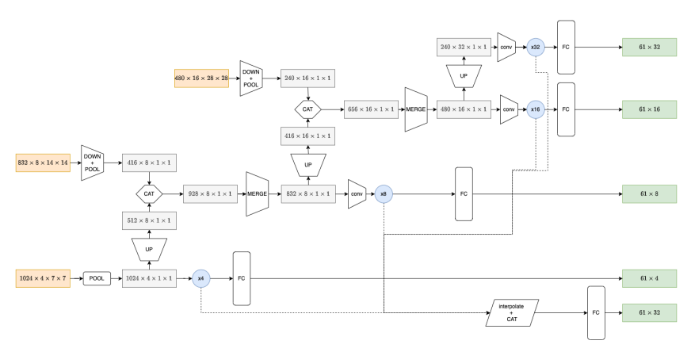
MSSL MODEL 1: Model by ryanwong Model Architecture

Slide 14
MSSL MODEL 1: Model by ryanwong TRAINING
The models are trained using 5-fold cross-validation for 200 epochs.
Random data augmentation techniques such as cropping, rotation, flipping, and color manipulation and mixup augmentation are applied.
The Adam optimizer with an initial learning rate of 3x10⁻⁴ is utilized.
Three different random sampling probabilities are employed (0%, 10%, and 50%) to select frame regions, balancing precision and recall.
Cross-entropy loss is used for training, with an additional unknown class for segments without known class labels.
The best checkpoint is chosen based on local validation F1-score.

Slide 15
MSSL MODEL 1: Model by ryanwong EVALUATION
The final submission utilizes a 7-fold cross-validation set, including a mixture of training and validation data.
Models trained on the fold containing signer 5 in the local validation set are excluded from the ensemble due to performance degradation.
An ensemble of 30 models is used, and the final predictions are obtained by averaging overlapping time segments.
The obtained results indicate an average F1-score of 0.606554, securing the first rank.

Slide 16
MSSL MODEL 2: Model by th Model Architecture
Preprocessing: Signer spatial location is detected using MMDetection, followed by MMPose for body and hand pose extraction. The upper-body patch of the signer is cropped, and flow is calculated using the TV-L1 algorithm. Three modalities (RGB, flow, and pose) are generated.
Feature Extraction: Different backbones are employed for each modality. The BSL-1k pretrained I3D backbone is used for RGB, the AUTSL pretrained I3D backbone for flow, and the GCN pretrained model for pose. Features from all modalities are concatenated.
Temporal Sign Action Localization: The Transformer backbone is utilized for action localization. It combines multiscale feature representation with local self-attention. A lightweight decoder is employed for action classification and boundary estimation.

Slide 17
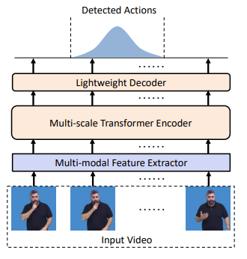
MSSL MODEL 2: Model by th Model Architecture

Slide 18
MSSL MODEL 2: Model by th training and evaluatıon
PyTorch is used for implementation, and training is performed on NVIDIA RTX 3090.
Focal loss is used for sign action classification, and generalized IoU loss is used for distance regression.
The Adam optimizer with a peak learning rate of 2x10⁻⁴ is utilized.
Training lasts for 100 epochs, including a 10-epoch warm-up phase.
The obtained results indicate an average F1-score of 0.566752, securing the second rank.

Slide 19
MSSL MODEL 3: Model by RANDOM_GUESS Model Architecture
Data Preprocessing: Mediapipe is utilized to estimate 3D body and hand poses. The video frames are cropped and resized based on the skeleton center. Hand-oriented spatio-temporal features are extracted using region masking.
Feature Extraction: Different backbones are employed for different data modalities. I3D and P3D backbones, pretrained on Kinetics-400, are used for clipped video, masked video, and optical flow data. ST-GCN backbone is used for skeleton data.
Temporal Module: A two-layer 1D convolutional layer and a two-layer BiLSTM layer are used for local and contextual temporal information extraction. The outputs are integrated through a convolutional layer.
Classification and Regression Heads: Two collaborative heads are used to predict the sign class and the offsets to the start and end of the sign, respectively.

Slide 20
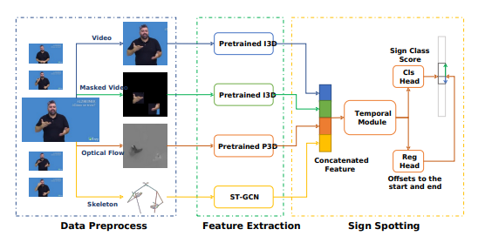
MSSL MODEL 3: Model by RANDOM_GUESS Model Architecture

Slide 21
MSSL MODEL 3: Model by RANDOM_GUESS TRAINING AND EVALUATION
Data Preprocessing: The original video is processed to extract cropped video, masked video, optical flow, and 3D skeleton data.
Backbone and Header Training: Two rounds of training are performed on the backbone. The first round focuses on clips containing query signs, while the second round includes all clips. Vanilla cross-entropy loss is used for clip-wise supervision.
Sign Spotting Training: The trained backbone is used to extract clip-wise feature sequences. Both classification and regression losses are utilized for accurate supervision.
The obtained results indicate an average F1-score of 0.564260, securing the last rank.

Slide 22
ONE SHOT LEARNING AND WEAK LABELS (OSLWL) MODELS
OSLWL is a realistic adaptation of the one-shot learning problem for sign language.
Finding a few examples of a sign using a sign language dictionary is relatively simple.
Locating co-articulated copies of the same sign poses a greater challenge.
Text analysis is commonly used to anticipate plausible intervals for sign occurrences when subtitles are available, as in broadcast-based datasets.

Slide 23
oslwL MODEL 1: Model by th Model Architecture
Preprocessing: MMDetection and MMPose are utilized to detect the signer's spatial location and extract body and hand poses.
Feature Extraction: The pre-trained GCN model is used to extract frame-level features from the pose modality.
Sign Instance Matching: A similarity graph is constructed to perform frame-wise matching between the query isolated sign and the long video.
The matching process involves cosine similarity calculations, trimming of the query sign using OpenPose-detected body pose, and creating a graph for matching frames between the query and reference videos.
The obtained results demonstrate an average F1-score of 0.595802, securing the first rank.

Slide 24
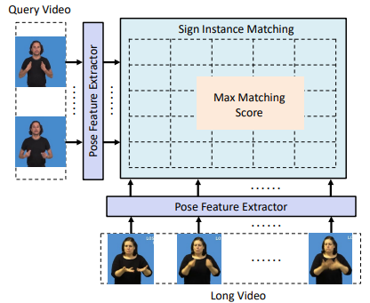
oslwL MODEL 1: Model by th Model Architecture

Slide 25
oslwL MODEL 2: Model by mıkedddd Model Architecture
The pipeline of the framework includes three models: 2D-Pose based SL-GCN, 3D-Pose based SL-GCN, and I3D-MLP.
The 2D-Pose based SL-GCN takes 2D key points generated by HRNet as input.
The 3D-Pose based SL-GCN takes angle-axis 3D pose joints generated by Frankmocap as input.
The I3D-MLP model takes RGB images as input.
Each model is trained separately and their visual features are fused for the sign spotting task during inference.

Slide 26
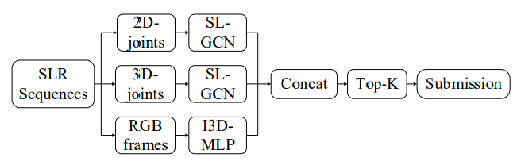
oslwL MODEL 2: Model by mıkedddd Model Architecture

Slide 27
oslwL MODEL 2: Model by mıkedddd training and evaluatıon
Triplet loss and cross-entropy loss are used as a combined loss during the training phase.
The triplet loss maximizes inter-class distances and minimizes intra-class distances, while cross-entropy loss is applied for sign classification.
The obtained results, demonstrate an average F1-score of 0.559295, securing the second rank.

Slide 28
oslwL MODEL 3: Model by ryanwong Model Architecture
Finding Important Frames in Isolated Sign Videos:
Pretrained I3D models on the WLASL dataset are used as feature extractors.
Cosine similarity is computed between frame features of isolated sign videos, creating a cosine similarity matrix.
The sum of cosine similarities is calculated to identify the most common frames (resting pose) by applying a threshold.
Start and stop frames for isolated signs are determined based on the identified important frames.
Identifying Similarities between Isolated and Continuous Sign Videos:
Query sequences and co-articulated sign videos undergo data augmentation and are fed into the pretrained I3D models.
Cosine similarity is computed between the query sequence and the co-articulated sign video at each time step.
The process is repeated with multiple combinations of augmented query sequences and co-articulated videos to obtain similarity scores.
Mean similarity scores are calculated to obtain the final similarity score.

Slide 29
oslwL MODEL 3: Model by ryanwong evaluatıon
Computing Sign Matches:
Normalized similarity scores are obtained by dividing the final similarity score by the maximum value in the sequence.
Indices with scores above a threshold indicate a match between isolated and continuous sign videos.
Matching frames are identified within a range of 10 frames, and subsequent frames are considered as spotting matches.
The obtained results demonstrate an average F1-score of 0.514309, securing the last rank.

Slide 30
Model Decision
One-shot learning focuses on learning from a limited number of examples per class, typically only one or a few, whereas multiple shot supervised learning assumes the availability of multiple labeled examples for each class.
Weak labels refer to incomplete or noisy labeling information, which may not provide precise class labels for each training example, while multiple shot supervised learning assumes precise labels for all training examples.
One-shot learning and weakly supervised learning both deal with scenarios where the training data is limited or noisy, but they address different aspects: one-shot learning focuses on limited examples, while weakly supervised learning focuses on imperfect labels.

Slide 31
Selected model

Slide 32
Vıdeo deframe
In video deframe step, individual frames of query and test videos are extracted as JPG files. These files will be processed further for feature extraction.

Slide 33
MMPOSE Pose Detectıon
MMPose feature extraction is used for detection of the location of the signer in every video frame for processing.
MMDetection results are processed to return a list of bounding boxes of the signer in every frame.

Slide 34
MMPOSE Pose Detectıon
An example output:
array([190.55792 , 48.425247 , 765.6285 , 718.1713 , 0.99944454], dtype=float32),
This output signifies the limits of bounding boxes of signer in the 7th frame of a video. The fifth element of the array is the confidence score.

Slide 35
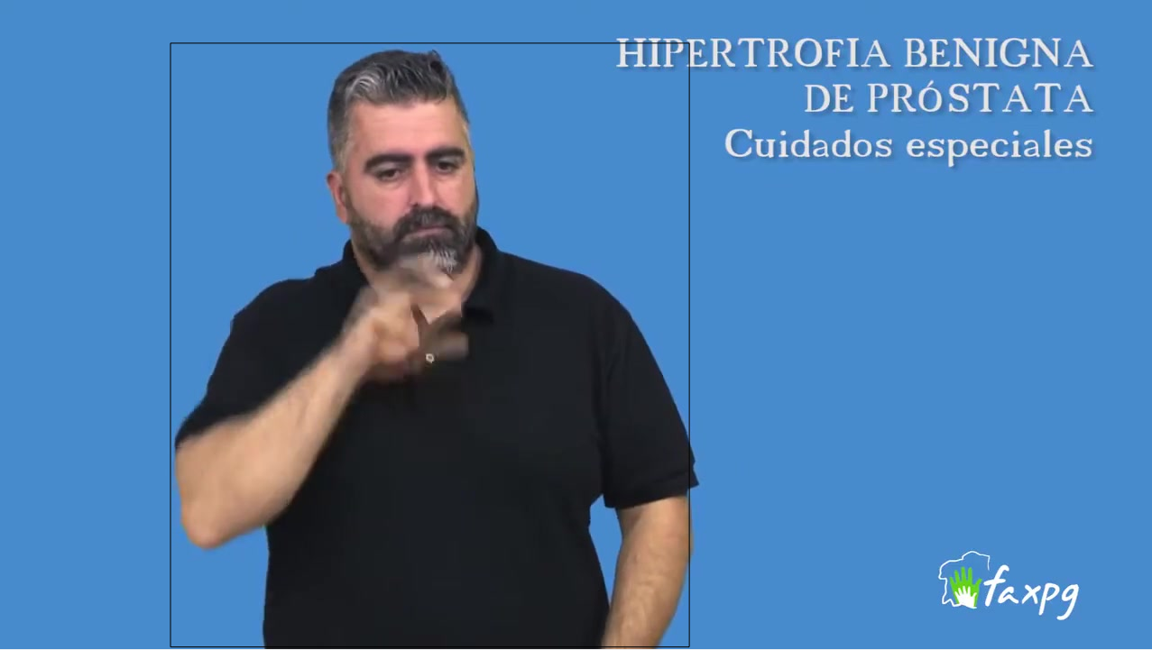
MMPOSE Pose Detectıon
array([190.55792 , 48.425247 , 765.6285 , 718.1713 , 0.99944454], dtype=float32),

Slide 36
Openpose Keypoınt Extractıon
For the training set, each video is processed with OpenPose to detect keypoints (landmarks) for pose, face, left and right hand. A list of keypoint locations and confidence scores are returned.

Slide 37
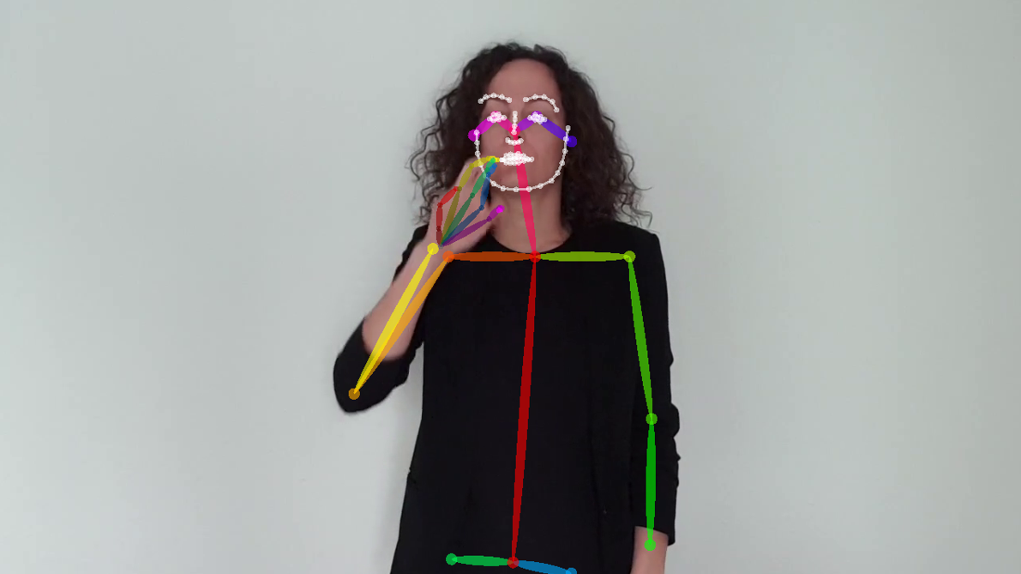
Openpose Keypoınt Extractıon

Slide 38
Cropped Hand Extractıon
Based on pose keypoints, confidence values, original image size, and hand side; bounding box of the hands are determined.
The hands are extracted for further processing.

Slide 39
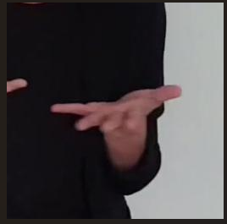
Cropped Hand Extractıon

Slide 40
Feature Extractıon
Previously obtained keypoint information is optimized for extracting pose features.
The extracted features are averaged over a certain number of frames with a specified stride. (Both 1 in our case)

Slide 41
Pose Trımmıng
The pose information extracted before are used to determine the valid data range based on specific conditions, and the results are saved in a text file with the name, start, end, and length information for each file.
This process ensures noisy parts are trimmed from the training videos, increasing the accuracy of predictions.

Slide 42
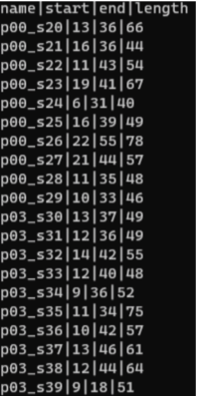
Pose Trımmıng

Slide 43
Fınal predıctıons
Calculates distances between query and test features.
Builds a directed graph to represent alignments.
Determines optimal alignment using the longest path in the graph.
Computes alignment score based on feature distances.

Slide 44



Fınal predıctıons

Slide 45
RESULTS
Dataset: LSE_ESAUDE_UVIGO Spanish Sign Language Dataset
20 isolated sign videos for training (query videos)
607 test sign videos for evaluation
Methodology:
Utilized OpenPose and MMPose for pose detection in query videos
Estimated starting and ending frames of sign performed in query videos
Constructed a graph for test video labeling using a graph construction algorithm
Performance:
Average number of successfully predicted test videos: 360 out of 607
Average F1 score: 0.595802

