Slide 1
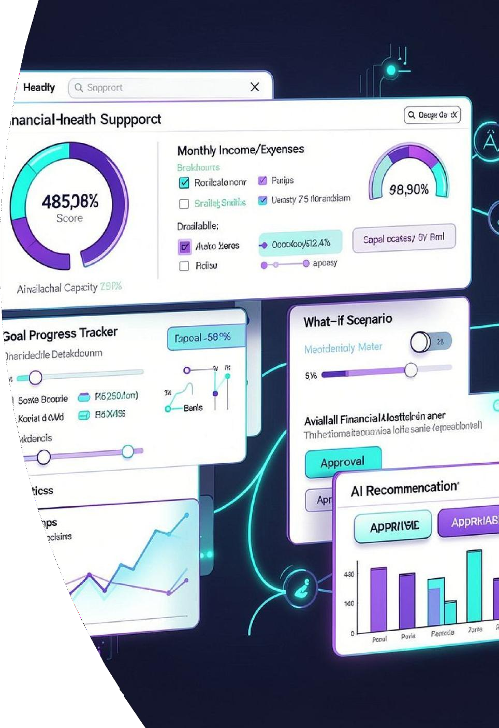





Slide 2








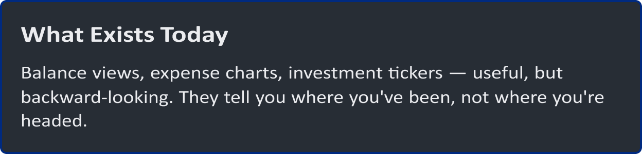
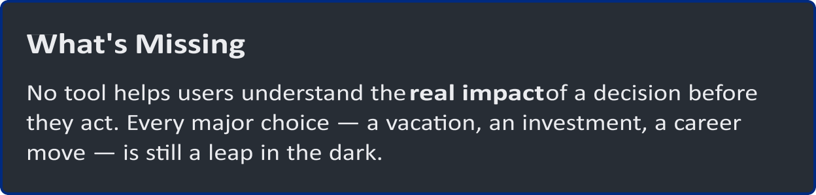

Slide 3















Slide 4
Eight Capabilities. One Unified Platform.
KEY FEATURES
Financial Dashboard
Health overview and goal tracking
Goaí Planning
Milestones and progress tracking
What-If Simulator
Model financial decisions before acting
Lifestyle Impact
Analyze vacations, dining, entertainment
Risk Scenarios
Explore investment outcomes
Startup Lab
Invest vs Build scenario modeling
AI Weaíth Assistant
Conversational financial guidance
Expíainabíe AI
Transparent recommendations with human controls

Slide 6










Slide 7





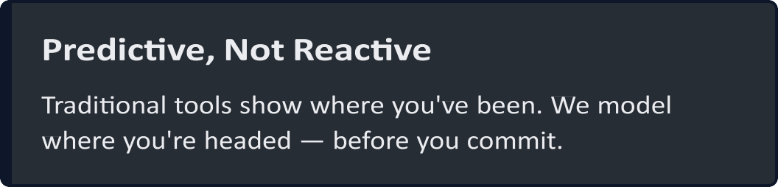
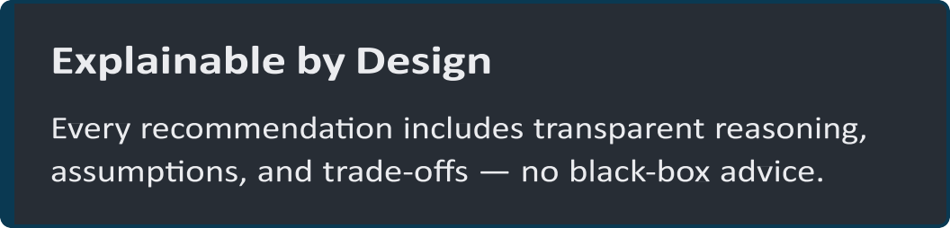
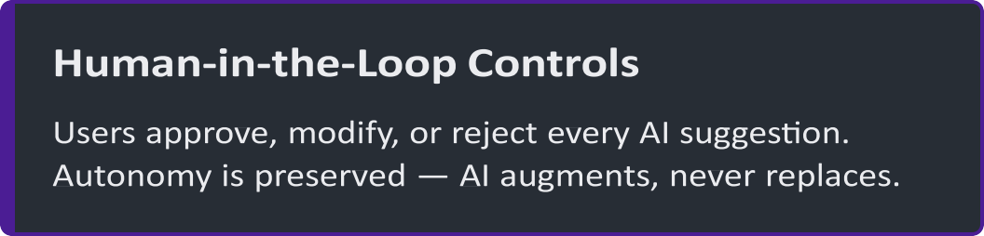
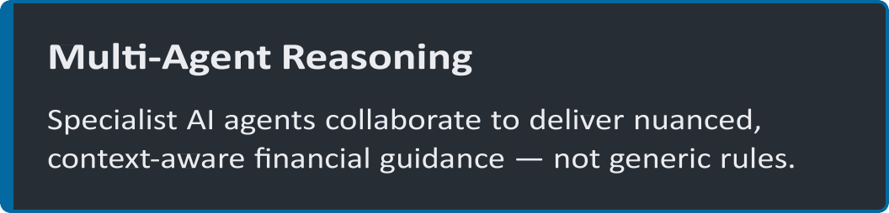

Slide 8




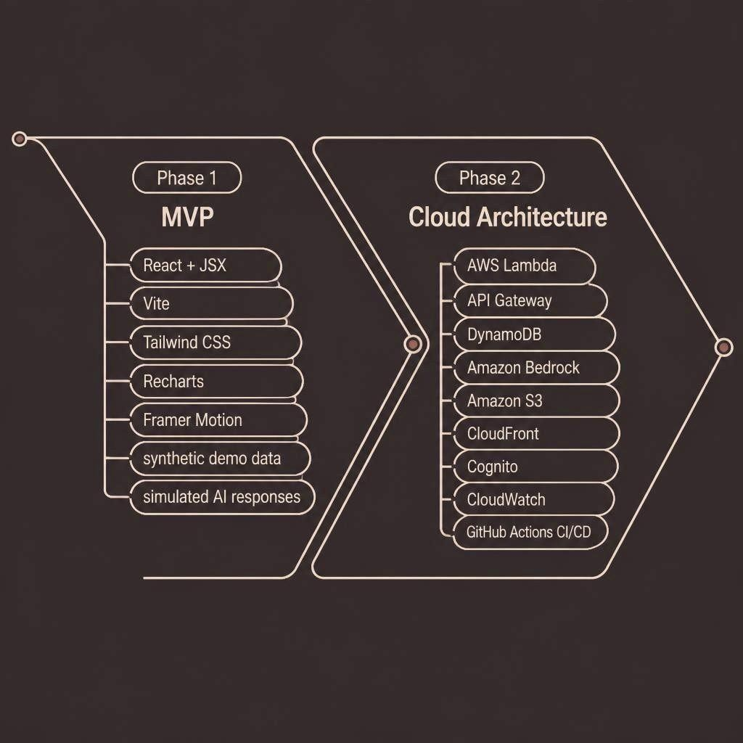


Slide 9




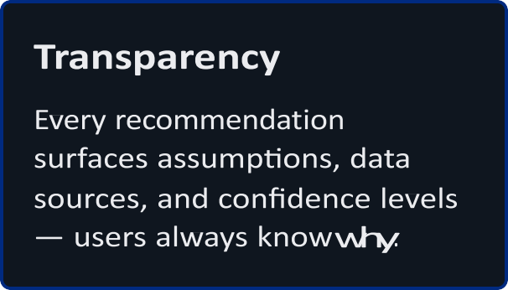
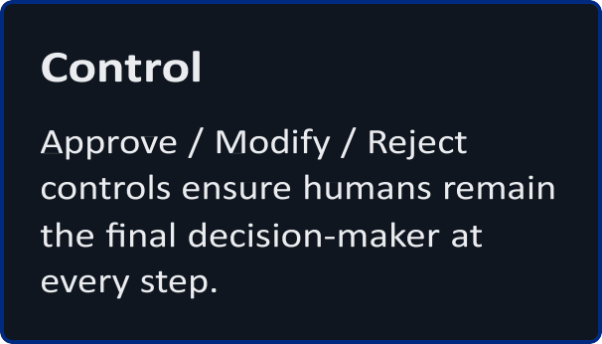


Slide 10
Thank
You

