Slide 1
SDU EDU-PORTAL
An official educational portal of SDU

Slide 2


Modules of Edu-Portal
1.-Web-cameras: In all(?) buildings web-cameras should be installed, so that we can see and check what’s going on in all buildings anytime we want. Also, for people who want to see our university, they can do this by using Internet. Library, dormitories, stadiums, etc.
2.- E-library: Books, journals, magazines are in electronic version. Catalog of these items should be divided according to alphabetical order. Also, students should use request for book in the e-library module. As an example, before coming to pick up the book,they have to order this book from the library,so that they will save their time. In the future, we can connect our system with other related systems of other universities and can try to connect world’s famous libraries.

Slide 3
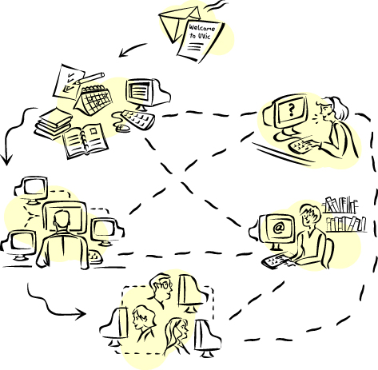
Modules of Edu-Portal
3.- Credit system: In this module, student after the enrollment will apply for courses, drop/withdraw a course, see his/her grades, and get the announcements.
4.- Distance Education: Using a web camera student can study from any place in the world and get the same diploma as the student in the university. Also, professor should post all the lectures and materials related to the course, as video-presentations of lectures, audio-presentations of lectures, lectures, homeworks, assignments, and in this module, should be the section, where student may take online- test and get his result immediately without wasting a time.

Slide 4


Modules of Edu-Portal
5.- Student’s Staff: Archive, Lectures, Homework, Assignments. Also, we can divide this section according to the departments that we have in our University, and post all the projects that have been created in the University previously.
6.- For parents module: This module will enable parents to monitor his/her son/daughter and make a payment for the education. Also, we can build the SMS- service, where we will send an info according to requests for a fee. Ex.:Parent will pay for a sms 150 tg, and will request an info about his kid’s grades, and we will send it by the request.

Slide 5
Modules of Edu-Portal
7. – Research database control for Master and PhD students: here any research made in the university will be stored and shared to the Master and PhD degree students. Also, publications, conference participations, books of our graduate students should be stored in this section. Also, information about conferences should be here (time, date, location, and requirements).
8. – Forum: Here student can ask a question and get an answer to it. A place for students to inter-connect.
9. – FAQ/Support: This module will explain how everything is going and make a support for university users.

Slide 6
Modules of Edu-Portal
10. – Apply online: To make an enrollment, student must go through several stages, and the first stage is English Test. Results of this Test will be stored in a database, and according to the results of a test, student will or will not take a background English class.
11. – Students Life: Every event, news, competitions, tournaments in the university will be placed here.
12. – Schedule: According to the taken credits of students the automated class schedule will be generated, students can see it online or on the digital display board.

Slide 7
Modules of Edu-Portal
13. – Current Students: A person who is still a student of a university can manage his/her resource and make a payment for education.
Also, related to this student info will appear while he/she will login using private information.
14.- Employment opportunity: For companies that are interested in our students.
Will be divided by departments, and also companies will be divided in such groups, as our partners, newcoming company, and so on. Also, by the request of the company, the info of the interested student will be send to this company.

Slide 8
Modules of Edu-Portal
Widescreen Test Pattern (16:9)
15. – Chancellor’s Page: Creating orders, assigning tasks, storing orders in archive, all the documents in the electronic version.
15.1 – Chancellor’s Page: Departments: Preparation of a contingent future student. Creation of groups and assigning teachers to courses. Report about students’ academic achievement.
15.2 – Chancellor’s Page: Administrative Department: Consists of four subgroups:
a) HR(Human Resources). Storing of documents of all employees and reporting about the budget to chancery.
4x3
16x9

Slide 9
Modules of Edu-Portal
b) Accounting: Any fees, and earnings of the all stuff will be calculated and send to the appropriate department.
c) Marketing and Advertisement Department
d) Chancery
16. – Game section: Download games, applications, any programs for your cell phone by sending a sms. We’ll post here all the best applications that have been created by our students and we’ll pay them by the demand their application has.

Slide 10
Modules of Edu-Portal
17.- Algoprog: For programmers, will be the world where they can discuss and solve programming examples. Has been created by the student of Enginnering Department- Ilyin German.
18.- Scientific centers for Researchers: According to departments, info about scientific research centers will be presented in this section.

Slide 11
Modules of Edu-Portal
19.- Advanced search engine: Using this engine, anyone can get the info that is being searched. This engine should be used in E-library section too, where we can make a search by index, by title, by author, by the name of the book, topic, and etc.
20.- Professor’s web-site: Template according to the Department.

