Slide 1
A
♠
♠
N
L
P
A
♠

Slide 2
A
♠
♠
A
♠

Slide 3
A
NLP
♠

Slide 4
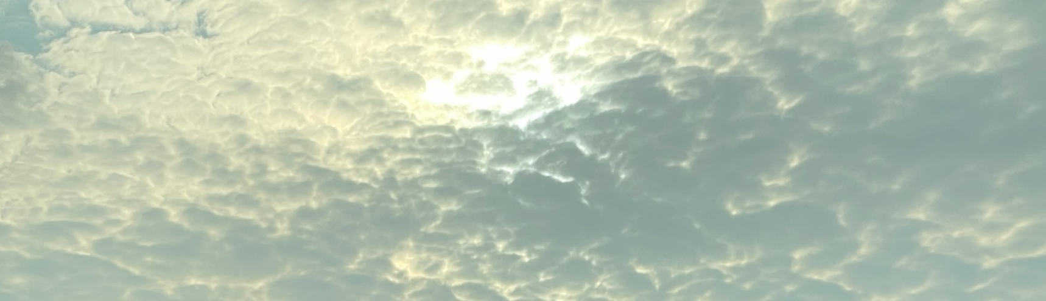
Perplexity
is the beginning of knowledge
Khalil Gibran

Slide 5
Perplexity
is the beginning of knowledge
Khalil Gibran

