Slide 1
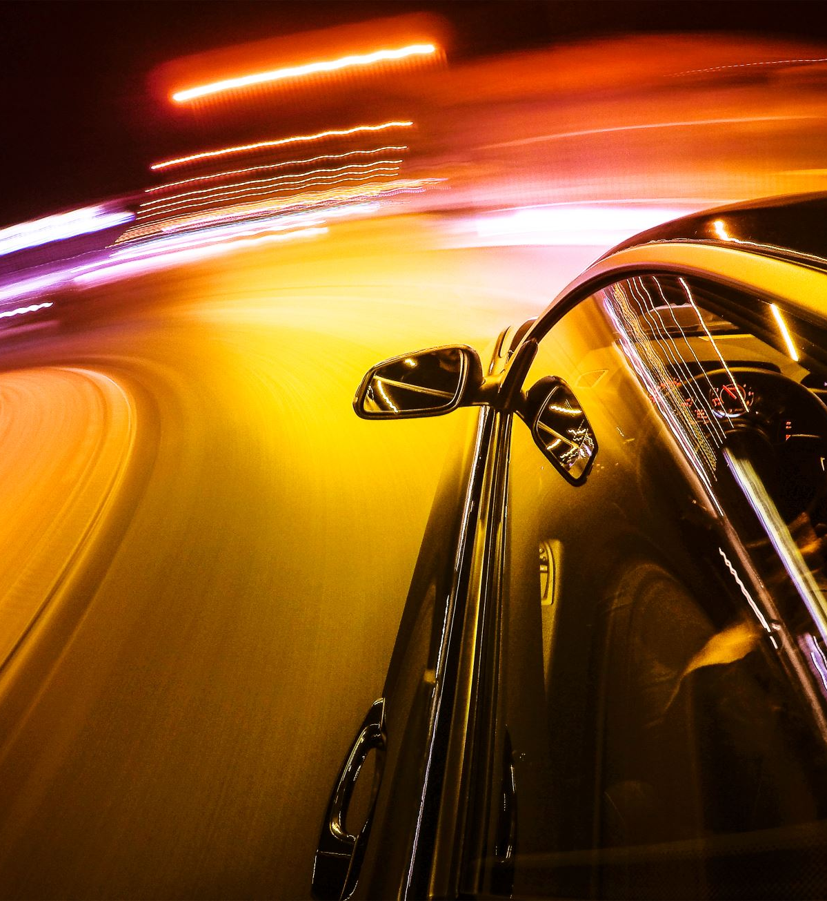
Car detectıon and brand RECOGNITION
Aras Güngöre

Slide 2

ıntroductıon
Aim of this project is to build a robust and accurate machine learning model capable of identifying car brands from digital images.
Utilizing convolutional neural networks, specifically the ResNet50 architecture, we process, learn, and predict car brands.
The ResNet50 model, pre-trained on the ImageNet dataset, provides a strong basis for recognizing complex image features, aiding in the accurate classification of car brands.

Slide 3
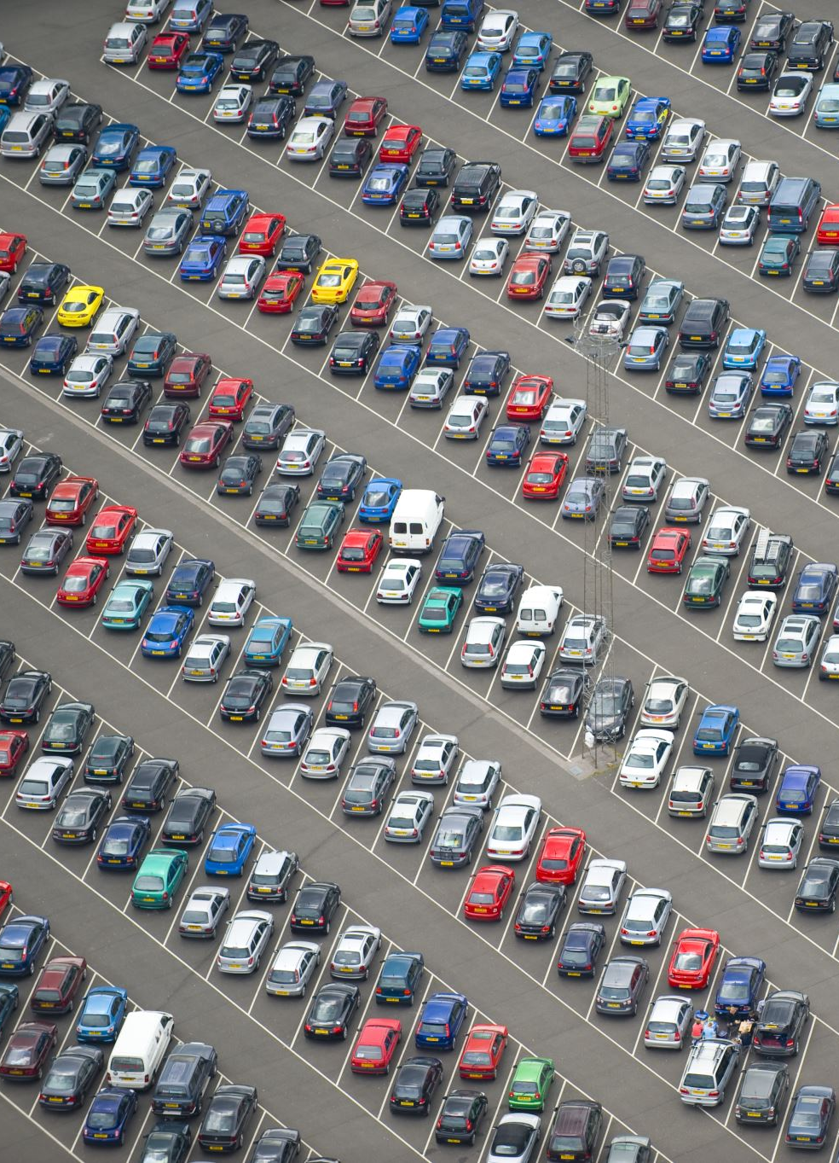
MOTIVATION
With the increasing number of vehicles on the roads, managing traffic and maintaining law and order has become more complex.
Automated car brand recognition systems can play a crucial role in modernizing and improving the efficiency of these tasks.
The project aims to develop a robust and accurate car brand recognition model that can contribute to traffic management, surveillance, security, and law enforcement.

Slide 4
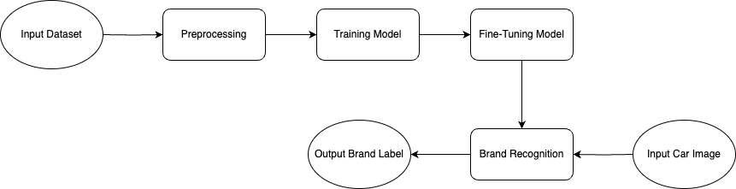
OVERALL DIAGRAM

Slide 5
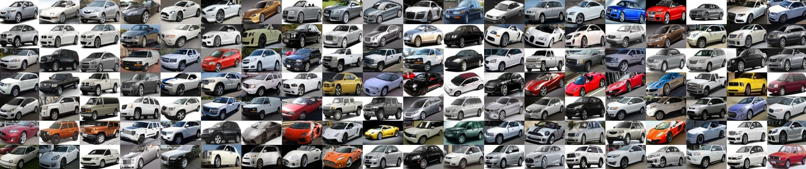
dataset
Our foundation is the Stanford Car Dataset, which consists of over 16,000 images representing 196 classes of cars.
With 8,144 training images and 8,041 testing images, this dataset offers an almost equal representation of each car class in both training and testing sets, ensuring a balanced learning environment for our model.

Slide 6
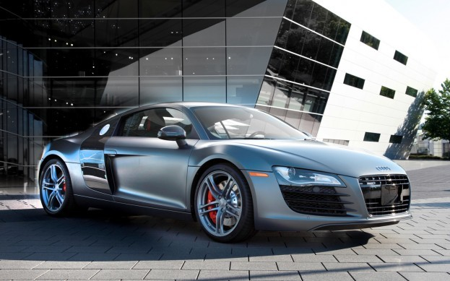
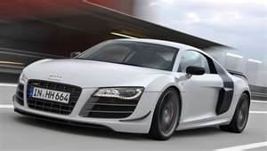
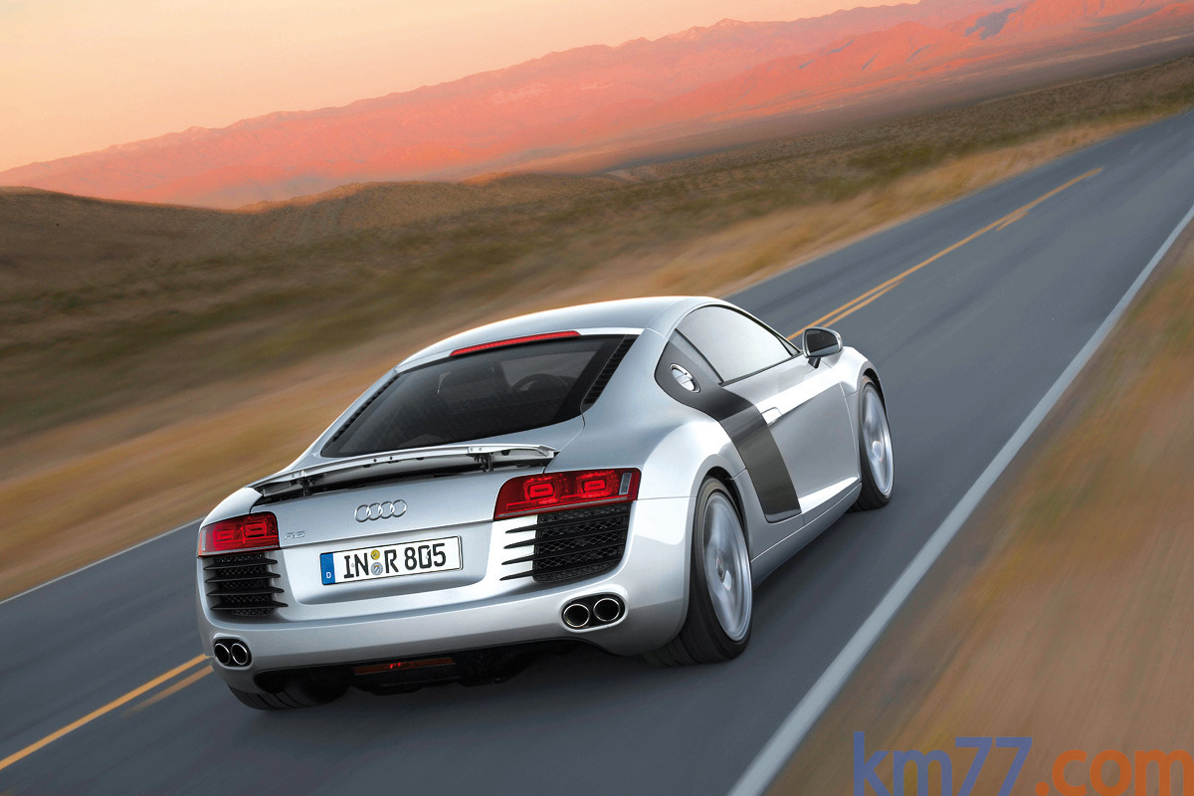
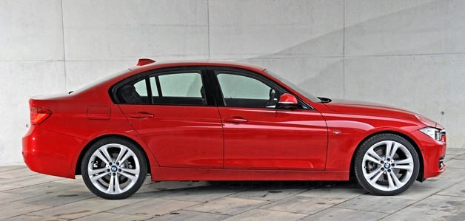
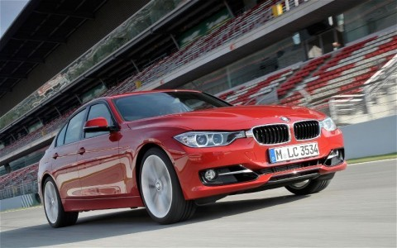
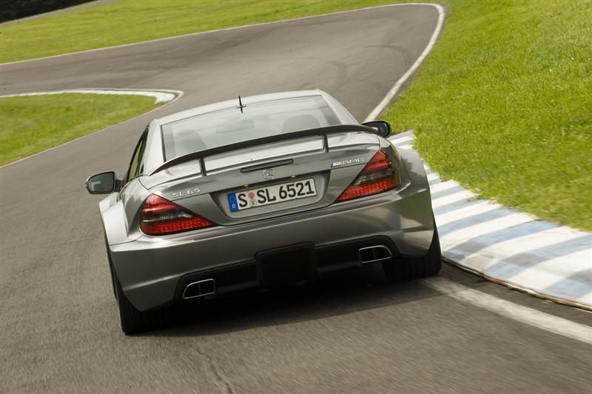
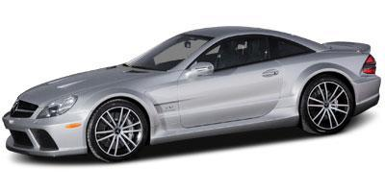
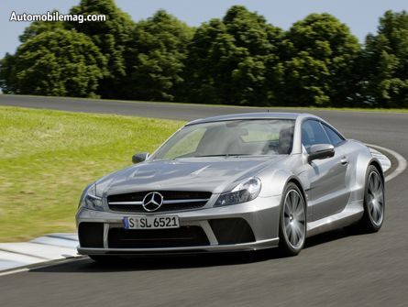
dataset
Audi R8 Coupe 2012
BMW 3 Series Sedan 2012
Mercedes-Benz SL-Class Coupe 2009

Slide 7
PREPROCESSING
Rotation: Each image is rotated by a random amount within the range of -20 to 20 degrees. This helps the model generalize to images where the car may not be perfectly upright.
Zoom: Each image is zoomed in on by up to 10%, which can help the model learn to recognize cars even when they occupy a larger or smaller portion of the image than in the training data.
Width/Height shift: Each image is shifted horizontally and vertically by a random amount up to 10% of the image's width and height, respectively. This helps the model learn to recognize cars even when they're not perfectly centered in the frame.
Normalization for ResNet50: The pixel values are zero-centered by subtracting the mean pixel value of each channel. This mean pixel value is calculated over the whole ImageNet training set. The channel-wise mean to subtract is [103.939, 116.779, 123.68] for BGR. This step is crucial because it makes the input features (pixel intensities) have zero mean, a common preprocessing step for machine learning.

Slide 8
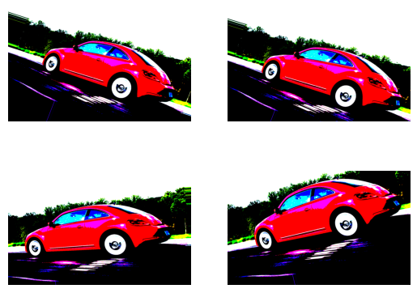
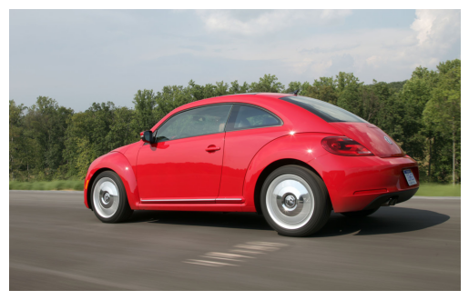
PREPROCESSING
Input Image
Preprocessed Images Over batch_size = 4

Slide 9
Model archıtecture
Our model of choice is the ResNet50, known for its outstanding performance in image classification tasks.
This model contains 50 layers, including convolutions, batch normalization, and ReLU activations, structured in multiple stages each containing a convolution and Identity block.
By using transfer learning, we are able to use the ResNet50 pre-trained on ImageNet as our base model, significantly reducing training time and computational resources.

Slide 10
traınıng
During the training phase, we use the combined training and testing sets from the Stanford Car Dataset to capture a higher performance and a wider variety of car models.
Data augmentation techniques such as rotation, zooming, and horizontal/vertical shifts is used in preprocessing to increase the diversity of the training data and improve the model's ability to generalize.
The model is trained using an Adam optimizer with a learning rate of 0.0001 and categorical cross-entropy as the loss function.
This phase sees the model learn and refine its ability to recognize and classify car brands over a course of 10 epochs.

Slide 11
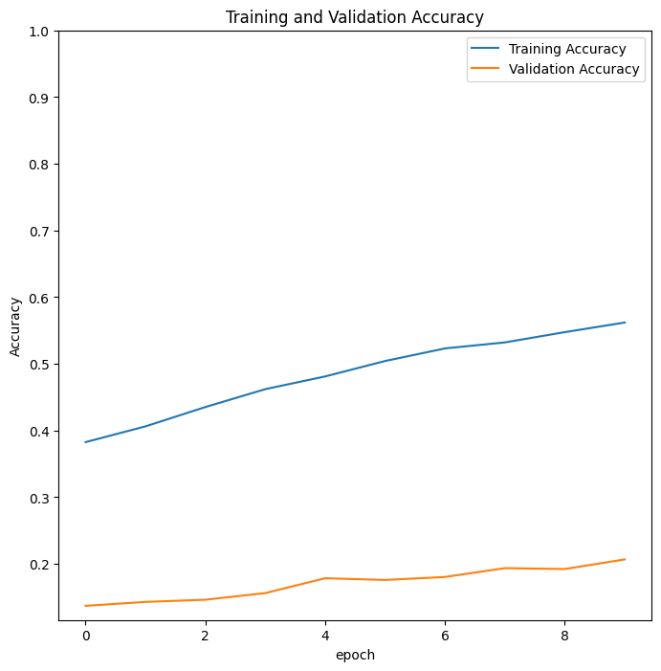
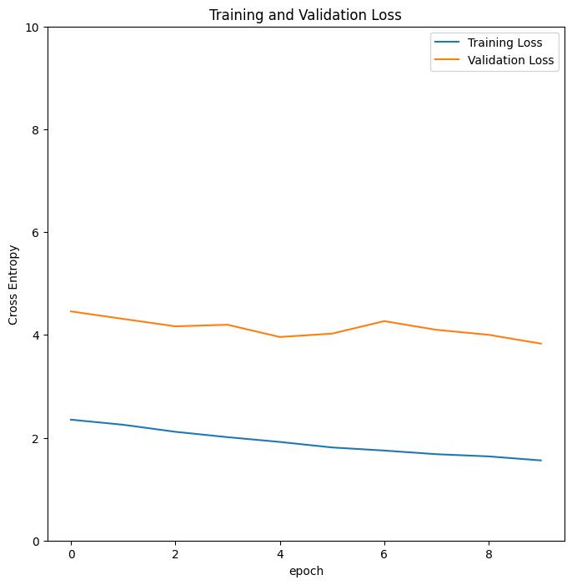
traınıng

Slide 12
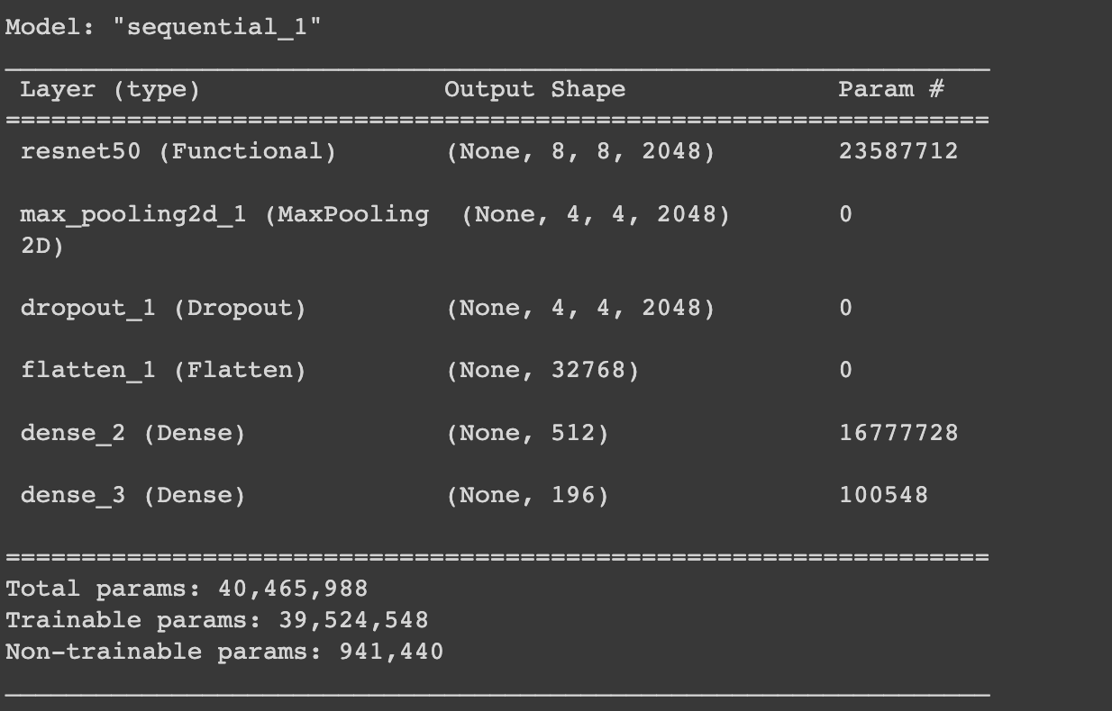
FINE-TUNING
To improve the model's predictive power, we executed a fine-tuning stage.
Here, we unfreeze some of the upper layers of the ResNet model and retrain the model with a 10% reduced learning rate.
This process is aimed at tailoring the model more closely to our specific task of car brand recognition.

Slide 13
FINE-TUNING
The fine-tuned model is a Sequential model that consists of several layers, including the ResNet50 base model, max pooling layer, dropout layer, flatten layer, and two dense (fully connected) layers.
ResNet50 (Functional): This layer represents the ResNet50 base model, which has been pre-trained on a large dataset (ImageNet).
MaxPooling2D: This layer performs max pooling to downsample the feature map obtained from the ResNet50 base model.
Dropout: Dropout is a regularization technique that helps prevent overfitting by randomly dropping 20% of the neurons during training.
Flatten: This layer flattens the 4D feature map into a 1D vector.
Dense: First layer uses the ReLU activation function, second layer uses the softmax activation function to produce probabilities for each class.

Slide 14
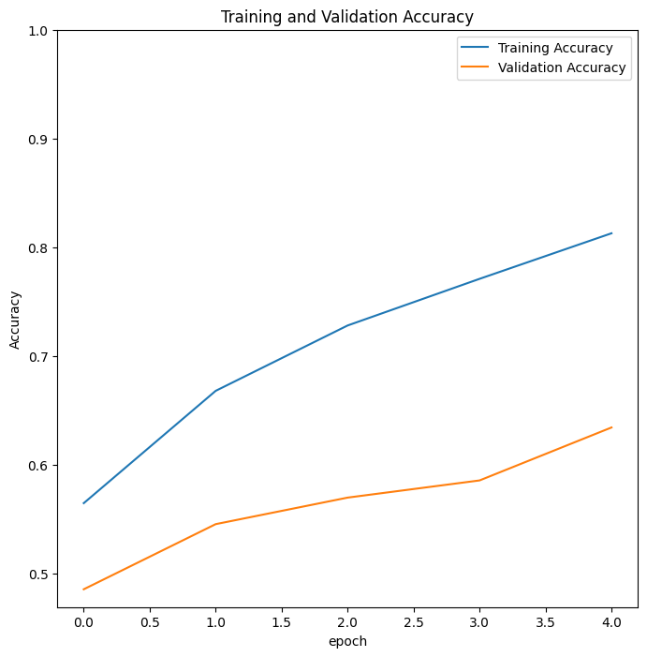
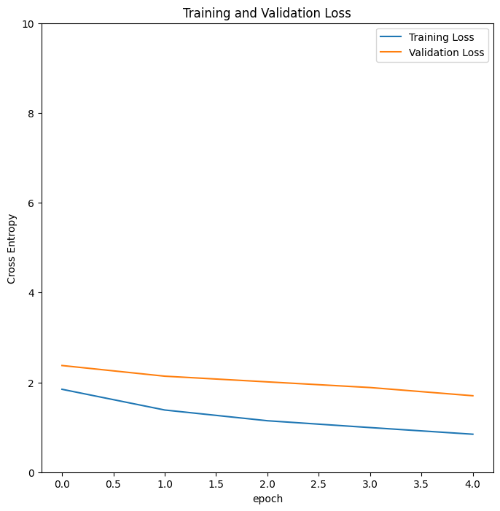
FINE-TUNING

Slide 15
RESULTS
Our model produced impressive results, with accuracy improving consistently over epochs. The effectiveness of our model is demonstrated through its ability to accurately identify car brands from the Stanford Car Dataset.

Slide 16
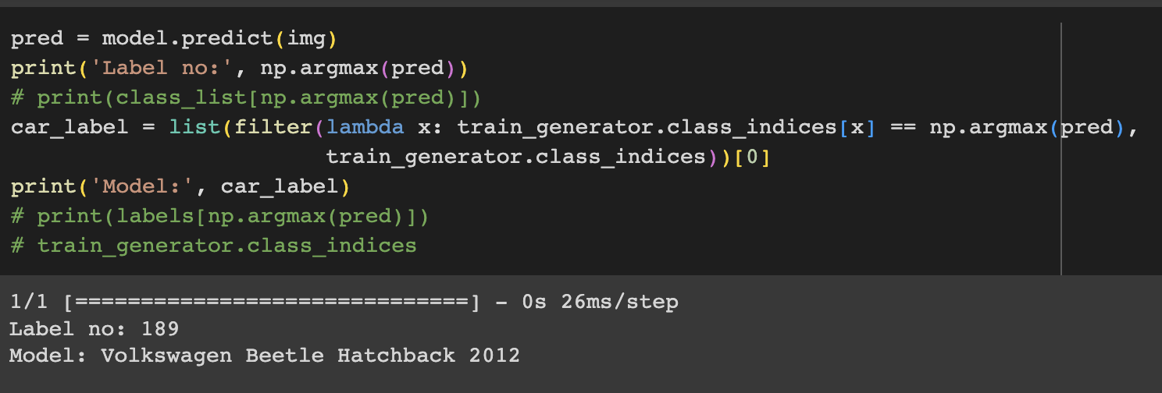
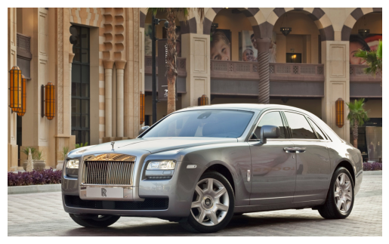
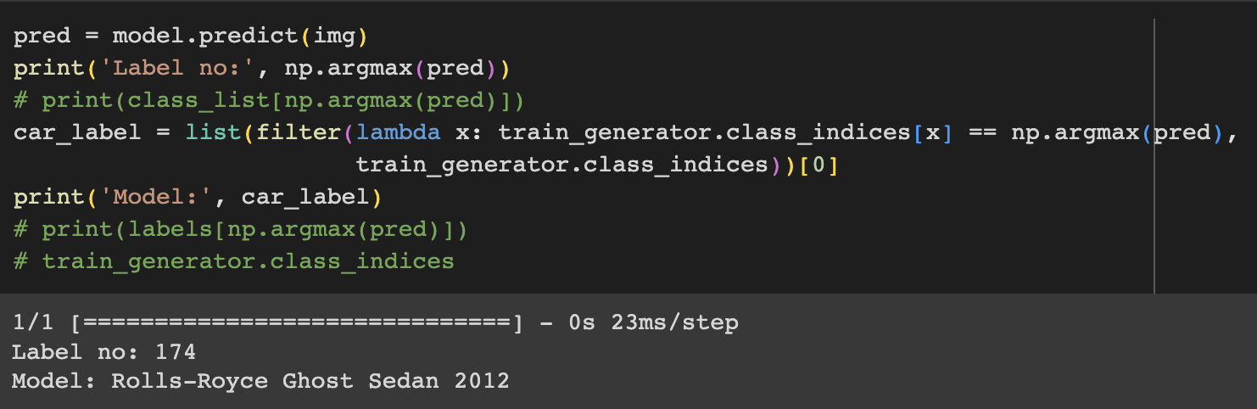
RESULTS

Slide 17
Performance metrıcs
To assess the performance of our model, we utilize a confusion matrix. The confusion matrix provides a detailed breakdown of the model's predictions and actual labels. This evaluation metric gives us insights into how well our model is able to classify different car brands.
In addition to the confusion matrix, we calculate precision, recall, and F1-score for each car brand. Precision measures the accuracy of positive predictions, recall measures the coverage of actual positives, and F1-score balances both precision and recall. By examining these metrics, we gain a comprehensive understanding of the model's performance in terms of both accuracy and class-specific measures.

Slide 18
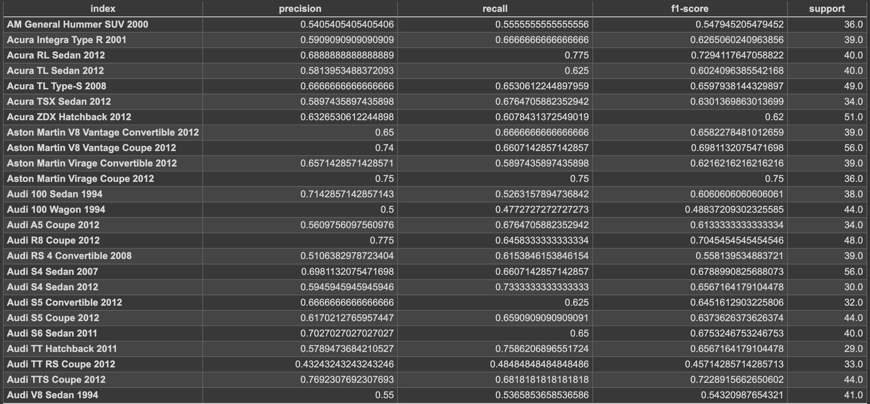
Performance metrıcs

Slide 19
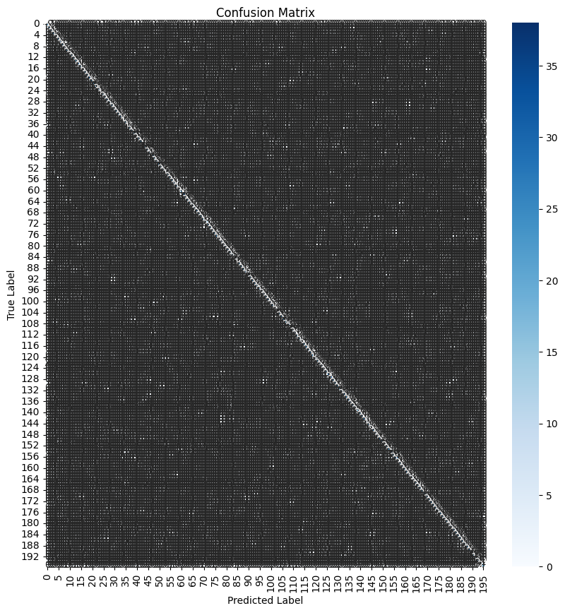
Performance metrıcs

Slide 20
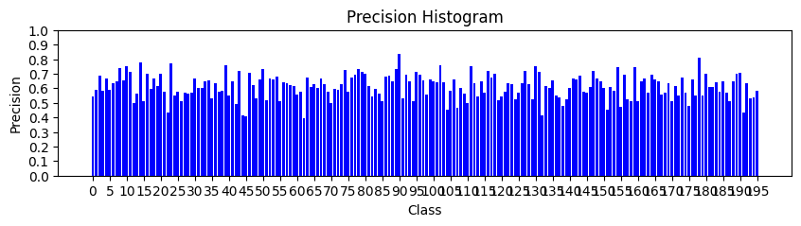
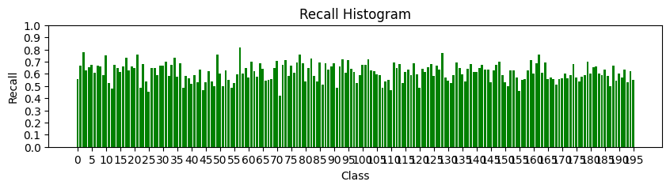
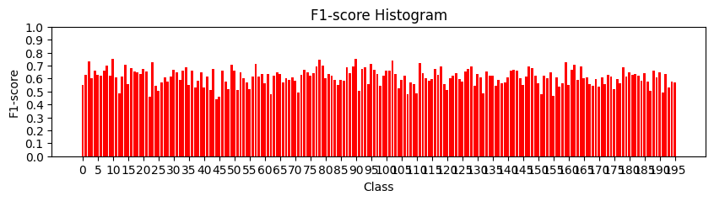
Performance metrıcs

