Slide 1

AKRAMI / CAPSTONE 1
01
CAPSTONE 1 / SALES ANALYSIS
Florida
sales analysis
In-store performance, 2022–2025
Sayaeed Arashullah Akrami
Florida findings and next-quarter recommendations
EmporiUm / Florida in-store sales / 2022–2025
Notes:
5-MINUTE CLASS PRESENTATION
0:00–0:15
Introduce yourself. Florida in-store sales, 2022–2025. Goal: understand performance and recommend next-quarter priorities.
Source: supplied SQL and workbook, Florida in-store sales 2022–2025. Speak from cues in your own words.

Slide 2
AKRAMI / CAPSTONE 1
02
DATABASE AND SCOPE
The data behind my analysis
sample_sales
TABLES I USED
store_sales
Sale amounts, dates, store and product IDs
MySQL database
Florida in-store sales
January 2022–December 2025
store_locations
Store names and states
products
Product details and category IDs
inventory_categories
Product category names
SQL calculates the answers.
Excel PivotCharts show the results.
management
The region for each state
I matched store IDs, product numbers, category IDs and states to connect the tables.
Notes:
5-MINUTE CLASS PRESENTATION
0:15–0:40
CUES: sample_sales / five tables / SQL then Excel
Say naturally: I used the sample_sales database. Sales gives me amounts and dates. Store locations identifies Florida. Products and categories describe what was sold, and management identifies the region. I used SQL for the calculations and Excel for the charts.
Do not read all table descriptions aloud.
Source: supplied SQL and workbook, Florida in-store sales 2022–2025. Speak from cues in your own words.

Slide 3
AKRAMI / CAPSTONE 1
03
01 / REVENUE AND DATES
Four years of Florida in-store sales
HOW I GOT THE RESULT
$3,930,187.55
1. JOIN + WHERE
Connect stores and keep Florida sales.
Total revenue
2. SUM
Add the sale amounts.
JANUARY 1, 2022
THROUGH DECEMBER 31, 2025
11 stores
3. MIN + MAX
28,616 transactions
Find the first and last sale dates.
Notes:
5-MINUTE CLASS PRESENTATION
0:40–1:15
CUES: $3.93M / four years / 11 stores
Explain the result first. Then follow the right-hand SQL steps briefly: connect stores, keep Florida, add sales, find earliest/latest dates.
Source: supplied SQL and workbook, Florida in-store sales 2022–2025. Speak from cues in your own words.

Slide 4
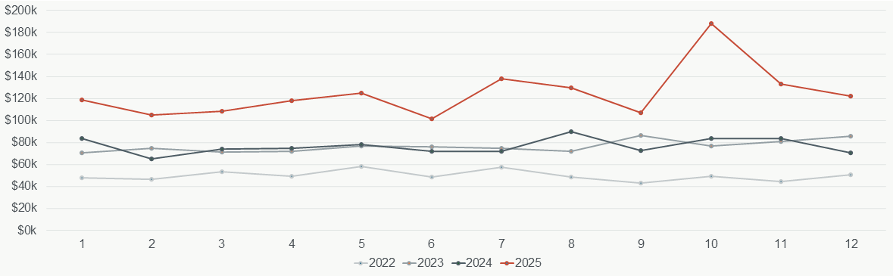
AKRAMI / CAPSTONE 1
04
02 / MONTHLY REVENUE
2025 was the strongest year
HOW I GOT THE RESULT
1. JOIN + WHERE
Connect stores and keep Florida sales.
2. YEAR + MONTH
Identify each sale’s year and month.
3. GROUP BY + SUM
$1.50M
October: $188,215.96
June: $101,328.59
Add sales for each year and month.
2025 revenue
Highest month in 2025
Lowest month in 2025
4. ORDER BY
Sort the monthly results by date.
Notes:
5-MINUTE CLASS PRESENTATION
1:15–1:55
CUES: 2025 strongest / October highest / June lowest
Point to the chart. About $1.50M in 2025. October about $188K, June about $101K. Explain that year/month grouping creates separate monthly totals. Investigate the pattern before planning promotions.
Source: supplied SQL and workbook, Florida in-store sales 2022–2025. Speak from cues in your own words.

Slide 5

AKRAMI / CAPSTONE 1
05
03 / REGIONAL COMPARISON
Florida contributed nearly half of South revenue
HOW I GOT THE RESULT
FLORIDA
SOUTH REGION
1. JOIN
$3,930,187.55
$7,996,850.12
Connect sales, stores and regions.
2. WHERE
Select Florida or the South Region.
3. SUM
49.15%
Florida is included in the South total.
Both figures cover the same period.
Calculate each revenue total.
Notes:
5-MINUTE CLASS PRESENTATION
1:55–2:20
CUES: $3.93M vs $8M / 49.15%
Florida is already part of South. Connect sales to regions, filter for the region, sum sales. Florida contributes nearly half.
Source: supplied SQL and workbook, Florida in-store sales 2022–2025. Speak from cues in your own words.

Slide 6
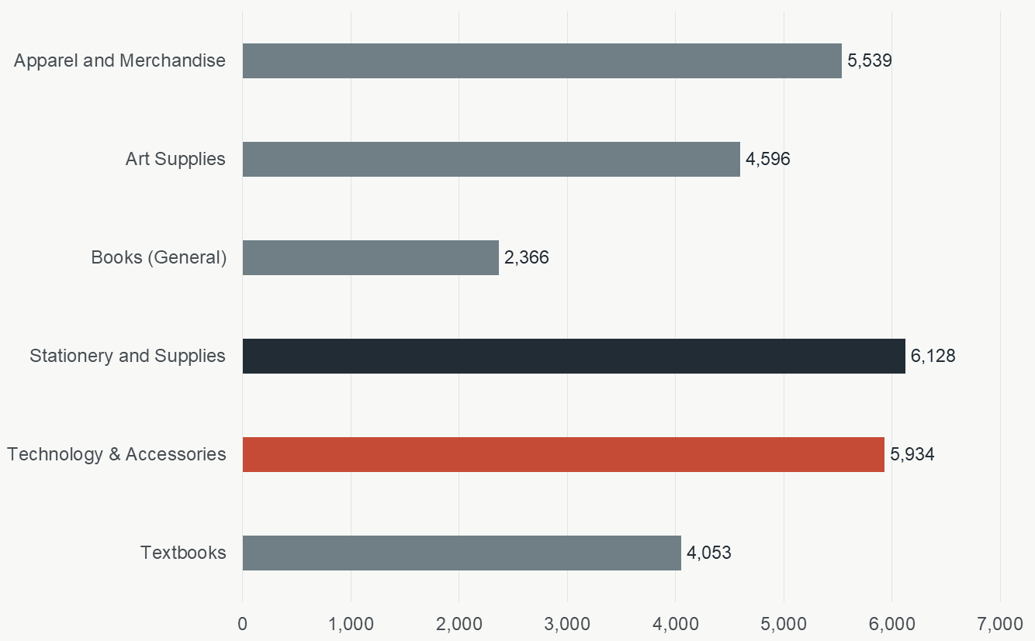
AKRAMI / CAPSTONE 1
06
04 / PRODUCT CATEGORIES
Purchases and average spending
HOW I GOT THE RESULT
A monthly example: January 2022
1. JOIN + WHERE
Category | Avg. sale | Count
Apparel | $30.01 | 66
Art supplies | $31.66 | 63
Books | $27.66 | 20
Stationery | $9.70 | 69
Technology | $435.45 | 75
Textbooks | $168.64 | 61
Identify categories and keep Florida.
2. GROUP BY
Separate each month and category.
3. COUNT(*)
Count the sales records.
Chart: total counts across 2022–2025
4. AVG + ROUND
Calculate average spending to 2 decimals.
Table averages apply to January 2022 only.
Notes:
5-MINUTE CLASS PRESENTATION
2:20–3:00
CUES: Stationery most purchases / Technology highest average
Chart counts span four years. Stationery 6,128. Table is January 2022 only, Technology average $435.45. COUNT counts records, AVG averages spending within each month/category.
Source: supplied SQL and workbook, Florida in-store sales 2022–2025. Speak from cues in your own words.

Slide 7
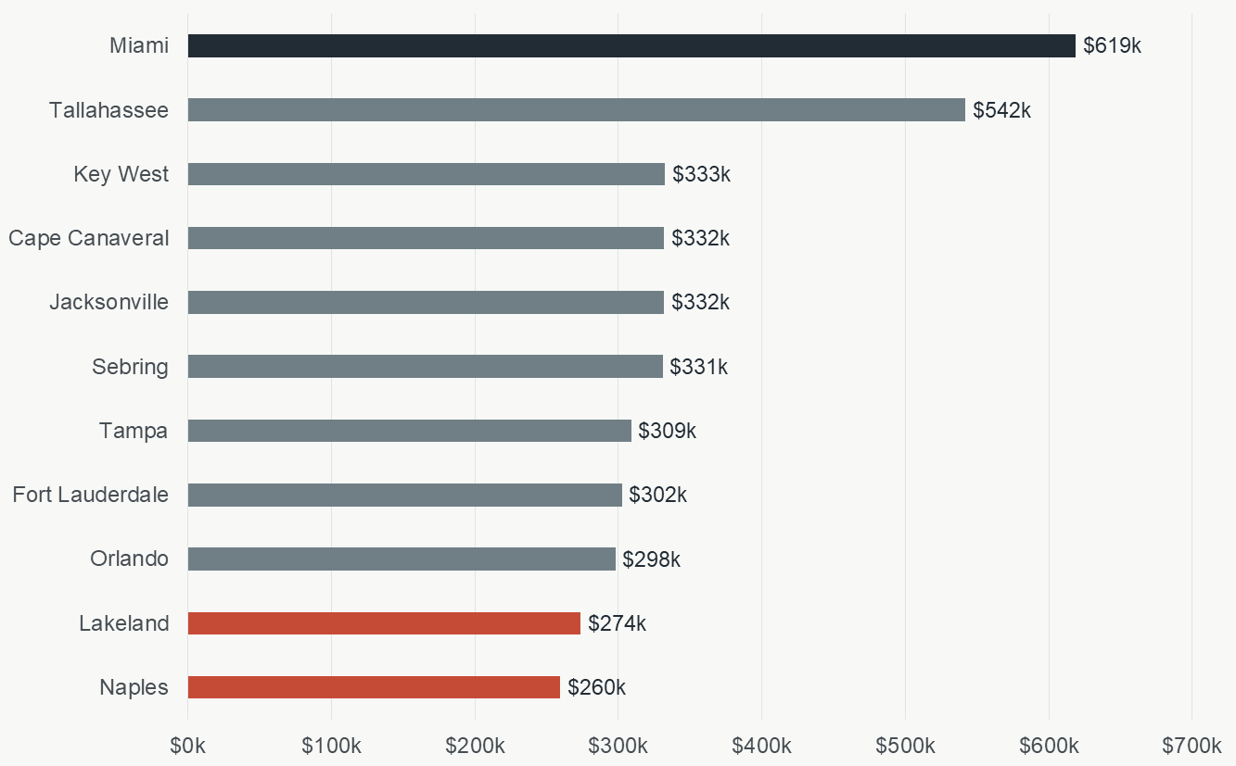
AKRAMI / CAPSTONE 1
07
05 / STORE PERFORMANCE
Miami led. Naples and Lakeland ranked lowest.
HOW I GOT THE RESULT
MIAMI
1. JOIN + WHERE
$618,846.25
Connect stores and keep Florida sales.
NAPLES
2. GROUP BY
$259,602.83
Make a group for each store.
3. SUM
LAKELAND
Add each store’s revenue.
$273,835.24
4. ORDER BY … DESC
Sort revenue from highest to lowest.
Notes:
5-MINUTE CLASS PRESENTATION
3:00–3:40
CUES: Miami leads / Naples and Lakeland lowest
Round figures aloud: Miami $619K, Naples $260K, Lakeland $274K. Group by store, sum sales, sort highest first. Investigate size/location before judging performance.
Source: supplied SQL and workbook, Florida in-store sales 2022–2025. Speak from cues in your own words.

Slide 8
AKRAMI / CAPSTONE 1
08
06 / RECOMMENDATION
What I recommend next quarter
01
02
03
Investigate Naples
and Lakeland
Test promotions in
slower periods
Review technology
stock and offers
Why: Lowest store revenue.
Action: Compare with Miami.
Consider store size and location.
Why: Sales vary by month.
Action: Choose a slower period.
Run a small promotion and compare.
Why: Highest monthly average sale.
Action: Review stock and test
an offer with related supplies.
Check whether revenue, purchase counts and average spending improve.
EmporiUm / Florida in-store sales / 2022–2025
Notes:
5-MINUTE CLASS PRESENTATION
3:40–4:40
CUES: WHY then ACTION
Lowest revenue: investigate Naples/Lakeland and compare with Miami while considering size/location.
Monthly variation: test a targeted promotion in a slower period.
Technology highest monthly average: review stock and test related offers.
Check revenue, purchase counts and average spending after the test.
Source: supplied SQL and workbook, Florida in-store sales 2022–2025. Speak from cues in your own words.

Slide 9
AKRAMI / CAPSTONE 1
09
07 / CONCLUSION
The main findings and next step
$3.93 million
Florida revenue across 2022–2025
Nearly half
Florida’s share of South revenue
Naples + Lakeland
The first stores I would investigate
Next step: investigate the gap, test a small change, and measure the results.
EmporiUm / Florida in-store sales / 2022–2025
Notes:
5-MINUTE CLASS PRESENTATION
4:40–5:00
CUES: $3.93M / nearly half / Naples and Lakeland
Close with those main findings. Next step: investigate the revenue gap, test a focused improvement and measure the outcome. Thank the class.
Source: supplied SQL and workbook, Florida in-store sales 2022–2025. Speak from cues in your own words.

