Slide 1


Bernard Ng¹, Arash Vahdat², Ghassan Hamarneh³, Rafeef Abugharbieh¹
Contact email: bernardn@ece.ubc.ca
¹Biomedical Signal and Image Computing Lab, The University of British Columbia, Canada
²Vision and Media Lab, Simon Fraser University, Canada
³Medical Image Analysis Lab, Simon Fraser University, Canada

Slide 2

Introduction
fMRI Analysis as Pattern Classification
Generalized Sparse Classifiers
  Graph Embedding
  Spectral Regression
  Spatially-Smooth Sparse LDA
Results
Conclusions

Slide 3

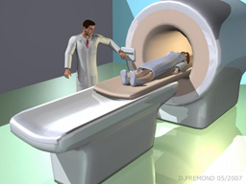
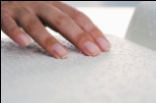
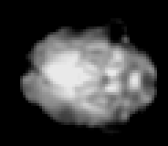
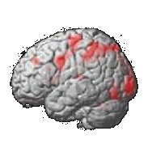
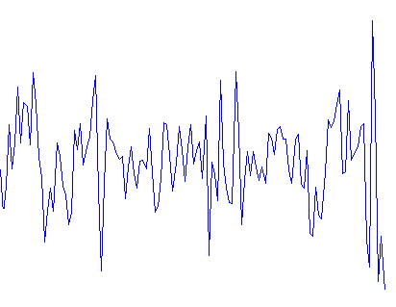
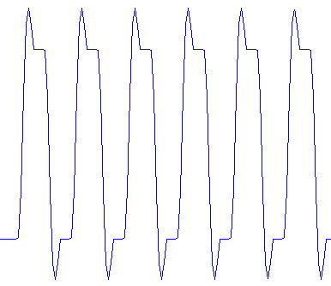

Stim
Stim
…
Rest
Rest
time (s)
…
Pre-processing
Voxel Time Course
≈
Expected Response
Activation Statistics Maps
BOLD Volumes
Introduction

Slide 4


Training Set
…
Test Set
…
A
B
?
time (s)
…
…
…
…
…
Classifier
Patt. Classif’n

Slide 5



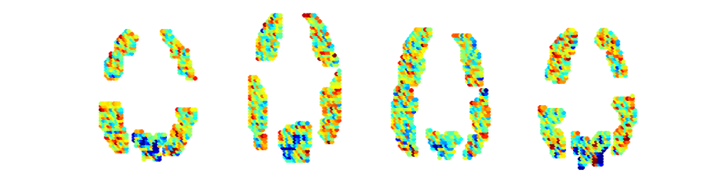
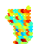
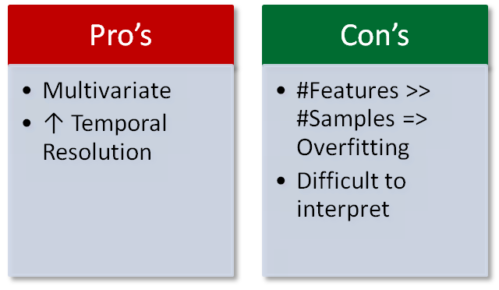

Training Set
Test Set
…
…
…
Sample SVM Weights
Patt. Classif’n

Slide 6







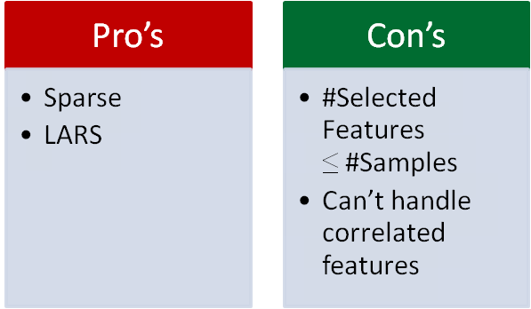



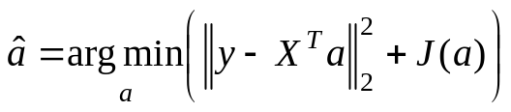

I. Graph Embedding (GE) (Yan et. al, 2007)
Subspace Learning
LDA
PCA
Isomap
Laplacian eigenmap
Locally linear embedding
…
II. Spectral Regression (Cai et. al., 2007)
Find y
Find y = X^{T}a
e.g. LASSO
GSC

Slide 7


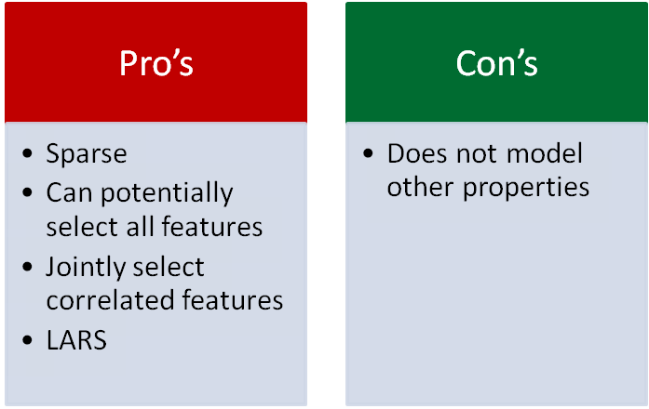
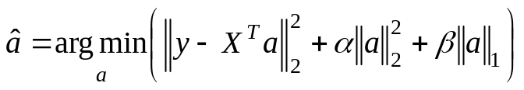

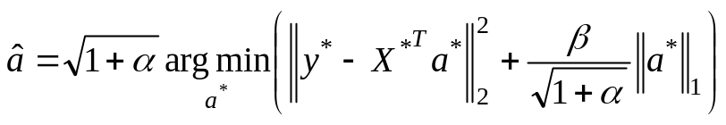

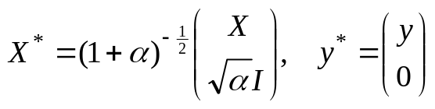


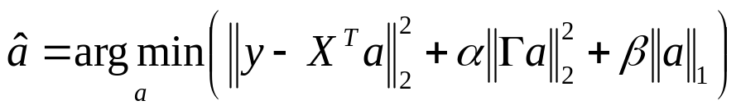
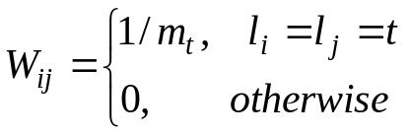

Elastic Nets (Zou et al., 2005)
GSC
SSLDA
Recall GE
GSC

Slide 8


Trial
Stim 1, 4s
Blank, 4s
Stim 2, 4s
Rest, 15s
+
It is true that the star
is below the plus.
*
6 subjects available online, 25 brain regions
40 trials => 320 samples per class
Distinguish pictures from sentences
Comparisons: LDA, SVM, SLDA, EN-LDA, SSLDA
Five-fold cross validation
Results

Slide 9

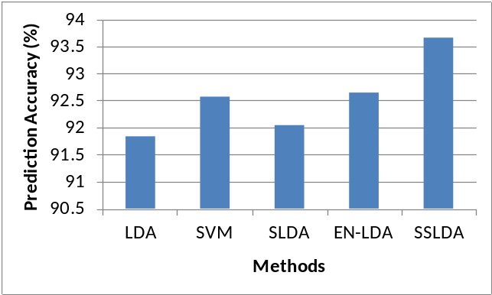
Results

Slide 10

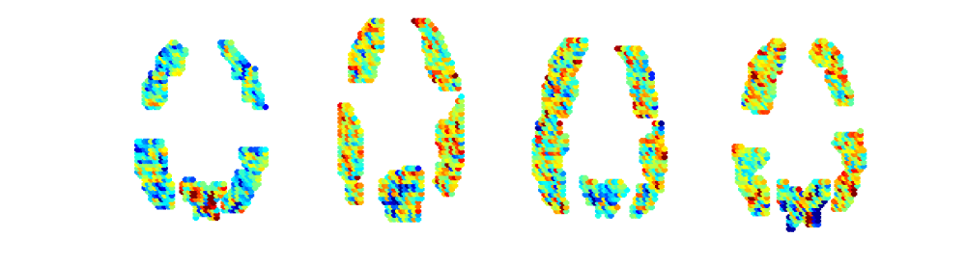
LDA Classifier Weights
SVM Classifier Weights
Results

Slide 11

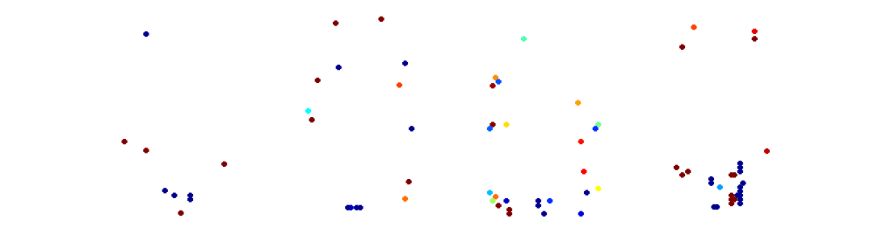
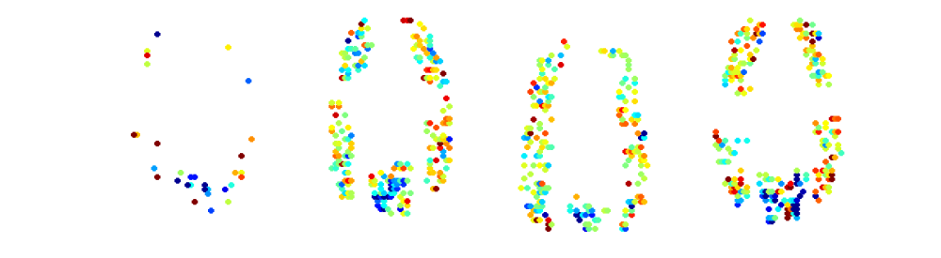
SLDA Classifier Weights
EN-LDA Classifier Weights
Results

Slide 12

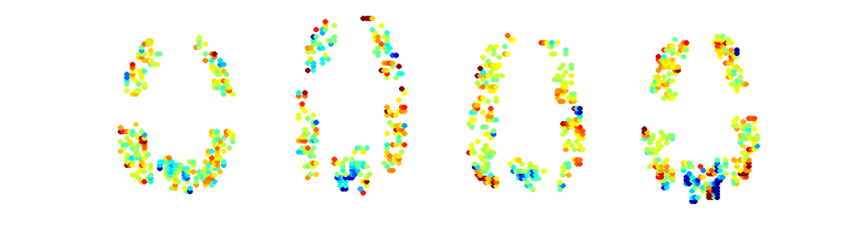
EN-LDA Classifier Weights
SSLDA Classifier Weights
Results

Slide 13

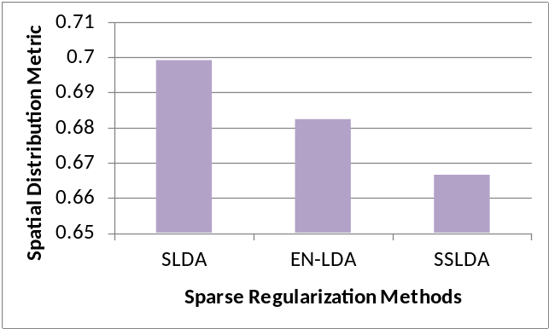



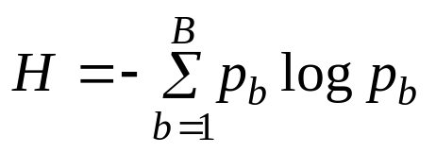

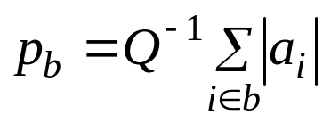
Spatial Distribution Metric (Carroll et al., 2009)
Results

Slide 14


Proposed using GSC for fMRI classification
  Simultaneous sparse feature selection and classification
  Greater flexibility in choice of penalties
Explicitly modeling spatial correlations
  ↑Predictive accuracy
  Neurologically plausible classifier weight patterns
Future Work
  Explore other applications, e.g. spatiotemporal smoothness
Conclusions

Slide 15


