Slide 1
Colour From Grey by Optimized Colour Ordering
Arash Vahdat | Mark S. Drew
avahdat@cs.sfu.ca | mark@cs.sfu.ca
School of Computing Science
Simon Fraser University
November 2010

Slide 2
Outline
Problem definition
Grey to Colour Transformation
Our Solution
Parametric Curve
Optimization
Results
Conclusion

Slide 3
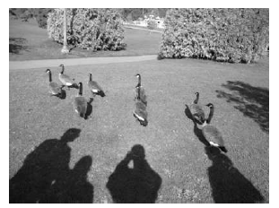
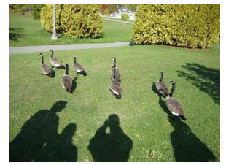
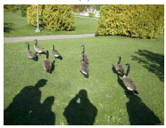
Problem Definition
The problem is to recover colour image from grey level image using the minimum amount of information.
( + extra information )
Encoder Side
Decoder Side

Slide 4


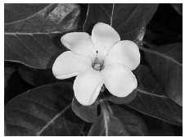
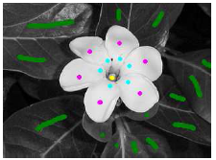
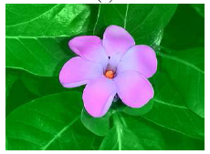
Problem Definition- Cont
Our Problem
Colorization Problem
( + extra information )
* Images from Drew & Finlayson (ICIP 08)
Colour image at encoder side.
No user interaction.
No colour image as input.
Colour hints are provided by human.

Slide 5
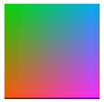

Colour from Grey is Hard!
There are many colours that can be assigned to a single grey level value.
e.g., simple definition from Multimedia:
Y’= 0.299 R’ + 0.578 G’ + 0.114 B’
u=(0.299,0.587,0.114)
Y’
RGB to Grey
G
B
R

Slide 6
Solution
Assume each grey level value represents particular fixed point in colour space.
c
Encoder: Colour to Grey
For each pixel in colour image we assign grey value of closest fixed point in colour space as its grey value.
d
g+1
b
a
g
G
B
g-1
(r_{d} ,g_{d} ,b_{d} )
g
g-1
R
Decoder: Grey to Colour
For each grey value use designated colour for that value.
RGB | Grey
r_{a} ,g_{a} ,b_{a} | g-1
r_{b} ,g_{b} ,b_{b} | g
r_{b} ,g_{b} ,b_{b} | g+1
g-1
(r_{a} ,g_{a} ,b_{a} )

Slide 7
Problems
Our Solution: A Parametric Curve
Both procedures in Encoder and Decoder add error to recovered colour image.
(r_{d} ,g_{d} ,b_{d} )
g
g-1
(r_{a} ,g_{a} ,b_{a} )
minimize error by tuning parameters
We need to encapsulate colour lookup table with the data, which is overhead.
attach a few parameter

Slide 8
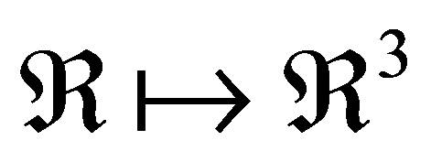
Parametric Curve:
C(g) : maps grayscale values to colour points.
The curve should traverse different regions of colour space.
perceptual colour difference is reflected well in CEILAB Colour space.
u=(0.299,0.587,0.114)
c
c
g+1
b
g+1
a
g
b
g
G
L*
a
B
g-1
b*
g-1
R
a *

Slide 9
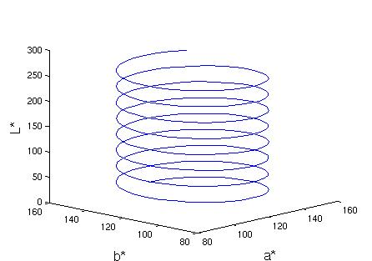
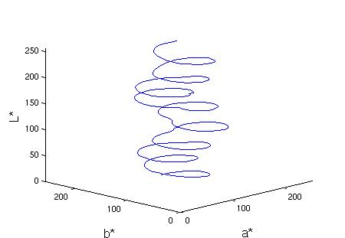
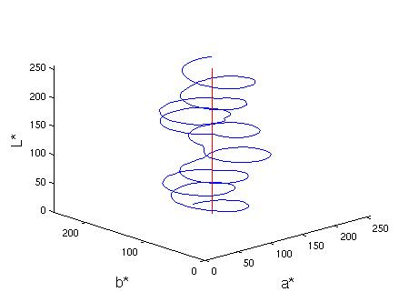
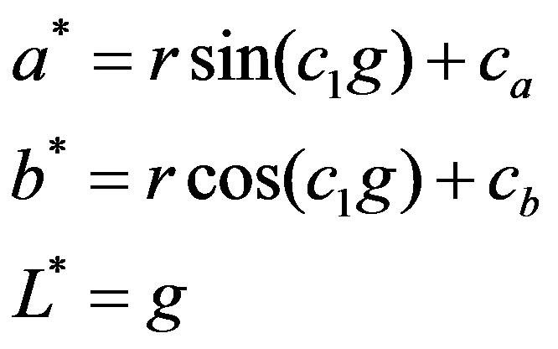
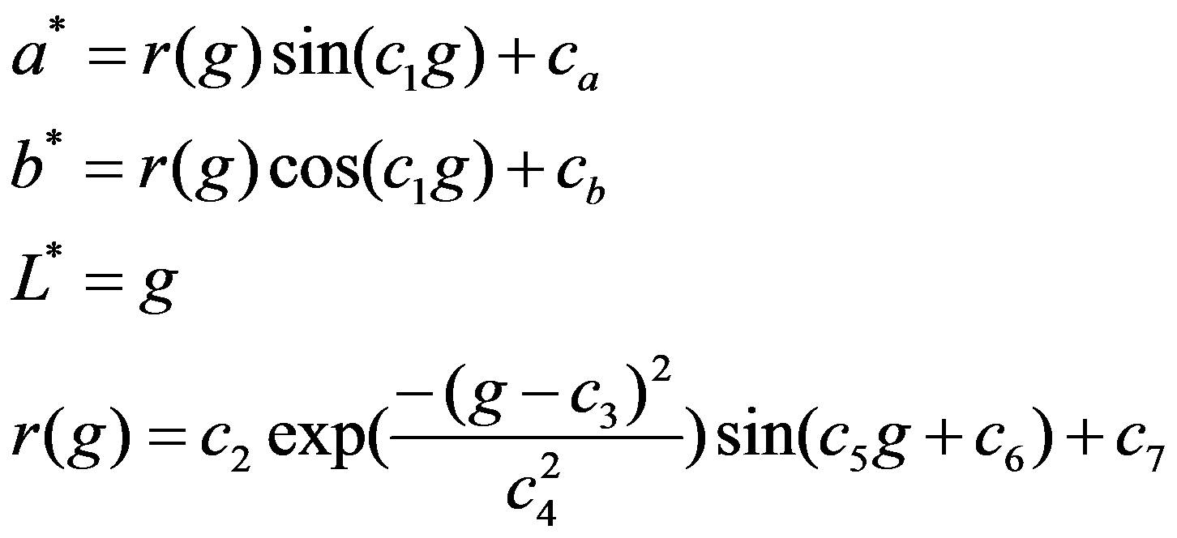
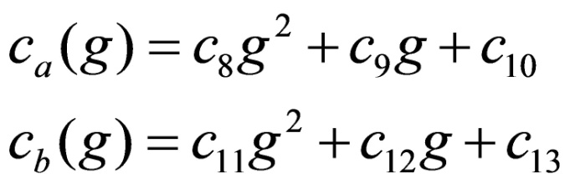
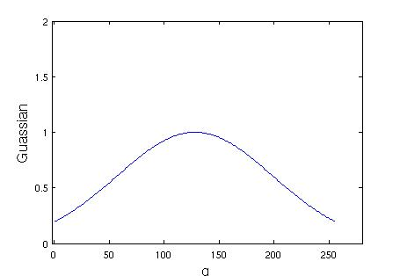
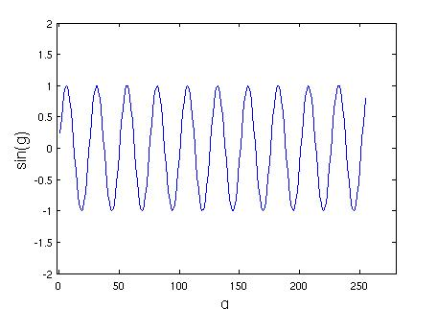
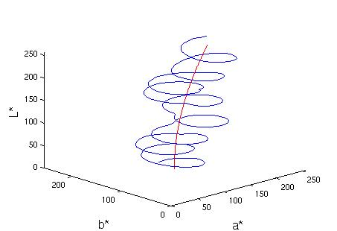
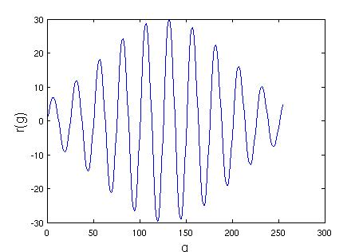
Parametric Curve:

Slide 10
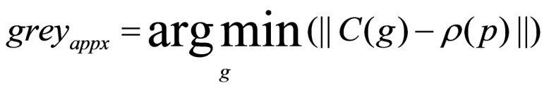


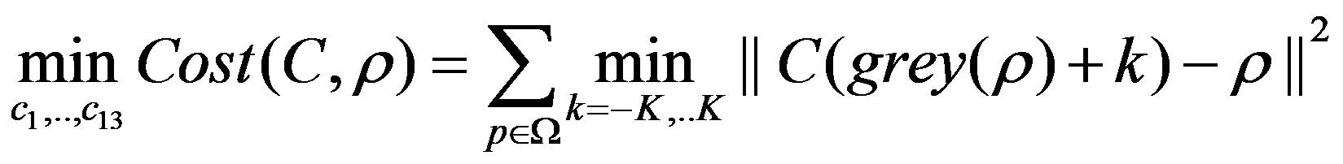
Optimization
Colour to Grey:
for pixel p with colour ρ(p) approximated grey scale value is:
Grey to Colour:
use the corrospondonding colour point on the curve.
Minimize Error:

Slide 11
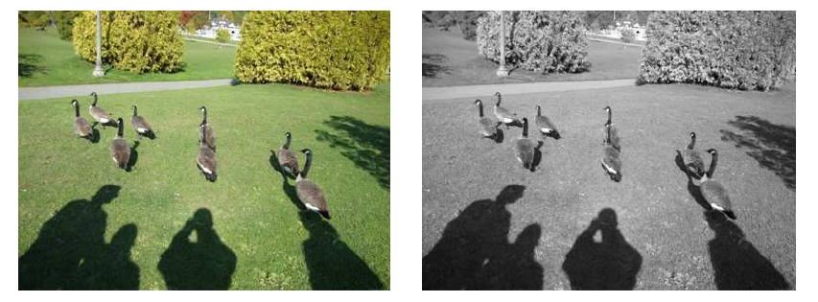
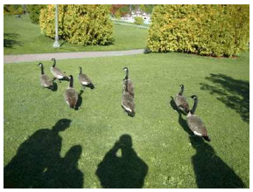
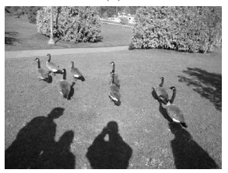
Results
input image
grey level image
our recovered colour image
our grey level image

Slide 12
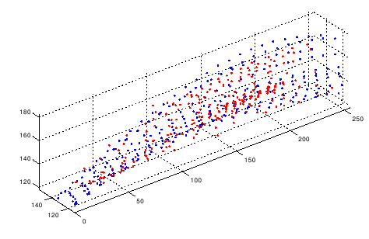
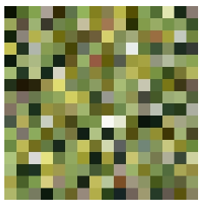
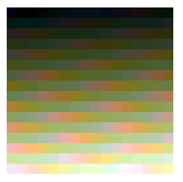
Results
L*
b*
a*
Gamut encompassed by parametric curve
GIF palette
Ordered Colours
along the curve

Slide 13
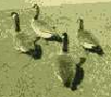
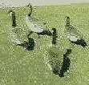
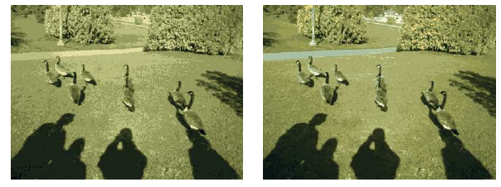
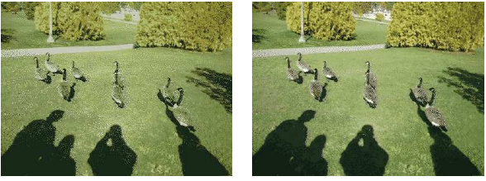
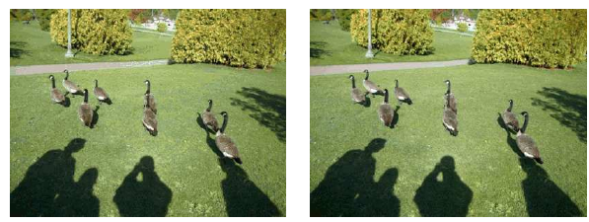
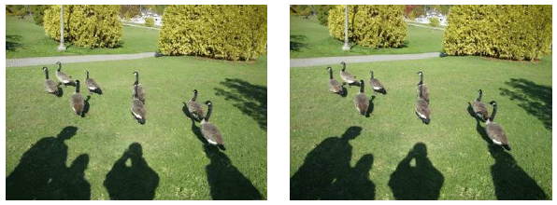
Results
GIF
our method
3 bits
4 bits
3 bits
4 bits
6 bits
8 bits
6 bits
8 bits

Slide 14
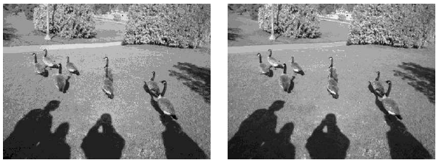
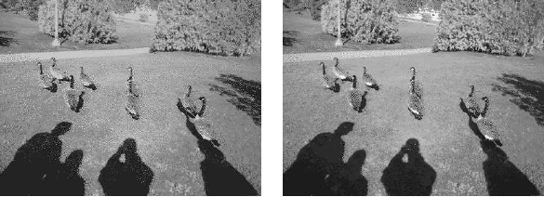
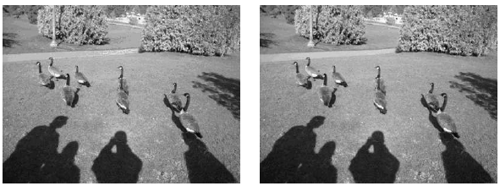
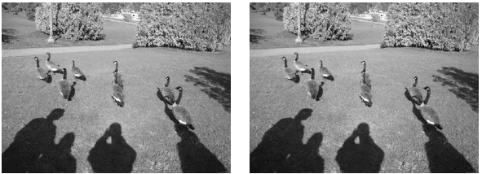
Results
our method
GIF
3 bits
4 bits
3 bits
4 bits
6 bits
8 bits
6 bits
8 bits

Slide 15
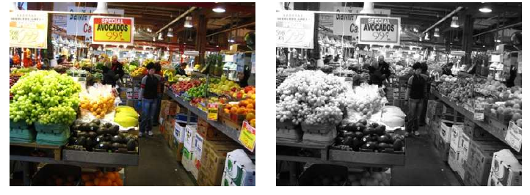
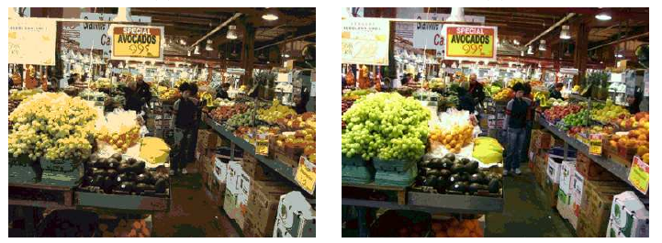
Results
input image
grey image
Colour output with 4 bpp
Colour output with 8 bpp

Slide 16
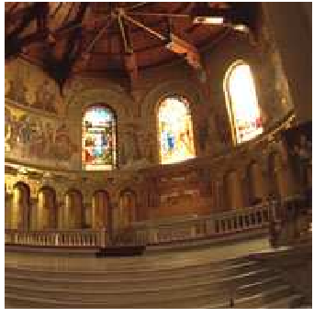
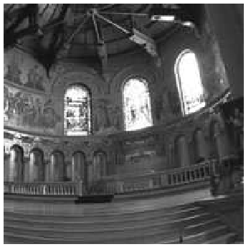
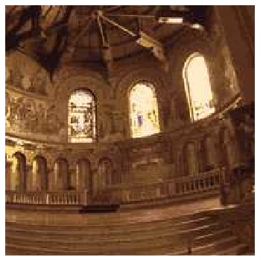
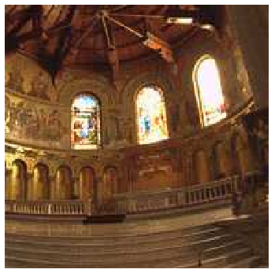
Results
input image
grey image
Colour output with 4 bpp
Colour output with 8 bpp

Slide 17
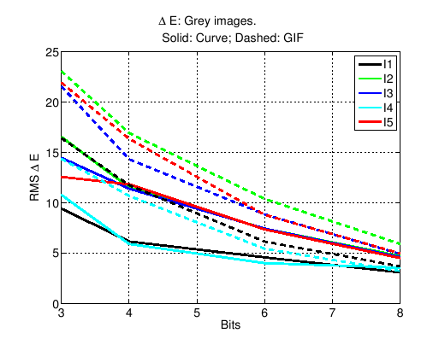
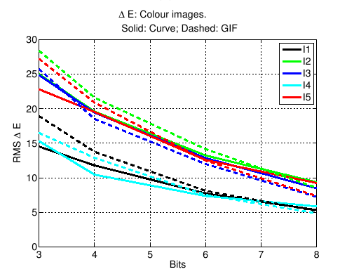
CIELAB errors
Grey image
Colour image

Slide 18
Conclusions
We propose a novel method to reconstruct colour from greyscale images, by optimizing a mapping from greyscale to colour using a parametric curve.
Almost always, grey version is better than GIF.
The colour image has comparable or lower error especially for low bitrate.
Future work:
non-constant quantization rate.
different curve form.

Slide 19


Questions?
Thank you.
Thanks!
To Natural Sciences and
Engineering Research Council of Canada

