Slide 1
Traffic Prediction using GNNs and
Graph Transformers
Course: MA-INF 4325 Lab Data Science in Practice: Spatio-Temporal Data Analytics, Summer Semester 2025
Team: Hitik Panchal, Haofan Wen, Arash Astanboos
My Role: Implemented and evaluated GraphTransformer and GPS models for traffic speed regression
Supervisor: Dr. Rajat Dadwal, Amitoz Azad
Date: July 2025
Notes:
"Good morning/afternoon, everyone. My name is [Your Name] and my matriculation number is [Your Matriculation Number]."
• "Today, I'll be presenting our work on 'Traffic Prediction using GNNs and Graph Transformers', conducted as part of the MA-INF 4325 Lab Data Science in Practice: Spatio-Temporal Data Analytics, in Summer Semester 2025."
• "Our team consisted of myself, Hitik Panchal, and Haofan Wen."
• "My specific focus within this project was on the implementation and evaluation of the GraphTransformer and GPS models for node-level traffic speed regression."

Slide 2
Introduction & Problem
Traffic Forecasting:
Crucial for urban planning & congestion management
Notes:
• "Traffic forecasting is a critically important task for modern urban planning, enabling efficient transportation systems and helping to mitigate congestion and its environmental impact."

Slide 3
Introduction & Problem
Traffic Forecasting:
Crucial for urban planning & congestion management.
Challenges:
Non-Euclidean road networks, complex spatio-temporal dependencies. Traditional DL struggles with irregular topology.
Notes:
"However, this task presents unique challenges. Road networks are inherently non-Euclidean, and traffic signals exhibit complex spatio-temporal dependencies. Traditional deep learning architectures, like CNNs or RNNs, often struggle to effectively model these irregular topologies and long-range spatial dependencies."

Slide 4
Introduction & Problem
Traffic Forecasting:
Crucial for urban planning & congestion management.
Challenges:
Non-Euclidean road networks, complex spatio-temporal dependencies. Traditional DL struggles with irregular topology.
Our Solution:
Graph Neural Networks (GNNs) and Transformer-based models capture spatial & temporal dynamics
Notes:
"In response, Graph Neural Networks and, more recently, Graph Transformers, have emerged as powerful alternatives. They offer a unified framework to integrate both structural information and temporal dynamics, making them well-suited for traffic prediction.

Slide 5
Introduction & Problem
Project Scope:
Benchmarked five GNNs and three Transformer variants (Graphormer, GraphTransformer, GPS) on METR-LA & PEMS-Bay. Explored custom adjacency matrices and temporal granularities.
Notes:
Our project aimed to benchmark the performance of five classical GNN architectures and, crucially for my part, three Transformer variants: Graphormer, GraphTransformer, and GPS, on two widely-used traffic datasets: METR-LA and PEMS-Bay.“
We also investigated the impact of different graph structures by generating four custom adjacency matrices, and explored various temporal granularities."

Slide 6
Graph Transformers for Traffic
Inspiration:
Success of Transformers in NLP/CV
Notes:
"My individual contribution focused on the Graph Transformer and GPS models. These models are inspired by the immense success of Transformers in areas like natural language processing and computer vision.

Slide 7
Graph Transformers for Traffic
Inspiration:
Success of Transformers in NLP/CV
Core Idea:
Integrates self-attention with graph structures
Notes:
Their core idea is to integrate self-attention mechanisms directly with graph structures to learn powerful feature representations."

Slide 8
Graph Transformers for Traffic
My Models: GraphTansformer and GPS (General, Powerful, Scalable)
My Models:
GraphTransformer and GPS (General, Powerful, Scalable)

Slide 9
Graph Transformers for Traffic
My Models: GraphTansformer and GPS (General, Powerful, Scalable)
My Models:
GraphTransformer and GPS (General, Powerful, Scalable)
  GraphTransformer: Generalises Transformers; uses edge-aware attention & random walk positional encodings (RWPE)
  Dwivedi, V.P., Bresson, X.: A generalization of transformer networks to graphs. arXiv preprint arXiv:2012.09699 (2021), https://arxiv.org/abs/2012.09699
Notes:
Specifically, I worked with GraphTransformer, which extends the Transformer concept to graph data by combining attention with positional encodings derived from random walks, and it supports edge-aware attention.

Slide 10
Graph Transformers for Traffic
My Models: GraphTansformer and GPS (General, Powerful, Scalable)
My Models:
GraphTransformer and GPS (General, Powerful, Scalable)
  GraphTransformer: Generalises Transformers; uses edge-aware attention & random walk positional encodings (RWPE)
  GPS: Hybrid architecture; combines local message passing (GNN layers) with global attention. Scales efficiently, preserves expressive power.
  Rampášek, L., Galkin, M., Dwivedi, V.P., Wolf, T.: Recipe for a general, powerful, scalable graph transformer. Advances in Neural Information Processing Systems 35, 14501–14515 (2022)
Notes:
"And the GPS model, short for 'General, Powerful, Scalable', which employs a hybrid architecture combining local message passing, similar to GNN layers, with global attention blocks. This design aims for efficiency on large graphs while maintaining expressive power."

Slide 11
Model Adaptation & Inputs
Task:
Node-level traffic speed regression: predict next 12 time steps for each sensor
Notes:
Our task was node-level traffic speed regression. Given 12 historical time steps of traffic data, the models predict the next 12 time steps for each traffic sensor.

Slide 12
Model Adaptation & Inputs
Task:
Node-level traffic speed regression: predict next 12 time steps for each sensor
Input Features per Node (12 historical steps):
▪ Traffic Speeds: Normalized historical speeds.
▪ Time-of-Day Encoding: Cyclical sine/cosine features.
▪ Node Degree: From symmetrised adjacency matrix.
▪ Positional Encoding: Random Walk Positional Encodings (RWPE), walk- length 20
Notes:
For each node, or sensor, we provided a rich set of input features: this included the normalized traffic speeds from the past 12 time steps, cyclical time-of-day encodings using sine and cosine transformations to capture daily patterns, the degree of each node derived from our adjacency matrix, and importantly, Random Walk Positional Encodings to embed structural awareness into the node features.

Slide 13
Model Adaptation & Inputs
Task:
Node-level traffic speed regression: predict next 12 time steps for each sensor
Input Features per Node (12 historical steps):
▪ Traffic Speeds: Normalized historical speeds.
▪ Time-of-Day Encoding: Cyclical sine/cosine features.
▪ Node Degree: From symmetrised adjacency matrix.
▪ Positional Encoding: Random Walk Positional Encodings (RWPE), walk- length 20
Output: Predicted speeds for N nodes over 12 future time steps (unscaled mph)
Notes:
The models output a tensor representing the predicted traffic speeds for all 'N' nodes over the '12' future time steps, unscaled back to miles per hour for evaluation.

Slide 14
Model Adaptation & Inputs
Adjacency Matrices (Symmetrised)
▪ k-NN (k=3), Radius-based (1000m).
▪ Lane-aware k-NN (k=3), Lane-aware Radius (1000m)
Notes:
"A key aspect of our approach was the use of four custom adjacency matrices, all symmetrised for undirected message passing: standard k-NN and Radius-based graphs, and then 'lane-aware' versions of both. These lane-aware graphs only connect sensors on the same lane, aiming to encode more specific road topology.

Slide 15
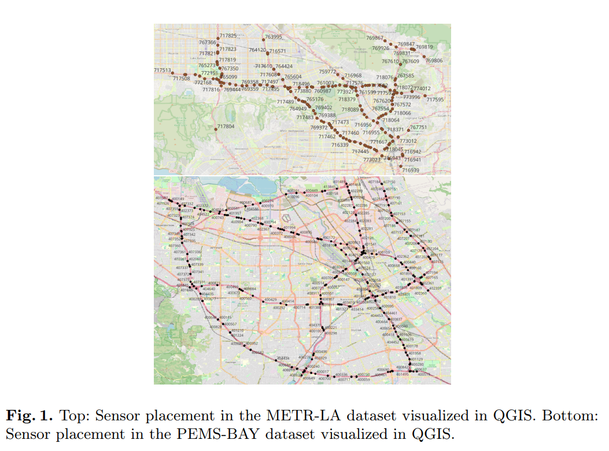
Model Adaptation & Inputs
Notes:
• "On this slide, you can see Figure 1 from our report, which visually depicts the sensor placements for the METR-LA and PEMS-Bay datasets in QGIS, giving us a clear understanding of the underlying graph structures we aimed to model."

Slide 16
Architecture & Implementation
Core Layer Structure (Both Models):
1. Local Message Passing: GatedGraphConv.
2. Global Attention: TransformerConv.
3. Residual connections, Layer Normalization, Feed-Forward Network
Notes:
"Each layer in these models consists of three main components: first, a local message-passing block using GatedGraphConv to capture immediate neighbourhood interactions. Second, a global attention block utilising TransformerConv for broader, attention-based information aggregation. These are followed by standard elements like residual connections, Layer Normalization, and a position-wise Feed-Forward Network to improve learning stability.

Slide 17
Model Adaptation & Inputs
Hyperparameters (Shared):
▪ Layers: 4 hybrid layers.
▪ Hidden Size: 64.
▪ Attention Heads: 4.
▪ Positional Encoding Dim: 20.
▪ Dropout: 0.1.
Notes:
We consistently used 4 such hybrid layers, with a hidden size of 64 and 4 attention heads. Positional encodings were set to 20 dimensions, and dropout at 0.1 for regularisation

Slide 18
Model Adaptation & Inputs
Training Details:
▪ Epochs: 20.
▪ Optimizer: AdamW, LR 0.001, Weight Decay 0.01.
▪ Loss: Mean Squared Error (MSE).
▪ Data Split: Chronological 60% train, 20% val, 20% test
Notes:
For training, we ran for 20 epochs using the AdamW optimizer with a learning rate of 0.001 and weight decay of 0.01. Mean Squared Error was our loss function, and we used a chronological 60/20/20 train/validation/test split to preserve temporal causality."

Slide 19
Results: METR-LA Dataset
Overall: Strong performance, competitive RMSEs. RMSE in mph.
◦ 5-minute Granularity: RMSE ~9.34-9.84 mph. GPS slightly better (e.g., KNN+Lane: GPS 9.34 vs. GT 9.43). Lane info offers marginal gains.
◦ 1-hour Resolution: RMSE ~11.29-11.66 mph. GT slightly better (e.g., Radius+Lane: GT 11.29 vs. GPS 11.40). Lane metadata has slight advantage for GT.
◦ 1-day Setting: RMSE higher ~14.28-19.54 mph. GPS better (e.g., KNN: GPS 14.28 vs. GT 14.42). GT sensitive to Radius+Lane (19.54 mph).
◦ Key Takeaway: GPS often better at 5-min & 1-day, GT slightly at 1-hour. Lane info beneficial at shorter scales
Notes:
ow, let's look at the experimental results, starting with the METR-LA dataset. Overall, both GPS and Graph Transformer demonstrated strong and competitive performance, with RMSE values reported in miles per hour."
• "At the 5-minute granularity, which is fine-grained, we observed RMSEs ranging from approximately 9.34 to 9.84 mph. The GPS model generally showed a slight edge, achieving its best RMSE of 9.34 mph with the KNN+Lane adjacency matrix, just outperforming Graph Transformer's best of 9.43 mph with the same setting. The inclusion of lane information provided marginal, but consistent, improvements."
• "Moving to the 1-hour resolution, the prediction task becomes slightly harder, with RMSEs between 11.29 and 11.66 mph. Here, the Graph Transformer actually had a slight advantage, achieving 11.29 mph with the Radius+Lane matrix, compared to GPS at 11.40 mph with the Radius variant. This suggests Graph Transformer's sensitivity to enhanced spatial encoding at this resolution."
• "For the 1-day setting, long-term forecasting presents the most challenges, and RMSEs naturally increased. The GPS model performed better, with a best RMSE of 14.28 mph using the standard KNN matrix. The Graph Transformer showed higher RMSEs, particularly a notable 19.54 mph with the Radius+Lane variant, indicating some sensitivity to specific adjacency configurations at this longest time scale."
• "In summary for METR-LA: GPS generally performed slightly better at 5-minute and 1-day granularities, while Graph Transformer had a slight edge at 1-hour. Lane information was marginally beneficial, especially at shorter time scales, highlighting the importance of structural priors."

Slide 20
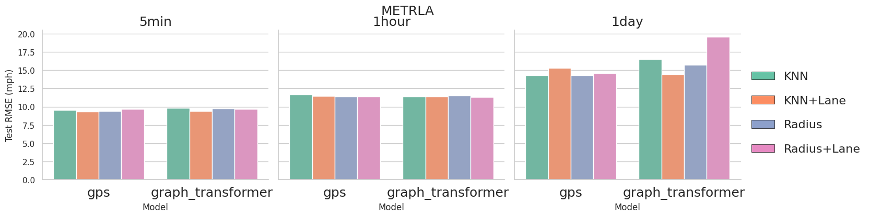
Results: METR-LA Dataset
Notes:
On this slide, you can see Figure 8 from our report, which visually summarises these results for METR-LA across different adjacency variants and temporal granularities for both GPS and Graph Transformer.

Slide 21
Results: PEMS-Bay Dataset
Overall: Significantly lower RMSEs than METR-LA. Performance of GPS and GT "remarkably similar," "virtually indistinguishable".
◦ 5-minute Granularity: RMSE ~4.7-5.5 mph. Adjacency choice has minor impact.
◦ 1-hour Resolution: Performance closely matched. KNN variant best for both (~4.65 mph).
◦ 1-day Forecasting: KNN+Lane provides distinct advantage (lowest RMSE: 3.77 mph for both). Highlights importance of lane-level info for long-term.
◦ Key Takeaway: Excellent robustness across adjacency types and granularities on PEMS-Bay.
Notes:
Turning to the PEMS-Bay dataset, a clear trend emerges: both models achieved significantly lower RMSE values compared to METR-LA. This indicates that the traffic patterns in PEMS-Bay are more regular and generally easier to predict."
• "Crucially, on PEMS-Bay, the performance of GPS and Graph Transformer was remarkably similar, almost virtually indistinguishable across most experimental settings."
• "At the 5-minute granularity, both models showed strong performance, with RMSEs between approximately 4.7 and 5.5 mph. The choice of adjacency matrix had only a minor impact here, with standard KNN and Radius sometimes even slightly outperforming their lane-aware counterparts."
• "At the 1-hour resolution, performance remained closely matched. The KNN variant yielded the best results for both models at around 4.65 mph, suggesting a simple k-NN based spatial representation is quite effective here."
• "For the 1-day forecasting horizon, we saw an interesting shift: the KNN+Lane adjacency matrix provided a distinct advantage, leading to the lowest RMSE of 3.77 mph for both models. This highlights the increased importance of lane-level structural information for accurate long-term predictions, demonstrating the value of incorporating precise road topology for more distant forecasts."
• "In conclusion for PEMS-Bay: Both GPS and Graph Transformer delivered excellent and highly robust performance across different adjacency types and temporal granularities, underscoring their effectiveness on datasets with smoother spatio-temporal dynamics."

Slide 22
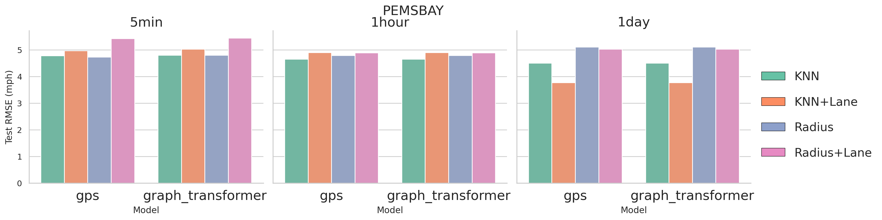
Results: PEMS-Bay Dataset
Notes:
Here, Figure 9 from our report illustrates these findings for PEMS-Bay, showcasing the consistent and similar performance of both models

Slide 23
Conclusion & My Contribution
Graph Transformer & GPS show strong performance for traffic speed prediction.
Impact of adjacency matrices and temporal resolution observed.
My Contribution: Implemented & evaluated these Transformer-based models, designed graph-specific attention, integrated RWPE, and conducted extensive experiments with various adjacency matrices to understand their effectiveness in complex spatio-temporal traffic networks.
Overall Project: Comprehensive analysis of GNNs vs. Graph Transformers, revealing strengths/limitations
Notes:
"To summarise, our experiments consistently demonstrate the strong performance of both Graph Transformer and GPS models for node-level traffic speed regression across both the METR-LA and PEMS-Bay datasets and different temporal granularities."
• "We also gained valuable insights into how the choice of adjacency matrix and temporal resolution impacts model performance, with lane information showing benefits especially at shorter and very long time scales."
• "As for my individual contribution, I was primarily responsible for implementing and evaluating these advanced Transformer-based models: the GraphTransformer and GPS."
• "My work involved designing the graph-specific attention mechanisms, integrating random walk positional encodings, and conducting extensive experiments with the various custom adjacency matrices to rigorously test and understand their effectiveness in capturing complex spatio-temporal dependencies in real-world traffic networks."
• "This work, combined with my teammates' contributions on GNNs and graph construction, provides a comprehensive comparative analysis, highlighting the respective strengths and limitations of these powerful architectures in traffic prediction."

Slide 24
Optimisation & Future Work
Exploring more sophisticated positional encodings
Investigating dynamic graph structures for evolving traffic patterns
Multi-task learning for related prediction challenges
Notes:
"While our models performed strongly, there are always avenues for further optimisation and future research." [91d]
• "One direction could be exploring more sophisticated positional encodings beyond random walks, perhaps incorporating more semantic or geometric information." [91d]
• "Another promising area is to investigate dynamic graph structures, where the graph connectivity itself evolves over time to reflect changing traffic conditions or road closures, rather than relying on static adjacency matrices." [91d]
• "Finally, exploring multi-task learning where traffic prediction is combined with other related tasks like anomaly detection or traffic flow estimation could lead to more robust and comprehensive models.

Slide 25
Ablation Study Results
Objective: Evaluated the impact of positional encodings (PE) on GraphTransformer performance for traffic speed prediction on PEMS-BAY dataset.
Notes:
"While our models performed strongly, there are always avenues for further optimisation and future research." [91d]
• "One direction could be exploring more sophisticated positional encodings beyond random walks, perhaps incorporating more semantic or geometric information." [91d]
• "Another promising area is to investigate dynamic graph structures, where the graph connectivity itself evolves over time to reflect changing traffic conditions or road closures, rather than relying on static adjacency matrices." [91d]
• "Finally, exploring multi-task learning where traffic prediction is combined with other related tasks like anomaly detection or traffic flow estimation could lead to more robust and comprehensive models.

Slide 26
Ablation Study Results
Experimental Setup:
Adjacency Matrix: k-NN (adj_mx_knn_pems.pkl)
Temporal Strides: 5 minutes (1 step), 1 hour (12 steps), 1 day (288 steps)
Positional Encodings: Laplacian Eigenvector PE, No PE, Random Walk PE (RWPE)
Metrics: Mean Absolute Error (MAE), Root Mean Squared Error (RMSE), Mean Absolute Percentage Error (MAPE)
Evaluation: Test set and 100th-day prediction
Notes:
"While our models performed strongly, there are always avenues for further optimisation and future research." [91d]
• "One direction could be exploring more sophisticated positional encodings beyond random walks, perhaps incorporating more semantic or geometric information." [91d]
• "Another promising area is to investigate dynamic graph structures, where the graph connectivity itself evolves over time to reflect changing traffic conditions or road closures, rather than relying on static adjacency matrices." [91d]
• "Finally, exploring multi-task learning where traffic prediction is combined with other related tasks like anomaly detection or traffic flow estimation could lead to more robust and comprehensive models.

Slide 27
Ablation Study Results
Results:
5-Minute Stride:
  No PE: MAE: 3.68, RMSE: 5.13, MAPE: 7.01%
  RWPE: MAE: 3.14, RMSE: 4.74, MAPE: 6.11%
  Laplacian PE: Failed (ARPACK non-convergence)
  Observation: RWPE outperforms No PE slightly; Laplacian PE not viable.
Notes:
"While our models performed strongly, there are always avenues for further optimisation and future research." [91d]
• "One direction could be exploring more sophisticated positional encodings beyond random walks, perhaps incorporating more semantic or geometric information." [91d]
• "Another promising area is to investigate dynamic graph structures, where the graph connectivity itself evolves over time to reflect changing traffic conditions or road closures, rather than relying on static adjacency matrices." [91d]
• "Finally, exploring multi-task learning where traffic prediction is combined with other related tasks like anomaly detection or traffic flow estimation could lead to more robust and comprehensive models.

Slide 28
Ablation Study Results
1-Hour Stride:
  No PE: MAE: 2.53, RMSE: 4.75, MAPE: 5.25%
  RWPE: MAE: 2.63, RMSE: 4.67, MAPE: 5.30%
  Laplacian PE: Failed (ARPACK non-convergence)
  Observation: RWPE and No PE perform closely, with No PE slightly better.
Notes:
"While our models performed strongly, there are always avenues for further optimisation and future research." [91d]
• "One direction could be exploring more sophisticated positional encodings beyond random walks, perhaps incorporating more semantic or geometric information." [91d]
• "Another promising area is to investigate dynamic graph structures, where the graph connectivity itself evolves over time to reflect changing traffic conditions or road closures, rather than relying on static adjacency matrices." [91d]
• "Finally, exploring multi-task learning where traffic prediction is combined with other related tasks like anomaly detection or traffic flow estimation could lead to more robust and comprehensive models.

Slide 29
Ablation Study Results
1-Day Stride:
  No PE: MAE: 3.23, RMSE: 4.26, MAPE: 4.98%
  RWPE: MAE: 4.16, RMSE: 5.27, MAPE: 6.35%
  Laplacian PE: MAE: 3.79, RMSE: 4.92, MAPE: 5.82%
  Observation: No PE performs best; RWPE shows higher errors.
Notes:
"While our models performed strongly, there are always avenues for further optimisation and future research." [91d]
• "One direction could be exploring more sophisticated positional encodings beyond random walks, perhaps incorporating more semantic or geometric information." [91d]
• "Another promising area is to investigate dynamic graph structures, where the graph connectivity itself evolves over time to reflect changing traffic conditions or road closures, rather than relying on static adjacency matrices." [91d]
• "Finally, exploring multi-task learning where traffic prediction is combined with other related tasks like anomaly detection or traffic flow estimation could lead to more robust and comprehensive models.

Slide 30
Ablation Study Results
100th-Day Prediction:
  Best performance with No PE (5-min: MAE: 2.29, RMSE: 4.29, MAPE: 4.62%) and RWPE (5-min: MAE: 2.27, RMSE: 4.28, MAPE: 4.57%).
  Laplacian PE struggles with long-term predictions (1-day: MAE: 5.25, RMSE: 8.17, MAPE: 12.38%).
Notes:
"While our models performed strongly, there are always avenues for further optimisation and future research." [91d]
• "One direction could be exploring more sophisticated positional encodings beyond random walks, perhaps incorporating more semantic or geometric information." [91d]
• "Another promising area is to investigate dynamic graph structures, where the graph connectivity itself evolves over time to reflect changing traffic conditions or road closures, rather than relying on static adjacency matrices." [91d]
• "Finally, exploring multi-task learning where traffic prediction is combined with other related tasks like anomaly detection or traffic flow estimation could lead to more robust and comprehensive models.

Slide 31
Ablation Study Results
Key Insights:
  RWPE enhances performance at finer granularities (5-min, 1-hour) but degrades for 1-day predictions.
  No PE is robust across all strides, especially for long-term (1-day) forecasting.
  Laplacian Eigenvector PE failed for shorter strides due to computational issues (ARPACK non-convergence).
Notes:
"While our models performed strongly, there are always avenues for further optimisation and future research." [91d]
• "One direction could be exploring more sophisticated positional encodings beyond random walks, perhaps incorporating more semantic or geometric information." [91d]
• "Another promising area is to investigate dynamic graph structures, where the graph connectivity itself evolves over time to reflect changing traffic conditions or road closures, rather than relying on static adjacency matrices." [91d]
• "Finally, exploring multi-task learning where traffic prediction is combined with other related tasks like anomaly detection or traffic flow estimation could lead to more robust and comprehensive models.

Slide 32
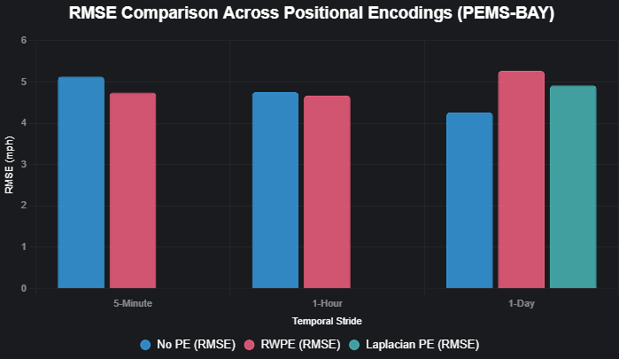
Ablation Study Results
Notes:
"While our models performed strongly, there are always avenues for further optimisation and future research." [91d]
• "One direction could be exploring more sophisticated positional encodings beyond random walks, perhaps incorporating more semantic or geometric information." [91d]
• "Another promising area is to investigate dynamic graph structures, where the graph connectivity itself evolves over time to reflect changing traffic conditions or road closures, rather than relying on static adjacency matrices." [91d]
• "Finally, exploring multi-task learning where traffic prediction is combined with other related tasks like anomaly detection or traffic flow estimation could lead to more robust and comprehensive models.

