Slide 1

CCC: scNotebooks
Arash Bagherabadi
May 6, 2026

Slide 2
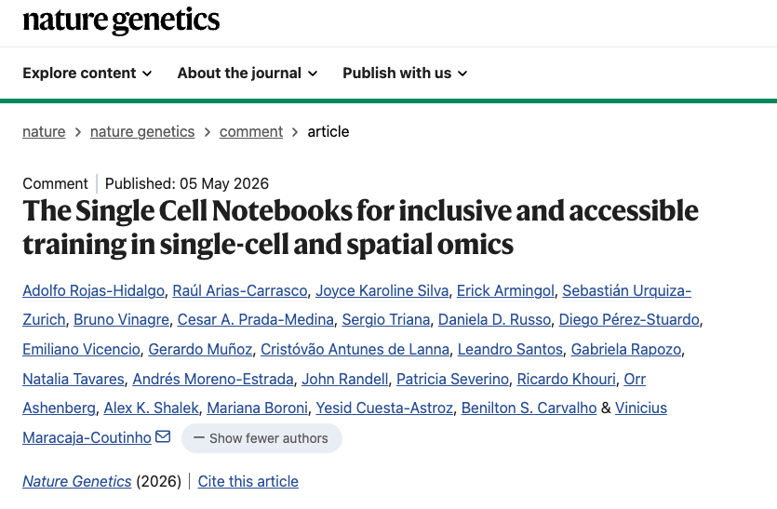

Slide 3
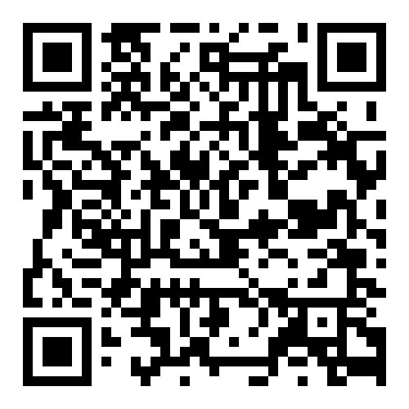

scNotebooks
Please Sign-in

