Slide 1
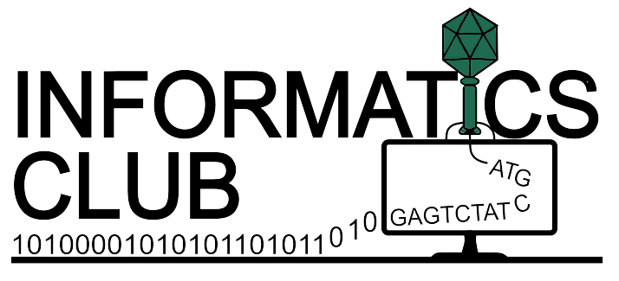

scTalk 6: One Dataset, Two Stories
Arash Bagherabadi
June 8, 2026

Slide 2

scTalk
Single-cell Journal Club Series
Break down key/new papers
Shared standards and critical thinking in analysis
Open questions, interruptions, and debate encouraged
Please Sign-in + Comments & Questions

Slide 3
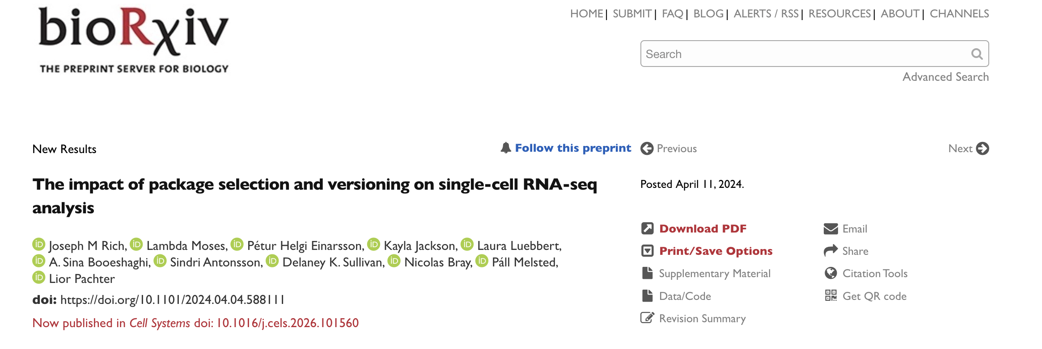

Slide 4
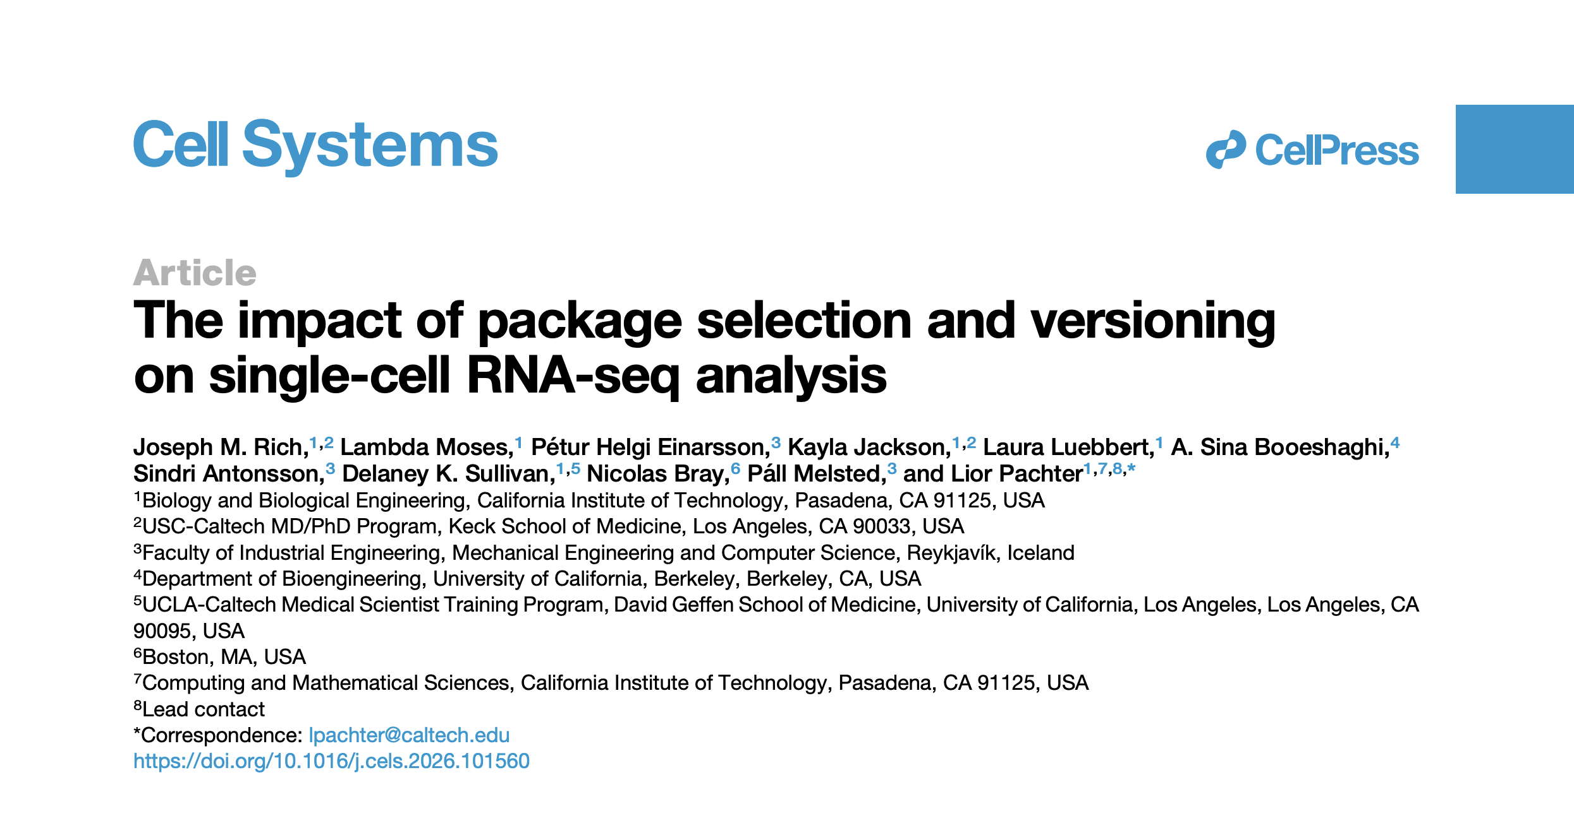

April 15, 2026

Slide 5
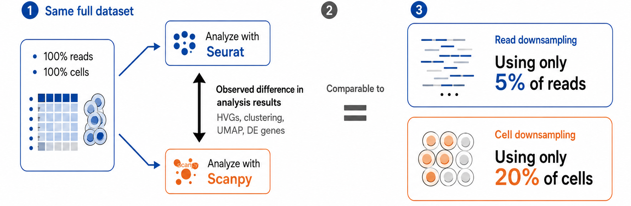
Comparison of effect size: If you ignore the differences between Seurat and Scanpy, you are effectively ignoring a source of variation whose magnitude is comparable to removing a large fraction of your data!

Slide 6
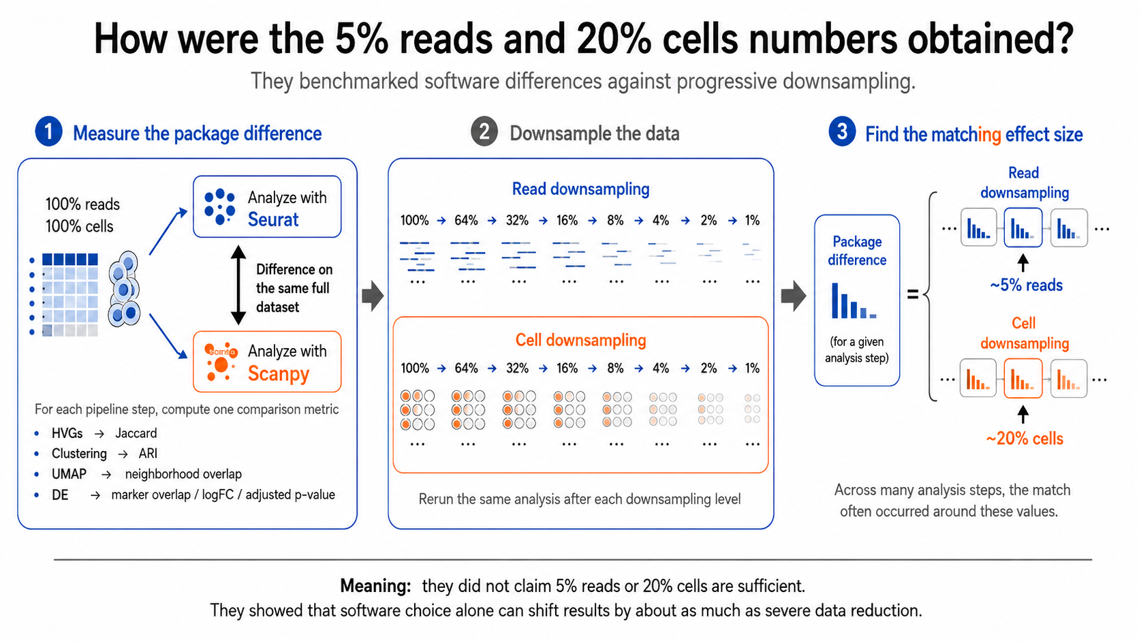

Slide 7
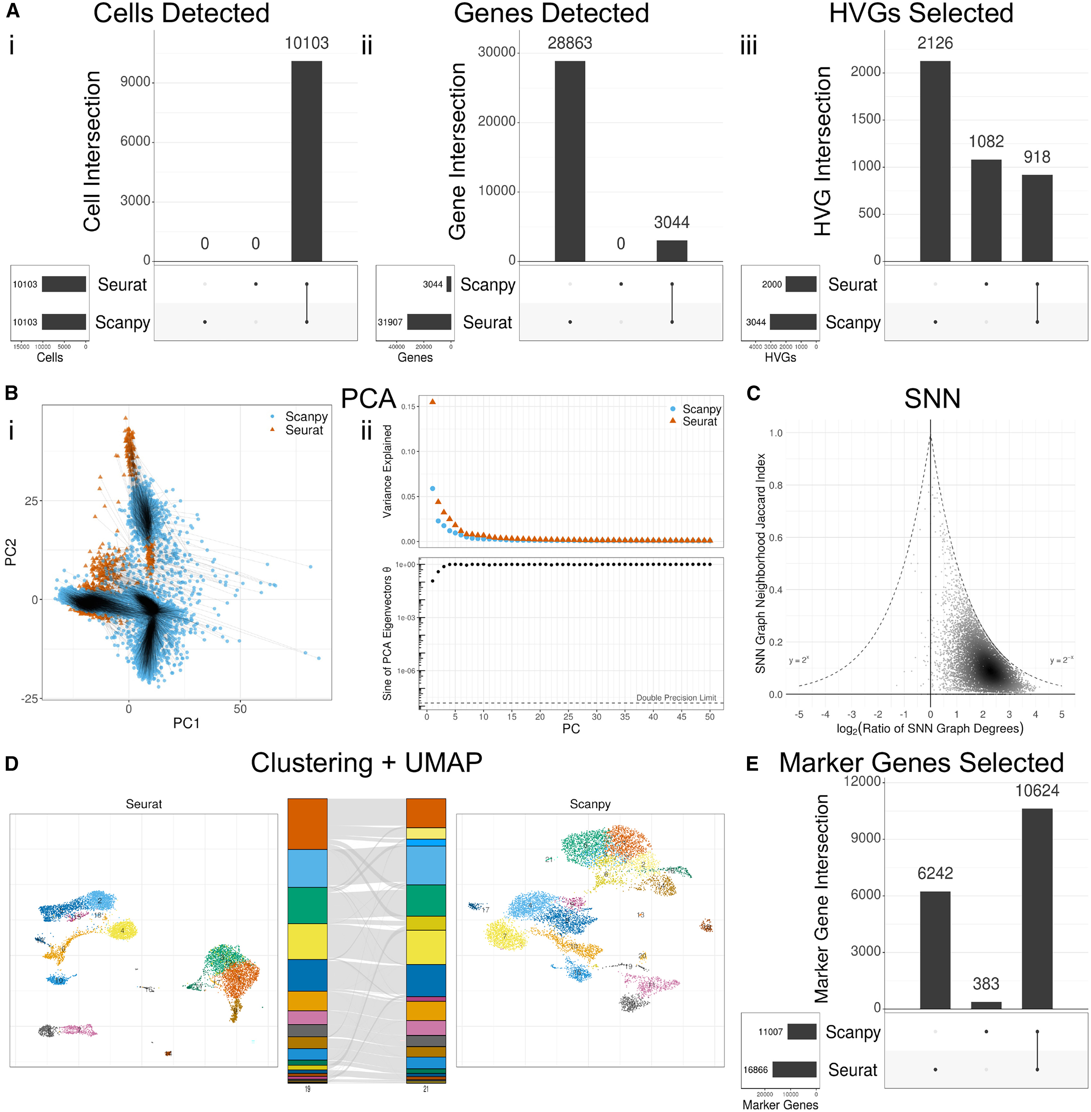
Fig1.

Slide 8
Fig1.

Slide 9
Fig1.

Slide 10
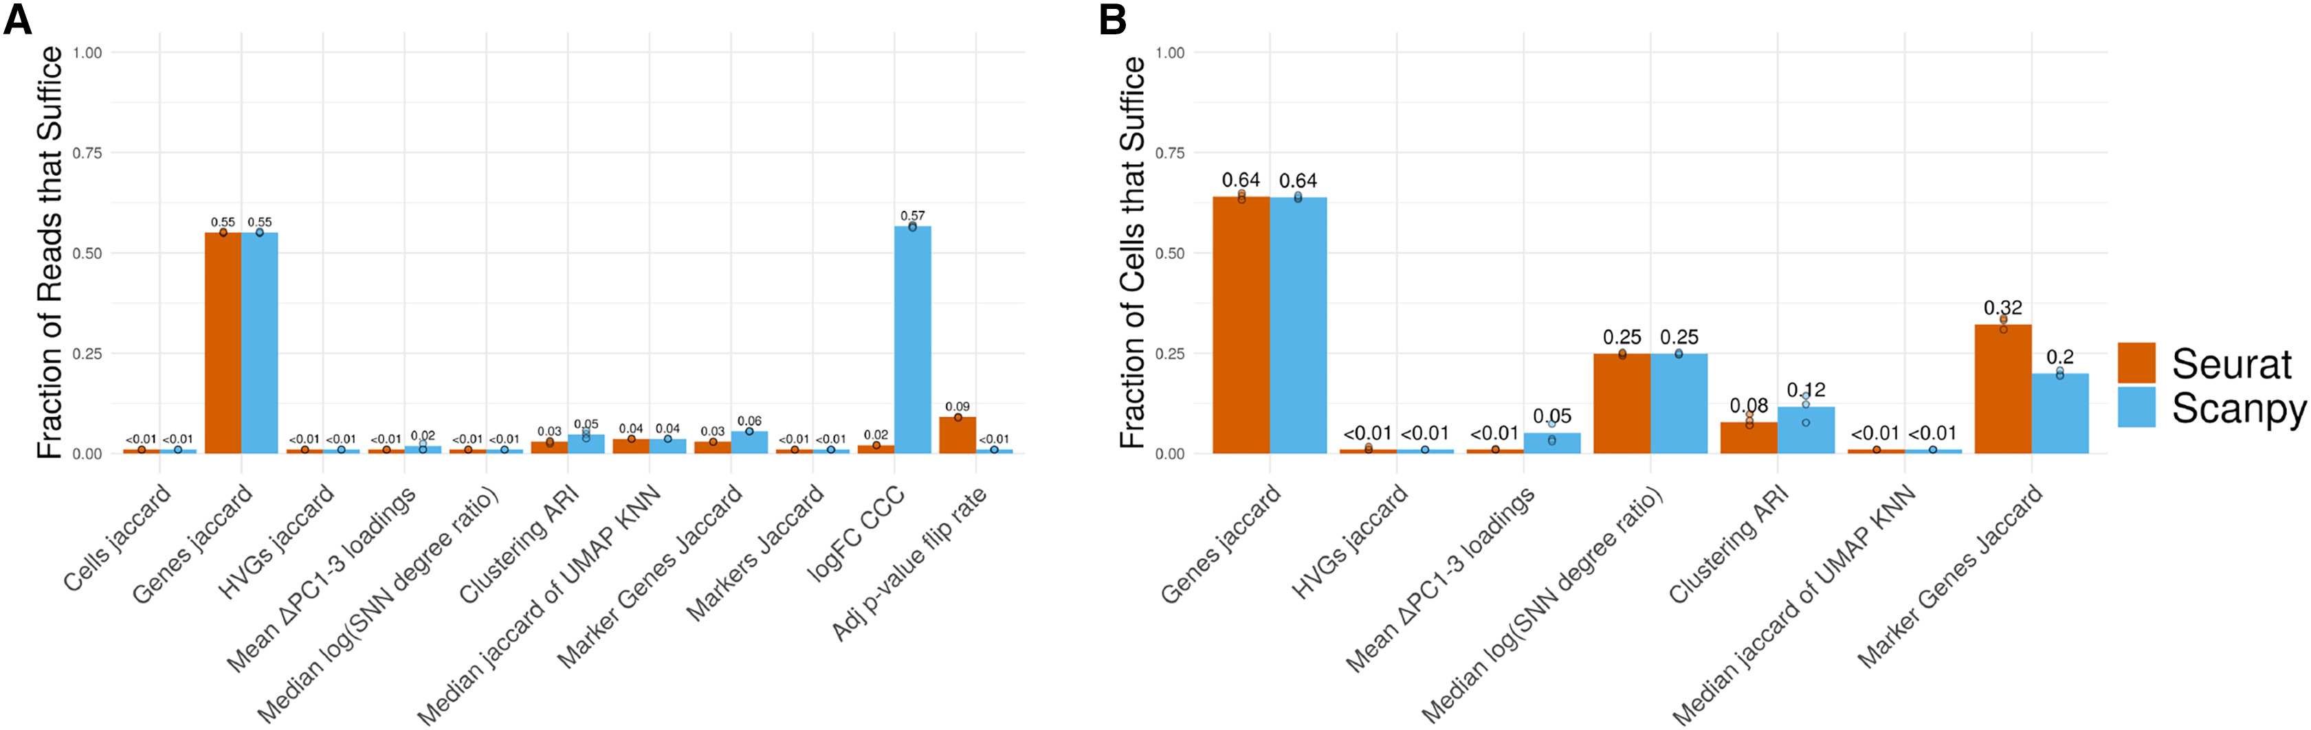
Fig2.

Slide 11
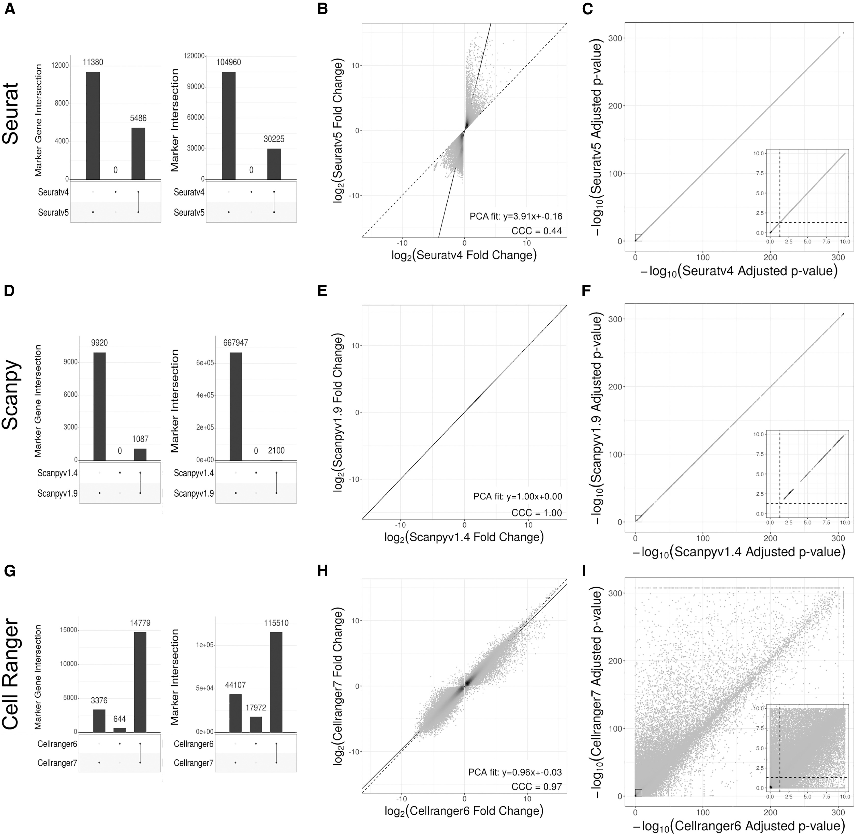
Fig3.

Slide 12
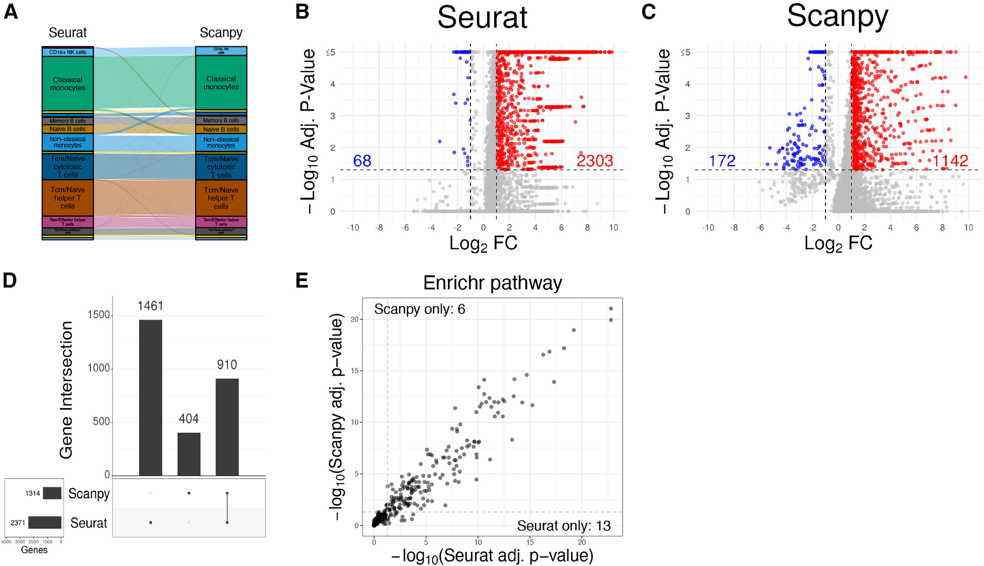
Fig4.

Slide 13
Thank you. Questions?

Slide 14
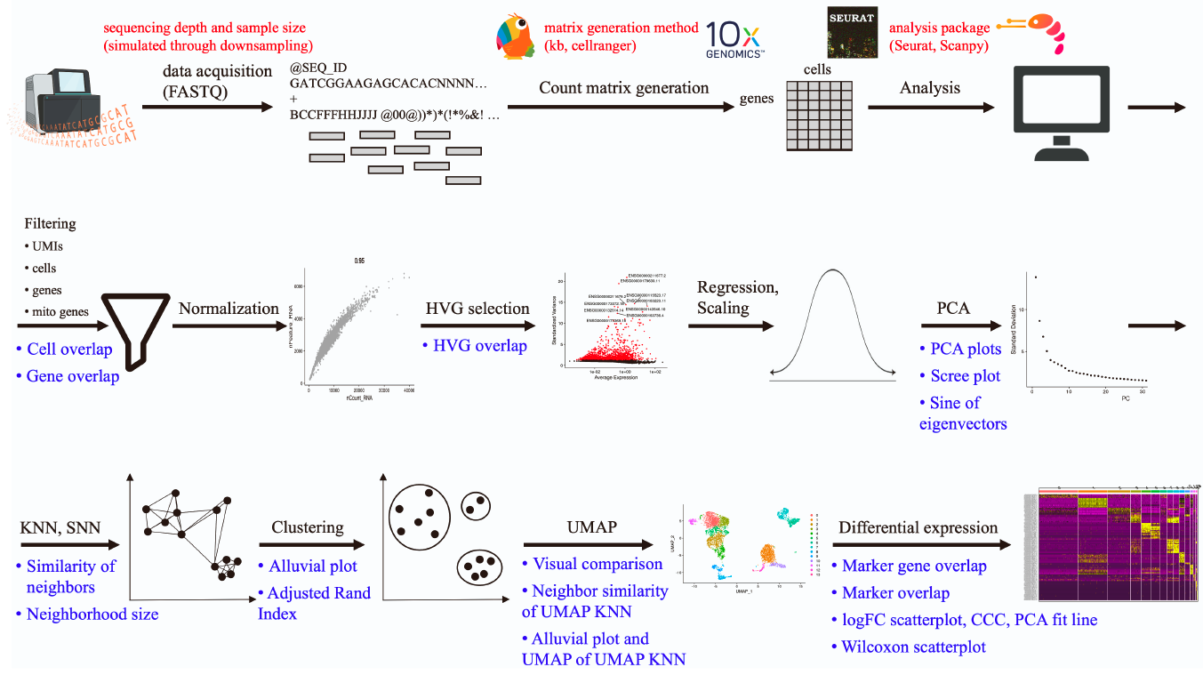
FigS1.
Notes:
Supplemental Figure 1: scRNA-seq matrix generation and analysis overview. Red =
sources of variability explored in this study; Blue = plots and metrics used to assess function
similarity.
kb means kallisto-bustools, often used through kb-python.

Slide 15
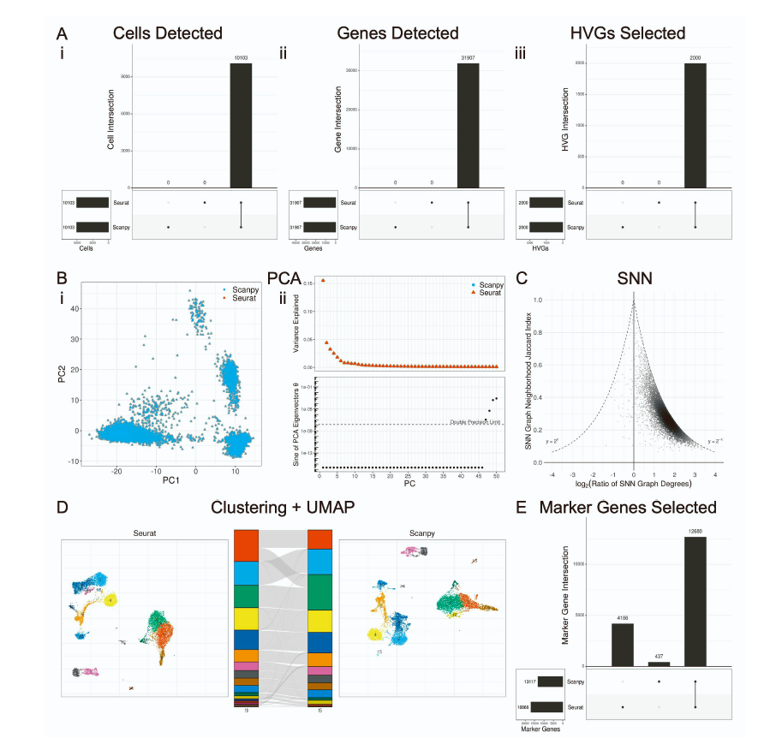
FigS2.
Notes:
Supplemental Figure 2: Seurat vs. Scanpy, aligned function arguments (Seurat-like arguments
used in Scanpy), sequential analysis (data is run from start to end through each
package without modification). (A) Filtering and HVG selection analysis UpSet plots consisting
of sets of (i) cells, (ii) genes, and (iii) HVGs. (B) (i) PCA analysis through projection
onto the first 2 PCs. (ii) Scree plot and the sine of eigenvectors. Black lines = point mapping
between conditions. (C) KNN/SNN analysis through SNN neighborhood Jaccard index and
degree ratio (Seurat/Scanpy) per cell. (D) Clustering and UMAP analysis through UMAP
plots of Seurat (left) and Scanpy (right), with the alluvial diagram (middle) showing cluster
assignment mapping and degree of cluster agreement. Numbers at the bottom of the alluvial
diagram represent the total number of clusters in each group. (E) Di↵erential expression
analysis UpSet plot through overlap of all significant (p < 0.05) marker genes across all
clusters.

Slide 16
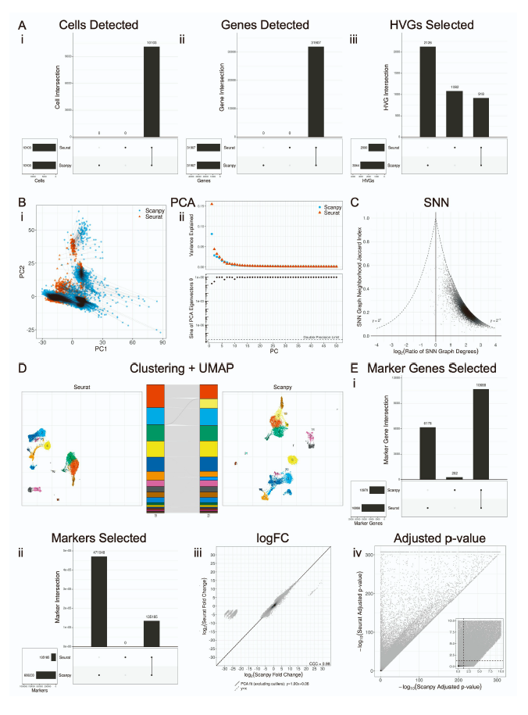
FigS3.
Notes:
Supplemental Figure 3: Seurat vs. Scanpy, default function arguments, controlled analysis
(the data created by Scanpy is replaced by the data created by Seurat following each
step, such that each step sees identical input). (A) Filtering and HVG selection analysis
UpSet plots consisting of sets of (i) cells, (ii) genes, and (iii) HVGs. (B) (i) PCA analysis
through projection onto the first 2 PCs. (ii) Scree plot and the sine of eigenvectors. Black
lines = point mapping between conditions. (C) KNN/SNN analysis through SNN neighborhood
Jaccard index and degree ratio (Seurat/Scanpy) per cell. (D) Clustering and UMAP
analysis through UMAP plots of Seurat (left) and Scanpy (right), with the alluvial diagram
(middle) showing cluster assignment mapping and degree of cluster agreement. Numbers at
the bottom of the alluvial diagram represent the total number of clusters in each group. (E)
(i) Di↵erential expression analysis through overlap of all significant (p < 0.05) marker genes
across all clusters. (ii) Di↵erential expression analysis with matched clusters of overlap of all
markers. (iii) Di↵erential expression analysis with matched clusters of logFC similarity. (iv)
Di↵erential expression analysis with matched clusters of adjusted p-value similarity. Dataset:
10k PBMC. Dataset: 10k PBMC.

Slide 17
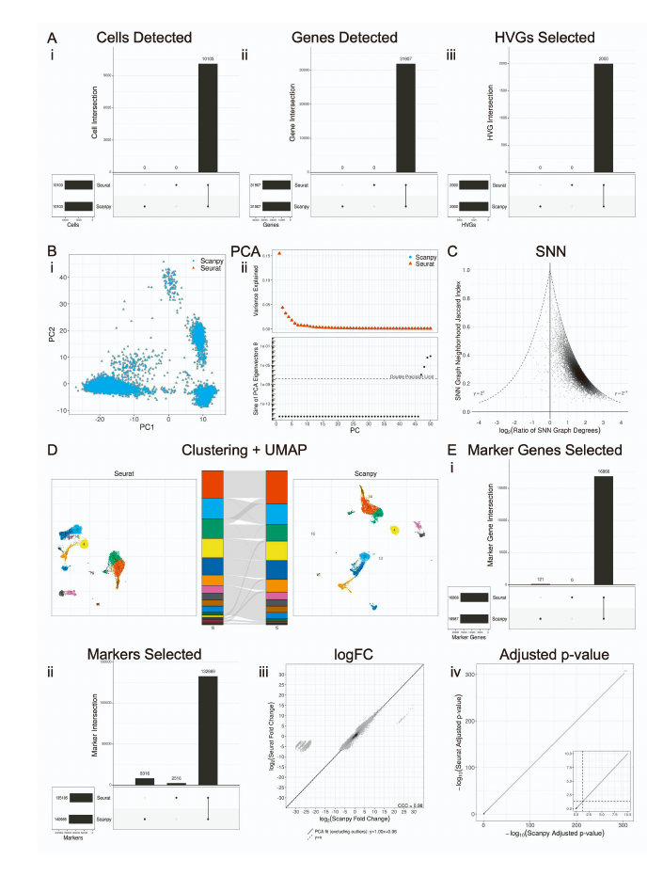
FigS4.
Notes:
Supplemental Figure 4: Seurat vs. Scanpy, aligned function arguments (Seurat-like
arguments used in Scanpy), controlled analysis (the data created by Scanpy is replaced by
the data created by Seurat following each step, such that each step sees identical input). (A)
Filtering and HVG selection analysis UpSet plots consisting of sets of (i) cells, (ii) genes, and
(iii) HVGs. (B) (i) PCA analysis through projection onto the first 2 PCs. (ii) Scree plot and
the sine of eigenvectors. Black lines = point mapping between conditions. (C) KNN/SNN
analysis through SNN neighborhood Jaccard index and degree ratio (Seurat/Scanpy) per
cell. (D) Clustering and UMAP analysis through UMAP plots of Seurat (left) and Scanpy
(right), with the alluvial diagram (middle) showing cluster assignment mapping and degree
of cluster agreement. Numbers at the bottom of the alluvial diagram represent the total
number of clusters in each group. (E) (i) Di↵erential expression analysis through overlap
of all significant (p < 0.05) marker genes across all clusters. (ii) Di↵erential expression
analysis with matched clusters of overlap of all markers. (iii) Di↵erential expression analysis
with matched clusters of logFC similarity. (iv) Di↵erential expression analysis with matched
clusters of adjusted p-value similarity. Dataset: 10k PBMC

Slide 18
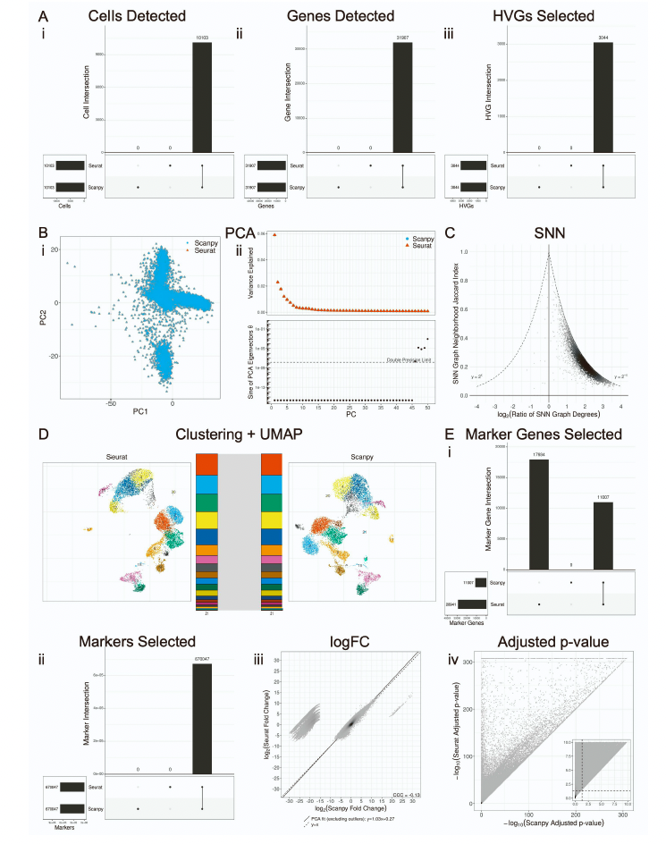
FigS5.
Notes:
Supplemental Figure 5: Seurat vs. Scanpy, aligned function arguments (Scanpy-like
arguments used in Seurat), controlled analysis (the data created by Seurat is replaced by the
data created by Scanpy following each step, such that each step sees identical input). (A)
Filtering and HVG selection analysis UpSet plots consisting of sets of (i) cells, (ii) genes, and
(iii) HVGs. (B) (i) PCA analysis through projection onto the first 2 PCs. (ii) Scree plot and
the sine of eigenvectors. Black lines = point mapping between conditions. (C) KNN/SNN
analysis through SNN neighborhood Jaccard index and degree ratio (Seurat/Scanpy) per
cell. (D) Clustering and UMAP analysis through UMAP plots of Seurat (left) and Scanpy
(right), with the alluvial diagram (middle) showing cluster assignment mapping and degree
of cluster agreement. Numbers at the bottom of the alluvial diagram represent the total
number of clusters in each group. (E) (i) Di↵erential expression analysis through overlap
of all significant (p < 0.05) marker genes across all clusters. (ii) Di↵erential expression
analysis with matched clusters of overlap of all markers. (iii) Di↵erential expression analysis
with matched clusters of logFC similarity. (iv) Di↵erential expression analysis with matched
clusters of adjusted p-value similarity. Dataset: 10k PBMC.

Slide 19
FigS2.

Slide 20
FigS2.

Slide 21
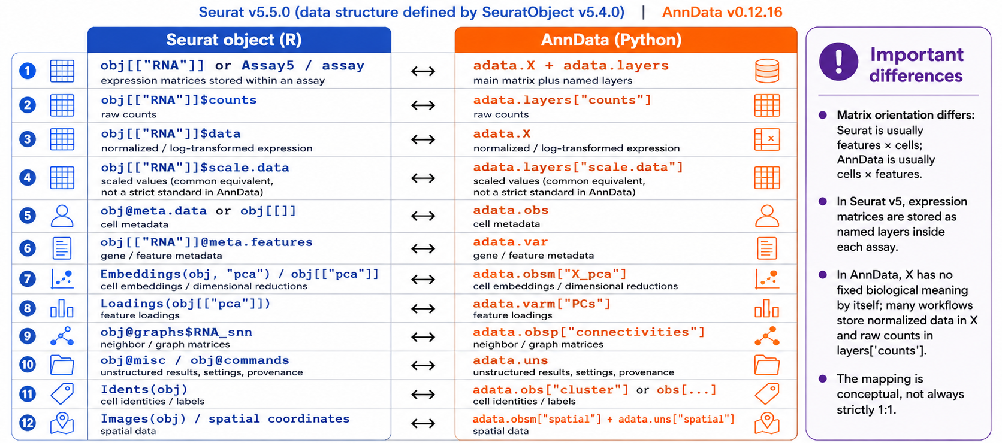

Slide 22
