Slide 1


scTalk 7: scCODA
(Einstein Was Right, Cell Types Are Relative)
Arash Bagherabadi
Aug 19, 2026

Slide 2

scTalk
Single-cell Journal Club Series
Break down key/new papers
Shared standards and critical thinking in analysis
Open questions, interruptions, and debate encouraged
Please Sign-in + Comments & Questions

Slide 3
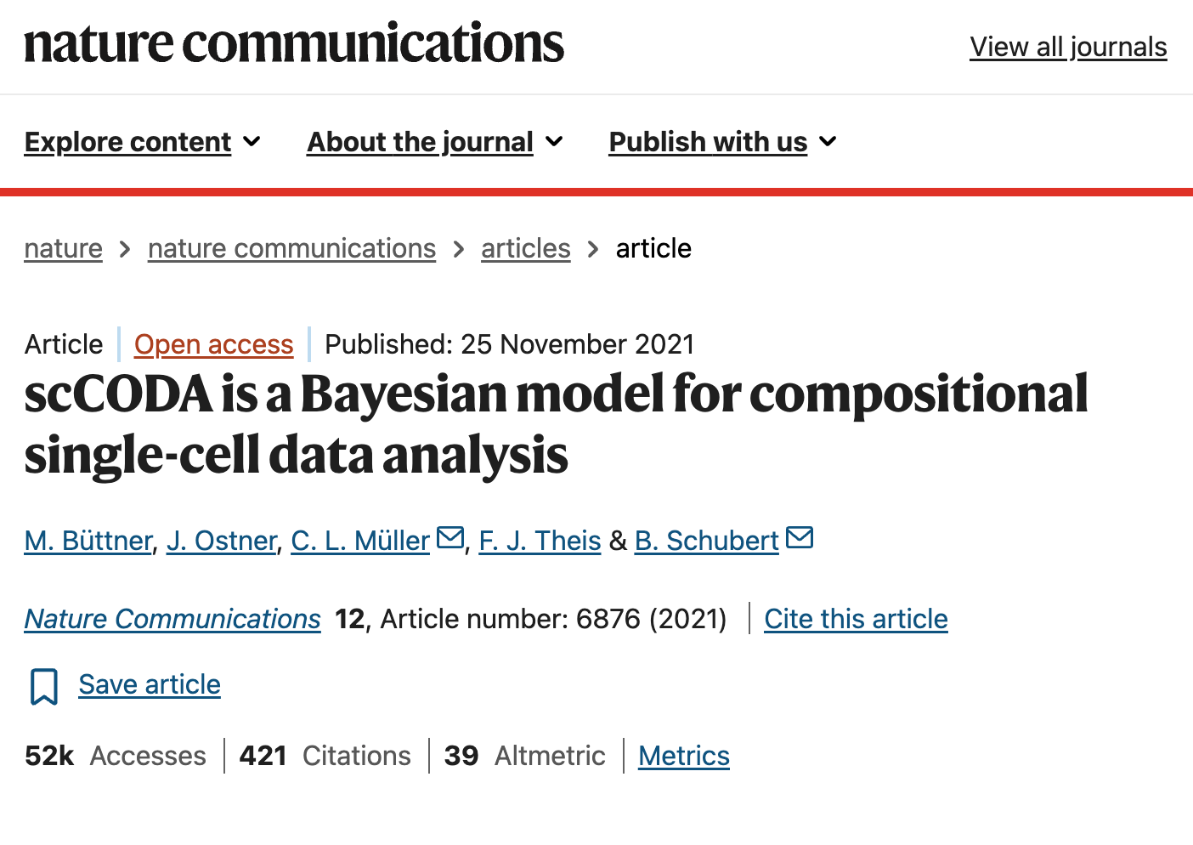

Slide 4
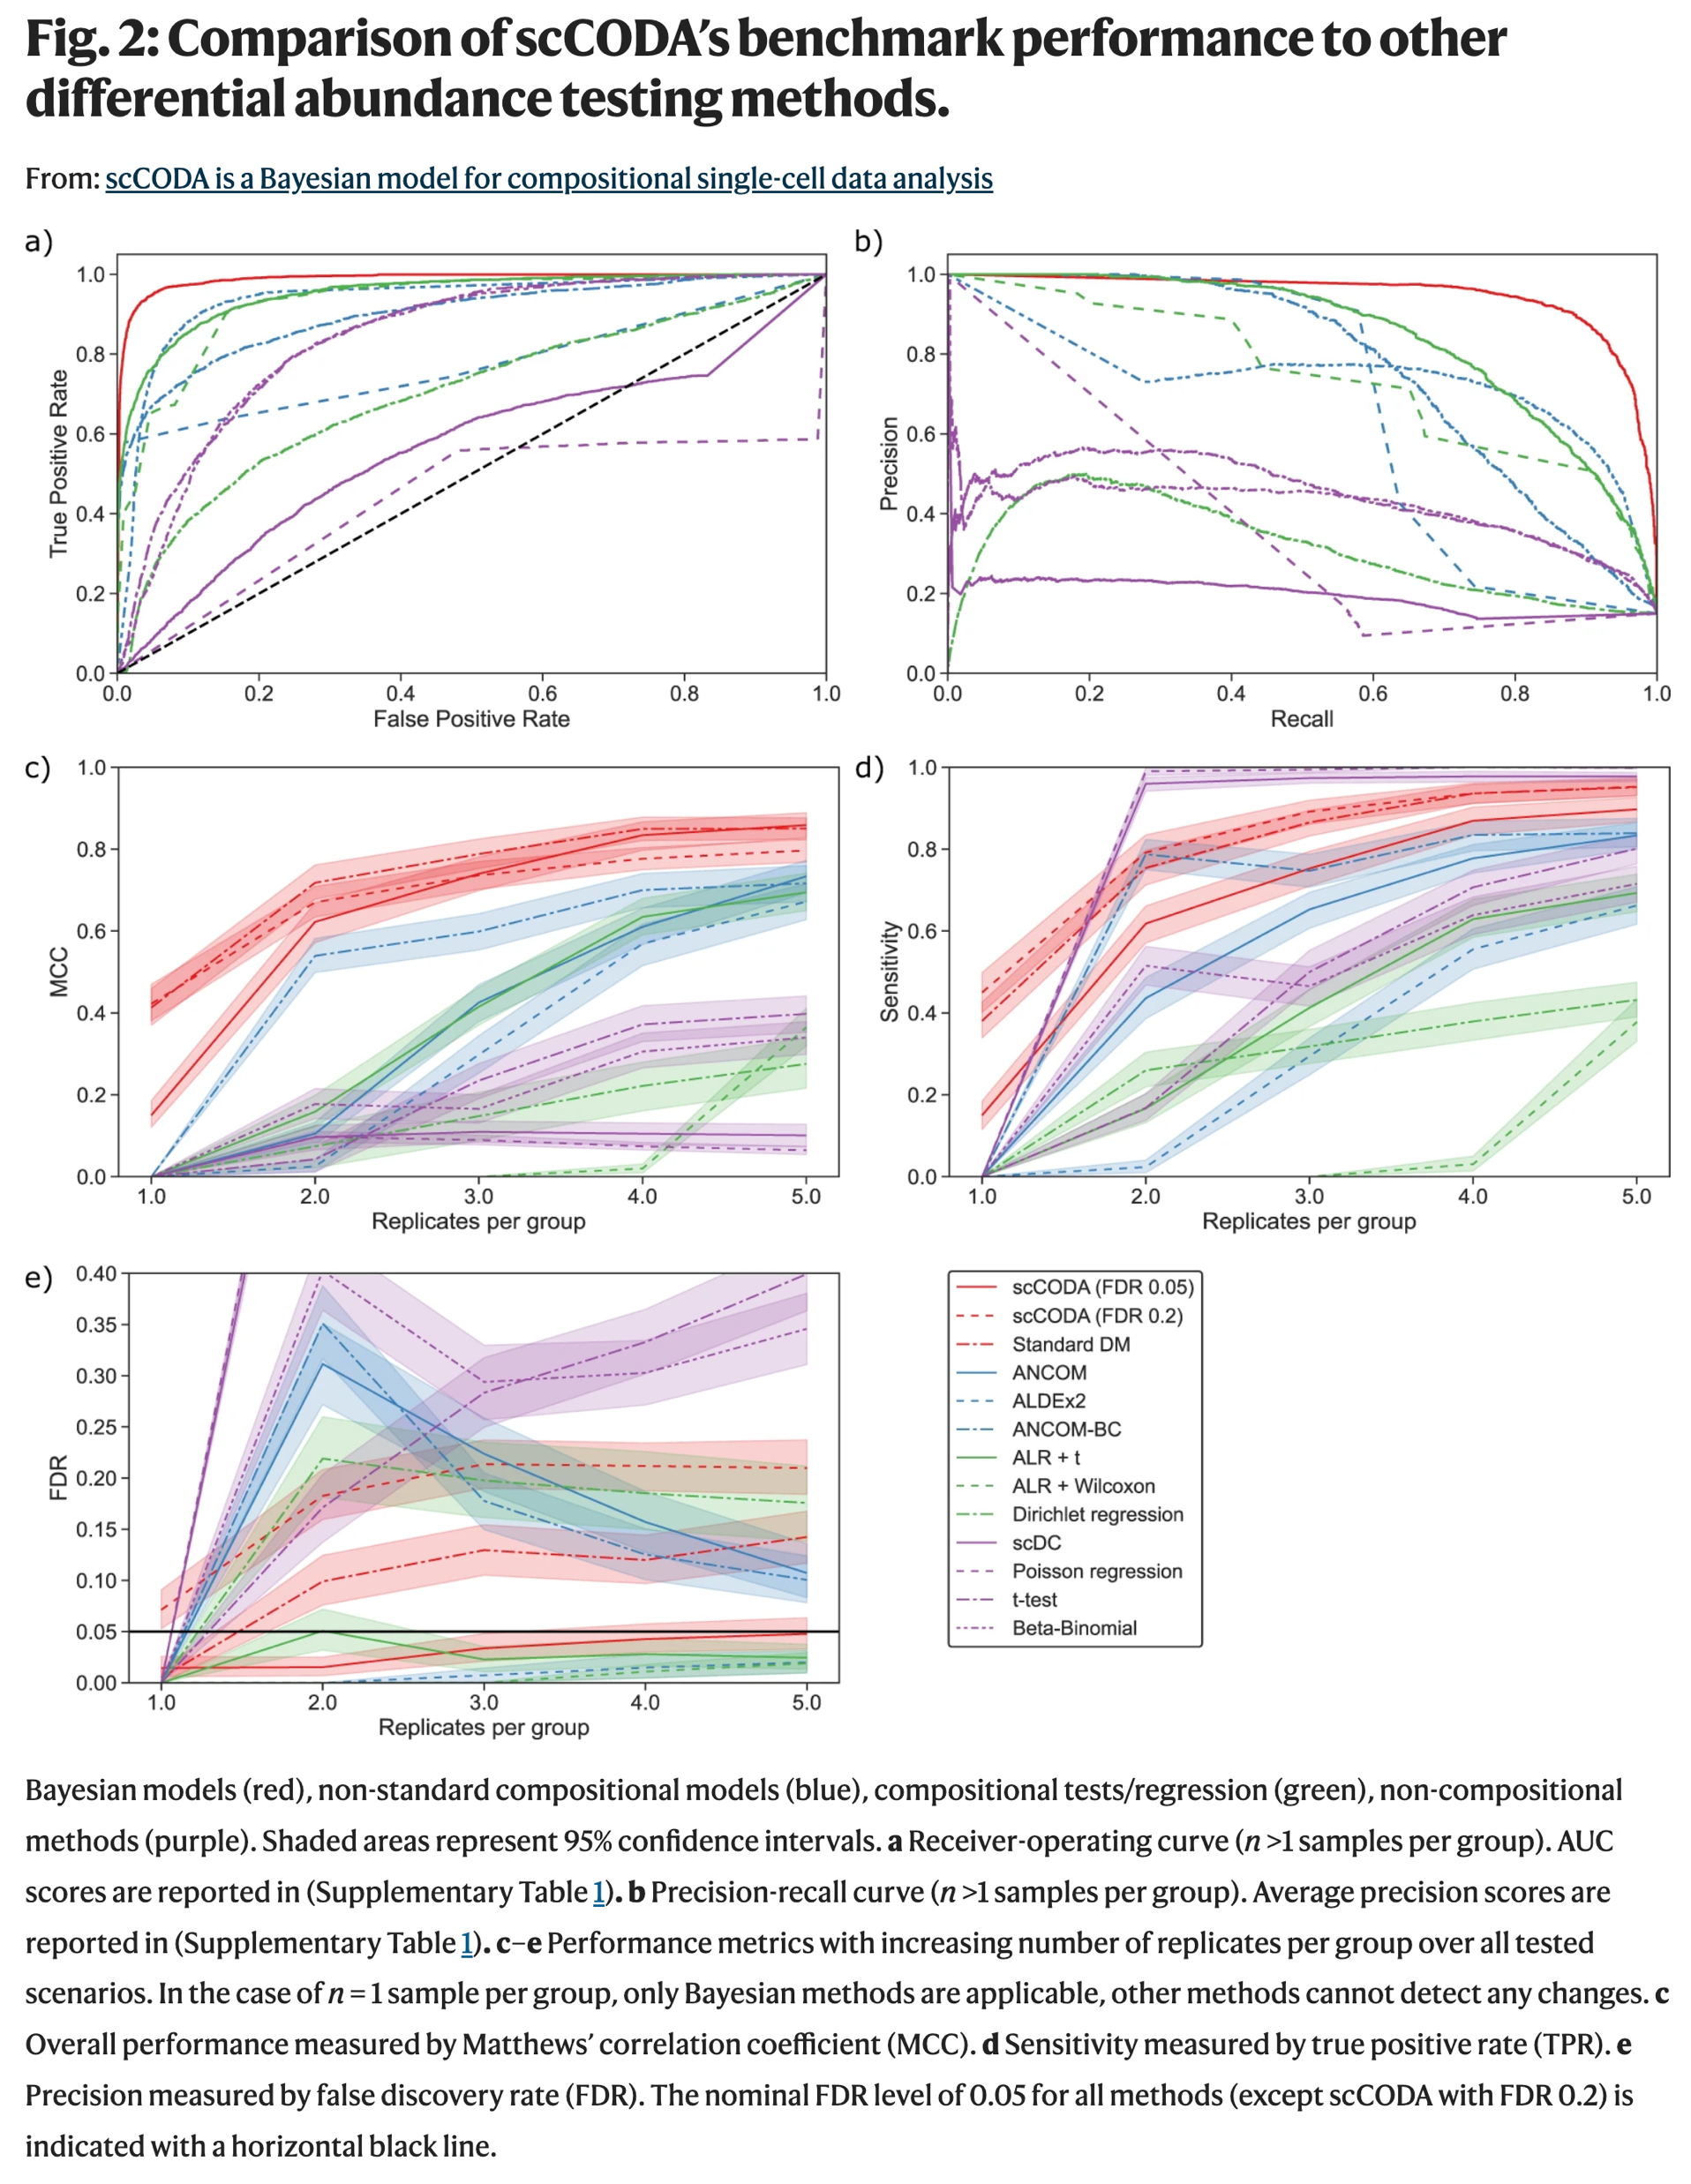

Slide 5
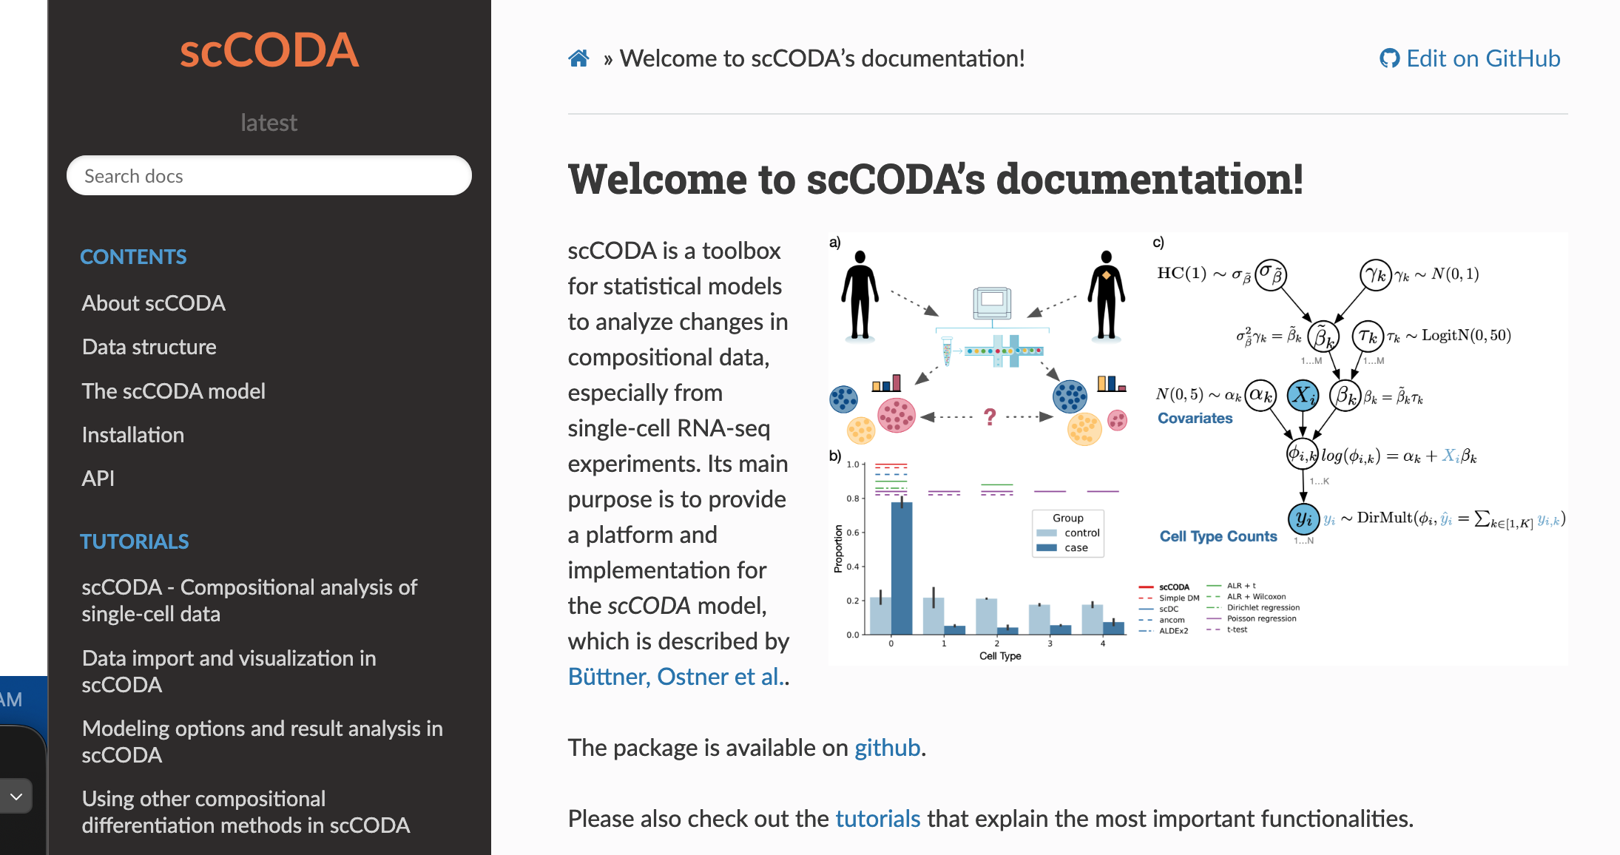

Slide 6
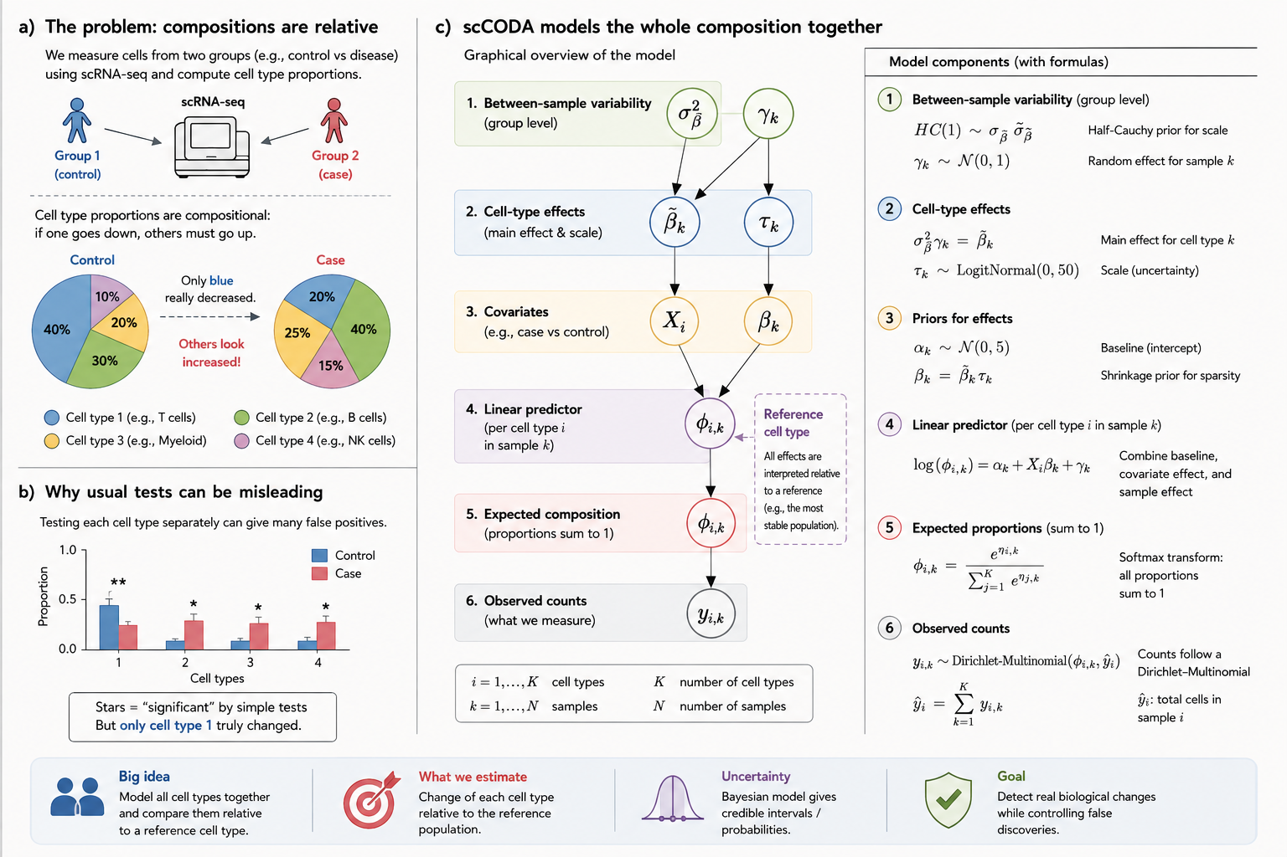

Slide 7
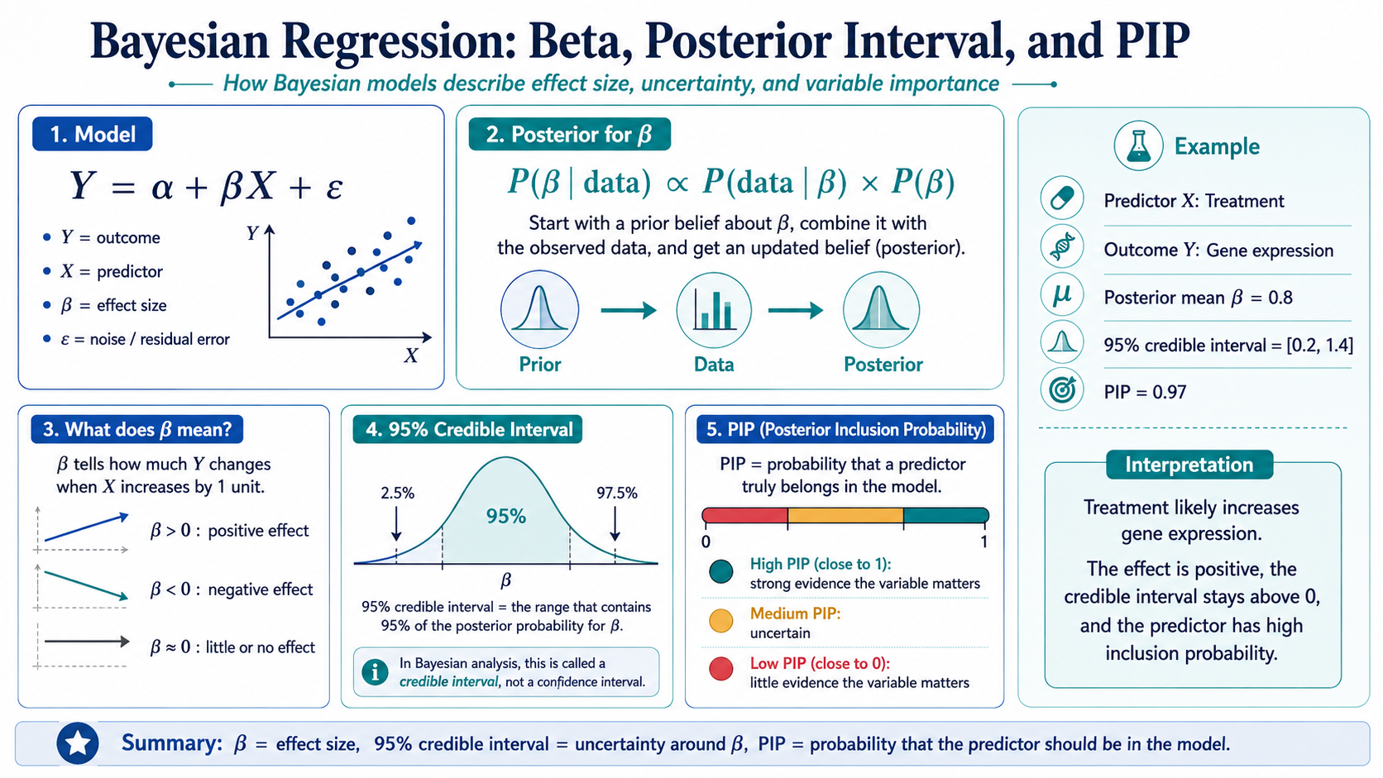

Slide 8
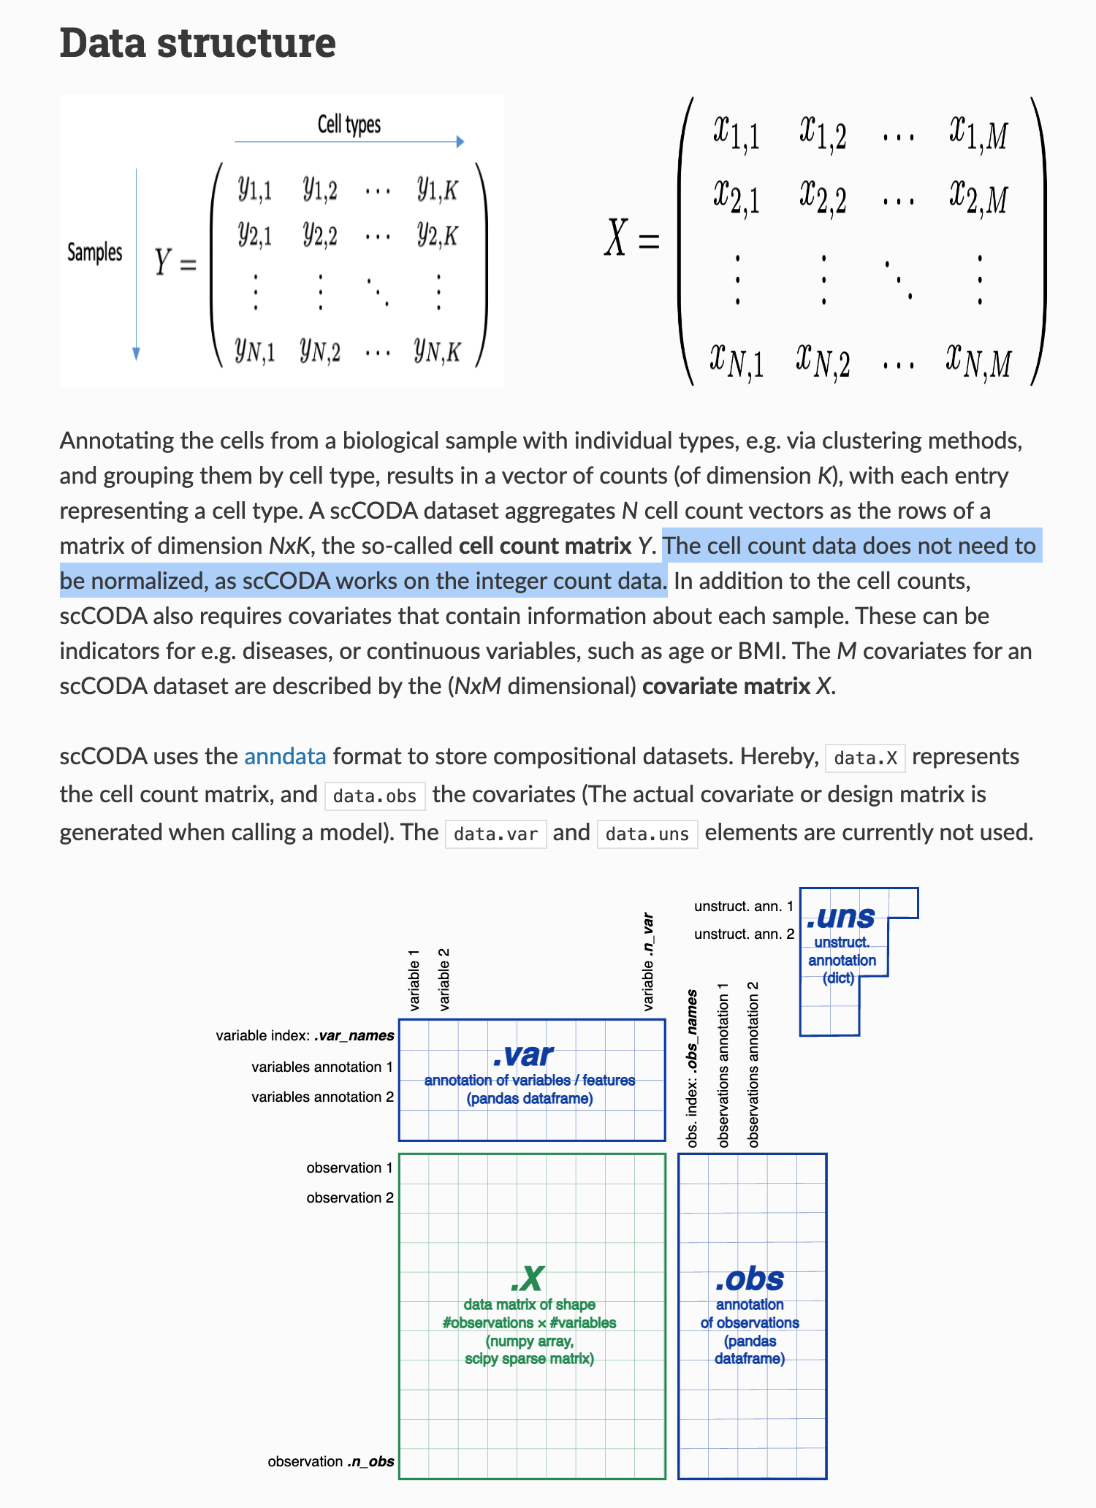

Slide 9
How to visualize the results?

Slide 10
1. FixNCut — scCODA compositional analysis
Figure 2h — Mouse lung
بالای panel تفاوت observed cell-type proportions بین fresh و fixed را نشان می‌دهد و پایین همان panel نتیجه‌ی compositional analysis با scCODA را؛ * یعنی credible compositional change.
Observed cell-type proportions were compared directly between fresh and fixed tissue preparations.
scCODA identified which apparent shifts remained credible after accounting for the compositional structure of the data.
همین طراحی در Fig. 3h برای mouse colon و Fig. 6h برای human colon هم تکرار شده است.

Slide 11
2. Aberrant basal cell clonal dynamics — Science
Figure 3D–E
Fig. 3D: stacked barplot از relative abundance انواع epithelial cells در Control و NTCU-treated.
Fig. 3E: barplot از log2FC محاسبه‌شده با scCODA؛ FDR < 0.05 برای differential abundance استفاده شده است.
NTCU treatment produced a clear shift in tracheal epithelial cell-type composition.
scCODA identified the specific epithelial populations driving this compositional shift, including enrichment and depletion of distinct basal-cell states.
این یکی از بهترین نمونه‌ها برای شکل خودت است چون دقیقاً ساختار observed composition → scCODA effect دارد.
https://www.science.org/doi/10.1126/science.ads9145

Slide 12
3. Coupling of response biomarkers
Figure 2D — Forest plot
scCODA را با چند seed و دو chain length اجرا کرده‌اند و average log2 fold changes را به شکل forest plot نشان داده‌اند. Positive effect نشان‌دهنده‌ی differential abundance نسبت به responders است.
scCODA effect sizes were visualized as a forest plot to compare compositional changes across immune populations.
CD8⁺ effector-memory T cells emerged as the only population consistently enriched in treatment responders across time points.
این از نظر visualization خیلی نزدیک به posterior-effect plot خودت است.

Slide 13
4. Cell-death pathways and tau-associated neuronal vulnerability
Figure 3A — Dot-and-whisker plot
هر point تخمین parameter حاصل از scCODA است و whiskerها 95% interval را نشان می‌دهند. Authors با scCODA رابطه‌ی abundance subtypeهای neuronal را با local phospho-tau burden بررسی کرده‌اند.
scCODA effect estimates and their uncertainty were displayed using a dot-and-whisker plot.
L2/3 IT neurons showed a negative association between relative abundance and local phospho-tau burden.
این شاید بهترین precedent برای plot فعلی تو باشد:
dot = posterior effect
whisker = interval

Slide 14
5. Single-nucleus multiomics in early-onset Alzheimer’s disease
Figure 1E + Extended Data Figure 1A–D
Fig. 1E: proportion major cell types را برای هر sample و brain region نشان می‌دهد.
Extended Data Fig. 1A–D: boxplots برای composition differences؛ تغییرات credible حاصل از scCODA با Pinc مشخص شده‌اند.
Cell-type proportions were shown directly across brain regions and disease conditions.
scCODA posterior inclusion probabilities were used to annotate statistically credible compositional changes on the biological abundance plots.
این برای تو مهم است چون نشان می‌دهد لازم نیست حتماً یک PIP panel مستقل داشته باشی؛ می‌توانی PIP/FDR را annotation کنی.

Slide 15
6. Integrated multimodal cell atlas of Alzheimer’s disease
Figure 3B — Effect-size bar plots
Authors relative-abundance effect sizes را برای cognitive status، AD neuropathology و continuous pseudoprogression score نشان داده‌اند. رنگ‌ها مشخص می‌کنند کدام cell populations compositional changes معنی‌دار دارند.
scCODA effect sizes were summarized as bar plots to highlight cell populations changing along Alzheimer’s disease progression.
Reference sensitivity was addressed by repeating the compositional analysis with each supertype as the reference population.
این آخری برای analysis خودت خیلی مهم است، چون تو Cluster 10 را reference گرفته‌ای؛ این مقاله precedent خوبی است برای اینکه نشان بدهی نتیجه نسبت به انتخاب reference robust است.

Slide 16
Bigger Picture

Slide 17
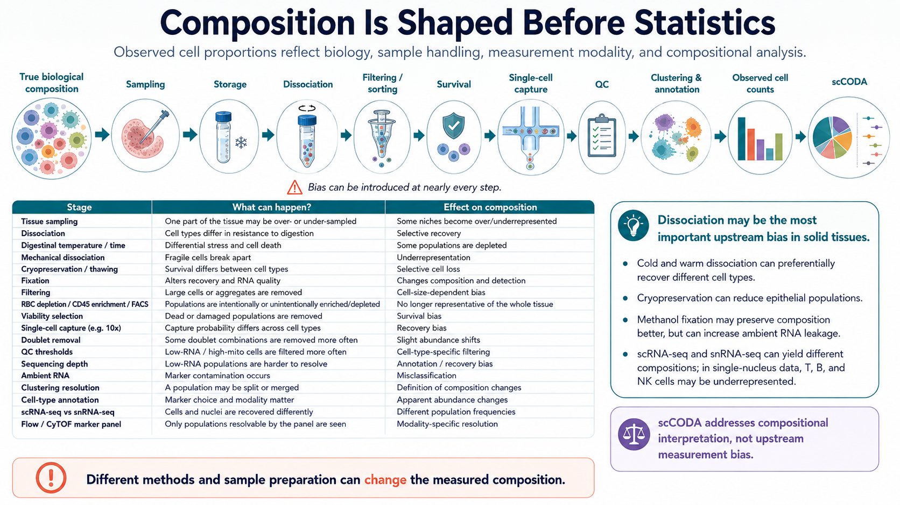
Notes:
Although, compositional bias is not only a statistical problem.
The composition we observe is already shaped by how the sample was collected, processed, captured, and annotated.

Slide 18
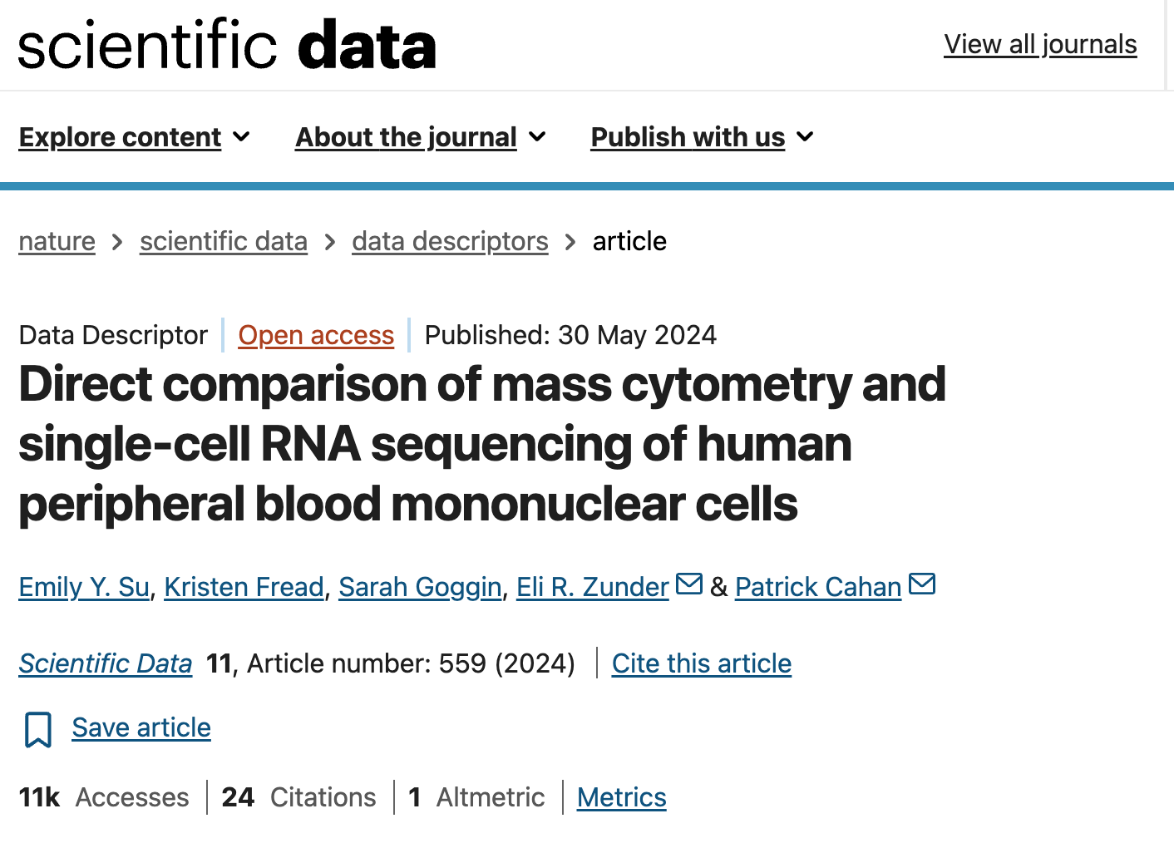

Slide 19
