Slide 1


Git
By Arash Jafarzadeh

Slide 2
What is GIT
Git is a distributed version-control system for tracking changes in source code during software development

Slide 3
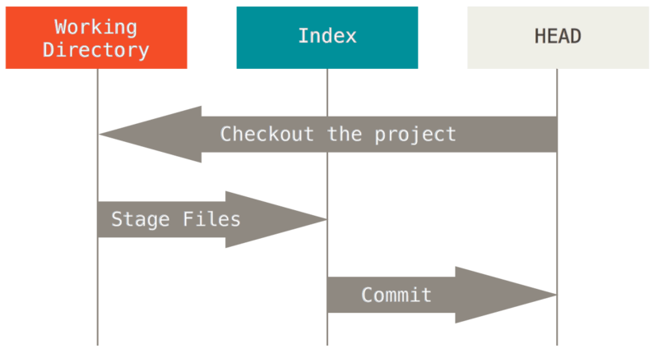
Three tree

Slide 4
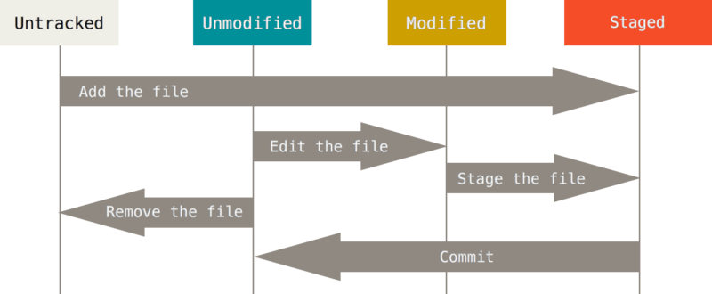
File states

Slide 5
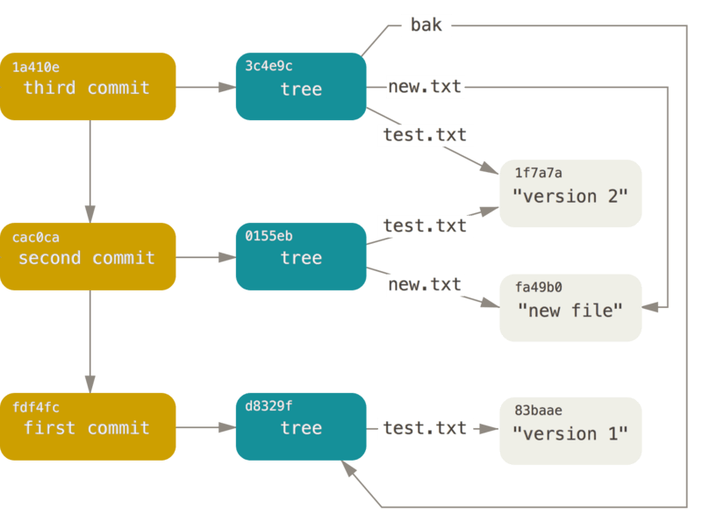
Commit

Slide 6
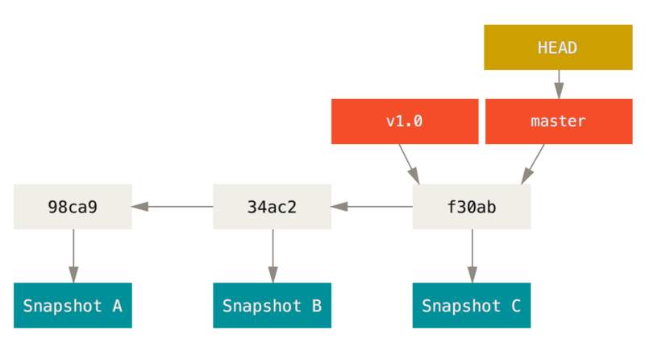
Branch

Slide 7
Revert
HEAD
C1
C2
C3
-C3

Slide 8
Reset
HEAD
C1
C2
C3

Slide 9
Reset (mixed,soft,hard)
SOFT
Working
Directory
Index
Commit
History
MIXED
HARD

Slide 10
Merge
feature
master

Slide 11
Rebase
feature
feature
master

Slide 12
Remote
Fetch
Push
Clone

Slide 13
Tracking and upstream Branch
Local
Remote
C1
C1
C2
master
C2
origin/master
C3
C3
master
Track for pull

Slide 14
Fetch
Local
Remote
C1
C1
origin/master
C2
master
C2
C3
C3
master

Slide 15
Push
Local
Remote
C1
C1
origin/master
C2
C2
master
C3
master
C3

Slide 16
Pull
Local
Remote
C1
C1
origin/master
C2
C2
C3
C4
master
C3
master
C5

Slide 17

Stash
Working
Directory
Index
Commit
History

Slide 18
Interactive rebase
pick
C1
C1
drop
C2
squash
C3
C3+
C4
pick
C4
C5
edit
C5 + C6
C6

