Slide 1
Music OCR
by Raquel Fallman
Ji Yeon Kim
Arash Nabili

Slide 2
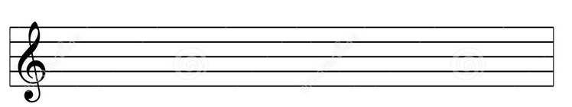

Stage 1
Input: A staff of music
Output: Recognized # of notes (regardless of placement)
Play number of notes at a default frequency
Example input:
Example output:
# of notes: 5
Plays note with default frequency for 5 times.

Slide 3
Stage 2
Input: A staff of music
Output: Recognized # of notes and pitch
(one octave)
Play number of notes based on placement
Example input:
Example output:
# of notes: 5 (G, F, A, G, A)
Plays frequency for ( G, F, A, G, A)

Slide 4



Stage 3
Input: A staff of music
Output: Recognized # of notes, timing and Pitch
(multiple octaves)
Play number of notes based on placement and timing
Example input:
Example output:
# of notes: 5 ( G, F, G, C, A,…) and times (whole,
quarter, half, quarter,…etc)
Plays frequency for ( G, F, G, C, A,…)
and timing delays

Slide 5
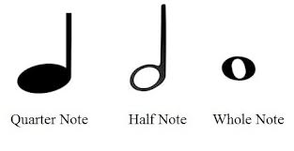
Current Program

Slide 6
How it works

Slide 7
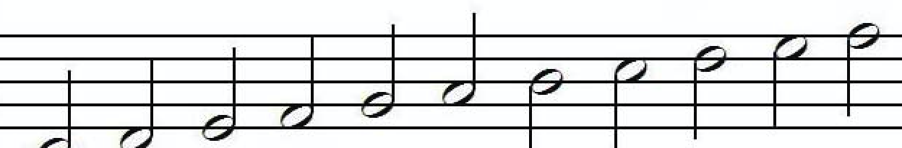
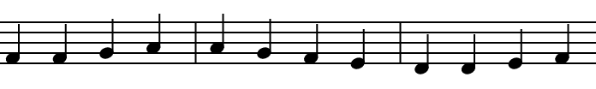
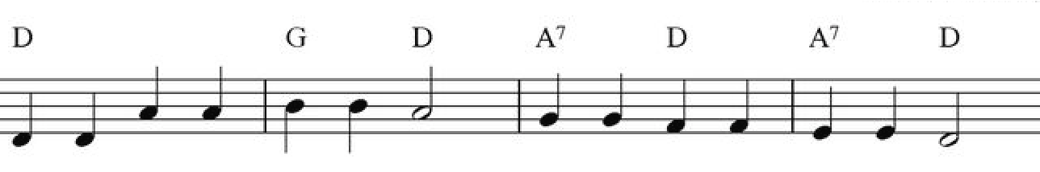
Demo Input
C major scale
Ode to Joy
Twinkle Twinkle Little Star

