Slide 1


Slide 2
Introduction
Formulation of Guiding Principle:
Guiding principle established by considering intracellular [Ca2+] dynamics during cellular events like action potentials.
Brief periods of elevated [Ca2+] are sparsely interspersed among background-dominated time frames.
Sparseness in Temporal and Spatial Domains:
Sparseness observed both temporally and spatially.
Temporal sparseness: Elevated [Ca2+] periods are brief and infrequent.
Spatial sparseness: Each cell occupies only a small subset of pixels.
Quantifiability of Sparseness:
Ca2+ signals' sparseness deemed a general attribute.
Quantifiable through simple measures like the skewness of amplitude distributions.

Slide 3
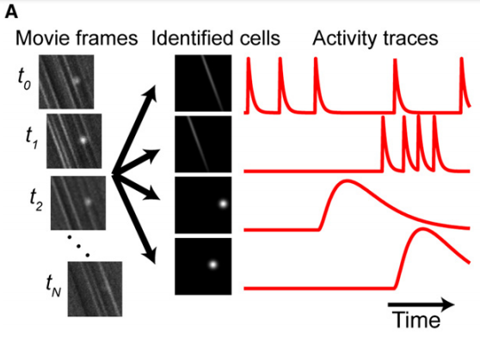
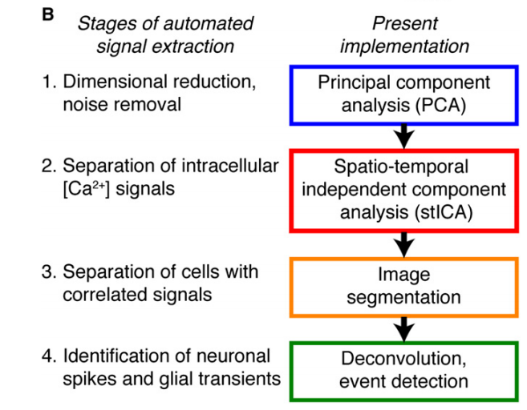
Figure 1. Analytical Stages of Automated Cell Sorting
(A) The goal of cell sorting is to extract cellular signals from imaging data (left) by estimating spatial filters (middle) and activity traces (right) for each cell. The example depicts typical fluorescence transients in the cerebellar cortex as observed in optical cross-section. Transients in Purkinje cell dendrites arise across elongated areas seen as stripes in the movie data. Transients in Bergmann glial fibers tend to be more localized, appearing ellipsoidal.
(B) Automated cell sorting has four stages that address specific analysis challenges.

Slide 4
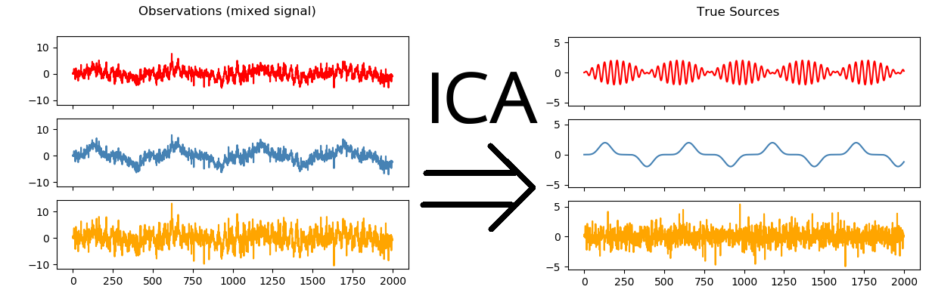
Independence: ICA aims to identify components that are as statistically independent from each other as possible. Independence is a crucial aspect of ICA, as it helps to uncover hidden factors contributing to the observed data.
Linear Transformation: The observed data, which is a linear combination of the independent components, is represented as a matrix. The goal is to find a transformation matrix that, when applied to the observed data, separates it into components that are as independent as possible.
Statistical Measures: ICA typically relies on statistical measures, such as higher-order statistics, to estimate the independence of the components. These measures capture the non-Gaussian nature of the components, as independence often implies non-Gaussianity.

Slide 5
In examinations involving animals through imaging, obtaining corroborative data for studies on human brain activity in living subjects proved to be challenging.
They validated their method by utilizing simulated movies that replicated Ca2+ imaging data obtained in the cerebellar cortex.
Their sorting procedure demonstrated superior signal estimates and reduced susceptibility to crosstalk compared to reconstructions conducted through ROI analysis.
The analysis was also tested on data recorded by two-photon microscopy in the cerebellar cortex of awake behaving mice, extracting Ca2+ signals from over 100 total Purkinje cells and Bergmann glia.
To showcase the utility of their method, they applied it to explore the spatiotemporal organization of Purkinje cells' Ca2+ spiking activity in behaving mice.
Their findings revealed that synchronously active cells form clusters in neighborhoods ranging from 7 to 18 cells across the mediolateral dimension.
These clusters were identified as cerebellar microzones, representing small patches of Purkinje cells receiving similar climbing fiber input (Andersson and Oscarsson, 1978).
Their data further unveiled that microzones in awake animals have well-defined mediolateral boundaries, with a precision of about a single cell.

Slide 6
The study addressed the question of whether microzones have stable anatomical boundaries.
It considered the possibility of microzones being dynamic entities with cellular variations across behavioral states.
Findings indicated that during mouse locomotion, microzones' spatial organization remained unchanged from that in awake but resting animals.
This suggests that microzones are stationary anatomical units.
The study's results reveal fundamental features of cerebellar dynamics.
They emphasize the significance of automated procedures for analyzing imaging data.

Slide 7
The study addressed the question of whether microzones have stable anatomical boundaries.
It considered the possibility of microzones being dynamic entities with cellular variations across behavioral states.
Findings indicated that during mouse locomotion, microzones' spatial organization remained unchanged from that in awake but resting animals.
This suggests that microzones are stationary anatomical units.
The study's results reveal fundamental features of cerebellar dynamics.
They emphasize the significance of automated procedures for analyzing imaging data.

